Slide 1
Calculating Harmonics and Instruments
IB Physics | Waves - Sound

Slide 2
Standing Waves Review
Nodes
Antinodes

Slide 3
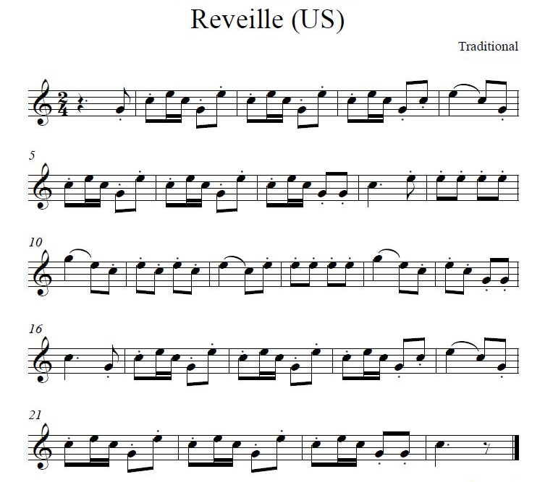
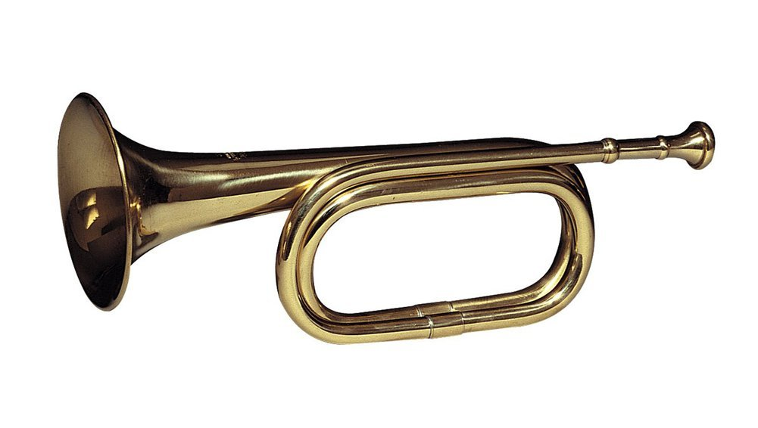
Harmonics

Slide 4



Open Pipe Resonance
L =
$$\frac{3}{2}λ$$
Antinode
Antinode
$$1λ$$
$$\frac{1}{2}λ$$

Slide 5



Closed Pipe Resonance
L =
$$\frac{5}{4}λ$$
Node
Antinode
$$\frac{3}{4}λ$$
$$\frac{1}{4}λ$$

Slide 6
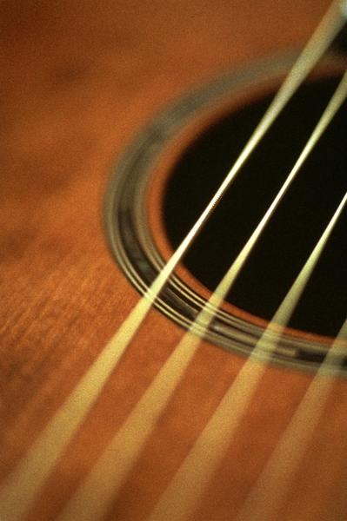
Strings make sound too!
wave speed
_________________
changes depending on the string tension
Two ways to increase frequency in string:
increase
tension
decrease
length

Slide 7
String Resonance
L =
$$\frac{3}{2}λ$$
$$1λ$$
Node
Node
$$\frac{1}{2}λ$$

Slide 8
Review of End Conditions
Closed Pipe
Open Pipe
String
Node
Antinode
Antinode
Antinode
Node
Node

Slide 9
All the Harmonics!
Open
Closed
String

Slide 10
Remember Pitch and Frequency
High pitched sounds have high frequencies
Low pitched sounds have low frequencies

Slide 11
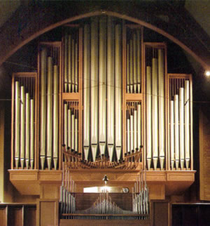
Making Different Pitches
The lengths are designed for the fundamental frequency

Slide 12


Calculating Frequency | Open Pipes
L
An open organ pipe is 2.1 m long and the speed of sound in the pipe is 341 m/s. What is the fundamental frequency of the pipe?
$$v=fλ$$
$$f=\frac{v}{λ}$$
$$=\frac{341}{4.2}$$
$$f= ?$$
$$v=341 m s^{−1}$$
$$=81.2 Hz$$
$$λ=$$
$$4.2 m$$
$$L=\frac{1}{2}λ$$
$$λ=2L$$
$$=2\left(2.1\right)=4.2 m$$

Slide 13
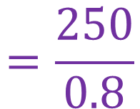
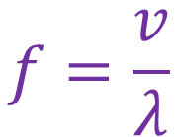
Resonant String Practice
The note produced on a violin string of length 40 cm produces a wave speed of 250 m/s. What is the first harmonic of this note?
$$v=fλ$$
$$f=\frac{v}{λ}$$
$$=\frac{250}{0.8}$$
$$f= ?$$
$$v=250 m s^{−1}$$
$$λ=$$
$$0.8 m$$
$$=312.5 Hz$$
$$L=\frac{1}{2}λ$$
$$λ=2L$$
$$=2\left(0.4\right)=0.8 m$$

Slide 14
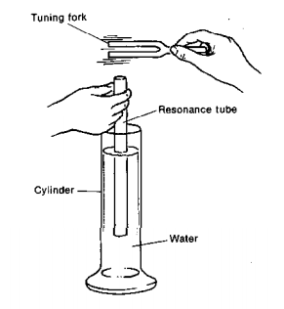
Finding Resonance

Slide 15
Calculating Frequency | Closed Pipes
You found an unmarked tuning fork in your collection. You notice that the smallest length for resonance is 12 cm. If the speed of sound is 345 m/s, what is the tuning fork frequency?
L
$$L=\frac{1}{4}λ$$
$$λ=4L$$
$$=4\left(0.12\right)=0.48 m$$
12 cm
$$f=\frac{v}{λ}$$
$$=\frac{345}{0.48}=718.75 Hz$$
What should the length of the tube be for the 2nd resonant position?
$$L=\frac{3}{4}λ$$
$$=\frac{3}{4}\left(0.48\right)$$
$$=0.36 m$$

Slide 16
Lesson Takeaways
I can identify and label the node and antinodes on a standing wave diagram
I can describe the end conditions and nodes/antinodes for open/closed pipes and vibrating strings
I can calculate the wavelength or instrument length of a standing wave for different harmonics

