Slide 1
Wave Interference
IB Physics | Waves - Sound

Slide 2
Interference
When several waves are in the same location, they combine to produce a new wave that is different from the original waves.
After waves pass by one another continue on _____________
unchanged

Slide 3
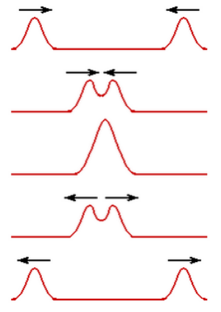
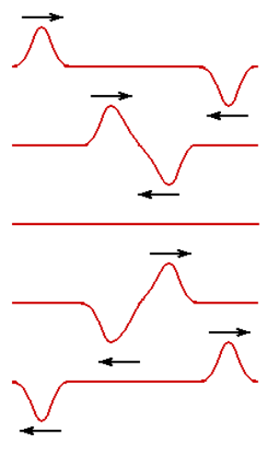
Name that Interference
Constructive
Destructive
_________ Interference
_________ Interference

Slide 4
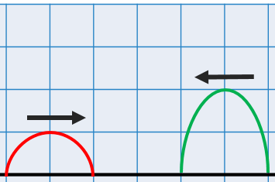
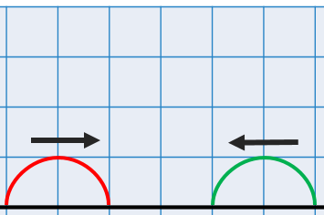
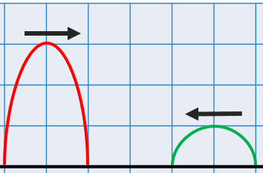
Constructive Interference
What is the resulting amplitude when these waves meet?

Slide 5
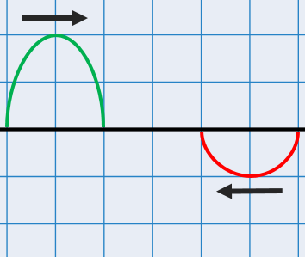
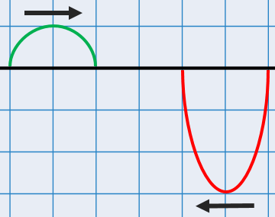
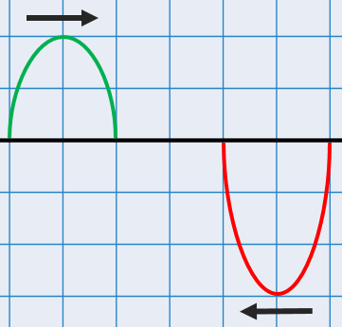
Destructive Interference
What is the resulting amplitude when these waves meet?

Slide 6
Superposition of Waves
Wave A
Time
Wave B
Time
Superposition
Time

Slide 7
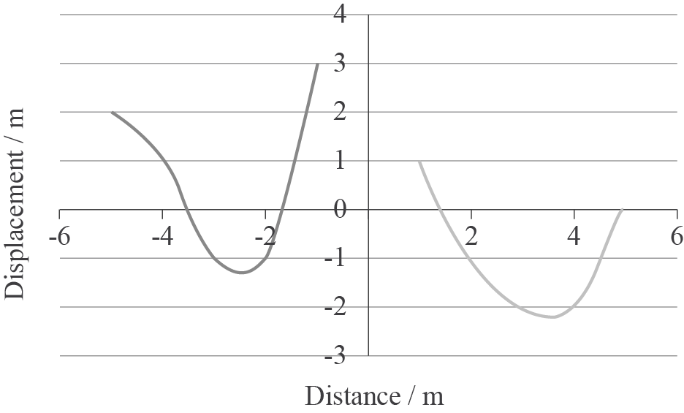
IB Sample Question
Both the waves below are moving at 0.5 m s⁻¹ towards each other. What is the displacement at a distance of 1 m, after 4 s has passed?
(+3) + (-2)
= +1

Slide 8
IB Sample Question
Both the waves below are moving at 0.5 m s⁻¹ towards each other. What is the displacement at a distance of 1 m, after 4 s has passed?
(+3) + (-2) = +1

Slide 9
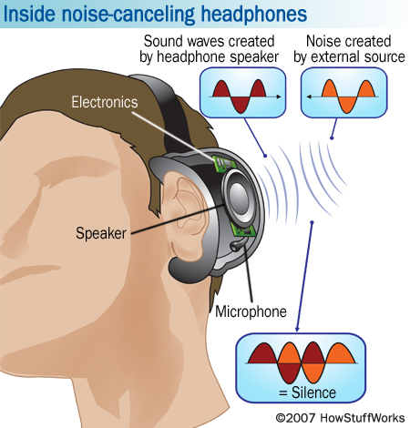
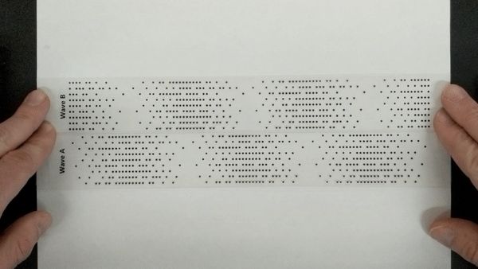
Noise Canceling Headphones

Slide 10
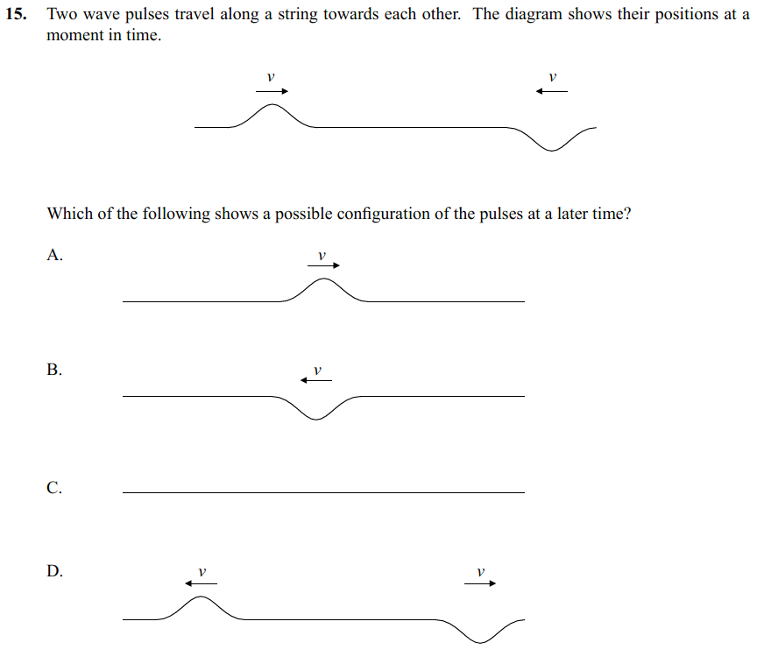
IB Sample Question

Slide 11
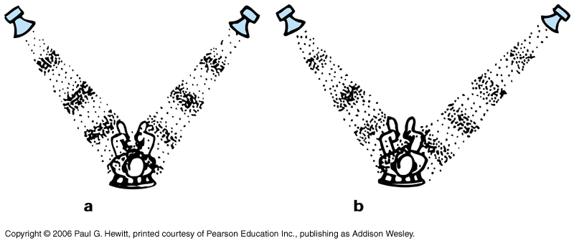
Interference from Multiple Sources
Constructive
Destructive

Slide 12
1D Sound Interference
λ
Path Difference =
2.5λ
0λ
0.5λ
1λ
1.5λ
2λ
0λ | 0.5λ | 1λ | 1.5λ | 2λ | 2.5λ
 |  |  |  |  |  | Constructive
 |  |  |  |  |  | Destructive
Path Difference = $nλ$
Path Difference = $(n+\frac{1}{2})λ$
*$n$is any integer
These are known as “coherent waves” because they have the same frequency and a constant phase difference

Slide 13
IB Physics Data Booklet

Slide 14
Finding a Minimum
λ = 0.6 m
2.1 m
1.8 m
Path Difference = 2.1 – 1.8
= 0.3 m
Path Difference = ( ) × λ
Constructive | Path Difference = $nλ$
0.3 m = ( ) × 0.6 m
0.5
Destructive | Path Difference = $(n+\frac{1}{2})λ$

Slide 15
Finding a Maximum
λ = 0.6 m
2.1 m
1.5 m
Path Difference = 2.1 – 1.5
= 0.6 m
Path Difference = ( ) × λ
Constructive | Path Difference = $nλ$
0.6 m = ( ) × 0.6 m
1
Destructive | Path Difference = $(n+\frac{1}{2})λ$

Slide 16
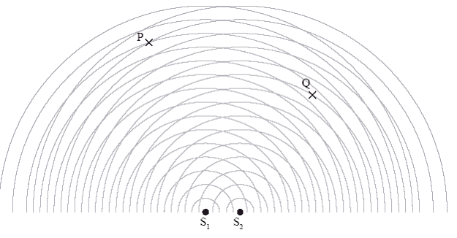
Try This
Two coherent point sources S₁ and S₂ emit spherical waves.
Which of the following best describes the intensity of the waves at P and Q?
 | P | Q
A | Maximum | Minimum
B | Minimum | Maximum
C | Maximum | Maximum
D | Minimum | Minimum
Max
Min

Slide 17
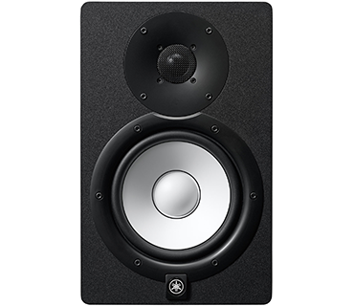
Try this #1
5 m
Two speakers are separated by a distance of 5 meters, if they emit a coherent sound signal of 850 Hz. If the speed of sound is 340 m s⁻¹, is this person in a maximum or minimum location?
2.1 m
2.9 m
$$v=fλ$$
$$λ=\frac{v}{f}$$
$$=\frac{340}{850}=0.4 m$$
Path Difference
Path Difference = (___) × λ
2.9 – 2.1 = 0.8 m
Maximum because result is a perfect integer
$$\frac{0.8}{0.4}=2$$

Slide 18
Try This #2
4 m
If these speakers are playing a note with a frequency of 680 Hz, is this person standing at a maximum or minimum spot? Assume a speed of sound of 340 m s⁻²
Path Difference
5 - 3= 2 m
$$λ=\frac{v}{f}=\frac{340}{680}=0.5 m$$
5 m
Maximum because result is a perfect integer
3 m
$$\frac{2}{0.5}=4$$
Path Diff. = ( ) × λ
What frequency would result in the opposite effect?
$$( )=\frac{2 m}{λ}$$
$$λ=0.44 m$$
$$4.5$$
$$f=\frac{v}{λ}$$
$$=\frac{340}{0.44}=773 Hz$$
(Could be anything that ends in .5)

Slide 19
Lesson Takeaways
I can qualitatively and quantitatively interpret cases of constructive and destructive interference
I can add up two waves with superposition to create a new waveform
I can use wavelength and source distance to identify maxima and minima for interference

