Slide 1
Light and the EM Spectrum
IB Physics | Waves - Light

Slide 2
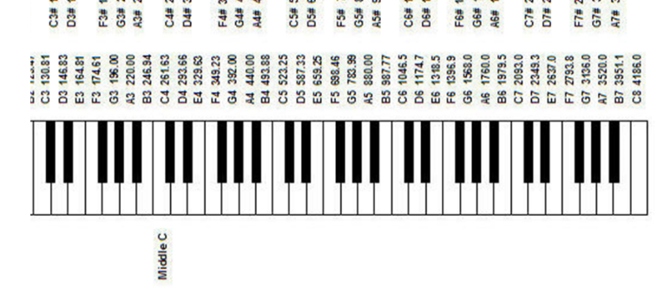
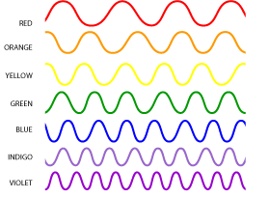
Frequency and Light
Sound
Change in Frequency
Pitch
Light
Change in Frequency
Color

Slide 3
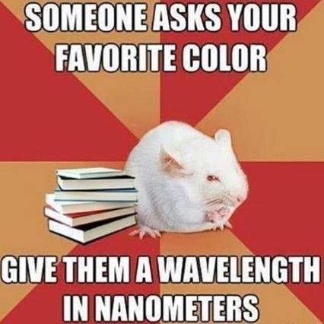
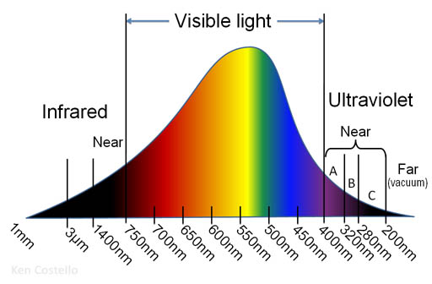
Frequency and Light

Slide 4
Speed of Electromagnetic Waves
In a vacuum All electromagnetic waves travel at:
c = 299,792,458 m s⁻¹
c = 3.00 × 10⁸ m s⁻¹

Slide 5
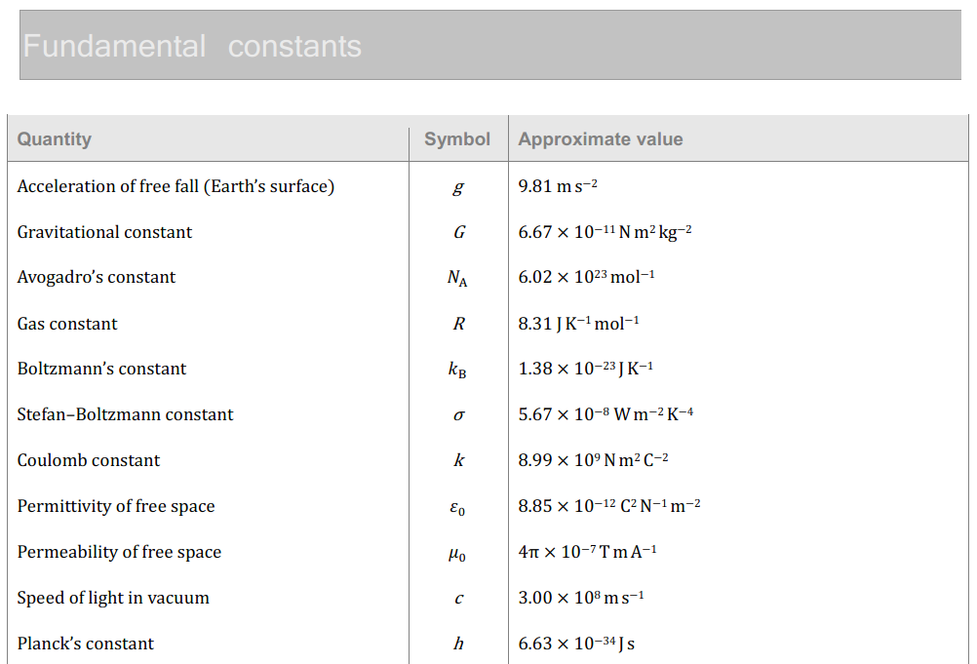
Speed of Electromagnetic Waves

Slide 6
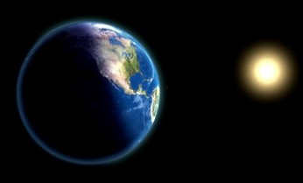
Try this…
The sun is roughly 149,600,000 km from Earth, how long has the light from the sun been traveling before it gets here?
$$v=\frac{d}{t}$$
$$t=\frac{d}{v}$$
$$=\frac{149,600,000,000 m}{3.00×{10}^{8} m s^{−1}}$$
$$t=499 s$$
$$=8.31 min$$

Slide 7
Light Equation
You already know the wave speed equation
v = f λ
Works the same for electromagnetic waves
c = f λ

Slide 8
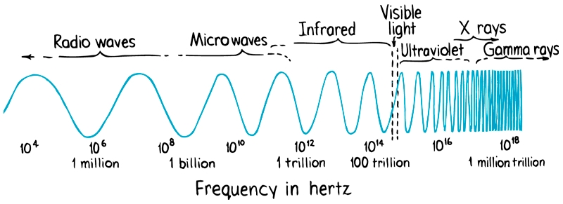
Electromagnetic Spectrum
Visible light is just part of the picture…

Slide 9
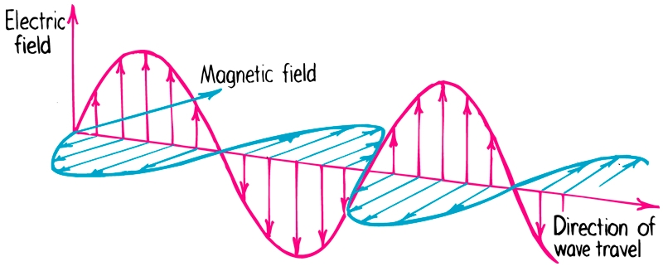
Electromagnetic Waves
Transverse
or
Longitudinal
?
?

Slide 10
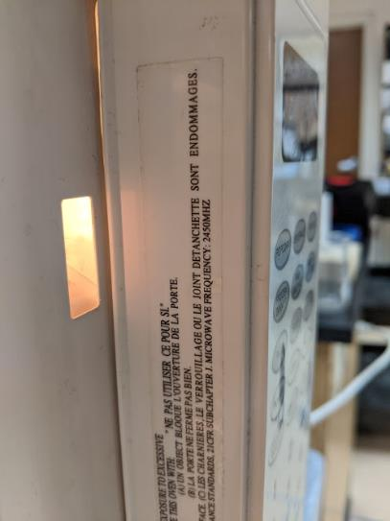
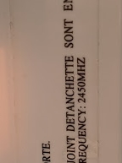
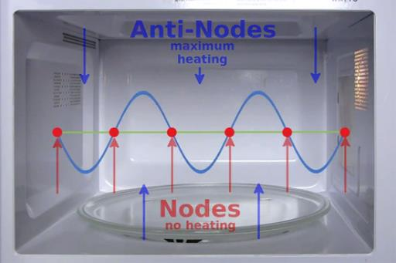
Standing Waves in a Microwave
How far between antinodes of a 2450 MHz standing wave in a microwave?
$$v=fλ$$
$$λ=\frac{v}{f}$$
$$=\frac{3.00×{10}^{8}}{2450×{10}^{6}}$$
$$=0.12 m$$
$$\frac{0.12 m}{2}$$
$$=0.06 m$$
$$=6 cm$$
λ

Slide 11
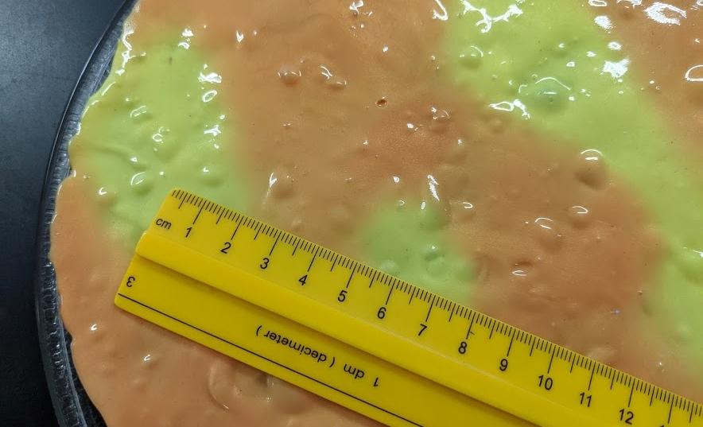
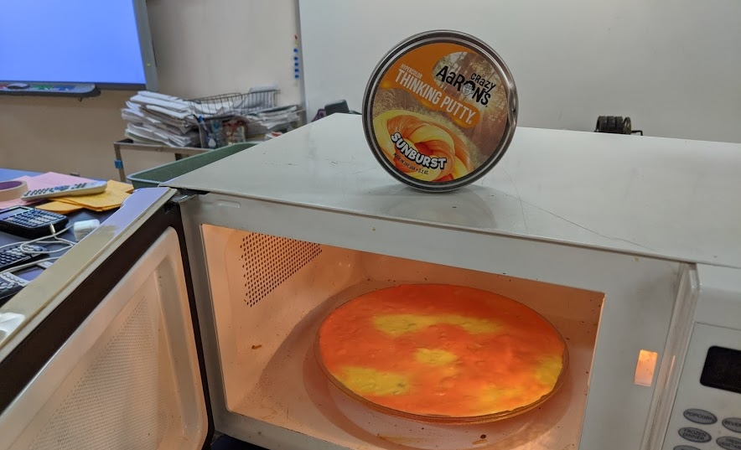
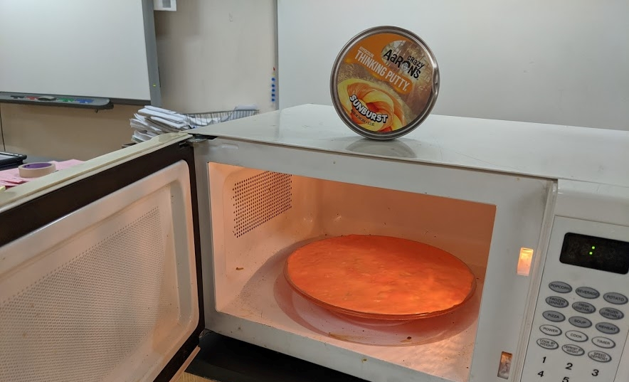
Standing Waves in a Microwave

Slide 12
Electromagnetic Spectrum

Slide 13
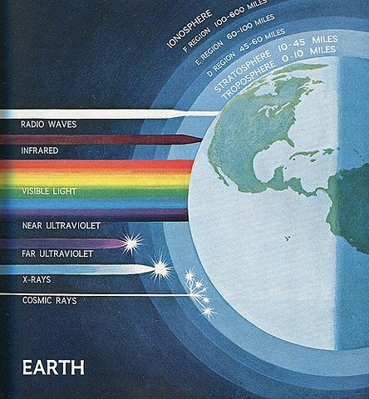
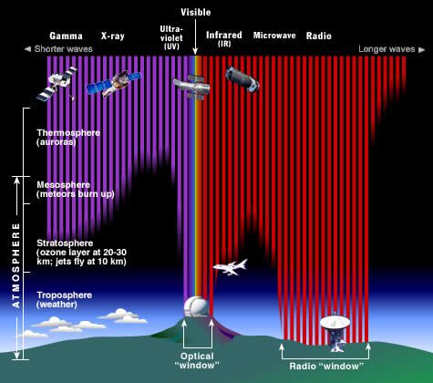
Not everything makes it to Earth

Slide 14
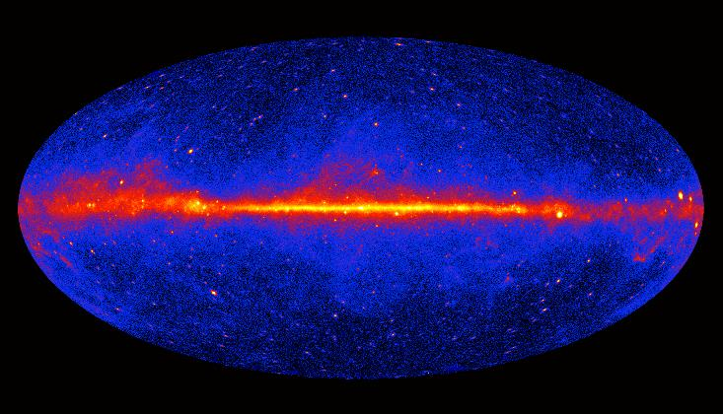
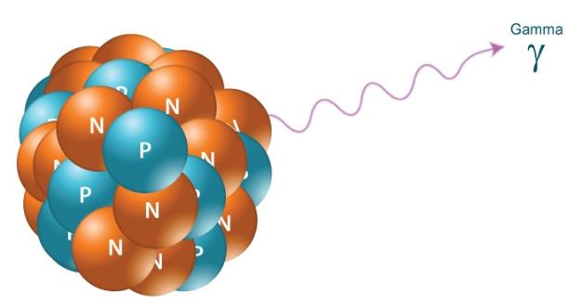
Gamma Ray
Wavelength: 10⁻¹² m | 1 pm

Slide 15
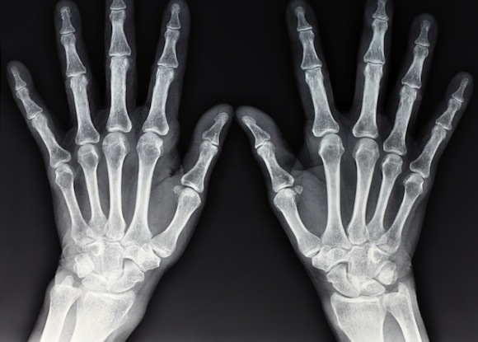
X-Rays
Wavelength: 10⁻¹⁰ m | 10 nm

Slide 16
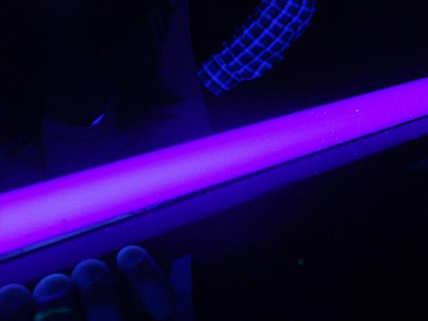
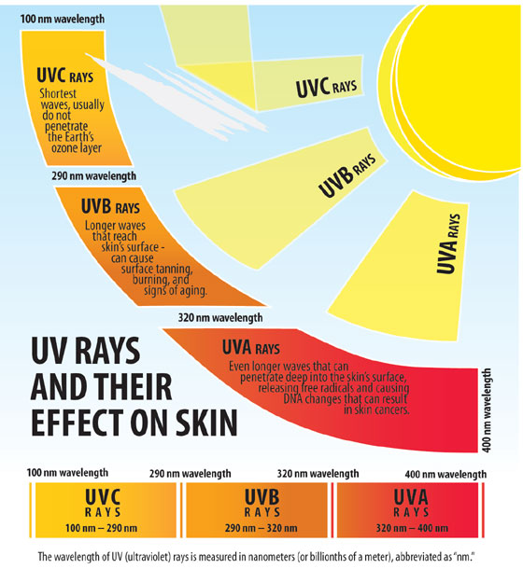
Ultraviolet
Wavelength: 10⁻⁸ m | 10 nm

Slide 17
Visible Light
Wavelength: 0.5 × 10⁻¹² m | 500 nm

Slide 18
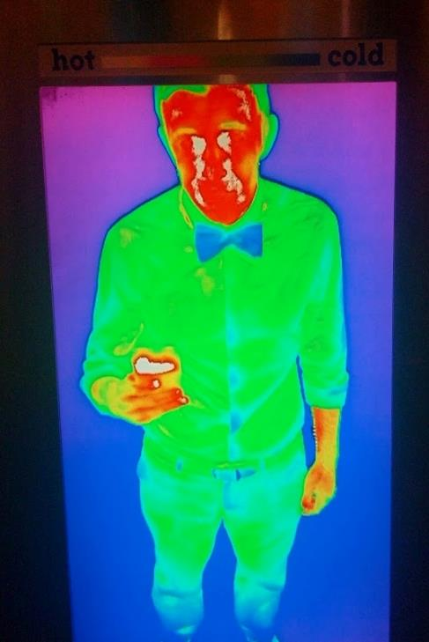
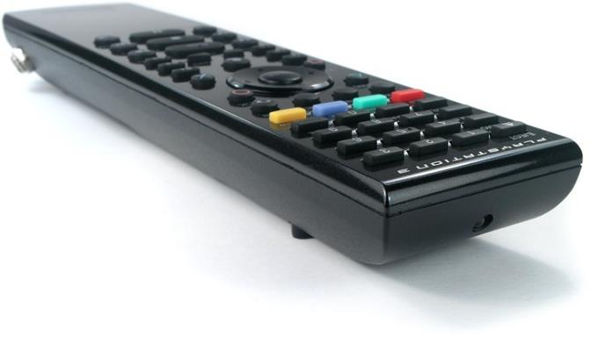
Infrared
Wavelength: 10⁻⁵ m | 0.01 mm

Slide 19
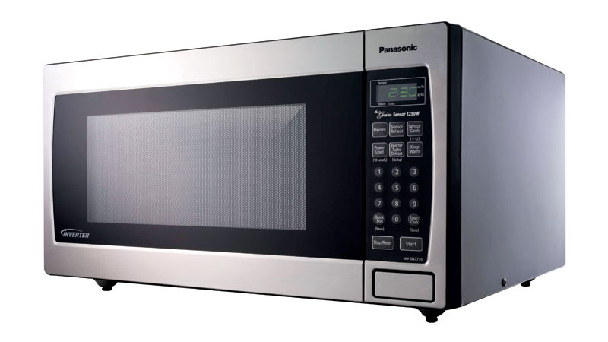
Microwaves
Wavelength: 10⁻² m | 1 cm

Slide 20
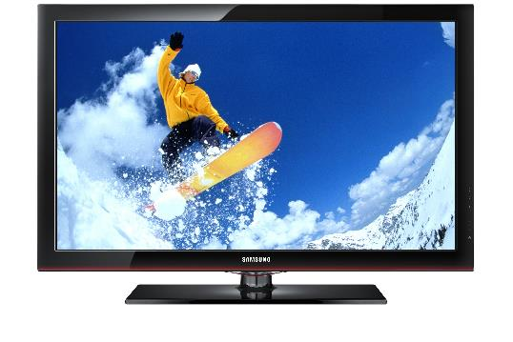
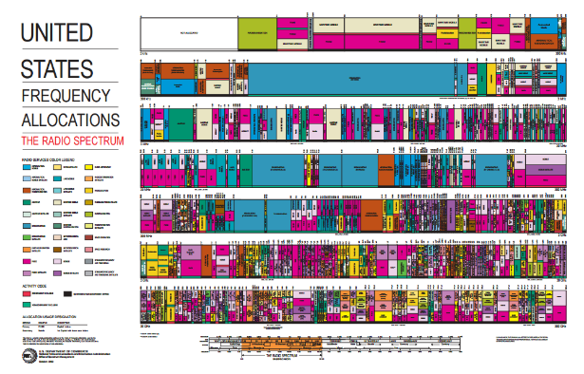
Radiowaves
Wavelength: 10³ m | 1 km

Slide 21
Wireless Data Transfer

Slide 22
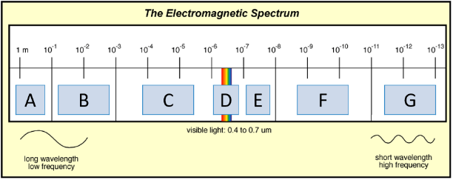
Can you name them? You should.
A | Radio
B | Microwaves
C | Infrared
D | Visible
E | Ultraviolet
F | X-Rays
G | Gamma
Higher Frequency
More Energy

Slide 23
Lesson Takeaways
I can identify and use the speed of light to solve wave problems with the wave equations
I can estimate the wavelength magnitude for the different EM waves
I can provide real world examples for each of the electromagnetic waves

