Slide 1
Reflection & Refraction
IB Physics | Waves - Light

Slide 2
Reflection
Incidence
Reflection
Angle of ______________ = Angle of _______________
Normal Line (⟂ to surface)

Slide 3
Reflection

Slide 4
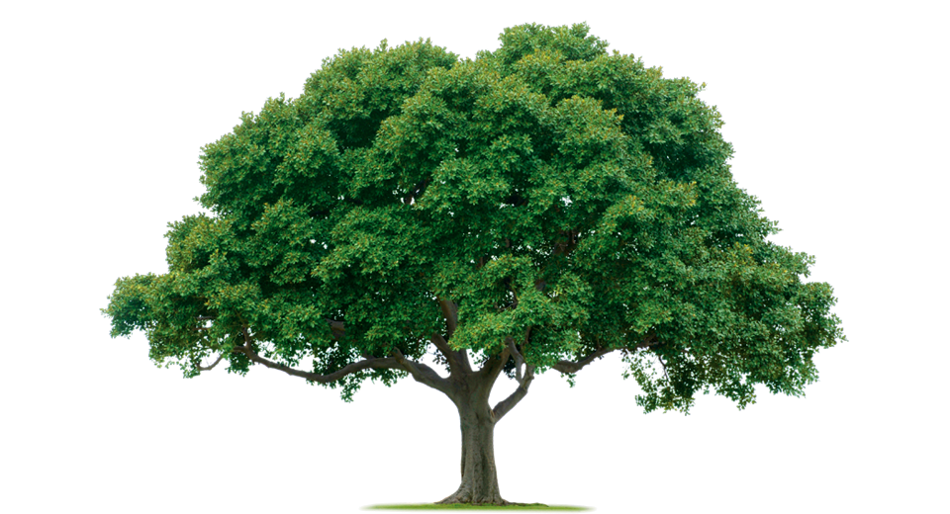
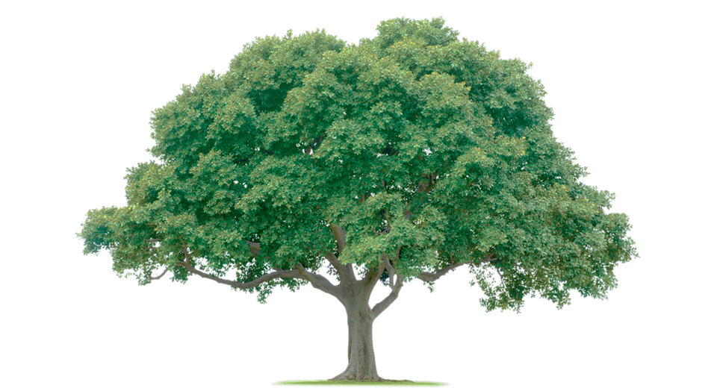
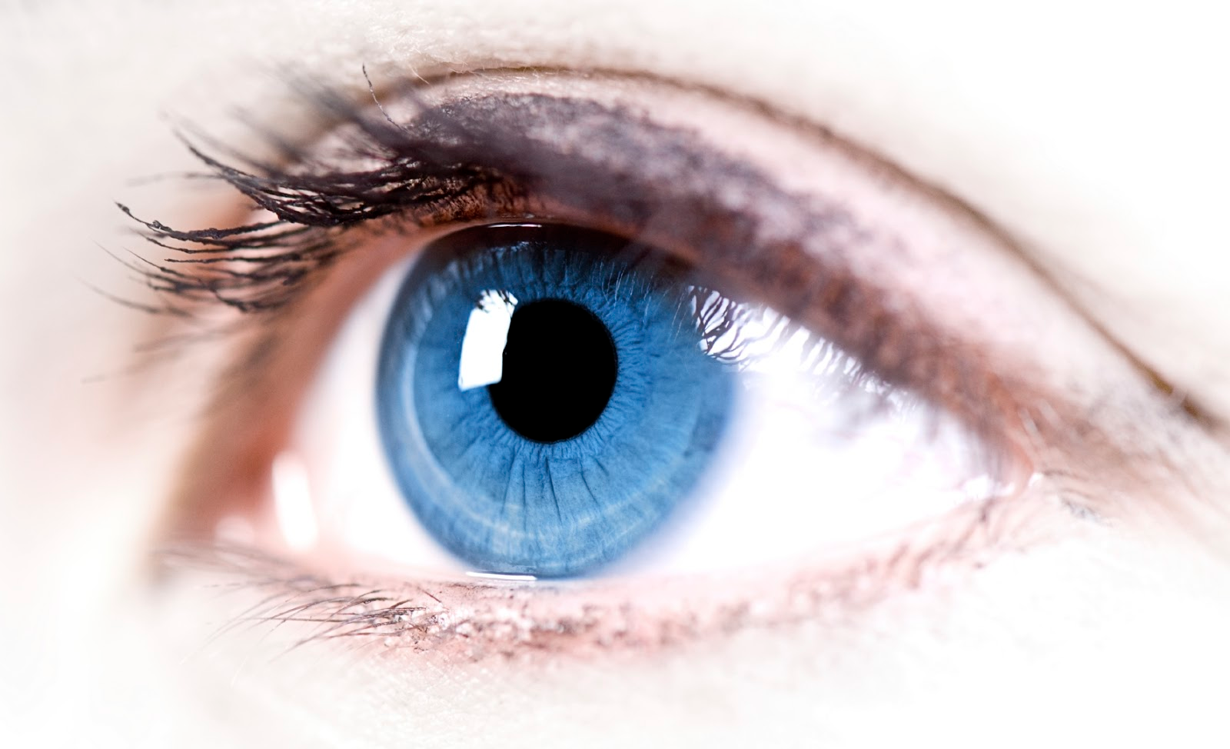
Reflection
Virtual Image

Slide 5
Predict
Can this person see their feet in the mirror?
No
If the angle of reflection equals the angle of incidence, the light can never reflect from their feet into their eyes

Slide 6
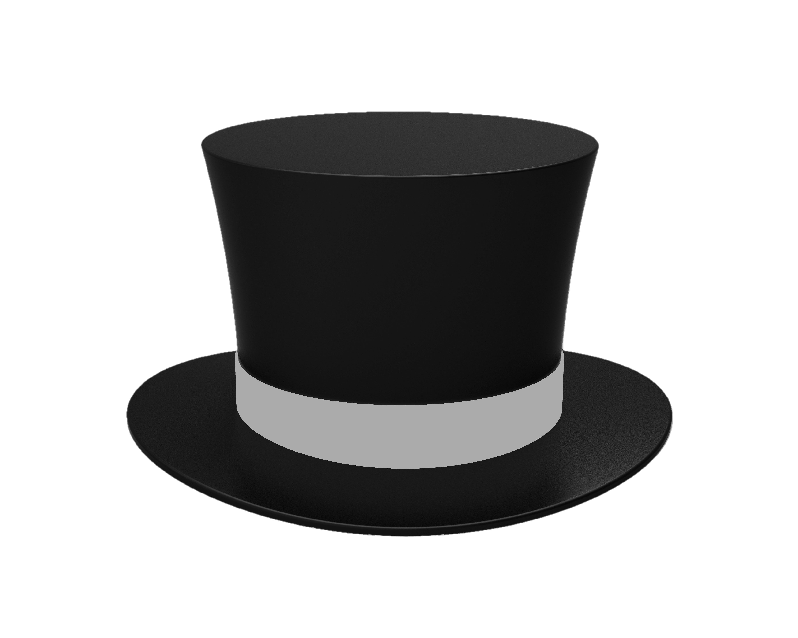
“Full Length” Mirrors
Same mirror size and placement for any distance

Slide 7
“Full Length” Mirrors
45 cm
207 cm
Same mirror size and placement for any distance

Slide 8
Not every surface is a flat mirror
Even surfaces that seem nice and flat are often textured
Diffuse Reflection

Slide 9
Retro-reflective Mirrors
Light always reflects directly back to the source

Slide 10
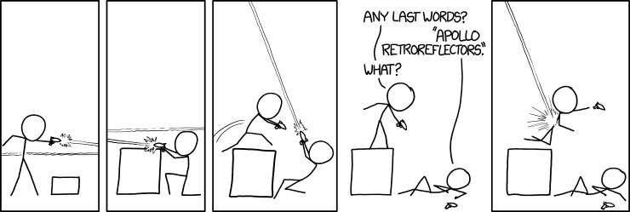
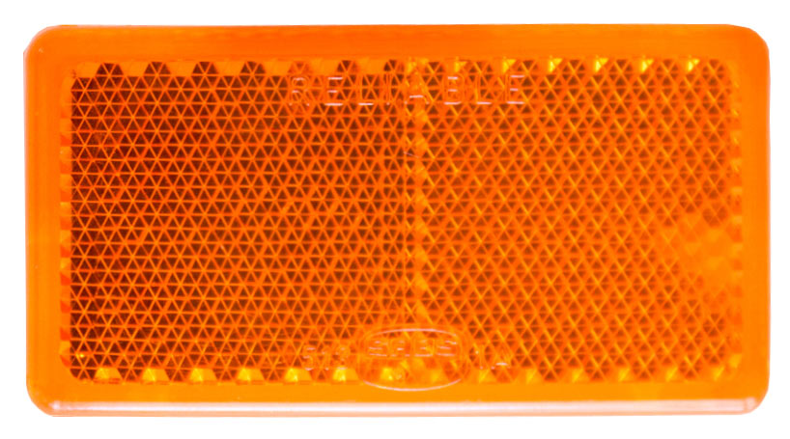
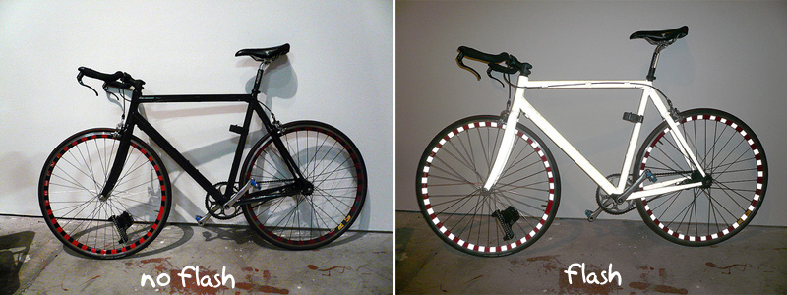
Retro-reflective Mirrors

Slide 11
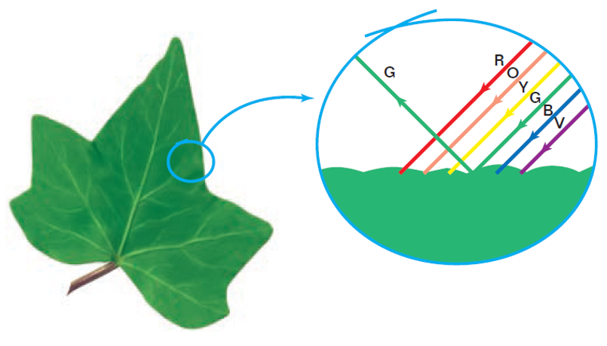
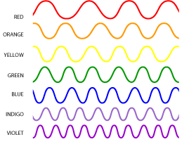
Colors
We perceive colors in objects depending on how different wavelengths are reflected

Slide 12
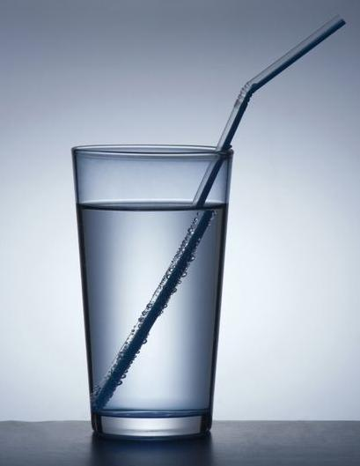
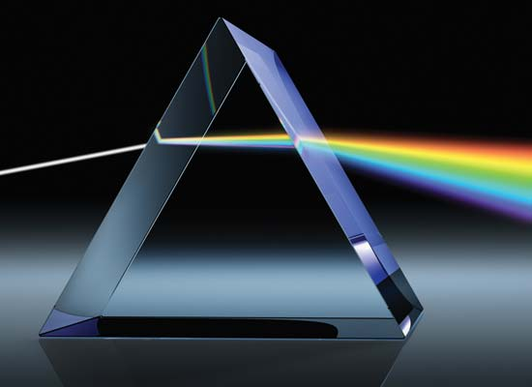
Refraction
Bends because of a change in medium

Slide 13
Speed of Light
In a vacuum all electromagnetic waves travel at:
c = 299,792,458 m/s = 3.00 × 10⁸ m/s
Light slows down when it travels through different mediums
Air
Water
Glass
2.999 × 10⁸ m s⁻¹
2.256 × 10⁸ m s⁻¹
1.974 × 10⁸ m s⁻¹

Slide 14
Index of Refraction → n
$$\frac{n_{1}}{n_{2}}=\frac{v_{2}}{v_{1}}$$
$$\frac{1}{1.52}=\frac{1.974×{10}^{8}}{3.00×{10}^{8}}$$
n₁
v₂
n₂
v₁
1
Vacuum | 3.00 × 10⁸ m s⁻¹ | 1
Air | 2.999 × 10⁸ m s⁻¹
Water | 2.256 × 10⁸ m s⁻¹
Glass | 1.974 × 10⁸ m s⁻¹
1.0003
~ 1
1.33
2
1.52

Slide 15
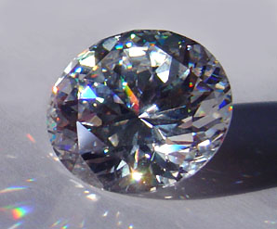
Try This
How fast does light travel through cubic zirconia (n = 2.15)?
$$\frac{n_{1}}{n_{2}}=\frac{v_{2}}{v_{1}}$$
$$\frac{1}{2.15}=\frac{v_{2}}{3.00×{10}^{8}}$$
$$v_{2}=1.40×{10}^{8} m s^{−1}$$

Slide 16
Predicting the Bend
faster
n = 1
n = 1.33
Bends toward the most optically dense medium normal line
slower

Slide 17
Predicting the Bend
Bends away from the least optically dense medium normal line
faster
n = 1
n = 1.33
slower

Slide 18
Refraction Boundary
faster
n = 1
n = 1.33
Bends toward the most optically dense medium normal line
slower

Slide 19
Refraction Boundary
Bends away from the least optically dense medium normal line
faster
n = 1
n = 1.33
slower

Slide 20
How Much Bend?
What’s the relationship between index of refraction (n) and the amount that light bends?
Air
n = 1
Air
n = 1
Larger difference in index means more bending at boundary
More to less optically dense will bend away from normal
Water
n = 1.33
Water
n = 1.33
Glass
n = 1.52
Glass
n = 1.52

Slide 21
Lesson Takeaways
I can identify the angle of incidence and angle of reflection for a reflected wave ray
I can use the law of reflection to predict the way light bounces off of a plane mirror
I can relate the index of refraction of a material to the speed of light as it travels through
I can qualitatively predict how light bends when transitioning between boundaries

