Slide 1
The Scale of Astrophysics
IB Physics | Astrophysics

Slide 2
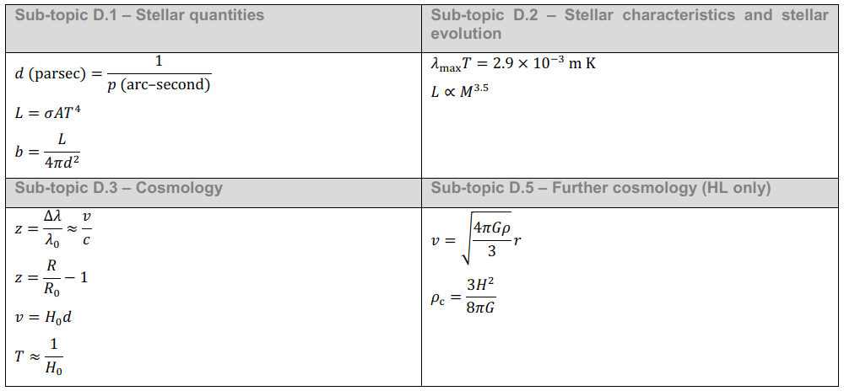
IB Physics Data Booklet
$$λ_{max}(metres)=\frac{2.90×{10}^{−3}}{T (kelvin)}$$
$$P=eσAT^{4}$$
$$I=\frac{P}{A}=\frac{P}{4πr^{2}}$$
Anything look familiar?

Slide 3
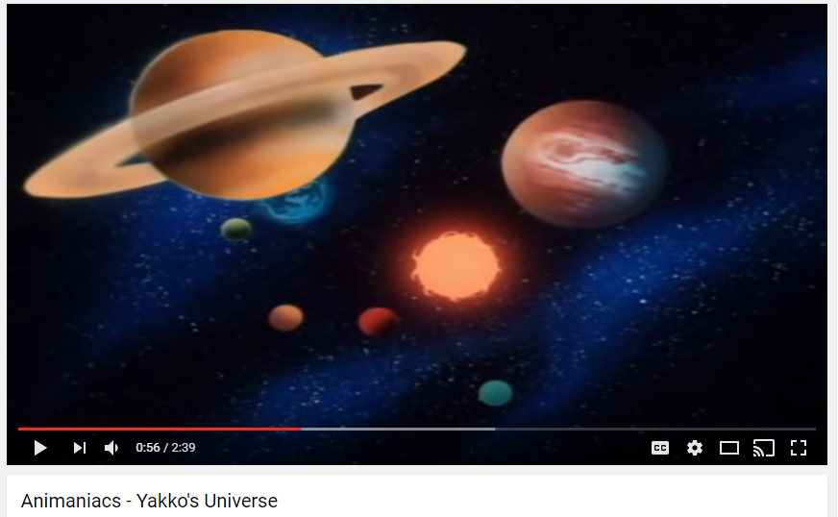
It’s a Great Big Universe…

Slide 4
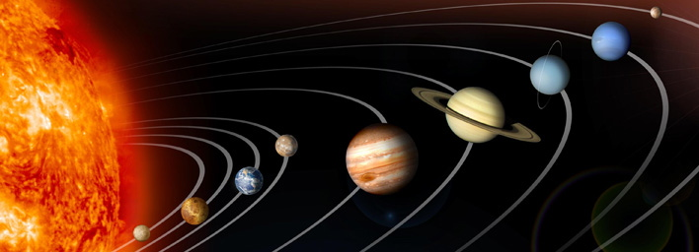
The Solar System
 | Mercury | Venus | Earth | Mars | Jupiter | Saturn | Uranus | Neptune
Diameter [km] | 4,880 | 12,104 | 12,756 | 6,787 | 142,800 | 120,000 | 51,800 | 49,500
Distance to Sun [× 10⁸ m] | 58 | 107.5 | 149.6 | 228 | 778 | 1,427 | 2,870 | 4,497

Slide 5
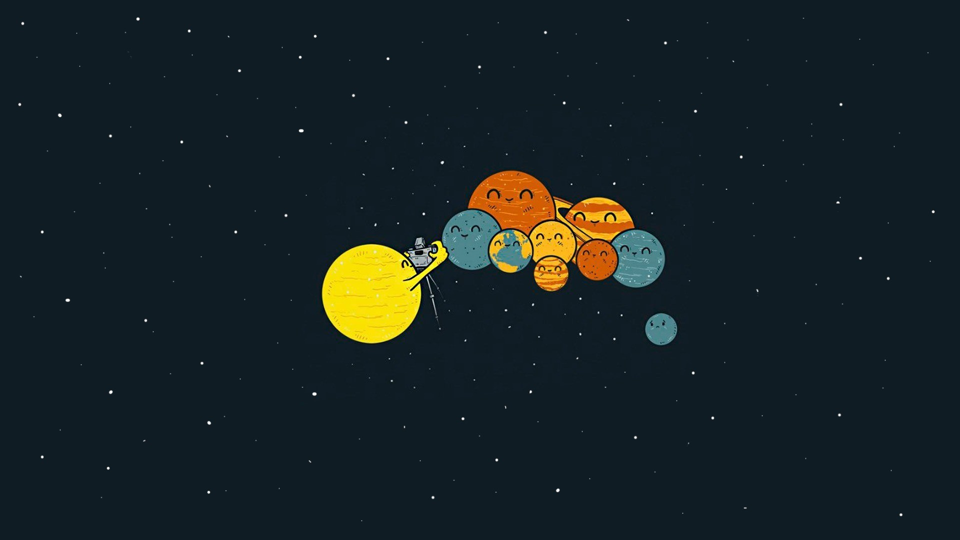
Poor Pluto… :’(
Definition of a Planet (as of 2006)
A celestial body that (a) is in orbit around the Sun, (b) has sufficient mass for its self-gravity to overcome rigid body forces so that it assumes a hydrostatic equilibrium (nearly round) shape, and (c) has cleared the neighbourhood around its orbit.

Slide 6
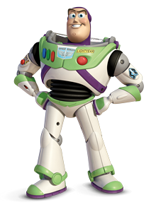
Measuring Distances
Speed of Light: c =
3.00 × 10⁸ m s⁻¹
How far is one light year (ly)
$\frac{3.00×{10}^{8} m}{1 s}×\frac{60 s}{1 min}×\frac{60 min}{1 hr}$ $×\frac{24 hr}{1 day}$ $×\frac{365 days}{1 yr}$
$$=9.46×{10}^{15} m {yr}^{−1}$$

Slide 7
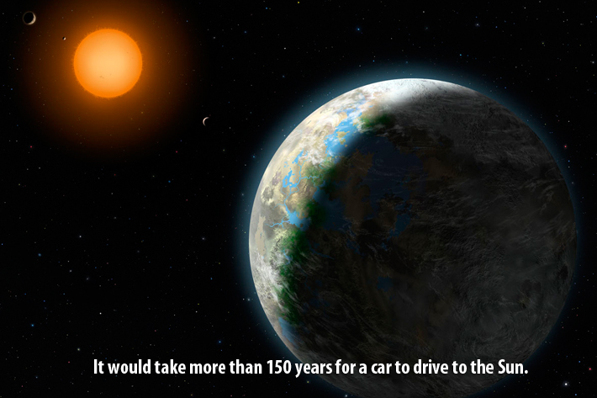
Measuring Distances
Average Distance between the Earth and the Sun
Astronomical
Unit
[AU]
1.5 × 10¹¹ m

Slide 8
Measuring Distances
1 light year (ly) = 9.46 × 10¹⁵ m
The distance that light travels in an earth year
1 astronomical unit (AU) = 1.50 × 10¹¹ m
The average distance between the earth and the sun

Slide 9
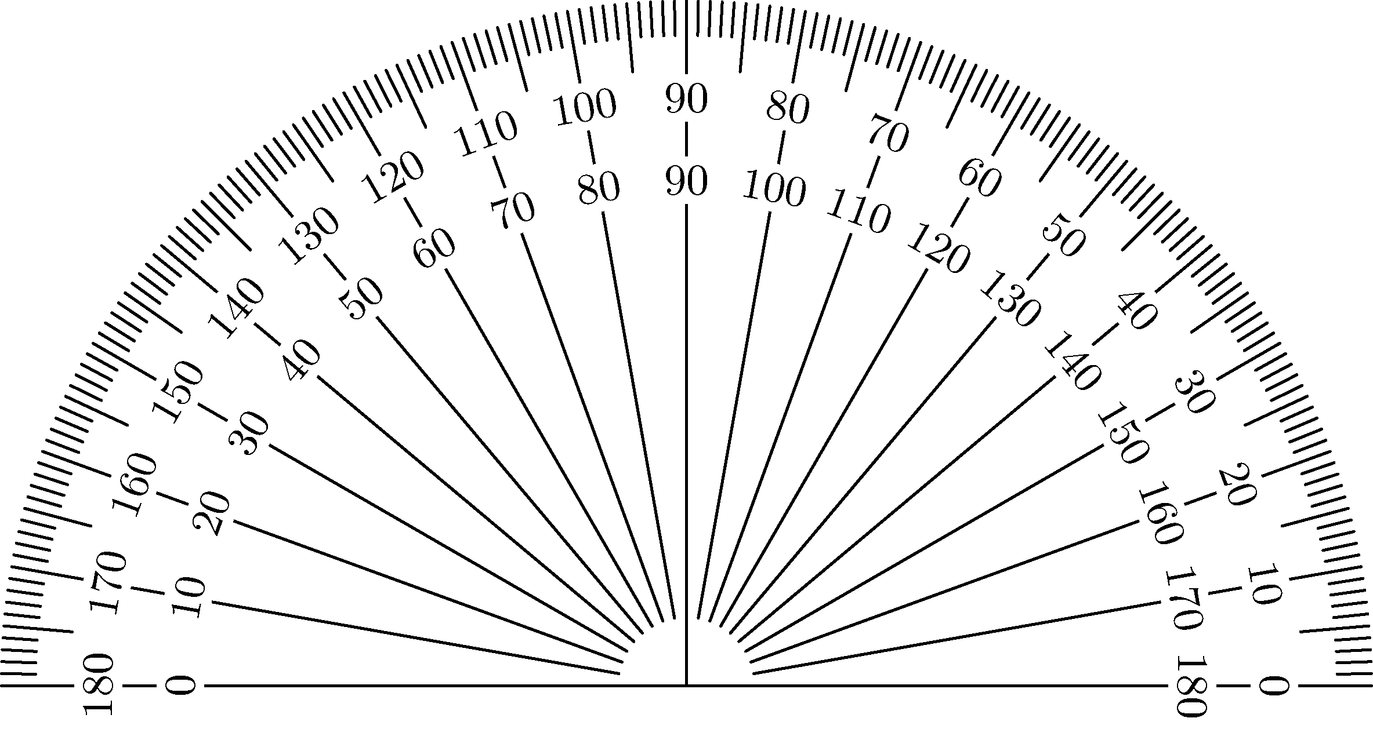
Measuring Angles
60 seconds in 1 minute
“
60 minutes in 1°
‘
1° = 3600 arcseconds
1° = 3600 as

Slide 10
Parsecs
1 parsec (pc) = 3.26 ly
distance at which the mean radius of the earth's orbit subtends an angle of one second of arc.
parsec stands for parallax angle of one second
1 parsec
1 second

Slide 11
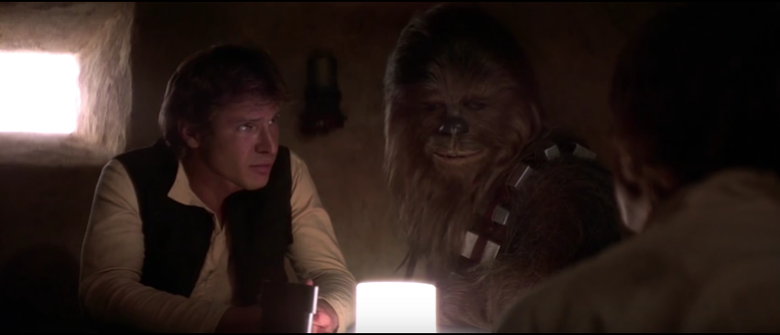
Parsecs
Why is this claim a little odd?
“It's the ship that made the Kessel run in less than 12 Parsecs.”
distance

Slide 12
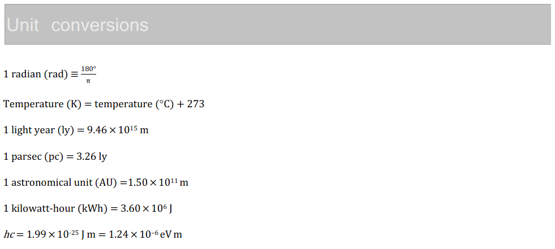
IB Physics Data Booklet

Slide 13
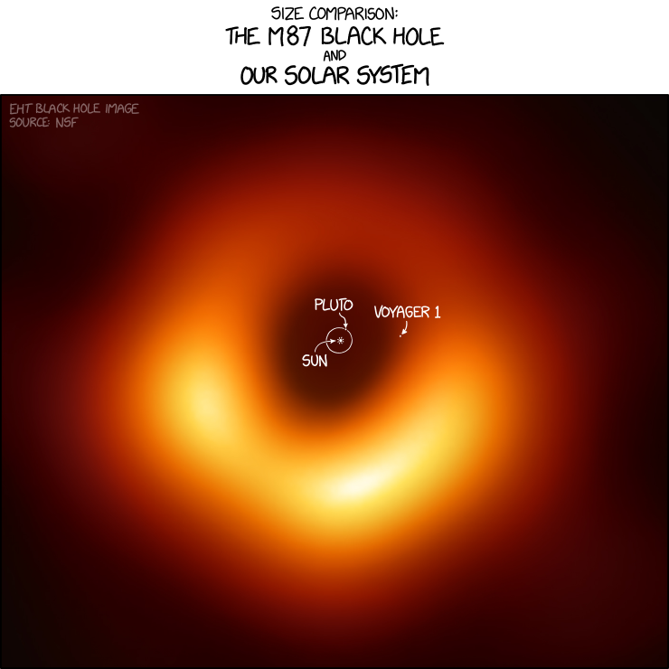
The Black Hole – by the numbers
Just bigger than our solar system
6.5 billion times the mass of the Sun
55 million light years from Earth

Slide 14
The Science Behind the Picture
Remember: 1° = 3600 arcseconds
1 arcsecond = 1,000,000 μas
*60 μas is about the same as resolving a picture of an orange sitting on the surface of the moon

Slide 15
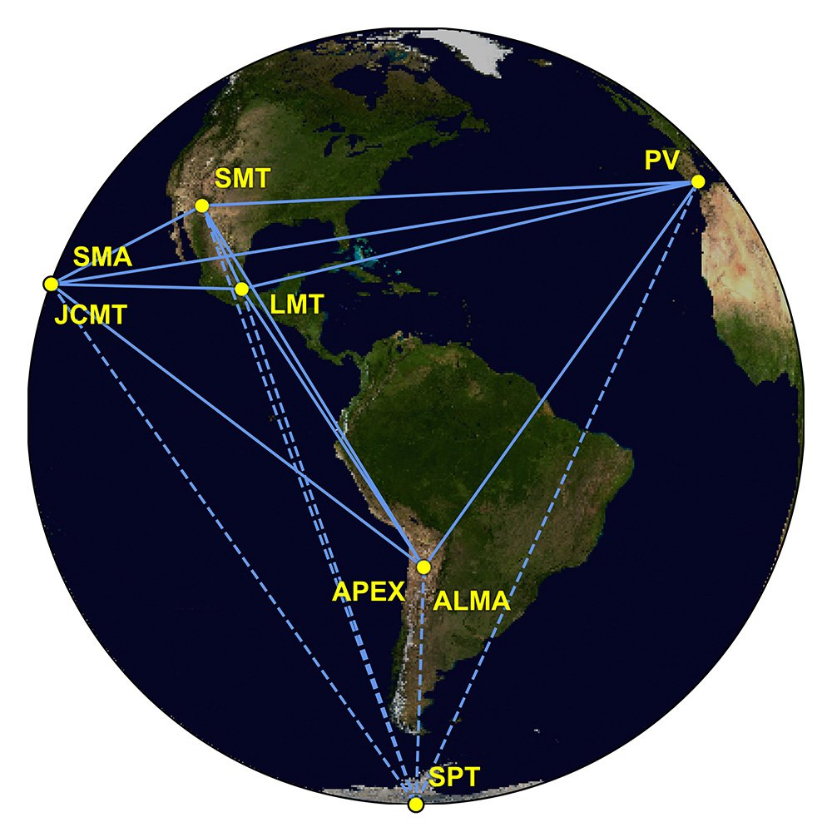
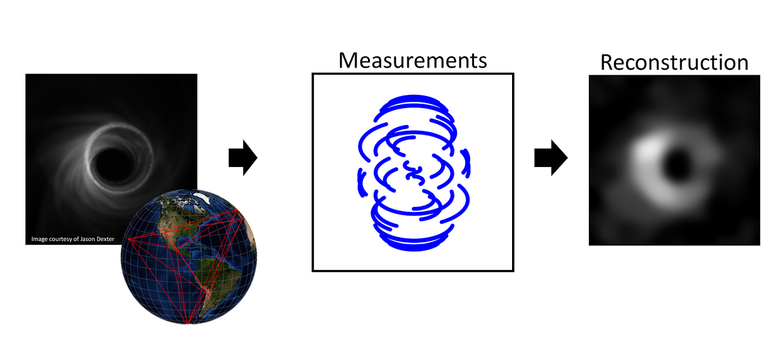
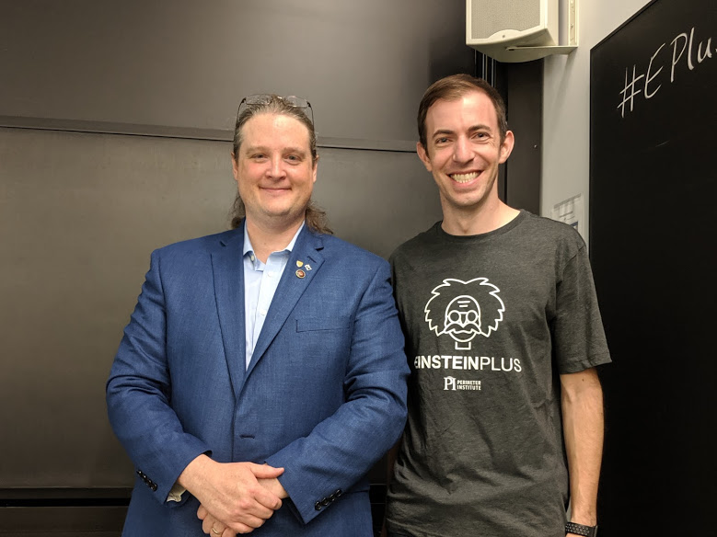
The Science Behind the Picture

