Slide 1
Stellar Quantities
IB Physics | Astrophysics

Slide 2
Measuring Distances
1 light year (ly) = 9.46 × 10¹⁵ m
The distance that light travels in an earth year
1 astronomical unit (AU) = 1.50 × 10¹¹ m
The average distance between the earth and the sun
1 parsec (pc) = 3.26 ly
distance at which the mean radius of the earth's orbit subtends an angle of one second of arc.

Slide 3
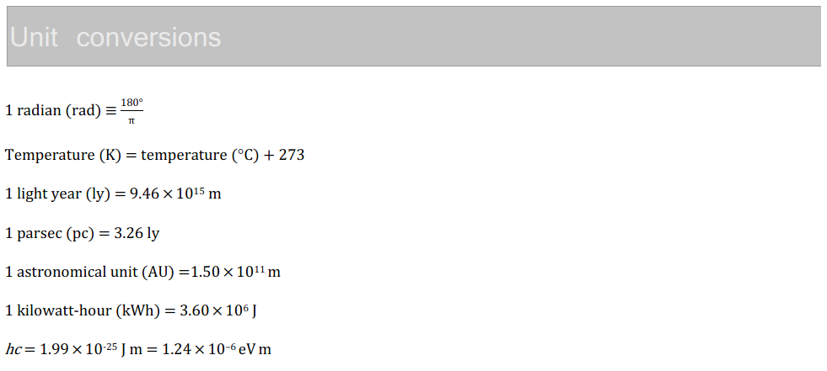
IB Physics Data Booklet

Slide 4
Calculating Stellar Quantities
Distance
Brightness
Luminosity
Temperature
Radius

Slide 5
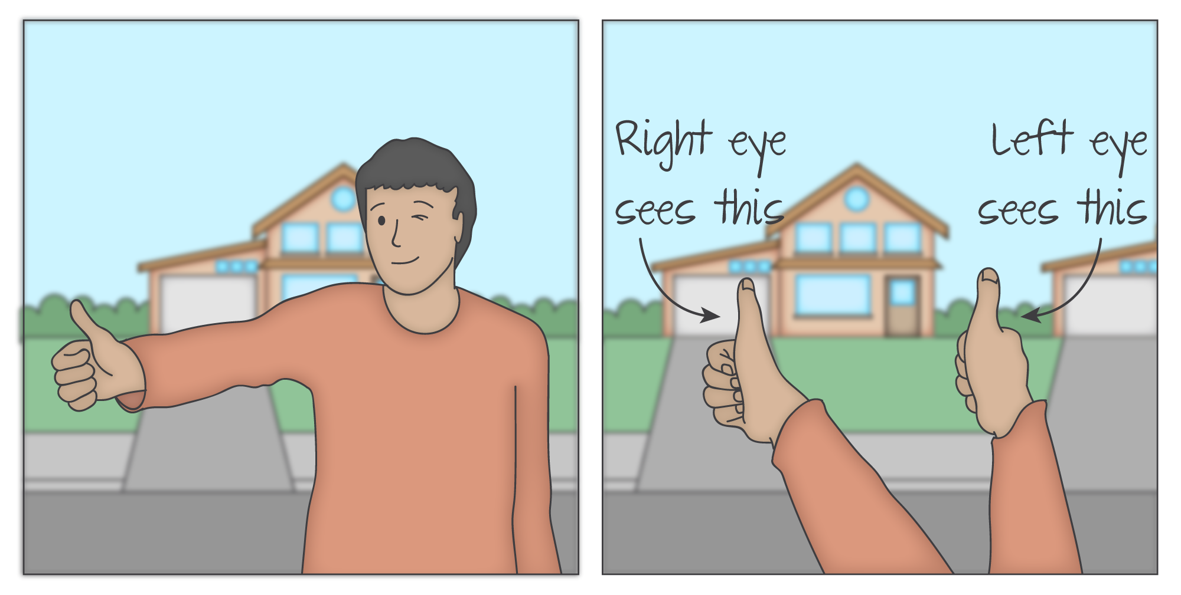
Stellar Parallax
Distance
Brightness
Luminosity
Temperature
Radius

Slide 6
Stellar Parallax
d (parsec)
p (arc second)
$$d \left(parsec\right)=\frac{1}{p (arc second)}$$
Distance
Brightness
Luminosity
Temperature
Radius

Slide 7
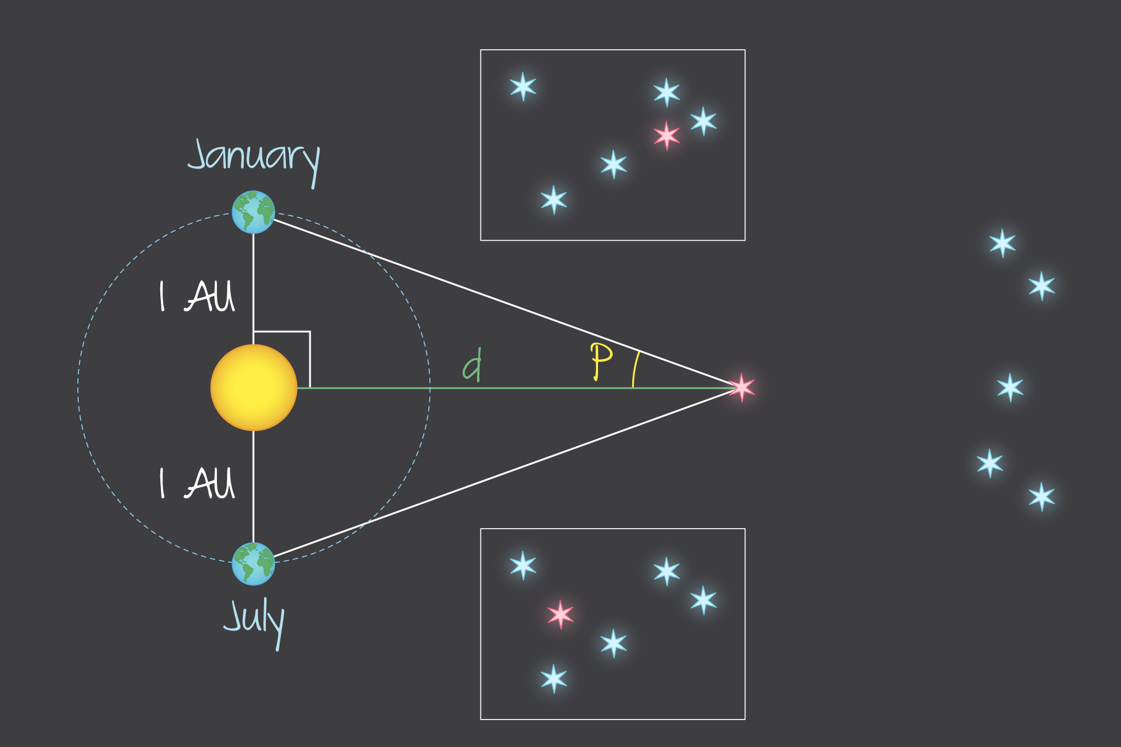
Stellar Parallax
The angle must be measured to a very distant field of other stars
*The parallax method only works for stars that are relatively close to earth
Distance
Brightness
Luminosity
Temperature
Radius

Slide 8
Try This… | #1
$$d \left(parsec\right)=\frac{1}{p (arc second)}$$
The star Betelgeuse has a parallax angle of 7.7 × 10⁻³ arc seconds. Calculate its distance.
arc-seconds → parsecs → light years → meters
$$d=\frac{1}{p}=\frac{1}{7.7×{10}^{−3} arc seconds}=129.9 parsecs$$
$$129.9 pc×\frac{3.26 ly}{1 pc}×\frac{9.46×{10}^{15} m}{1 ly}=$$
$$4.0×{10}^{18} m$$
Distance
Brightness
Luminosity
Temperature
Radius

Slide 9
Luminosity vs Brightness
Luminosity |  | Brightness
L
b
Power Emitted
Intensity
Watts [W]
W/m² or W m⁻²
*Depends on the observer distance
Distance
Brightness
Luminosity
Temperature
Radius

Slide 10
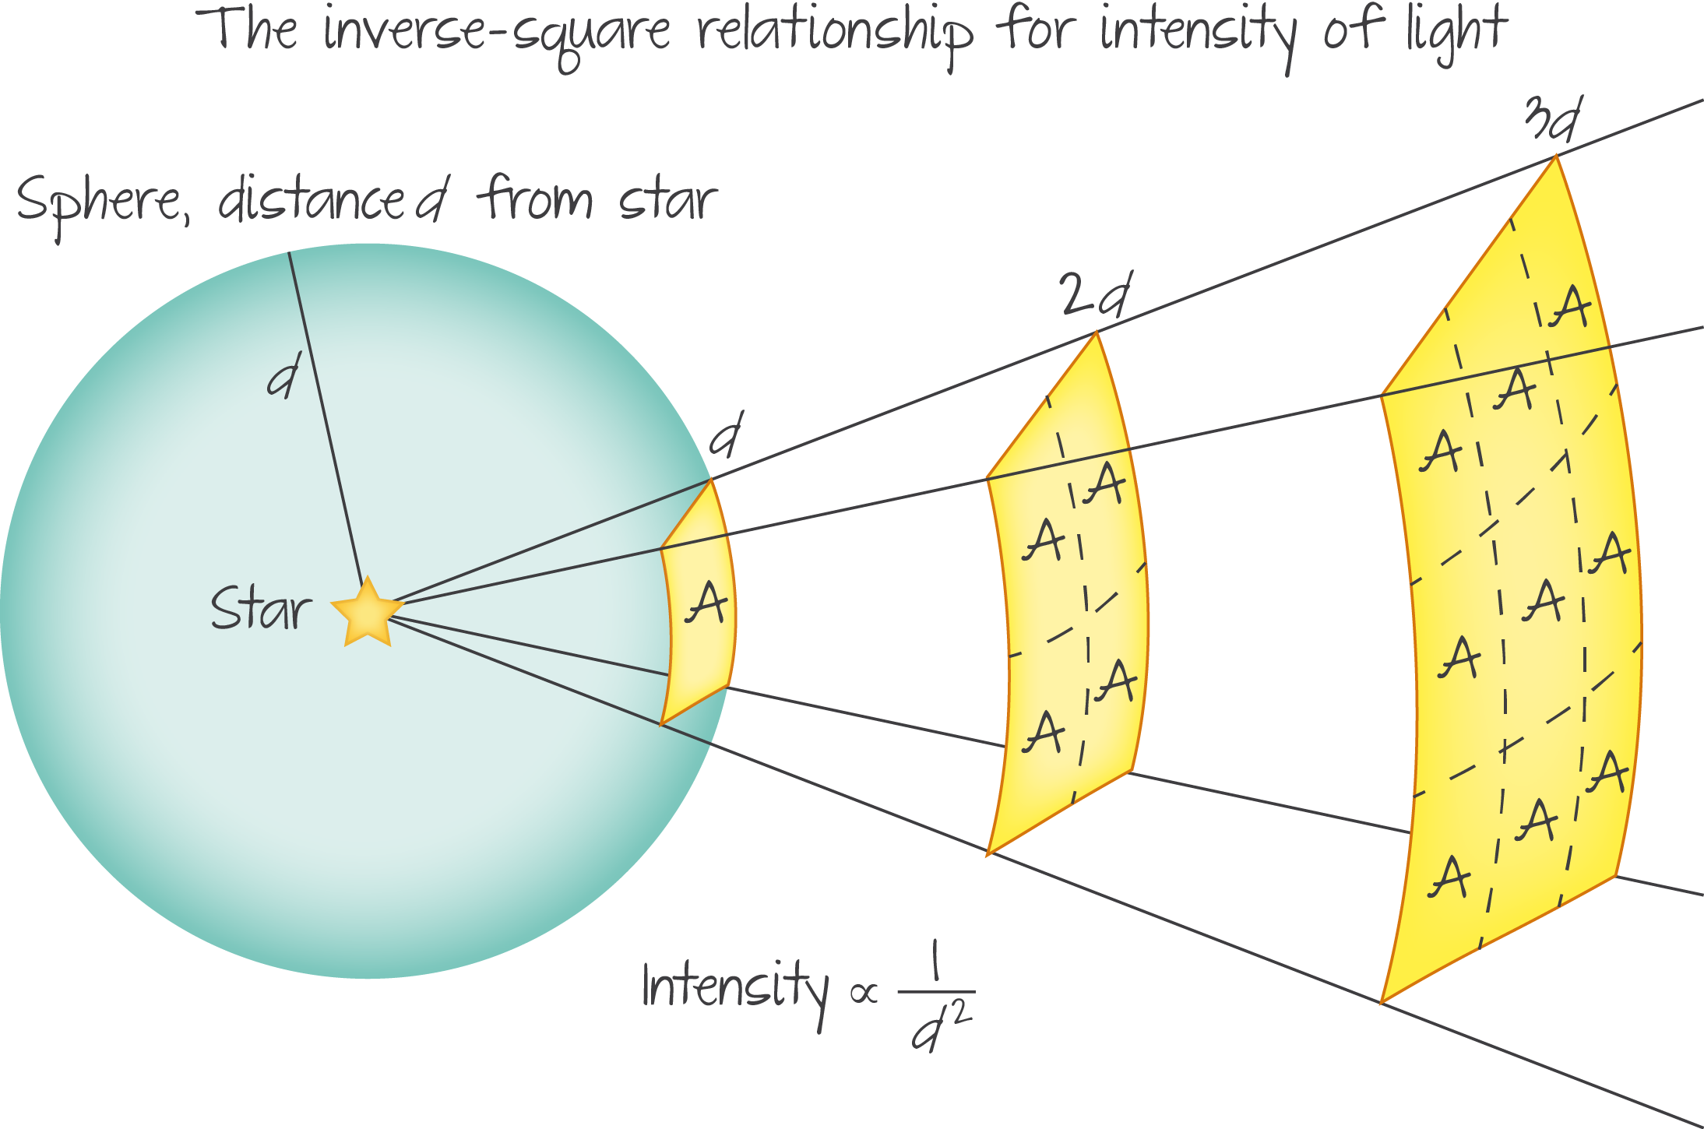
Brightness
$$b=\frac{L}{4πd^{2}}$$
Distance | Brightness
x
2x
3x
4x
Distance from star
b
b/4
b/9
b/16
Distance
Brightness
Luminosity
Temperature
Radius

Slide 11
Same Brightness, Different Stars
It is possible for stars to have the same brightness but have different distances and luminosities
Distance
Brightness
Luminosity
Temperature
Radius

Slide 12
Try This… | #2
The star Betelgeuse has an apparent brightness of 2.0 × 10⁻⁷ W m⁻². Calculate its luminosity.
d = 4.0 × 10¹⁸ m
$$b=\frac{L}{4πd^{2}}$$
$$L=\left(b\right)\left(4πd^{2}\right)$$
$$=\left(2.0×{10}^{−7}\right)\left(4π{(4.0×{10}^{18})}^{2}\right)$$
$$=4.0×{10}^{31} W$$
Distance
Brightness
Luminosity
Temperature
Radius

Slide 13
Calculating Stellar Quantities
Distance
Brightness
Luminosity
Temperature
Radius

Slide 14
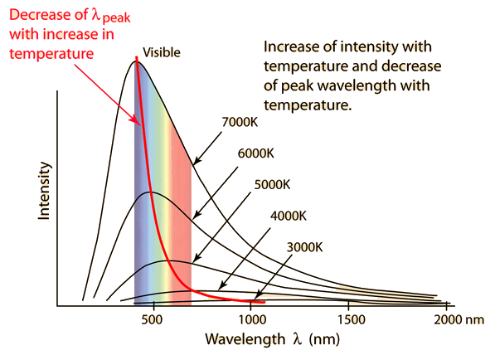
Wien’s Displacement Law
$$λ_{max}T=2.90×{10}^{−3} mK$$
This equation shows up in subtopic 8.2 as
$$λ_{max}(metres)=\frac{2.90×{10}^{−3}}{T (kelvin)}$$
*Note: This assumes perfect blackbody radiation
Distance
Brightness
Luminosity
Temperature
Radius

Slide 15
Try This… | #3
The star Betelgeuse has a max wavelength of 828.6 nm.
What is its surface temperature?
$$828.6×{10}^{−9} m$$
$$λ_{max}T=2.90×{10}^{−3} mK$$
Solve for T
$$T=\frac{2.90×{10}^{−3} mK}{λ_{max}}$$
$$=\frac{2.90×{10}^{−3} mK}{828.6×{10}^{−9}}=$$
$$3500 K$$
Distance
Brightness
Luminosity
Temperature
Radius

Slide 16
Luminosity
$$L=σAT^{4}$$
Stefan-Boltzmann Constant | σ | 5.67 × 10⁻⁸ W m⁻² K⁻⁴
Temperature
[K]
Luminosity
[W]
Surface Area (sphere)
A=4πr²
Distance
Brightness
Luminosity
Temperature
Radius

Slide 17
Try This… | #4
Knowing everything else that we know about Betelgeuse, calculate the average radius of the star.
L = 4.0 × 10³¹ W
T = 3,500 K
$$L=σAT^{4}$$
Solve for r
$$4.0×{10}^{31}=(5.67×{10}^{−8})(4πr^{2}){(3500)}^{4}$$
$$r=6.12×{10}^{11}$$
Distance
Brightness
Luminosity
Temperature
Radius

Slide 18
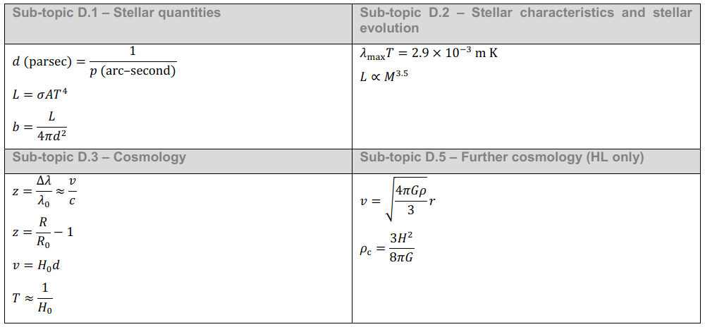
IB Physics Data Booklet
Distance
Brightness
Luminosity
Temperature
Radius

Slide 19
All together now!
Brightness (W m⁻²)
Max Wavelength (m)
Distance (m)
Luminosity (W)
Temperature (K)
Radius (m)
The brightest star in the sky is known as Sirius and has a parallax angle of 0.379 arc seconds, apparent brightness of 1.2 × 10⁻⁷ W m⁻², and a max wavelength of 292 nm. Complete this table of stellar properties.
1.2 × 10⁻⁷ W m⁻²
292 × 10⁻⁹ m
8.14 × 10¹⁶ m
$$292×{10}^{−9} m$$
$$d=\frac{1}{p}=\frac{1}{0.379 arc seconds}=2.64 parsecs$$
$$2.64 pc×\frac{3.26 ly}{1 pc}×\frac{9.46×{10}^{15} m}{1 ly}=8.14×{10}^{16} m$$
9.98 × 10²⁷ W
$$L=\left(b\right)\left(4πd^{2}\right)=\left(1.2×{10}^{−7}\right)\left(4π{(8.14×{10}^{16})}^{2}\right)=9.98×{10}^{27} W$$
9930 K
$$T=\frac{2.90×{10}^{−3} mK}{λ_{max}}=\frac{2.90×{10}^{−3} mK}{292×{10}^{−9}}=9930 K$$
1.2 × 10⁹ m
$$L=σAT^{4}$$
$$9.98×{10}^{27}=(5.67×{10}^{−8})(4πr^{2}){(9930)}^{4}$$
$$r=1.2×{10}^{9} m$$
Distance
Brightness
Luminosity
Temperature
Radius

