Slide 1
H-R Diagrams and Stellar Spectra
IB Physics | Astrophysics

Slide 2
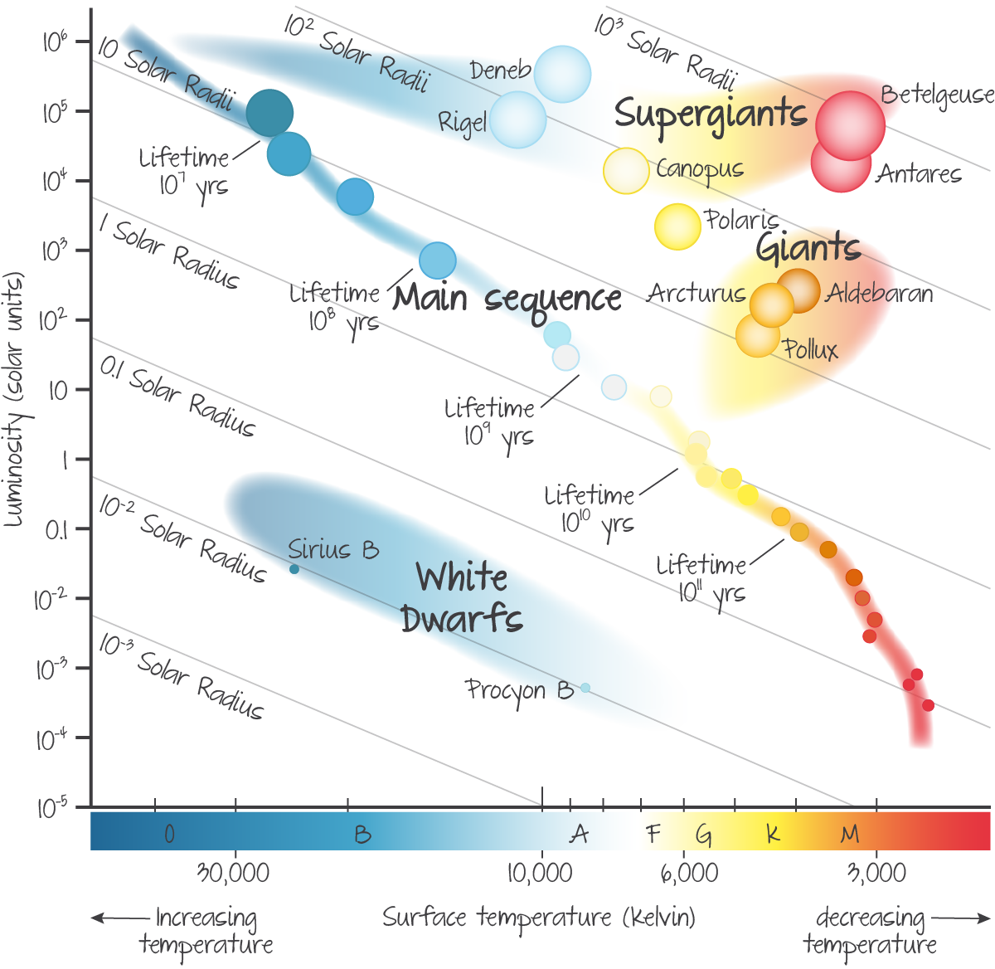
H-R Diagrams
L_{sun}
L_{ⵙ}

Slide 3
H-R Diagrams
Large Hot
Large Cool
Our Sun
Small Hot
Small Cool

Slide 4
H-R Diagrams

Slide 5
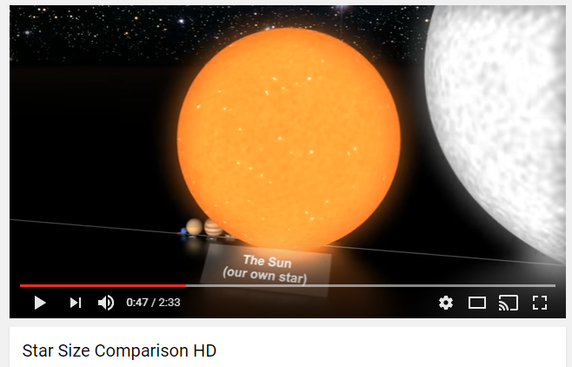
Sizes of Stars

Slide 6
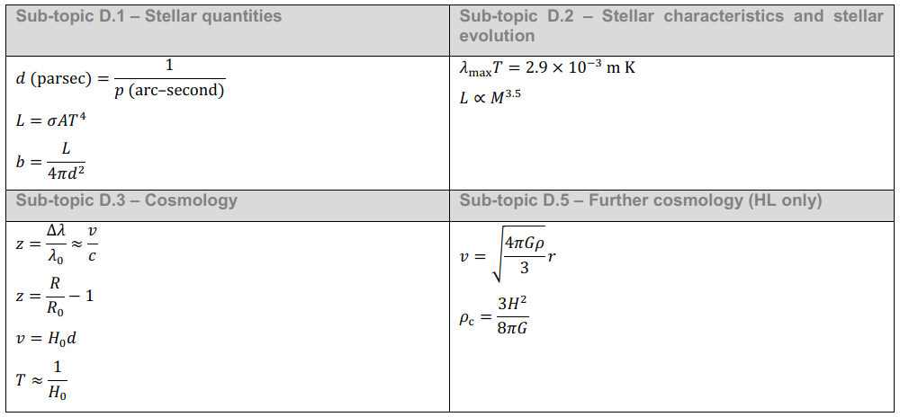
IB Physics Data Booklet

Slide 7
H-R Diagram for Calculating Distance
The maximum wavelength of a distant star is measured to be 600 nm, suggesting that it has a temperature of ~4800 K. If this star has a brightness of 1.0 × 10⁻¹² W m⁻², what is its distance from Earth?
L_{sun} = 3.84 × 10²⁴ W
$$L_{star}=0.5×(3.84×{10}^{24})$$
$$=1.92×{10}^{24} W$$
~0.5 L_{sun}
$$d=\sqrt{\frac{L}{4πb}}$$
$$b=\frac{L}{4πd^{2}}$$
4800 K
$$d=\sqrt{\frac{{1.92×10}^{24}}{4π(1.0×{10}^{−12})}}=$$
$$3.9×{10}^{17} m$$

Slide 8
Try This
The maximum wavelength of a distant star is measured to be 400 nm. If this star has a brightness of 0.5 × 10⁻¹² W m⁻², what is its distance from Earth?
L_{sun} = 3.84 × 10²⁴ W
$$T=\frac{2.90×{10}^{−3}}{400×{10}^{−9}}$$
$$L_{star}=10×(3.84×{10}^{24})$$
~10 L_{sun}
$$T=7250 K$$
$$=3.84×{10}^{25} W$$
$$d=\sqrt{\frac{L}{4πb}}$$
$$b=\frac{L}{4πd^{2}}$$
7250 K
$$d=\sqrt{\frac{{3.84×10}^{25}}{4π(0.5×{10}^{−12})}}=$$
$$2.47×{10}^{18} m$$

Slide 9
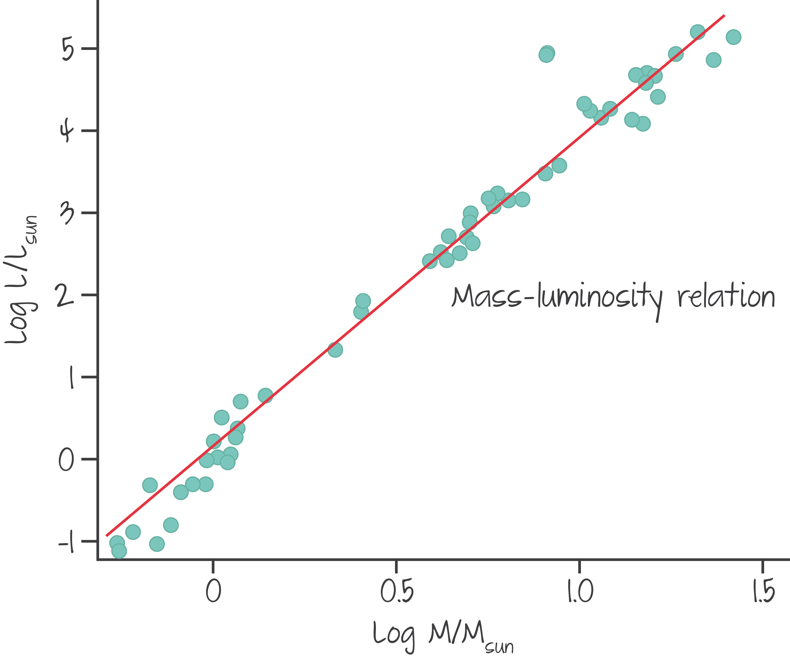
Mass-Luminosity Relationship
For stars on the main sequence, there is a relationship between luminosity and mass
$$L∝M^{3.5}$$

Slide 10
IB Physics Data Booklet

Slide 11
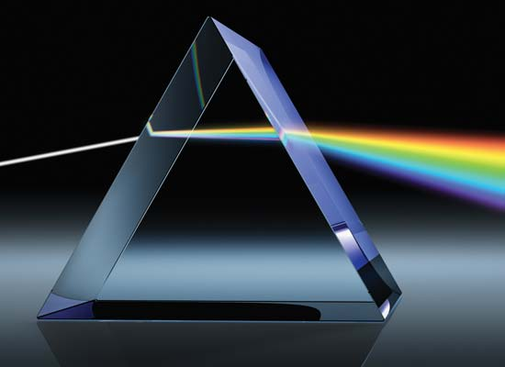
Continuous Spectrum
When white light from the sun passes through a prism, the light is dispersed into its component colors in a continuous spectrum

Slide 12
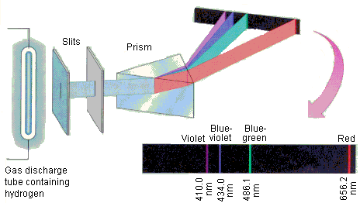
Emission Spectrum
If an electric current is passed through an element in the form of a low-pressure gas, it will produce its own unique emission spectrum

Slide 13
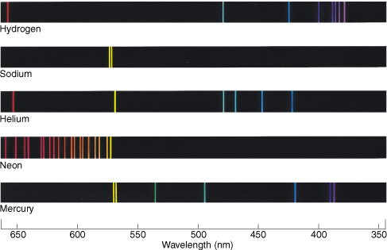
Emission Spectrum
These spectra can be used to identify elements like a fingerprint

Slide 14
Absorption Spectrum
If white light is passed through a sample of gaseous atoms or molecules, it is found that the light of certain wavelengths is missing

Slide 15
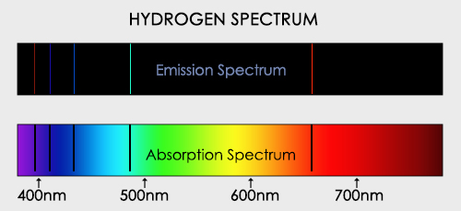
Absorption Spectrum

Slide 16
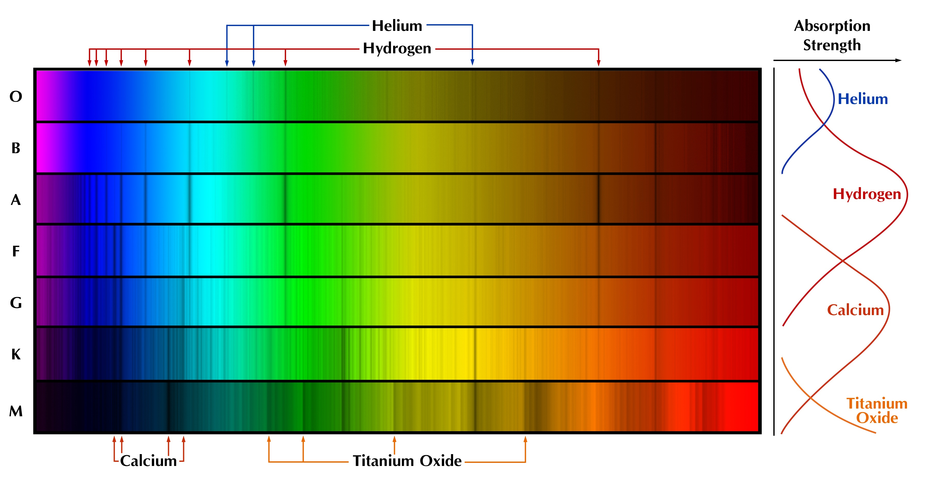
Stellar Spectra
Studying the Spectra of Stars can help determine what the stars are made of
Are these Emission Spectra or Absorption Spectra?

Slide 17
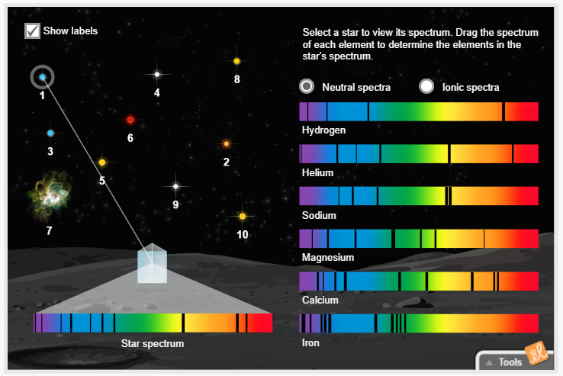
Stellar Spectra | Try it out
Compare the spectra of the stars with the known absorption spectra of different elements to determine the composition of the stars
N → Neutral Spectra
I → Ionic Spectra
1 | 2 | 3 | 4 | 5 | 6 | 7 | 8 | 9 | 10
1 | 2 | 3 | 4 | 5 | 6 | 7 | 8 | 9 | 10
N |  | N | N | N |  | N |  | N
N |  | I |  |  |  | N
 |  |  | I | N |  | N |  | N | N
 | N
 | N |  | I |  | N |  | N |  | I
 | N |  |  |  | N |  | I
Redshifted

