Slide 1
The Expanding Universe
IB Physics | Unit 13 | Astrophysics

Slide 2
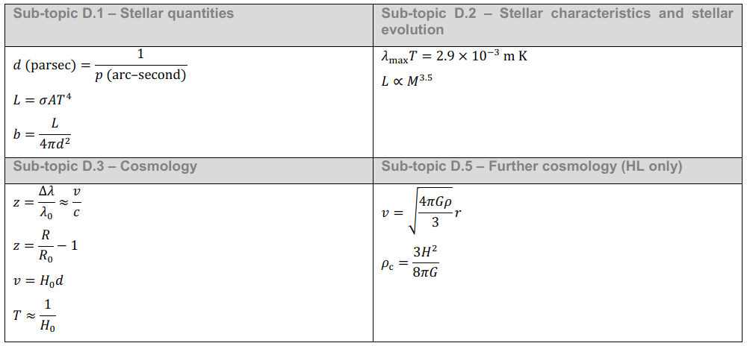
IB Physics Data Booklet

Slide 3
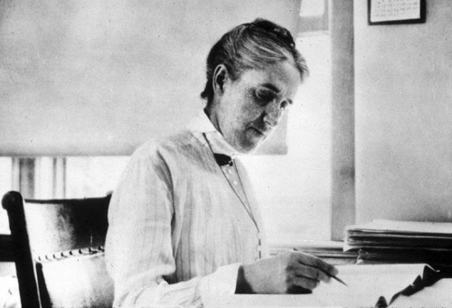
Henrietta Swan Leavitt

Slide 4
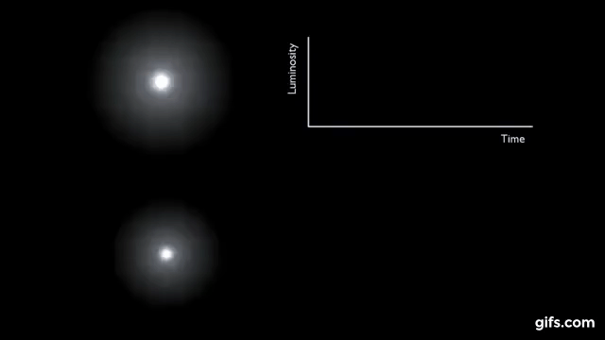
Cephid Variables

Slide 5
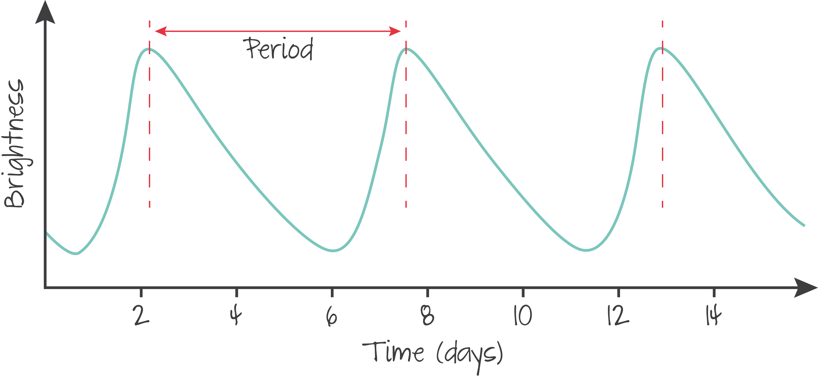
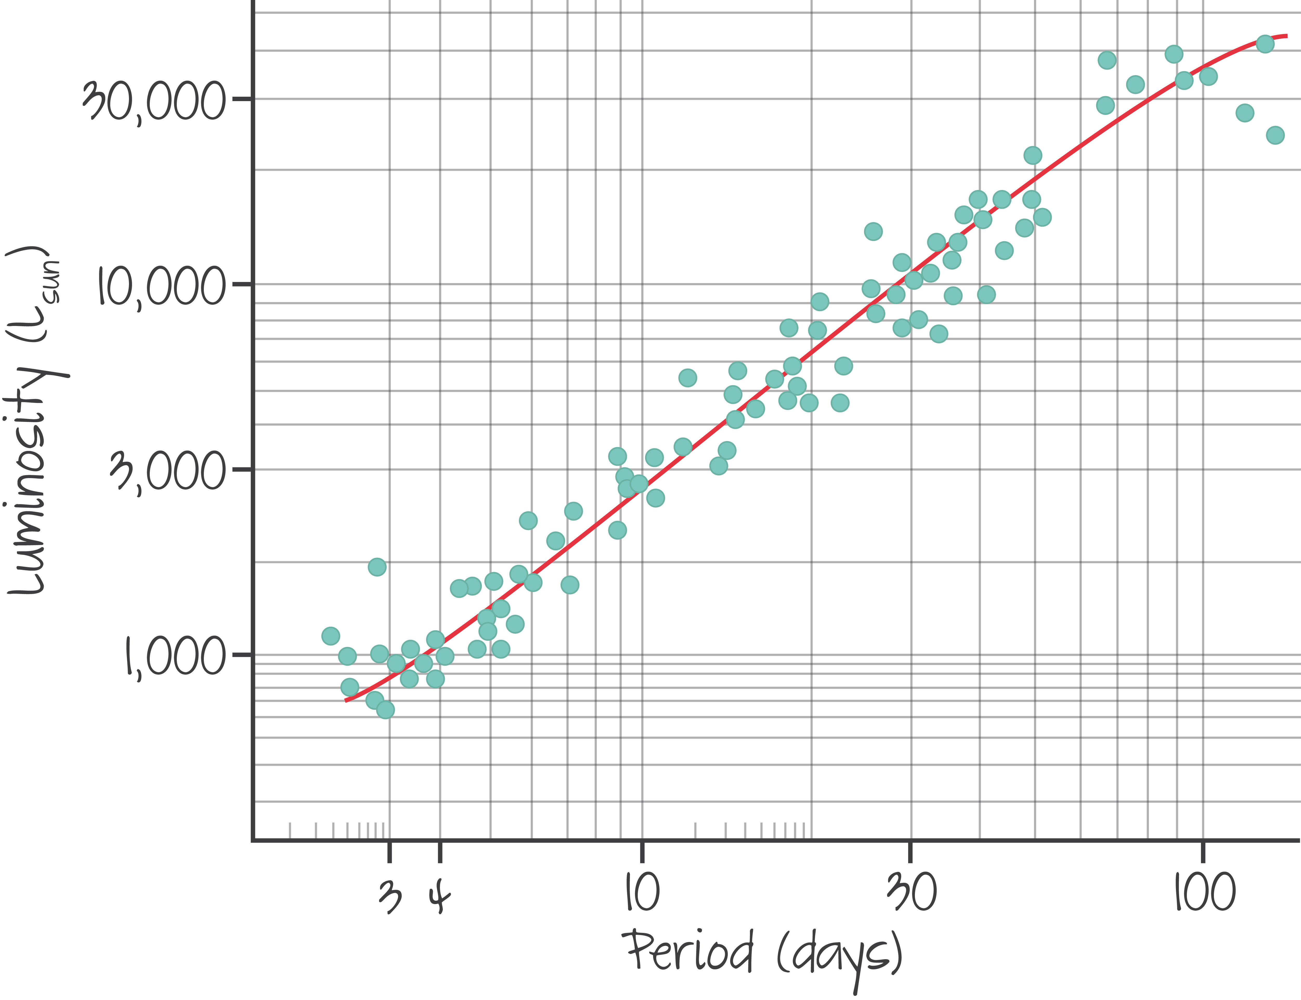
“Standard Candle”
Cephid Variables with longer brightness periods are more luminous
With this table, the luminosity of this “standard candle” can be determined as long as the period is known

Slide 6
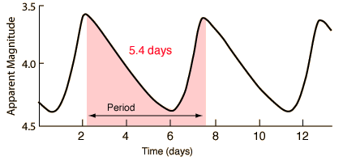
Cephid Variables
1 L_{sun} = 3.84 × 10²⁴ W
What is the distance of the Cephid Variable with the period shown in the graph above? The brightness of this star is 8 × 10⁻¹⁰ W m⁻².
~1500 L_{sun}
5.4 days
$$L_{star}=1500×(3.84×{10}^{24})$$
$$=5.76×{10}^{27} W$$
$$d=\sqrt{\frac{L}{4πb}}$$
$$d=\sqrt{\frac{{5.76×10}^{27}}{4π(8×{10}^{−10})}}=$$
$$b=\frac{L}{4πd^{2}}$$
$$7.57×{10}^{17} m$$

Slide 7
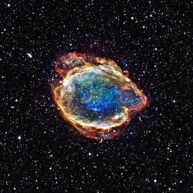
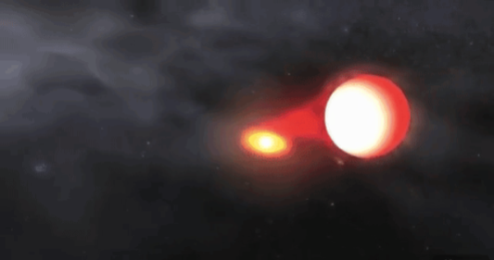
Type Ia Supernova
A type Ia Supernova forms when a white dwarf accretes matter from a companion star until it exceeds the Chandrasekhar limit and explodes
These supernovae have a constant luminosity so their brightness can be analyzed as a standard candle much like the Cephid Variables

Slide 8
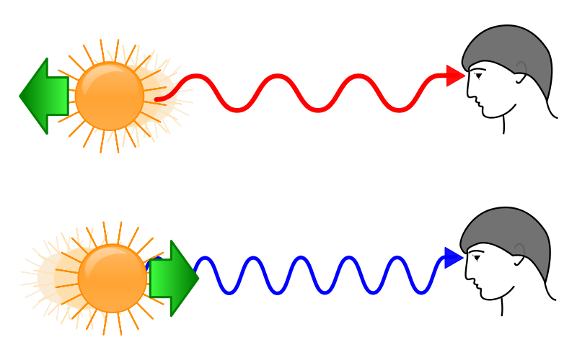
Doppler Effect
Red-shifted

Slide 9
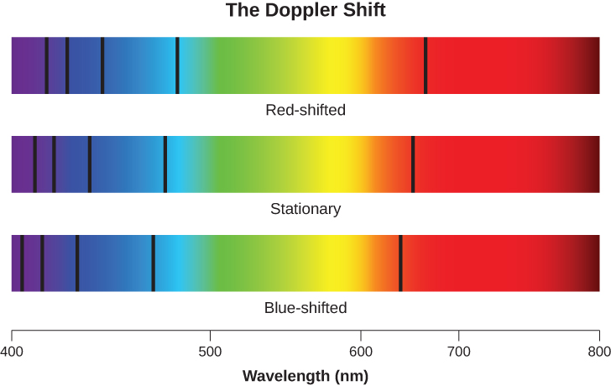
Red Shift, Blue Shift

Slide 10
Calculating Redshift
Change in Wavelength
Velocity of the Source
Redshift
$$z=\frac{∆λ}{λ_{o}}≈\frac{v}{c}$$
Speed
of Light
Wavelength
Emitted
(3.00×10⁸ m s⁻¹)

Slide 11
IB Physics Data Booklet

Slide 12
Calculating Redshift
A characteristic absorption line often seen in stars is due to ionized helium. It occurs at 468.6 nm. If the spectrum of a star has this line at a measured wavelength of 499.3 nm what is the recession speed of the star?
$$\frac{∆λ}{λ_{o}}≈\frac{v}{c}$$
$$\frac{499.3−468.6}{468.6}≈\frac{v}{3.00×{10}^{8}}$$
$$v=1.97×{10}^{7} m s^{−1}$$

Slide 13
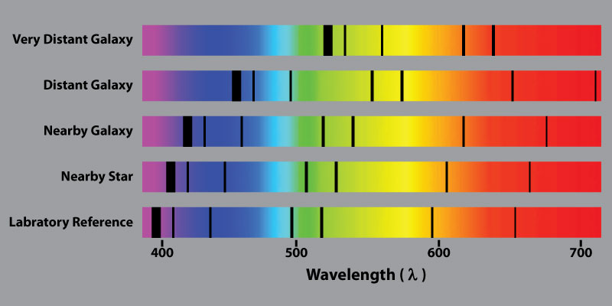
Hubble’s Big Discovery
Edwin Hubble discovered that the amount of redshift changed by the distance

Slide 14
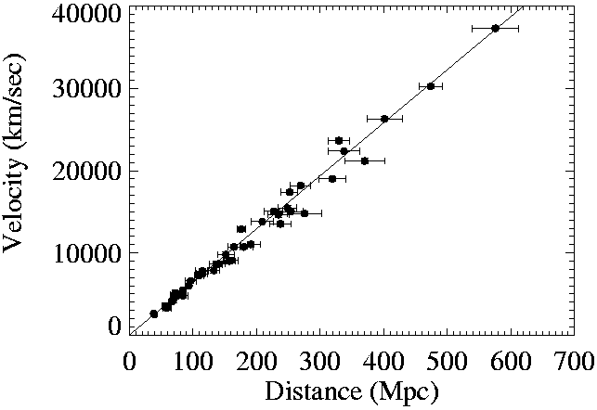
The Universe is Expanding
$$v=H_{0}d$$
Slope = H₀
H₀ ≈ 70 km s⁻¹ Mpc⁻¹
*current value is not necessarily constant

Slide 15
IB Physics Data Booklet

Slide 16
Using the Hubble “Constant”
Estimate the distance from the Earth to a galaxy with a recessional velocity of 150 km s⁻¹
$$d=\frac{v}{H_{0}}$$
$$=\frac{150 km s^{−1}}{70 km s^{−1}{ Mpc}^{−1}}=2.14 Mpc$$
$$v=H_{0}d$$
If a galaxy is 20 Mpc from Earth, how fast will it be receding?
$$v=H_{0}d$$
$$=\left(70 km s^{−1}{ Mpc}^{−1}\right)\left(20 Mpc\right)=1400 km s^{−1}$$

Slide 17
Calculating Redshift
Nothing can go faster than the speed of light so the Doppler effect can’t really hold up…

Slide 18
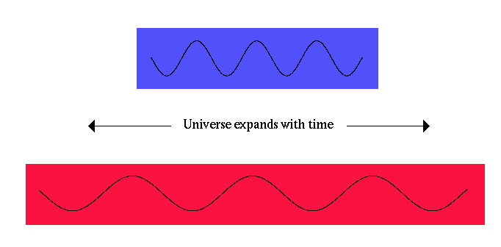
Calculating Redshift
Think of the wavelength change due to the stretching of space-time
Current Universe Size
$[R=1$]
$$z=\frac{R}{R_{o}}−1$$
Cosmological Redshift
Cosmic Scale Factor
Size of the universe at the time the light was emitted (relative to the current size)

Slide 19
Calculating Redshift
If the redshift z = 3, what was the scale factor at the time that the light was emitted?
$$z=\frac{R}{R_{o}}−1$$
$$3=\frac{1}{R_{o}}−1$$
$$R_{o}=\frac{1}{4}=0.25$$
Note: This means that to result in this cosmological redshift, the light had to have been emitted when the universe was a quarter of the size it is now

Slide 20
The Universe is Expanding
Think of a rubber band with marks when it is stretched out… Relative to the first dot, which dot moves the fastest?
2 cm
4 cm
6 cm

Slide 21
The Universe is Expanding
Think of a rubber band with marks when it is stretched out… Relative to the first dot, which dot moves the fastest?
2 cm
4 cm
6 cm
4 cm
8 cm
12 cm
The farthest dot moves away the fastest

Slide 22
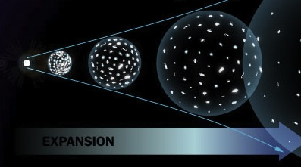
The Universe is Expanding

