Slide 1
Radioactive Decay
IB Physics | Atomic Physics

Slide 2
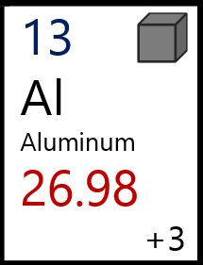
Standard Notation
What do you notice about the notation written below?
Can you determine what each color represents?
Mass Number
27
Al
A
X
13
Z
Atomic Number

Slide 3
Try This
23
Na
25
Mg
11
12
Mass Number
Atomic Number
# of Protons
# of Neutrons
Mass Number
Atomic Number
# of Protons | 12
# of Neutrons | 13
23
25
11
12
11
12

Slide 4
Sample IB Question
A nucleus of Californium (Cf) contains 98 protons and 154 neutrons. Which of the following correctly identifies this nucleus of Californium?
$${}_{254}^{98}{Cf}$$
$${}_{98}^{252}{Cf}$$
$${}_{98}^{154}{Cf}$$
$${}_{154}^{350}{Cf}$$

Slide 5
Isotopes & Nuclides
12
C
14
C
6
6
Isotopes of Carbon
Nuclide
Single atom configuration
Same # of protons
Different # of neutrons

Slide 6
Fundamental Forces
Remember Coulomb’s Law?
$$F=k\frac{q_{1}q_{2}}{r^{2}}$$
11
B
Opposite charges attract
Like charges repel
5

Slide 7
Fundamental Forces
Strong Nuclear Force
Very short range
Very strong
Electromagnetic Force
Like Velcro
Gravitational Force
Weak Nuclear Force

Slide 8
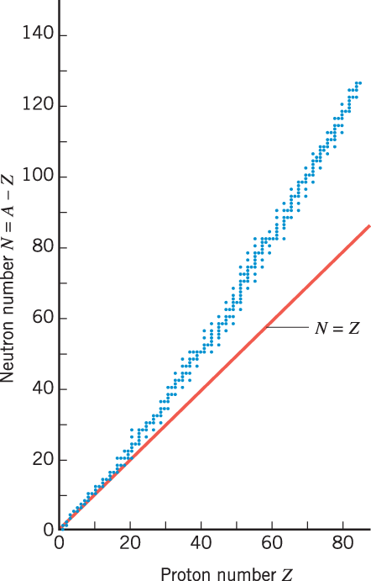
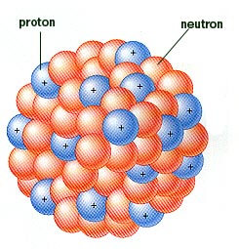
Unstable Nuclei
More neutrons than protons
Line of Stability
Neutrons serve as a buffer between repelling protons

Slide 9
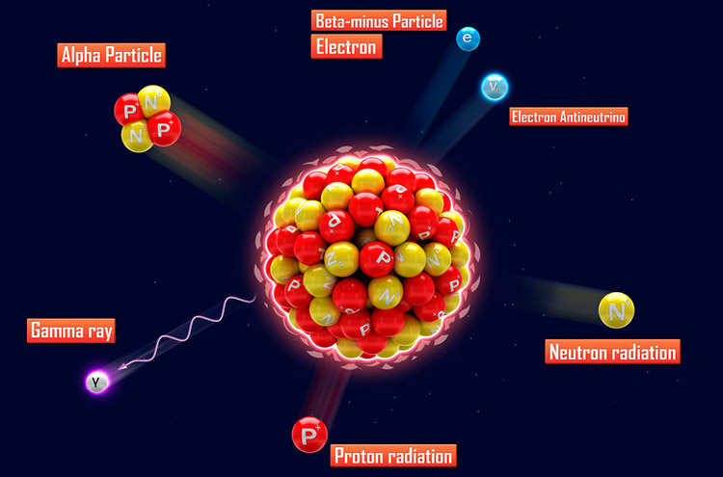
Radioactivity
Radioactivity is a process where unstable elements decay into new elements and release energy as particles and/or waves

Slide 10
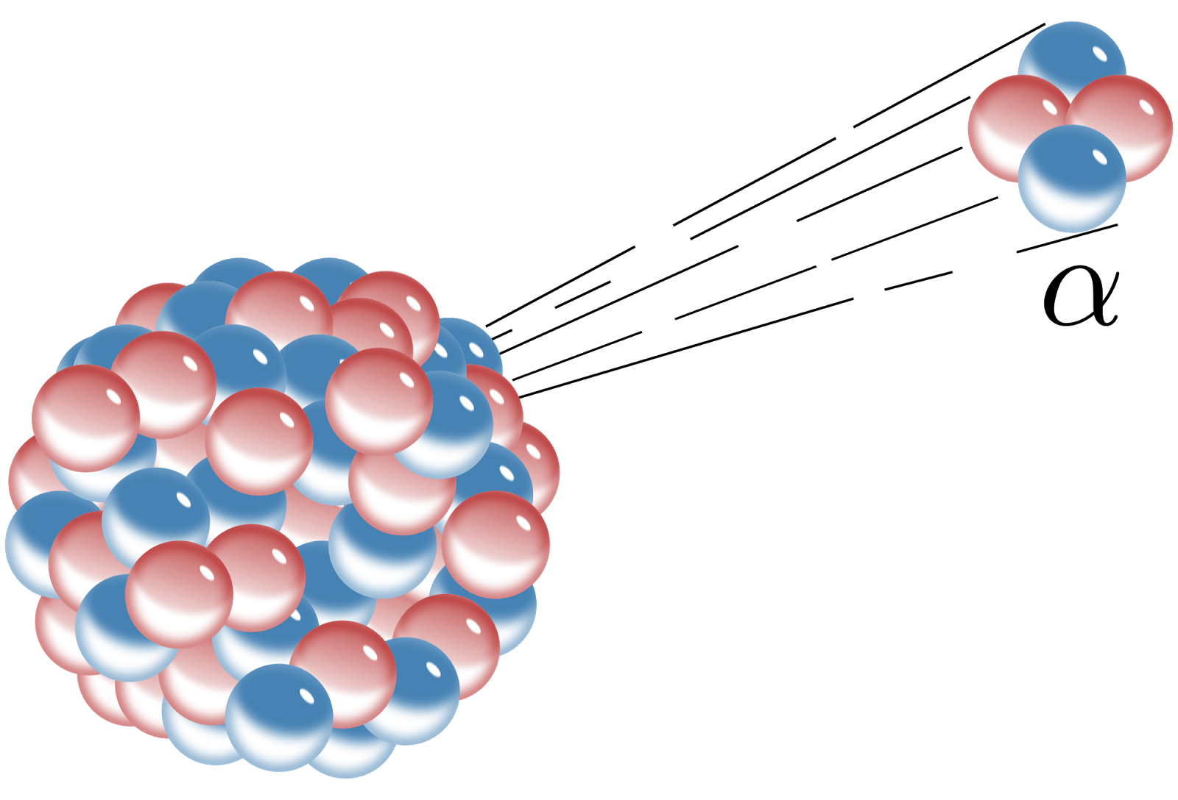
Alpha Decay
An unstable nucleus sheds alpha particle (helium nucleus) made from 2 protons and 2 neutrons
$${}_{Z}^{A}X→{}_{Z−2}^{A−4}X+{}_{2}^{4}{He}$$
Parent
Nuclide
Daughter
Nuclide
Alpha
Particle
Complete the missing notation:
$$234$$
$${}_{92}^{238}U→ {}_{ }^{ }{Th}+{}_{2}^{4}{He}$$
$$90$$

Slide 11
Alpha Decay - Predict
$$4$$
$$He$$
$${}_{88}^{222}{Ra}→{}_{86}^{218}{Rn}+ ______$$
$$2$$
$$204$$
$${}_{84}^{208}{Po}→ {}_{ }^{ }{Pb}+{}_{2}^{4}α$$
$$82$$

Slide 12
Beta-Negative Decay
In an unstable nucleus, sometimes a neutral neutron is converted into a positive proton and negative electron. When this happens, another particle called an antineutrino ${(\overline{v}}_{e})$ is also formed
Charge
= 0
“anti-”
$$p$$
$${}_{0}^{1}n→{}_{1}^{1}p+{}_{−1}^{0}e+{\overline{v}}_{e}$$
$$e^{−}$$
$${\overline{v}}_{e}$$
$$n$$
Charge = 0

Slide 13
Beta-Negative Decay

Slide 14
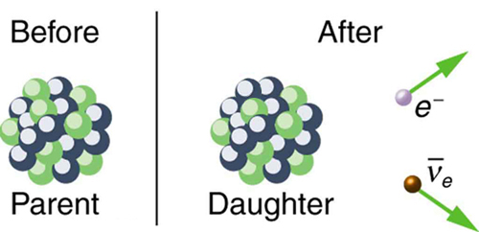
Beta-Negative Decay
$${}_{Z}^{A}X→{}_{Z+1}^{A}X+{}_{−1}^{0}e+{\overline{v}}_{e}$$
Parent
Nuclide
Daughter
Nuclide
Electron
Antineutrino
**The proton stays and the electron and antineutrino flies away as “radiation”

Slide 15
Beta-Positive Decay
In an opposite process, a positive proton can be converted into a neutral neutron and positively charged electron (known as a positron). When this happens, another particle called a neutrino ${(v}_{e})$ is also formed
$$n$$
$${}_{1}^{1}p→{}_{0}^{1}n+{}_{+1}^{0}e+v_{e}$$
$$e^{+}$$
$$v_{e}$$
$$p$$

Slide 16
Beta-Positive Decay
$${}_{Z}^{A}X→{}_{Z−1}^{A}X+{}_{+1}^{0}e+v_{e}$$
Parent
Nuclide
Daughter
Nuclide
Positron
Neutrino

Slide 17
Beta Decay - Predict
$${}_{90}^{234}{Th}→{}_{91}^{234}{Pa}+{}_{−1}^{0}e+{\overline{v}}_{e}$$
$${}_{−1}^{0}e$$
$${}_{53}^{131}I→{}_{54}^{131}{Xe}+_____+{\overline{v}}_{e}$$
$$14$$
$${}_{6}^{14}C→___N+{}_{−1}^{0}e+{\overline{v}}_{e}$$
$$7$$
$$23$$
$${}_{12}^{23}{Mg}→___Na+{}_{+1}^{0}e+v_{e}$$
$$11$$

Slide 18
Gamma Decay
After an unstable nucleus has emitted an alpha or beta particle, it can contain excess energy that is released as gamma radiation
$${}_{90}^{234}{{Th}^{∗}}→{}_{90}^{234}{Th}+{}_{0}^{0}γ$$

Slide 19
The Math Always Adds Up
$${}_{92}^{238}U→{}_{90}^{234}{Th}+{}_{2}^{4}{He}$$
$${}_{90}^{234}{Th}→{}_{91}^{234}{Pa}+{}_{−1}^{0}e+{\overline{v}}_{e}$$
$${}_{12}^{23}{Mg}→{}_{11}^{23}{Na}+{}_{+1}^{0}e+v_{e}$$
$${}_{90}^{234}{{Th}^{∗}}→{}_{90}^{234}{Th}+{}_{0}^{0}γ$$

Slide 20
Particle Review
 | Particle | Name
 | $${}_{1}^{1}p$$ | Proton
 | $${}_{0}^{1}n$$ | Neutron
 | $${}_{−1}^{0}e$$ | Electron
 | $${}_{+1}^{0}e$$
 | $${\overline{v}}_{e}$$
 | $$v_{e}$$
 | $${}_{2}^{4}{He}$$ | Alpha Particle
Positron
Antineutrino
Neutrino

Slide 21
Sample IB Question

Slide 22
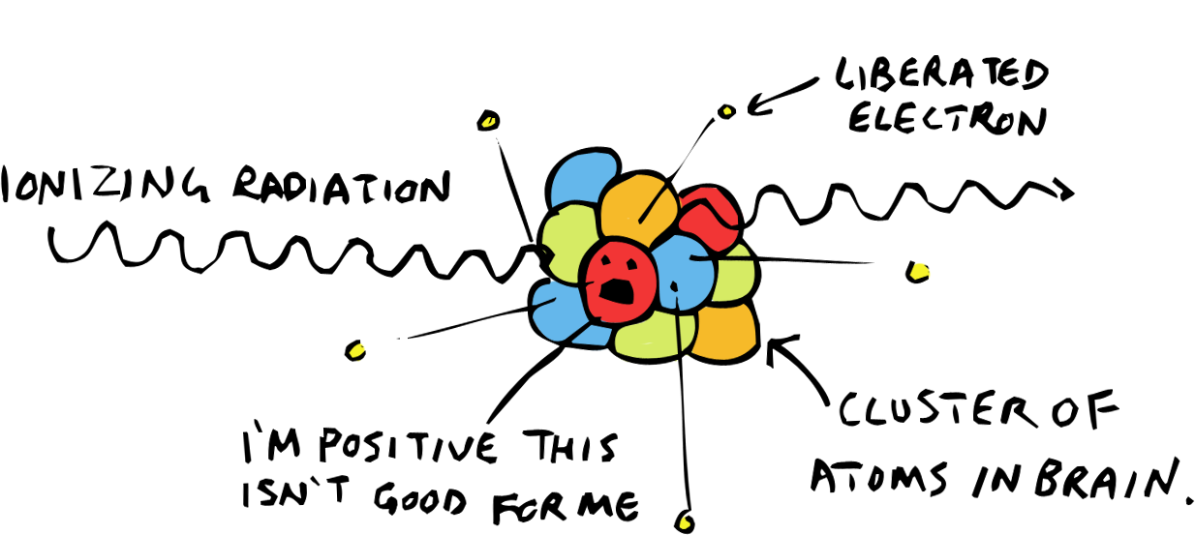
Ionizing Radiation
$$α$$
Most mass
Most ionizing
$$β$$
More mass allows particles to more efficiently transfer energy and ionize an atom
$$γ$$

Slide 23
Radiation Penetration
Paper
Aluminum
Lead
$$α$$
5 cm of air
$$β$$
30 cm of air
$$γ$$
Highly
Penetrating

Slide 24
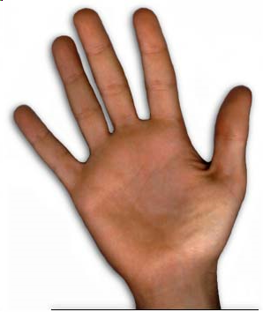
Remember the Right Hand Rule?
Thumb points in direction of the current
Fingers point in direction of the field lines
Palm points in direction of the force
How do you represent a direction that’s perpendicular to the paper?
Into the paper
Out of the paper

Slide 25
Radiation Deflection
magnetic field out of screen
Less mass
More deflection
-1
$$β$$
0
$$γ$$
+2
$$α$$

Slide 26
Radiation Deflection
+
-1
$$β$$
0
$$γ$$
+2
$$α$$
–

Slide 27
Summary of α, β, and γ
Property | Alpha (α) | Beta (β⁺ or β⁻) | Gamma (γ)
Relative Charge | +2 | +1 or -1 | 0
Relative Mass | 4 | 0.0005 | 0
Typical Penetration | 5 cm of air | 30 cm of air | Highly penetrating
Nature | Helium nucleus | Positron or Electron | Electromagnetic wave
Typical Speed | 10⁷ m s⁻¹ | 2.5 × 10⁸ m s⁻¹ | 3.00 × 10⁸ m s⁻¹
Notation | ${}_{2}^{4}{He}$ or ${}_{2}^{4}α$ | ${}_{−1}^{0}e$ or${}_{−1}^{0}β$ | $γ$ or${}_{0}^{0}γ$
Ionizing Effect | Strong | Weak | Very Weak
Abosorbed by | Paper or skin | 3 mm of Aluminum | Intensity halved by 2 cm of Lead

Slide 28
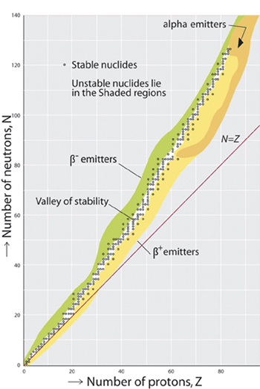
Valley of Stability

Slide 29
Graphing Decay
 |  | Z N
Z-2 N-2
α Decay
Z N
 | Z+1 N-1
β⁻ Decay
Mass #
Mass #
Neutron Number, N
Neutron Number, N
-4
same
Proton Number, Z
Proton Number, Z
$${}_{92}^{238}U→{}_{90}^{234}{Th}+{}_{2}^{4}{He}$$
$${}_{90}^{234}{Th}→{}_{91}^{234}{Pa}+{}_{−1}^{0}e+{\overline{v}}_{e}$$

Slide 30
Alpha Decay
82 Pb Lead | 83 Bi Bismuth | 84 Po Polonium | 85 At Astatine | 86 Rn Radon | 87 Fr Francium | 88 Ra Radium | 89 Ac Actinium | 90 Th Thorium | 91 Pa Protactinium | 92 U Uranium | 93 Np Neptunium | 94 Pu Plutonium | 95 Am Americium | 96 Cm Curium | 97 Bk Berkelium | 98 Cf Californium
α Decay of Radium-226
$${}_{88}^{226}{Ra}→{}_{86}^{222}{Rn}+{}_{2}^{4}{He}$$
 |  | Z N
Z-2 N-2
α Decay
Z N
 | Z+1 N-1
β⁻ Decay
Mass #
- 4
Mass #
Same
Neutron Number, N
Neutron Number, N
Proton Number, Z
Proton Number, Z

Slide 31
Beta Decay
82 Pb Lead | 83 Bi Bismuth | 84 Po Polonium | 85 At Astatine | 86 Rn Radon | 87 Fr Francium | 88 Ra Radium | 89 Ac Actinium | 90 Th Thorium | 91 Pa Protactinium | 92 U Uranium | 93 Np Neptunium | 94 Pu Plutonium | 95 Am Americium | 96 Cm Curium | 97 Bk Berkelium | 98 Cf Californium
β⁻ Decay of Protactinium-234
${}_{91}^{234}{Pa}→$ ${}_{92}^{234}U+{}_{−1}^{0}{e+{\overline{v}}_{e}}$
 |  | Z N
Z-2 N-2
α Decay
Z N
 | Z+1 N-1
β⁻ Decay
Mass #
- 4
Mass #
Same
Neutron Number, N
Neutron Number, N
Proton Number, Z
Proton Number, Z

Slide 32
$${}_{92}^{238}U$$
Keeps right on going…
$${}_{90}^{234}{Th}$$
$${}_{91}^{234}{Pa}$$
$${}_{92}^{234}U$$
82 Pb Lead | 83 Bi Bismuth | 84 Po Polonium | 85 At Astatine | 86 Rn Radon | 87 Fr Francium | 88 Ra Radium | 89 Ac Actinium | 90 Th Thorium | 91 Pa Protactinium | 92 U Uranium
$${}_{90}^{230}{Th}$$
$${}_{88}^{226}{Ra}$$
$${}_{86}^{222}{Rn}$$
$${}_{84}^{218}{Po}$$
$${}_{82}^{214}{Pb}$$
$${}_{83}^{214}{Bi}$$
$${}_{84}^{214}{Po}$$
$${}_{81}^{210}{Ti}$$
$${}_{82}^{210}{Pb}$$
$${}_{83}^{210}{Bi}$$
$${}_{81}^{206}{Ti}$$
$${}_{82}^{206}{Pb}$$

Slide 33
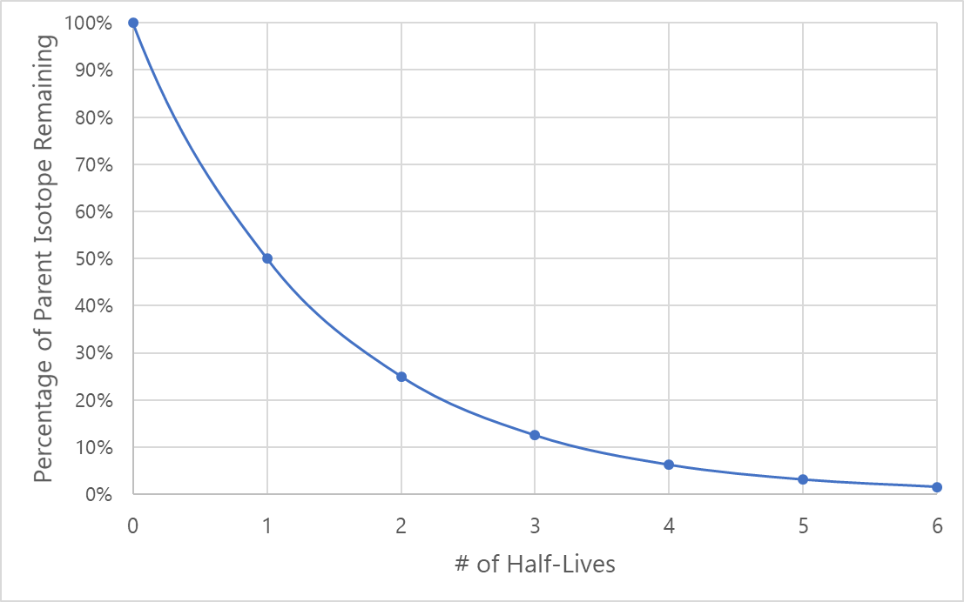
Half-Life
The amount of time it takes for one half of the original sample to decay
Radioactive Nuclide | Half-life
Uranium-238 | 4.5 × 10⁹ years
Radium-226 | 1,600 years
Radon-222 | 3.8 days
Francium-221 | 4.8 minutes
Astatine-217 | 0.03 seconds
This can be in the scale of seconds, minutes, days or even years!

Slide 34
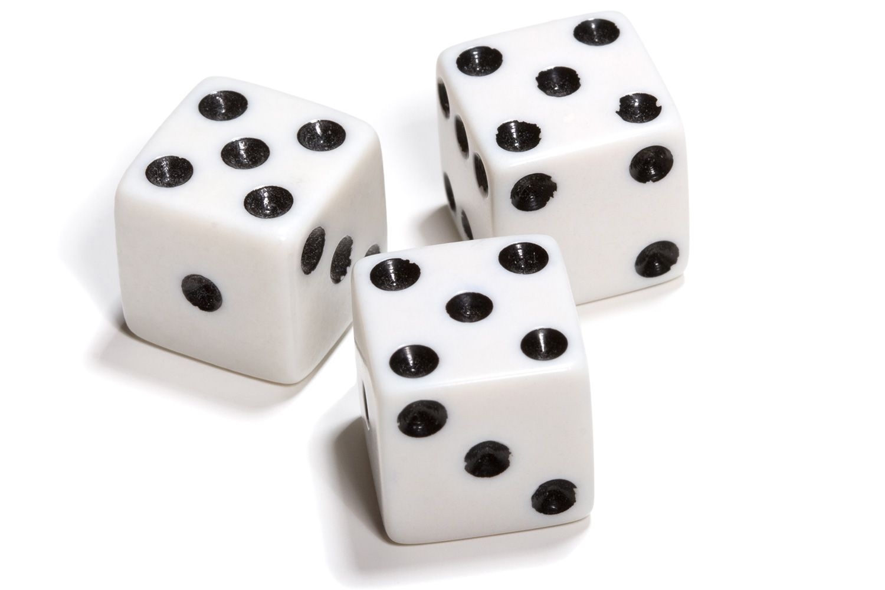
Half-Life of Dice
The Rules
Any dice that are rolled a 6 have decayed into a new isotope and are removed from the sample
Half-Life =

Slide 35
Half-Life Example
How many half-lives does it take for there to only be __% of the original sample remaining?
100% / 2 = remains after 1 half-life
50% /2 = remains after 2 half-lives
25% /2 = remains after 3 half-lives
12.5% /2 = remains after 4 half-lives
6.25% /2 = remains after 5 half-lives
50%
25%
12.5%
6.25%
3.125%

Slide 36
The length of a half life depends…
Radioactive Nuclide | Half-life
Uranium-238 | 4.5 × 10⁹ years
Radium-226 | 1,600 years
Radon-222 | 3.8 days
Francium-221 | 4.8 minutes
Astatine-217 | 0.03 seconds
3,200
1,600
0.06
0.03
4,800
0.09
6,400
0.12
8,000
0.15
9,600
0.18
Time (years)
Time (seconds)

Slide 37
The length of a half life depends…
Radioactive Nuclide | Half-life
Uranium-238 | 4.5 × 10⁹ years
Radium-226 | 1,600 years
Radon-222 | 3.8 days
Francium-221 | 4.8 minutes
Astatine-217 | 0.03 seconds
3,200
1,600
0.06
0.03
4,800
0.09
6,400
0.12
8,000
0.15
9,600
0.18
Time (years)
Time (seconds)

Slide 38
Half Life Problem:
How many half-lives does it take for 100 g of a radioactive sample to decay to 12.5 g?
If the half-life of the sample is 7 years, how long will this take?
The half-life of radium-226 is 1600 years. What percentage remains undecayed after 3200 years?
1
2
3
100 g → 50 g → 25 g → 12.5 g
3 Half-Lives
(3 half-lives) × (7 years) =
21 years
(3200 years) ÷ (1600 years)
= 2 Half-Lives
100% → 50% → 25%
1
2

Slide 39
Radiocarbon Dating
How old is a sample of rock that has 6.25% of its original C-14. The half-life of C-14 is 5,730 years.
100% → 50% → 25% → 12.5% → 6.25%
1
2
3
4
(4 half-lives) × (5730 years) =
22,920 years
6.25%
5,730
11,460
17,190
22,920
28,650
34,380
Time (years)

