Slide 1
Energy and Mass Defects
1 + 1 > 2
IB Physics | Atomic Physics

Slide 2
Unified Atomic Mass Unit
When measuring and reporting the mass of individual atoms and subatomic particles, kilograms are inconveniently large…
The unified atomic mass unit is defined as one-twelfth of the mass of an isolated carbon-12 atom
1 mole of Carbon Atoms = 0.012 kg
$$\frac{0.012 kg}{6.02×{10}^{23}}$$
$$=1.99×{10}^{−26} kg$$
$$\frac{1.99×{10}^{−26} kg}{12}=$$
1.661 × 10⁻²⁷ kg = 1 u

Slide 3
Unified Atomic Mass Unit
Electron (m_{e}) | 9.110 × 10⁻³¹ kg | 0.000549 u
Proton (m_{p}) | 1.673 × 10⁻²⁷ kg | 1.007276 u
Neutron (m_{n}) | 1.675 × 10⁻²⁷ kg | 1.008665 u
This is the only time that we will ever use 7 sig figs. In this case, rounding to 1.01 u just wouldn’t cut it…
Unified atomic mass unit | 1.661 × 10⁻²⁷ kg
$$p$$
$$n$$
$$e^{−}$$

Slide 4
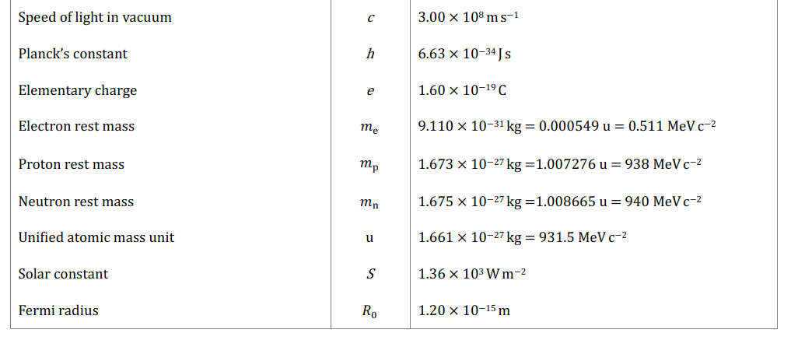
IB Physics Data Booklet

Slide 5
Einstein’s Famous Equation
According to Albert Einstein, “mass and energy are different manifestations of the same things”
E = mc²

Slide 6
Einstein’s Famous Equation
E = mc²
Energy
[J]
Mass
[kg]
Speed of Light
3.00 × 10⁸ m s⁻¹
What is the energy equivalence of 1 g of matter?
E = (0.001 kg)(3.00 × 10⁸ m s⁻¹)²
= 9 × 10¹³ J

Slide 7
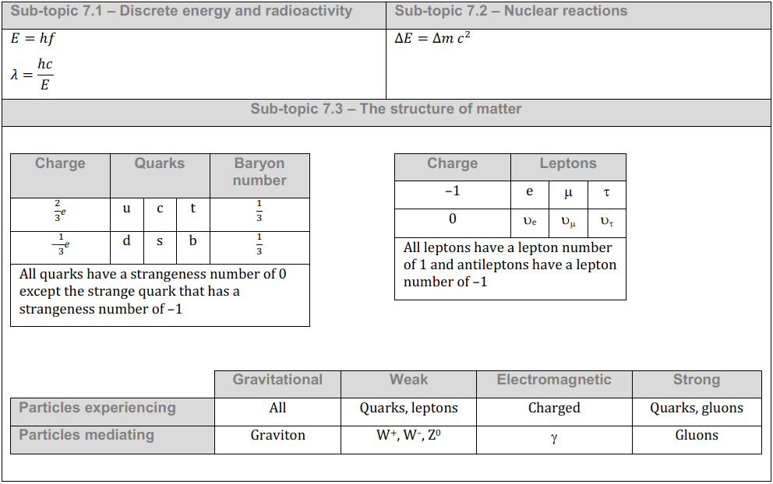
IB Physics Data Booklet

Slide 8
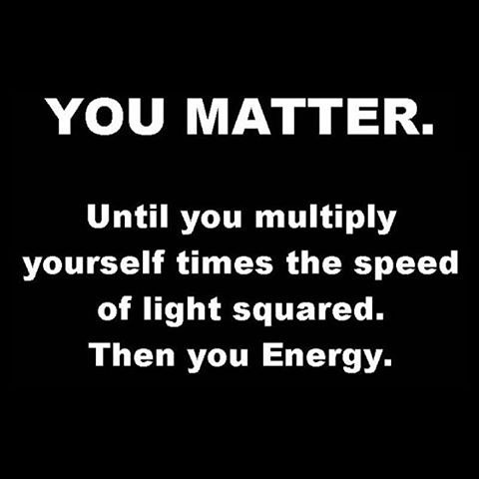
E = mc²

Slide 9
New Unit for Energy!
Electron-Volt | eV
$$\left\{Energy in eV\right\}=\frac{\left\{Energy in J\right\}}{1.60×{10}^{−19}}$$
1 MeV = 10⁶ eV
What is the energy equivalence of 1 proton (1.673 × 10⁻²⁷ kg)?
$$E=\left(1.673×{10}^{−27}\right){\left(3×{10}^{8}\right)}^{2}$$
$$=1.5057×{10}^{−10} J$$
$$\frac{1.5057×{10}^{−10} J}{1.60×{10}^{−19}}$$
$$=941,062,500 eV$$
$$≈941 MeV$$

Slide 10
New Unit for Mass
$$E=mc^{2}$$
$$m=\frac{E}{c^{2}}$$
$$=\frac{MeV}{c^{2}}$$
$$MeV c^{−2}$$

Slide 11
Unified Atomic Mass Unit
Electron rest mass (m_{e}) | 9.110 × 10⁻³¹ kg | 0.000549 u
Proton rest mass (m_{p}) | 1.673 × 10⁻²⁷ kg | 1.007276 u
Neutron rest mass (m_{n}) | 1.675 × 10⁻²⁷ kg | 1.008665 u
Electron rest mass (m_{e}) | 9.110 × 10⁻³¹ kg | 0.000549 u | 0.511 MeV c⁻²
Proton rest mass (m_{p}) | 1.673 × 10⁻²⁷ kg | 1.007276 u | 938 MeV c⁻²
Neutron rest mass (m_{n}) | 1.675 × 10⁻²⁷ kg | 1.008665 u | 940 MeV c⁻²
Unified atomic mass unit | 1.661 × 10⁻²⁷ kg | 1.000000 u
Unified atomic mass unit | 1.661 × 10⁻²⁷ kg | 1.000000 u | 931.5 MeV c⁻²

Slide 12
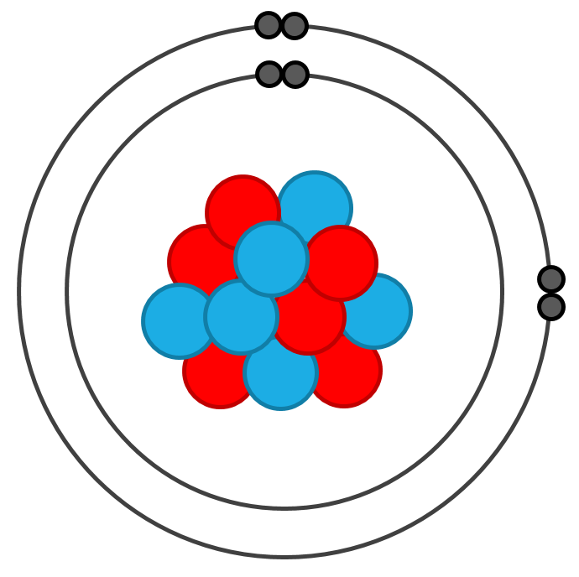
Mass of the Nucleus
A neutral Carbon-12 atom contains:
Electron rest mass (m_{e}) | 0.000549 u
Proton rest mass (m_{p}) | 1.007276 u
Neutron rest mass (m_{n}) | 1.008665 u
6 protons
6 neutrons
6 electrons
Unified atomic mass unit | 1.000000 u
If the mass of Carbon-12 is defined as exactly 12.00000u, then the nucleus mass is:
$$12.00000u−\left(6×0.000549u\right)$$
$$=11.996706u$$

Slide 13
Component Mass
A nucleus of Carbon-12 contains:
Electron rest mass (m_{e}) | 0.000549 u
Proton rest mass (m_{p}) | 1.007276 u
Neutron rest mass (m_{n}) | 1.008665 u
6 protons
6 neutrons
What is the total mass in terms of u?
Unified atomic mass unit | 1.000000 u
6 × 1.007276 u
6 × 1.008665 u
12.095646 u

Slide 14
Mass Defect | 1+1 > 2
Mass sum of the Carbon-12 subatomic particles:
$$\left(6×1.007276u\right)+\left(6×1.008665u\right)=12.095646u$$
Mass of Carbon-12 nucleus:
$$11.996706u$$
Mass Defect
$$12.095646u−11.99670u$$
$$=0.098946u$$
Energy
Where did the mass go?

Slide 15
Binding Energy
Binding Energy is the energy required to separate all of the nucleons
…or the energy released when a nucleus is formed from its nucleons

Slide 16
Mass Defect → Binding Energy
Unified atomic mass unit | 1.661 × 10⁻²⁷ kg | 1.000000 u | 931.5 MeV c⁻²
$$× \frac{931.5 MeV c^{−2}}{1 u}=$$
$$0.098946u$$
$$92.1682 MeV c^{−2}$$
E = mc²
$$=(92.1682 MeV c^{−2})(c^{2})$$
$$=92.17 MeV$$

Slide 17
Binding Energy per Nucleon
Binding Energy for Carbon-12 = 92.2 MeV
Number of Nucleons for Carbon-12 =
6 protons
6 neutrons
12
Binding Energy per Nucleon =
$$\frac{92.16 MeV }{12}$$
$$7.68 MeV per Nucleon$$

Slide 18
Calculate Binding Energy per Nucleon
Nuclide | # of p | # of n | Nucleus Mass
Iodine-127 |  |  | 126.87544u
53
74
Mass Defect
m_{e} | 0.000549u
m_{p} | 1.007276u
m_{n} | 1.008665u
53 × 1.007276 u
74 × 1.008665 u
$$128.026838u$$
$$–126.87544u$$
$$=1.15140u$$
1u | 931.5 MeV c⁻²
$$1.15140 u×\frac{931.5 MeV c^{−2}}{1 u}$$
$$=1072.53 MeV c^{−2}$$
Convert mass to MeV c⁻²
$$E=mc^{2}$$
$$=\left(1072.53 MeV c^{−2}\right)c^{2}$$
$$=1072.53 MeV$$
$${1072.53 MeV}/{127}=$$
$$8.45 MeV per Nucleon$$

Slide 19
Calculate Binding Energy per Nucleon
*For your assigned nuclide, calculate the binding energy per Nucleon and record data in shared spreadsheet
 | Element | Nucleus Mass (u)
1 | Hydrogen-2 | 2.013553
2 | Helium-3 | 3.014931
3 | Hydrogen-3 | 3.015500
4 | Helium-4 | 4.001505
5 | Lithium-6 | 6.013476
6 | Lithium-7 | 7.014356
7 | Beryllium-9 | 9.009987
8 | Carbon-12 | 11.996706
9 | Nitrogen-14 | 13.999231
10 | Oxygen-16 | 15.990523
11 | Fluorine-19 | 18.993462
12 | Magnesium-24 | 23.978454
13 | Phosphorus-31 | 30.965527
14 | Sulfur-34 | 33.959083
15 | Potassium-39 | 38.953275
 | Element | Nucleus Mass (u)
16 | Iron-56 | 55.920662
17 | Arsenic-75 | 74.903478
18 | Krypton-84 | 83.891734
19 | Zirconium-90 | 89.882739
20 | Silver-107 | 106.879287
21 | Tin-120 | 119.874752
22 | Iodine-127 | 126.875373
23 | Cesium-140 | 139.873608
24 | Europium-153 | 152.886650
25 | Tungsten-184 | 183.910307
26 | Gold-197 | 196.923199
27 | Lead-206 | 205.929447
28 | Bismuth-209 | 208.934833
29 | Uranium-235 | 234.993420
30 | Uranium-238 | 238.000282
Use a periodic table to determine atomic # for your element
m_{e} | 0.000549u
m_{p} | 1.007276u
m_{n} | 1.008665u
1u | 931.5 MeV c⁻²

Slide 20
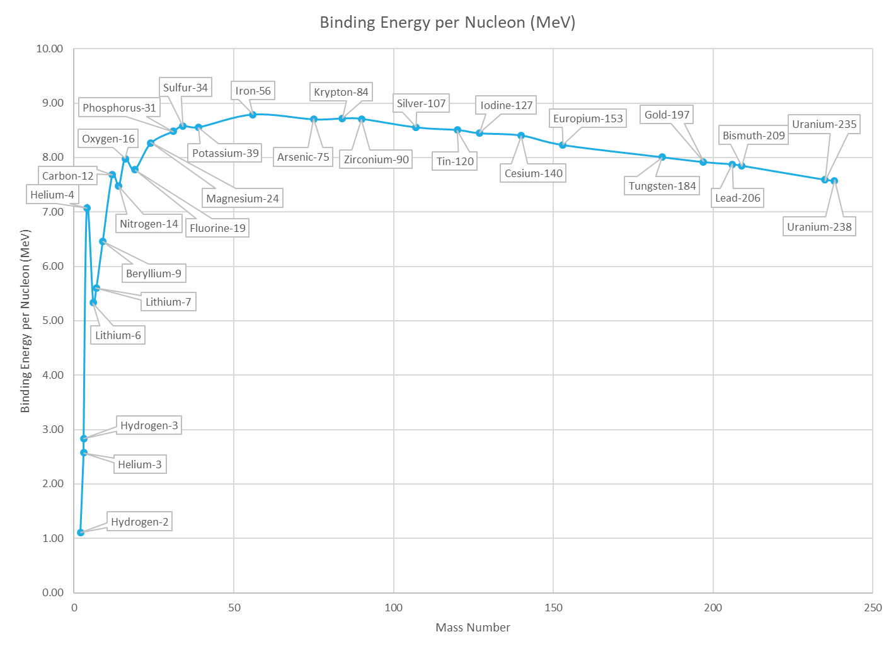
Binding Energy per Nucleon
Iron-56
(most stable)

