Slide 1
Feynman Diagrams & the Higgs Boson
IB Physics | Atomic Physics

Slide 2
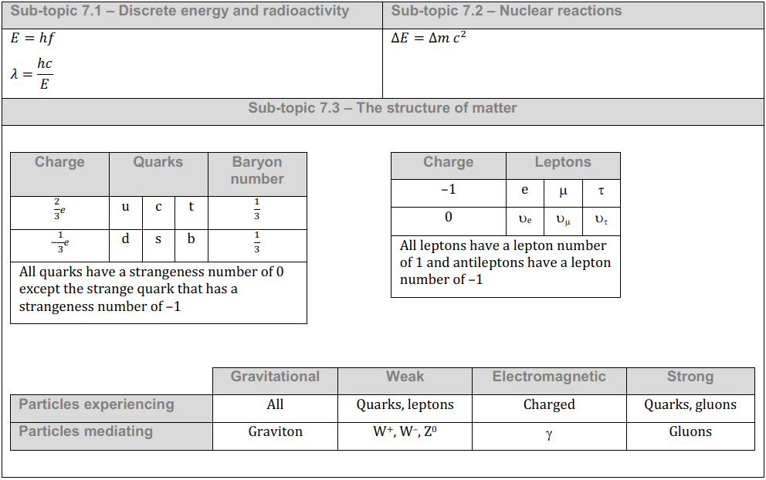
IB Physics Data Booklet

Slide 3
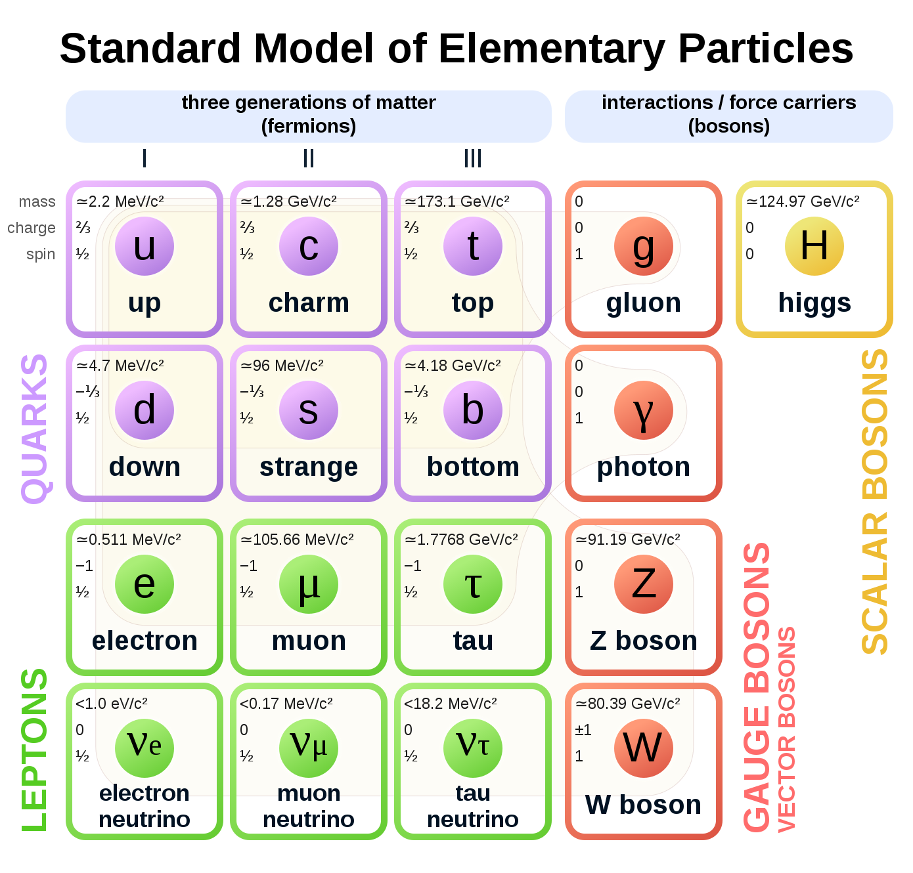
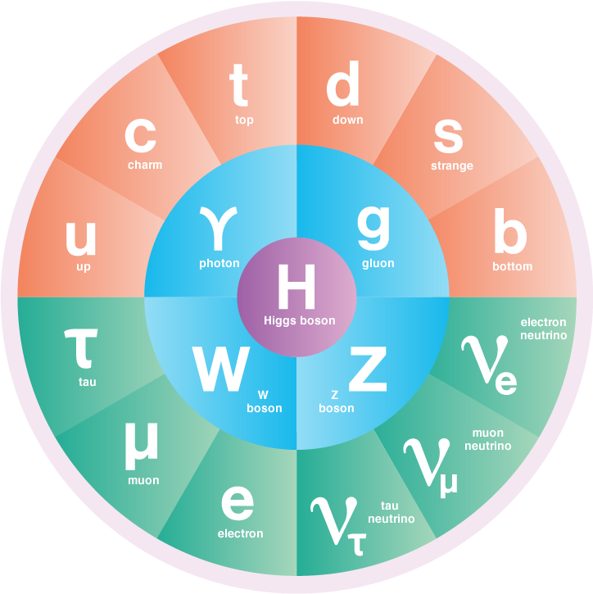
The Standard Model

Slide 4
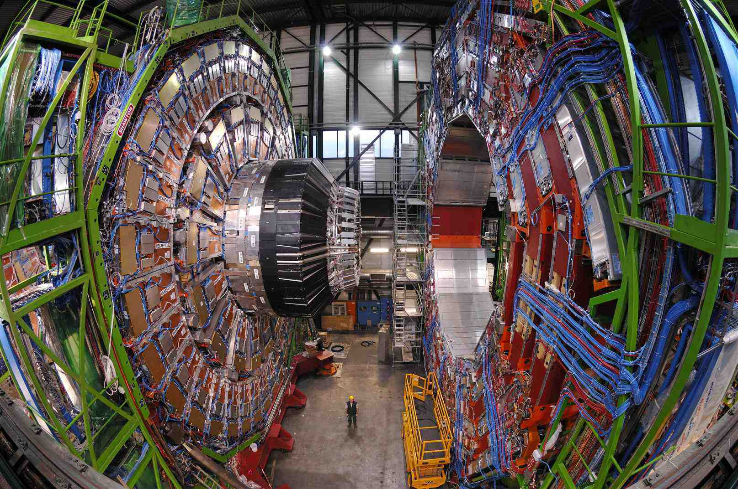
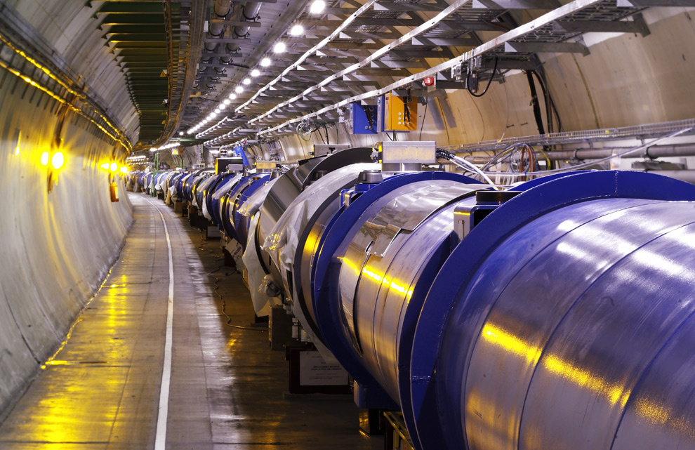
The Large Hadron Collider

Slide 5
The Large Hadron Collider
5.4 miles

Slide 6
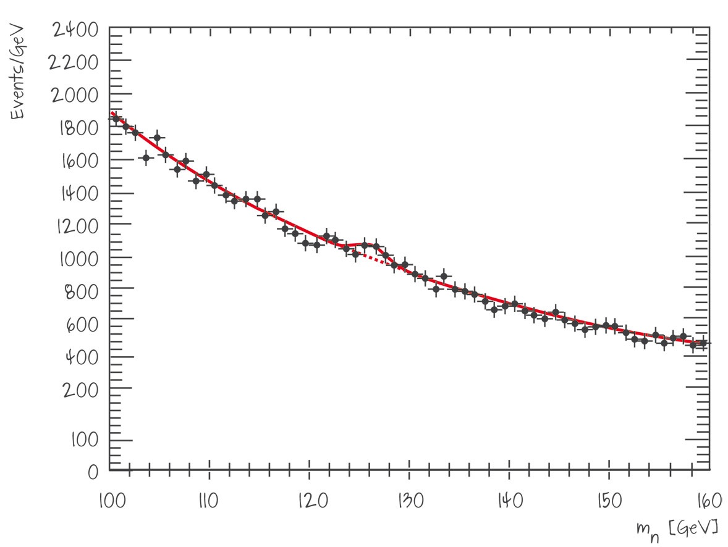
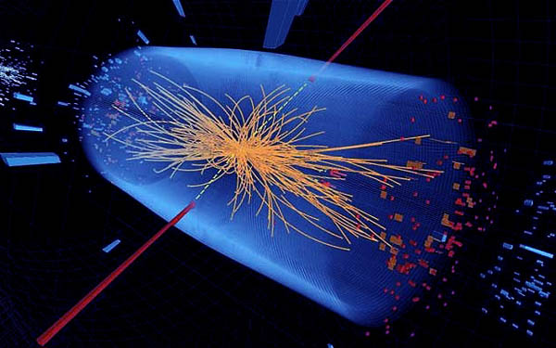
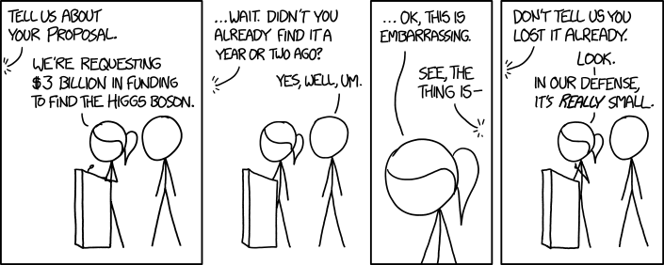
The Higgs Boson
Higgs Boson

Slide 7
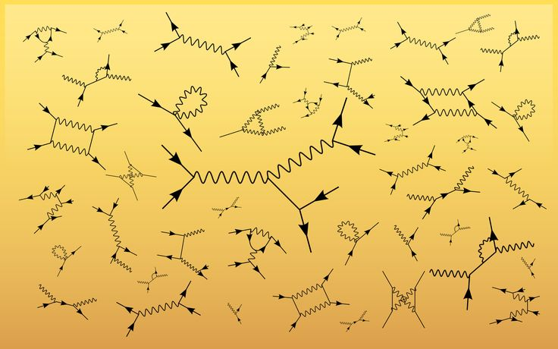
Feynman Diagrams
Useful to represent, analyze, and predict particle interactions

Slide 8
Feynman Diagrams are like Comics
Set Up
Event
Result
An electron and positron (antielectron) annihilate into a photon
γ
e⁻
e⁺
Notes:
Particles (matter, force)

Slide 9
“The Characters”
Matter Particle
Antimatter Particle
Notes:
Particles (matter, force)

Slide 10
Representing Time
An electron and positron (antielectron) annihilate into a photon
γ
e⁻
e⁺
$$e^{−}$$
$$γ$$
Time
$$γ$$
$$e^{−}$$
$$e^{+}$$
$$e^{+}$$
Time
Notes:
Particles (matter, force)

Slide 11
Match these!
Time
Time
Time
Time
a photon spontaneously “pair produces” an electron and positron | a positron absorbs a photon and keeps going | an electron emits a photon and keeps going | an electron and positron annihilate into a photon

Slide 12
Junction Conservation
Every junction will have two lines with arrows (one pointing in, one pointing out) meeting a single exchange particle and all properties are conserved before/after
$$e^{−}$$
$$v_{e}$$
$$e^{−}$$
$$W^{+}$$
$$v_{e}$$
Baryon #
Lepton #
Charge
0
0
0
1
1
0
0
-1
+1
$$W^{+}$$
Time
Notes:
Interaction

Slide 13
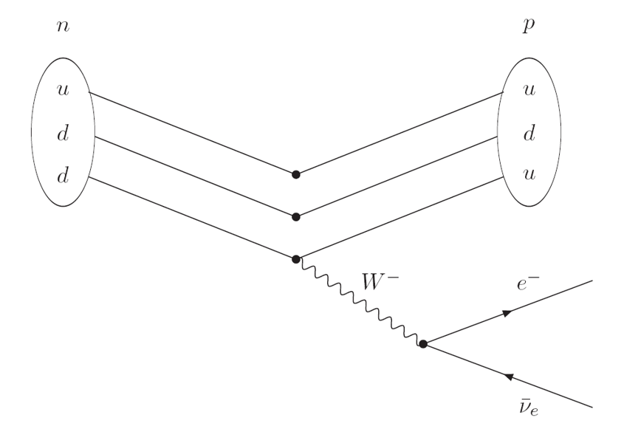
Beta-Negative Decay
$$n→p+e^{−}+{\overline{v}}_{e}$$
$$p$$
$$n$$
$$e^{−}$$
$$W^{−}$$
$${\overline{v}}_{e}$$
Time

Slide 14
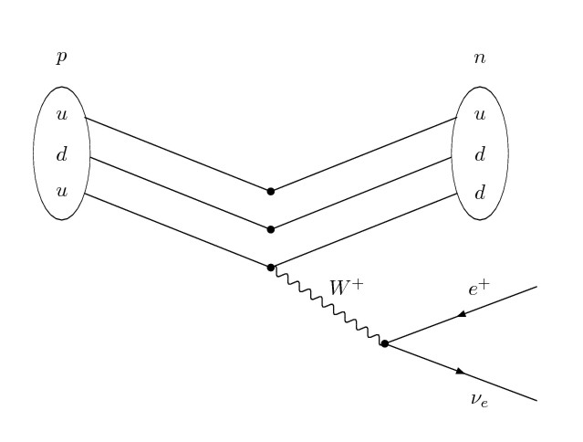
Beta-Positive Decay
$$p→n+e^{+}+v_{e}$$
$$n$$
$$p$$
$$e^{+}$$
$$W^{+}$$
$$v_{e}$$
Time

