Slide 1
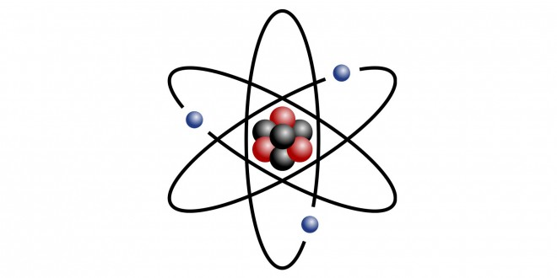
Atomic Structure Walk Around

Slide 2
How many protons does a neutral atom of Copper contain?
1
Notes:
29

Slide 3
How many electrons does a neutral atom of Neon contain?
2
Notes:
10

Slide 4
What is the average atomic mass of Aluminum?
3
Notes:
26.98

Slide 5
How many protons does a neutral atom of Potassium have?
4
Notes:
19

Slide 6
What is the element symbol for an atom that contains 50 protons?
5
Notes:
Sn

Slide 7
What is the term for carbon atoms that have different #’s of neutrons?
6
Notes:
isotope

Slide 8
How many protons?
7
Isotope: | Be-9
# of Protons | ?
# of Neutrons
Notes:
4

Slide 9
How many neutrons?
8
Isotope: | Be-9
# of Protons
# of Neutrons | ?
Notes:
5

Slide 10
What is the mass number?
9
Isotope: | Zn-??
# of Protons | 30
# of Neutrons | 36
Notes:
66

Slide 11
What is the element symbol?
10
Isotope: | ??-137
# of Protons | 56
# of Neutrons | 81
Notes:
Ba

Slide 12
What element symbol has the same # of protons as Fe-56 has neutrons?
11
Challenge
Notes:
Zn

Slide 13
How many protons does a molecule of pure water contain?
12
Challenge
Notes:
8

