Slide 1
😀⁺ | 😀⁺ | 😀⁺
🧐⁺ | 🧐⁺ | 🧐⁺
🤠²⁺ | 🤠²⁺ | 🤠²⁺
😎²⁺ | 😎²⁺ | 😎²⁺
🍇⁻ | 🍇⁻ | 🍇⁻
🍕²⁻ | 🍕²⁻ | 🍕²⁻
🍭³⁻ | 🍭³⁻ | 🍭³⁻
Notes:
Emoji Ion Cards - Front

Slide 2
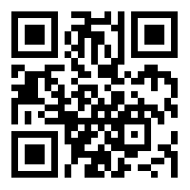
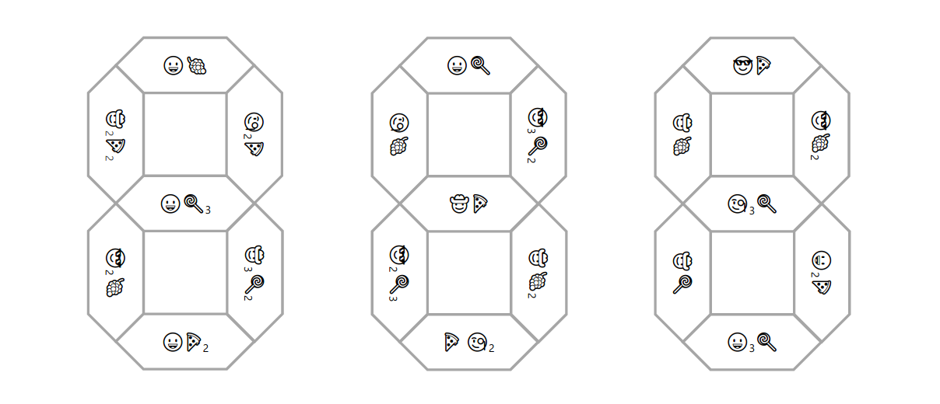
make compounds | make compounds | make compounds
and fill in | and fill in | and fill in
Notes:
Emoji Ion Cards - Back

