Slide 1
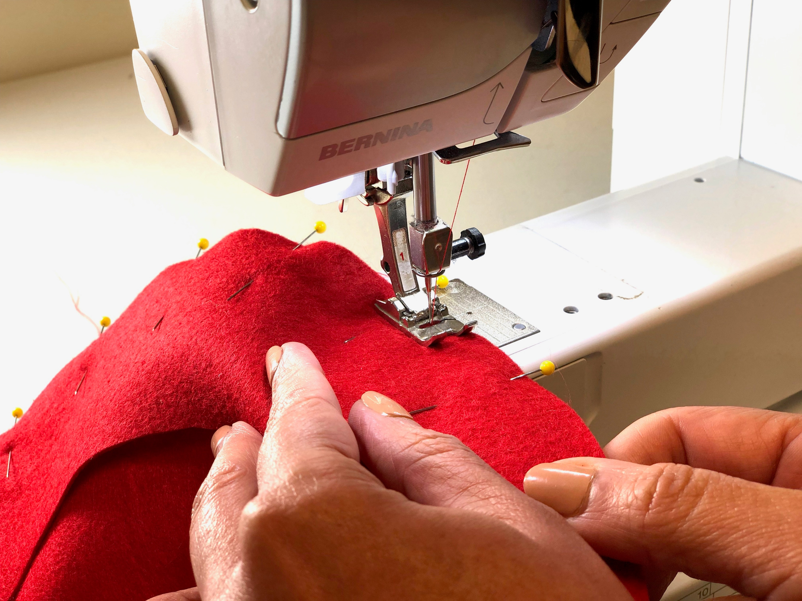
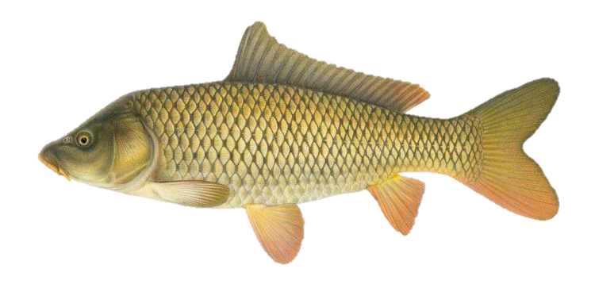
Find the Formula
Notes:
https://im-a-puzzle.com/compound_breakout.puzzle?st=em

