Slide 1
Defining Circular Motion
IB Physics | Circular Motion

Slide 2
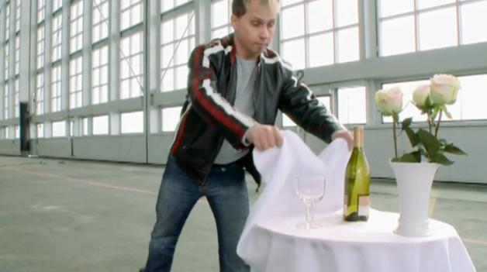
Remember Newton’s 1st?
A body will remain at rest or moving with constant velocity unless acted upon by an unbalanced force
“Law of
Inertia”

Slide 3
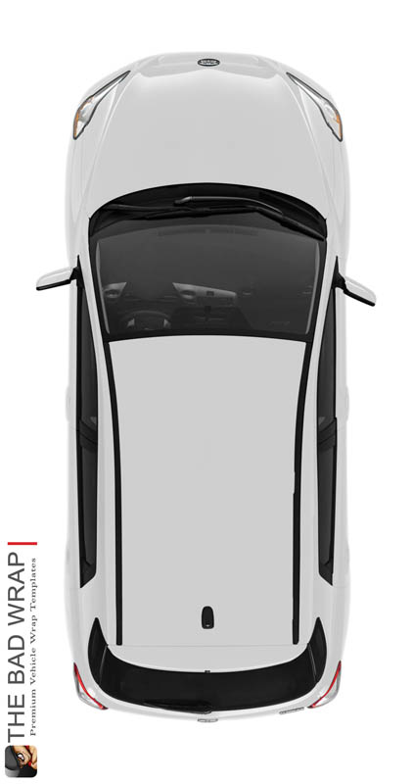
Try This…
I’m usually running late for school and sometimes I forget my plate of pop tarts on the top of my car. What happens when I take a sharp turn to the right? Why?
Pop Tarts will keep moving forward (in a straight line) unless an outside force acts upon them

Slide 4
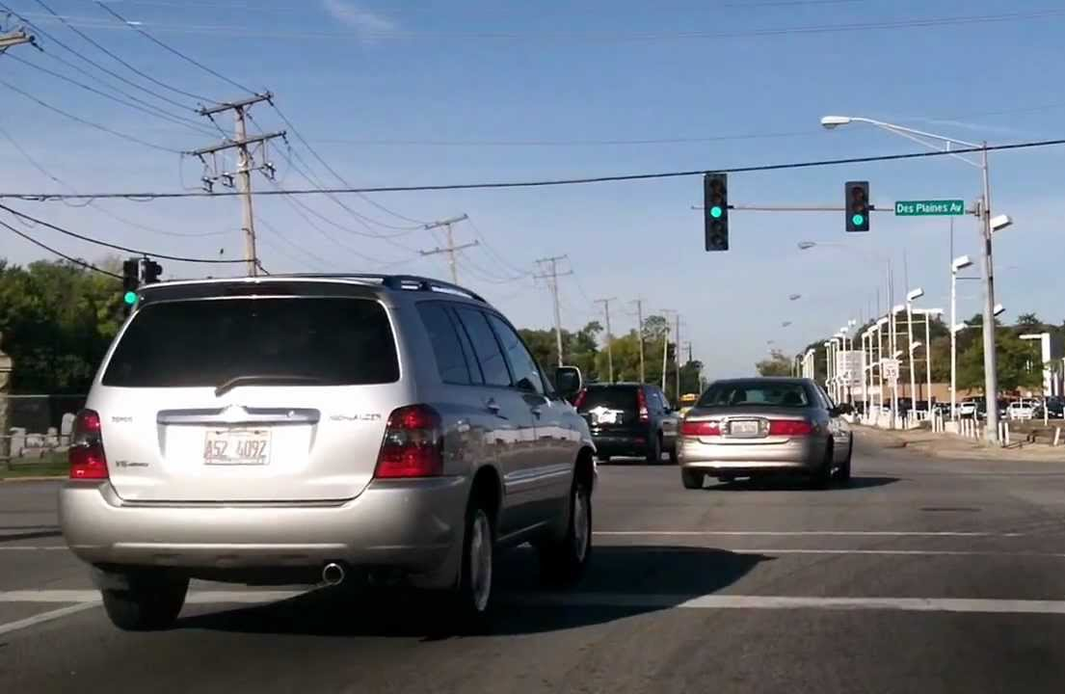
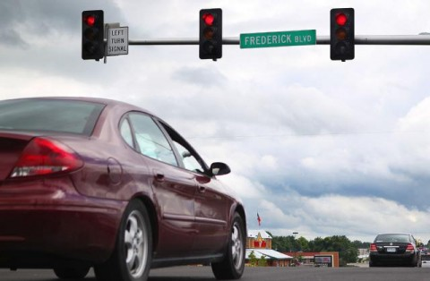
Remember back…
There are 3 ways that an object can be experiencing acceleration?
Speeding Up
Slowing Down
Changing Direction

Slide 5
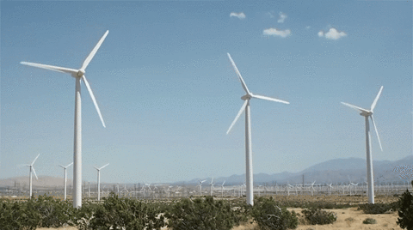
You already know some of this…
If each blade in the wind farm animation is 30 meters long, estimate the speed (in m s⁻¹) of the tip of one turbine blade.
Distance travelled by the tip of the blade for one revolution:
$$d=2πr$$
$$=2π(30)$$
$$=188.5 m$$
Time for one revolution =
2.9 seconds
$$v=\frac{d}{t}$$
$$=\frac{188.5 m}{2.9 s}$$
$$=65.0 m s^{−1}$$

Slide 6
Think about the Circle…
If you walked around this circle once, what is your total distance?
C = 2πr
= 2π(1 m)
= 2π(5 m)
5 m
1 m
C = 31.4 meters
C = 6.28 meters

Slide 7
What is a Radian??
We can define a circular distance in terms of a generic radius, r…
C = 2πr
r
How many radians are there in one full revolution?
1 rad
r
2π radians

Slide 8
Try this….
If a child on a merry-go-round rotates 3.5 times, what is their angular distance in radians?
If an ant on a record player spins for an angular displacement of 14 radians, how many revolutions has it experienced?
3.5(2π) = 7 π
2π
2π
2π
π
2π
= 22 rad
$$\frac{14}{2π}$$
$$=2.23 revolutions$$

Slide 9
Timing Circular Motion
Period
T
[s]
Time for complete revolution

Slide 10
Angular Velocity
For Linear Motion:
$$v=\frac{distance}{time}=\frac{d}{t}$$
For Circular Motion:
$$ω= \frac{angular distance}{time}$$
Angular Velocity [rad s⁻¹]
If you have a single revolution:
$$ω= \frac{angular distance}{time}$$
$$=\frac{2π }{ T }$$
Time for one revolution
= T
2π rad

Slide 11
Try this….
T
A ferris wheel takes 40 seconds to make on full revolution, what is its angular velocity in rad/s?
A car tire rotates with an average angular velocity of 29 rad/s. In what time interval will the tire rotate 3.5 times?
$$ω=\frac{2π}{T}$$
$$=\frac{2π}{40}=0.157 rad s^{−1}$$
2π rad
$$ω= \frac{angular distance}{time}$$
$$29 \frac{rad}{s}= \frac{3.5(2π)}{t}$$
$$t=0.758 s$$
$$ω=\frac{2π}{T}$$
$$29 \frac{rad}{s}=\frac{2π}{T}$$
$$T=0.217 s$$
$$0.217×3.5=0.758 s$$
Time for one revolution

Slide 12
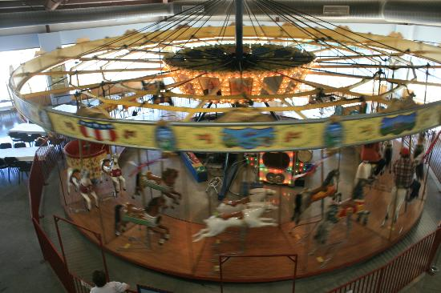
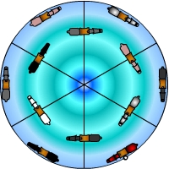
Linear Velocity
At any given point, an object with circular motion will also have an instantaneous linear velocity.
This velocity will be in the direction _________ to the curve
tangent

Slide 13
Calculating Linear Velocity
Distance of one complete rotation
(circumference)
2πr
$$v=\frac{d}{t}$$
$$v=\frac{ }{ }$$
T
Time for one complete rotation
(Period)
Remember me??

Slide 14
Calculating Linear Velocity
$$v=\frac{2πr}{T}$$
$$ω= \frac{2π}{T}$$
$$v=\frac{2πr}{T}$$
$$v=ωr$$

Slide 15
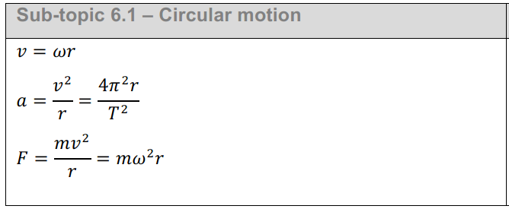
IB Physics Data Booklet
$$ω= \frac{angular distance}{time}$$
For one revolution:
$$ω= \frac{2π}{T}$$

Slide 16
Try this….
A
If the carousel spins at 1 complete rotation every 10 seconds, what is the angular and linear velocity of each row?
2 m
3 m
B
A | $$ω=\frac{2π}{T}$$ | $$v=ωr$$
B | $$ω=\frac{2π}{T}$$ | $$v=ωr$$
$$ω=\frac{2π}{10}$$
$$=0.63 rad s^{−1}$$
$$v=(0.63)(2)$$
$$=1.3 m s^{−1}$$
Time for 1 Rotation:
T = 10 s
$$ω=\frac{2π}{10}$$
$$=0.63 rad s^{−1}$$
$$v=(0.63)(3)$$
$$=1.9 m s^{−1}$$

Slide 17
Try this….
If you were sitting 4 m from the center of a carousel spinning at 12 rad s⁻¹ and threw a ball in the air, how fast would the ball continue in a straight line?
A woman passes through a revolving door with a tangential speed of 1.8 m s⁻¹. If she is 0.8 m from the center of the door, what is the door’s angular velocity?
r = 4 m
v = ωr
= (12)(4) = 48 m s⁻¹
ω = 12 rad s⁻¹
v = 1.8 m s⁻¹
r = 0.8 m
v = ωr
ω = 2.25 rad s⁻¹
1.8 = ω(0.8)

Slide 18
Lesson Takeaways
I can convert between angular displacement in revolutions and radians
I can define and measure the period of circular motion
I can calculate angular velocity in rad/s
I can describe and calculate tangential velocity based on the angular velocity and radius

