Slide 1
Vertical Circular Motion with Tension
IB Physics | Circular Motion

Slide 2
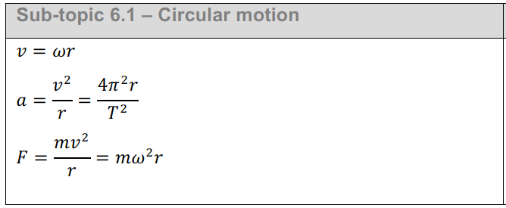
IB Physics Data Booklet
$v$ – linear velocity (m s⁻¹)
$ω$ – angular velocity (rad s⁻¹)
$r$ – radius (m)
$T$ – period (s)
$a$ – centripetal acceleration (m s⁻²)
$F$ – centripetal force (N)

Slide 3
Try This…
Top View
If you swing a ball on a string above your head, and the string breaks, what happens?
Travels in a straight line tangent to the circle
An inward facing force is required for circular motion

Slide 4
Think about it…
If you swing a ball on a string in a vertical circle, where is the string most likely to break? Why?
F
A
E
Because gravity is pulling against the string at this point
D
B
C

Slide 5
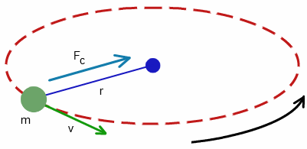
Centripetal Force
Remember, for an object to follow a curved path, there must be an inward pointing centripetal force (F_{c})
This is not really a force that shows up on a free body diagram like F_{g} , R, F_{f} , and F_{T} .
Rather, it is more like the net force that is required to create that circular motion
If an object is in circular motion:
F_{net} = F_{c}

Slide 6
Vertical Circle
When you make a vertical circle the net force at all points must equal the centripetal force (F_{c})
F_{c}
This is the case for horizontal circles too! The main difference is that now the weight is a factor…
F_{c}
F_{c}
F_{c}
F_{c}
Again, this isn’t some magical new force but rather a combination of all forces resulting in…
F_{c}
F_{net} = F_{c}

Slide 7
Let’s focus on the top and bottom…
At the Top:
F_{c}
F_{c}
F_{T}
F_{g} = mg
At the Bottom:
F_{T}
F_{c}
F_{c}
F_{g} = mg

Slide 8
Now with numbers!
F_{c} required is 20 N
F_{g} of object is 5 N
*F_{T} is determined by comparing the known forces (F_{g}) to the net force (F_{c}) and finding the difference
At the Top:
20 N
F_{T} = 15 N
F_{T}
F_{g} = 5 N
20 N
At the Bottom:
20 N
F_{T}
F_{T} = 25 N
20 N
F_{g} = 5N

Slide 9
What is the tension?
Top
Bottom
Top
Bottom
F_{T}
F_{c}
m | 2 kg
v_{t} | 5 m/s
r | 0.5 m
F_{c}
F_{net}
F_{g}
F_{T}
m | 2 kg
v_{t} | 5 m/s
r | 0.5 m
F_{c}
F_{net}
F_{g}
F_{T}
F_{c}
F_{T}
F_{g}
F_{g}
F_{c}
100 N
100 N
$$F_{c}=\frac{mv^{2}}{r}$$
$$=\frac{(2){(5)}^{2}}{0.5}$$
100 N
100 N
$$F_{c}=100 N$$
F_{c}
19.62 N
19.62 N
$$F_{g}=mg$$
80.38 N
119.62 N
$$(2)(9.81)=19.62 N$$

Slide 10
What is the tension?
What is the angular velocity in rad s⁻¹ at the bottom of a vertical circle created when a 0.2-kg phone charger is swung with a 0.8 m cord and a tension of 6 N at the lowest point?
$$F_{c}=mω^{2}r$$
$$F_{c}=\frac{mv^{2}}{r}=mω^{2}r$$
$$4.04 =(0.2)ω^{2}(0.8)$$
$$ω^{2}=25.25$$
$$ω=5.02 rad s^{−1}$$
F_{T}
= 6 N
F_{c}
F_{c}
F_{g}
= mg
= (0.2)(9.81)
= 1.96 N
F_{c} = 6 – 1.96 = 4.04 N

Slide 11
Lesson Takeaways
I can compare the forces on an object at different positions in vertical circular motion
I can determine the magnitude and direction of the forces needed for the overall centripetal force
I can qualitatively describe how tension changes in a vertical circle

