Slide 1
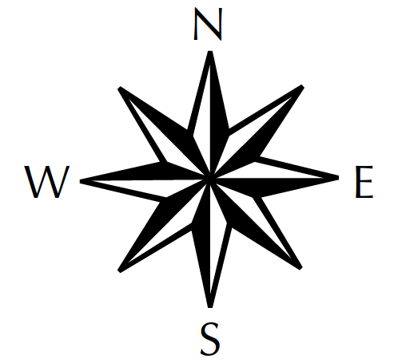
NORTH
Acting – Likes to act, try things, plunge in.

Slide 2
SOUTH
Caring – Likes to consider others feelings and makes sure everyone is heard.

Slide 3
EAST
Speculating – Likes to look at the big picture and possibilities before acting.

Slide 4
WEST
Attention to detail – Likes to know who what where and why before acting.

