Slide 1
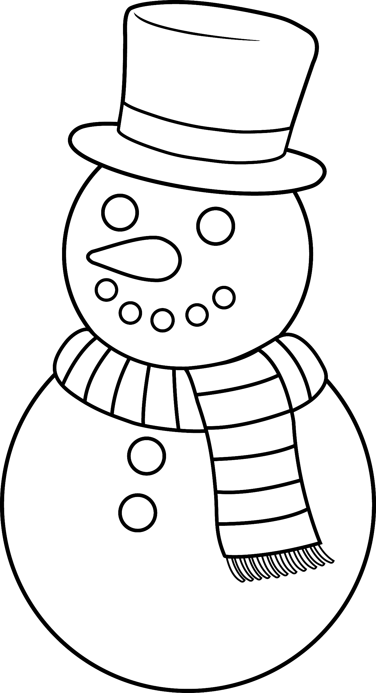

Slide 2
+
–
S
S
+
L
L
+
–
S
S
+
L
L

Slide 4
L
S
L
S
L
S
+
L
S
L
S
L
S
+

Slide 6
+
–
L
S
L
S
L
S
+
+
–
L
S
L
S
L
S
+

Slide 8
L
S
L
S
L
S
+
–
L
S
L
S
+
L
S
L
S
L
S
+
–
L
S
L
S
+

Slide 9
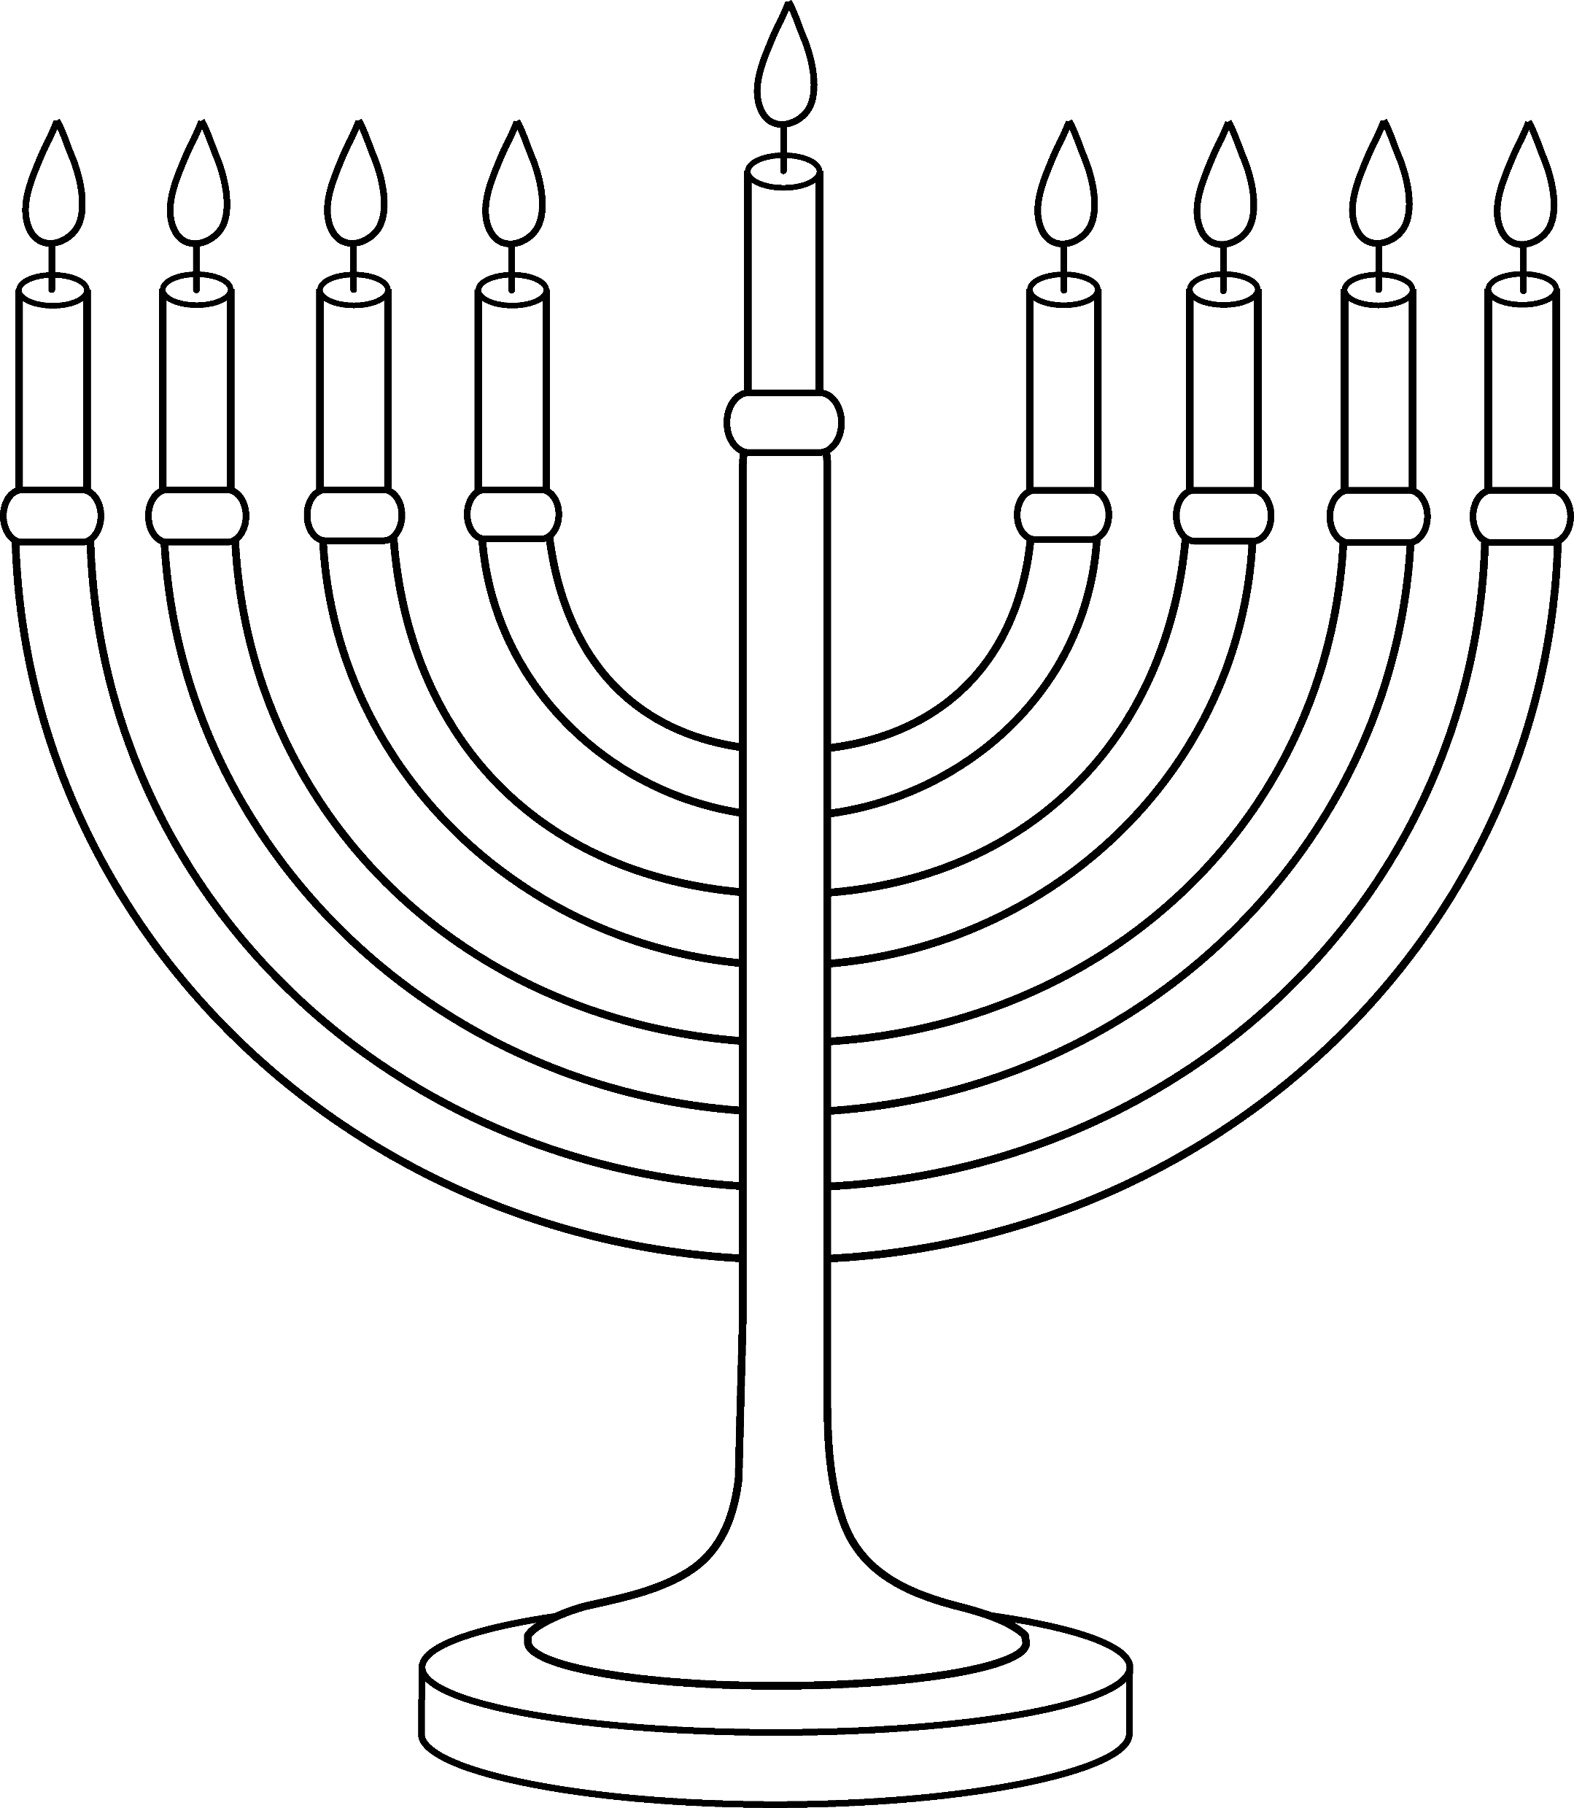

Slide 10
S
S
S
S
S
S
S
S
S
L
L
L
L
L
L
L
L
+
S
S
S
S
S
S
S
S
S
L
L
L
L
L
L
L
L
+

