Slide 1
Work and Power
IB Physics | Energy & Momentum

Slide 2
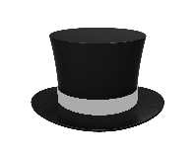
Where did the energy come from?
Initial Energy | Final Energy
$$mgh$$
$$0 J$$
$(80)(9.81$)(2.5)
$$1962 J$$
80 kg
2.5 m
80 kg

Slide 3
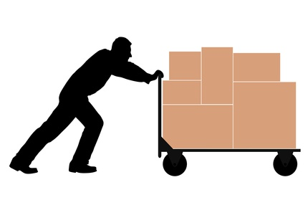
Where did the energy come from?
Initial Energy | Final Energy
$$\frac{1}{2}mv^{2}=\frac{1}{2}(200){(5)}^{2}$$
$$0 J$$
$$2500 J$$
0 m/s
200 kg
200 kg
5 m/s

Slide 4
Let’s give it a name
When the energy is added to or removed from a system, we call it
Work

Slide 5
How does Science Define Work?
Work is done when a force is applied to an object and the object moves in the same direction as the applied force.

Slide 6
How do you Calculate Work
Work* = Force × Displacement
= ×
= ×
*When force is constant and in the same direction as the movement
W
F
s
Symbols
[J]
[N]
[m]
Joules
Units

Slide 7
The things necessary for Work
There must be a force
There must be a displacement
What about direction?

Slide 8
Work at an Angle
Must use the component of the force that is in the same direction as the motion
$$cosθ=\frac{F_{x}}{F}$$
$$W=F_{x}s$$
$$W=Fcosθs$$
$$F_{x}=Fcosθ$$
F
F
F_{y}
θ
F_{x}
s

Slide 9
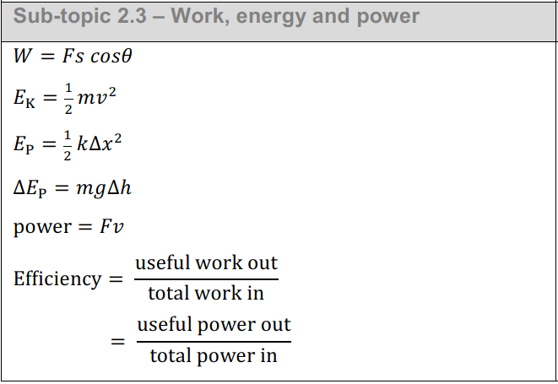
Work at an Angle
W = Fs cosθ
F
θ
Fcosθ
s

Slide 10
Does this always work?
$$θ=90°$$
W = Fs cosθ
$$\cos\left(90°\right)=0$$
$$W=0 J$$
F
$$θ=0°$$
F
$$\cos\left(0°\right)=1$$
$$W=Fs$$
F
θ
θ
θ

Slide 11
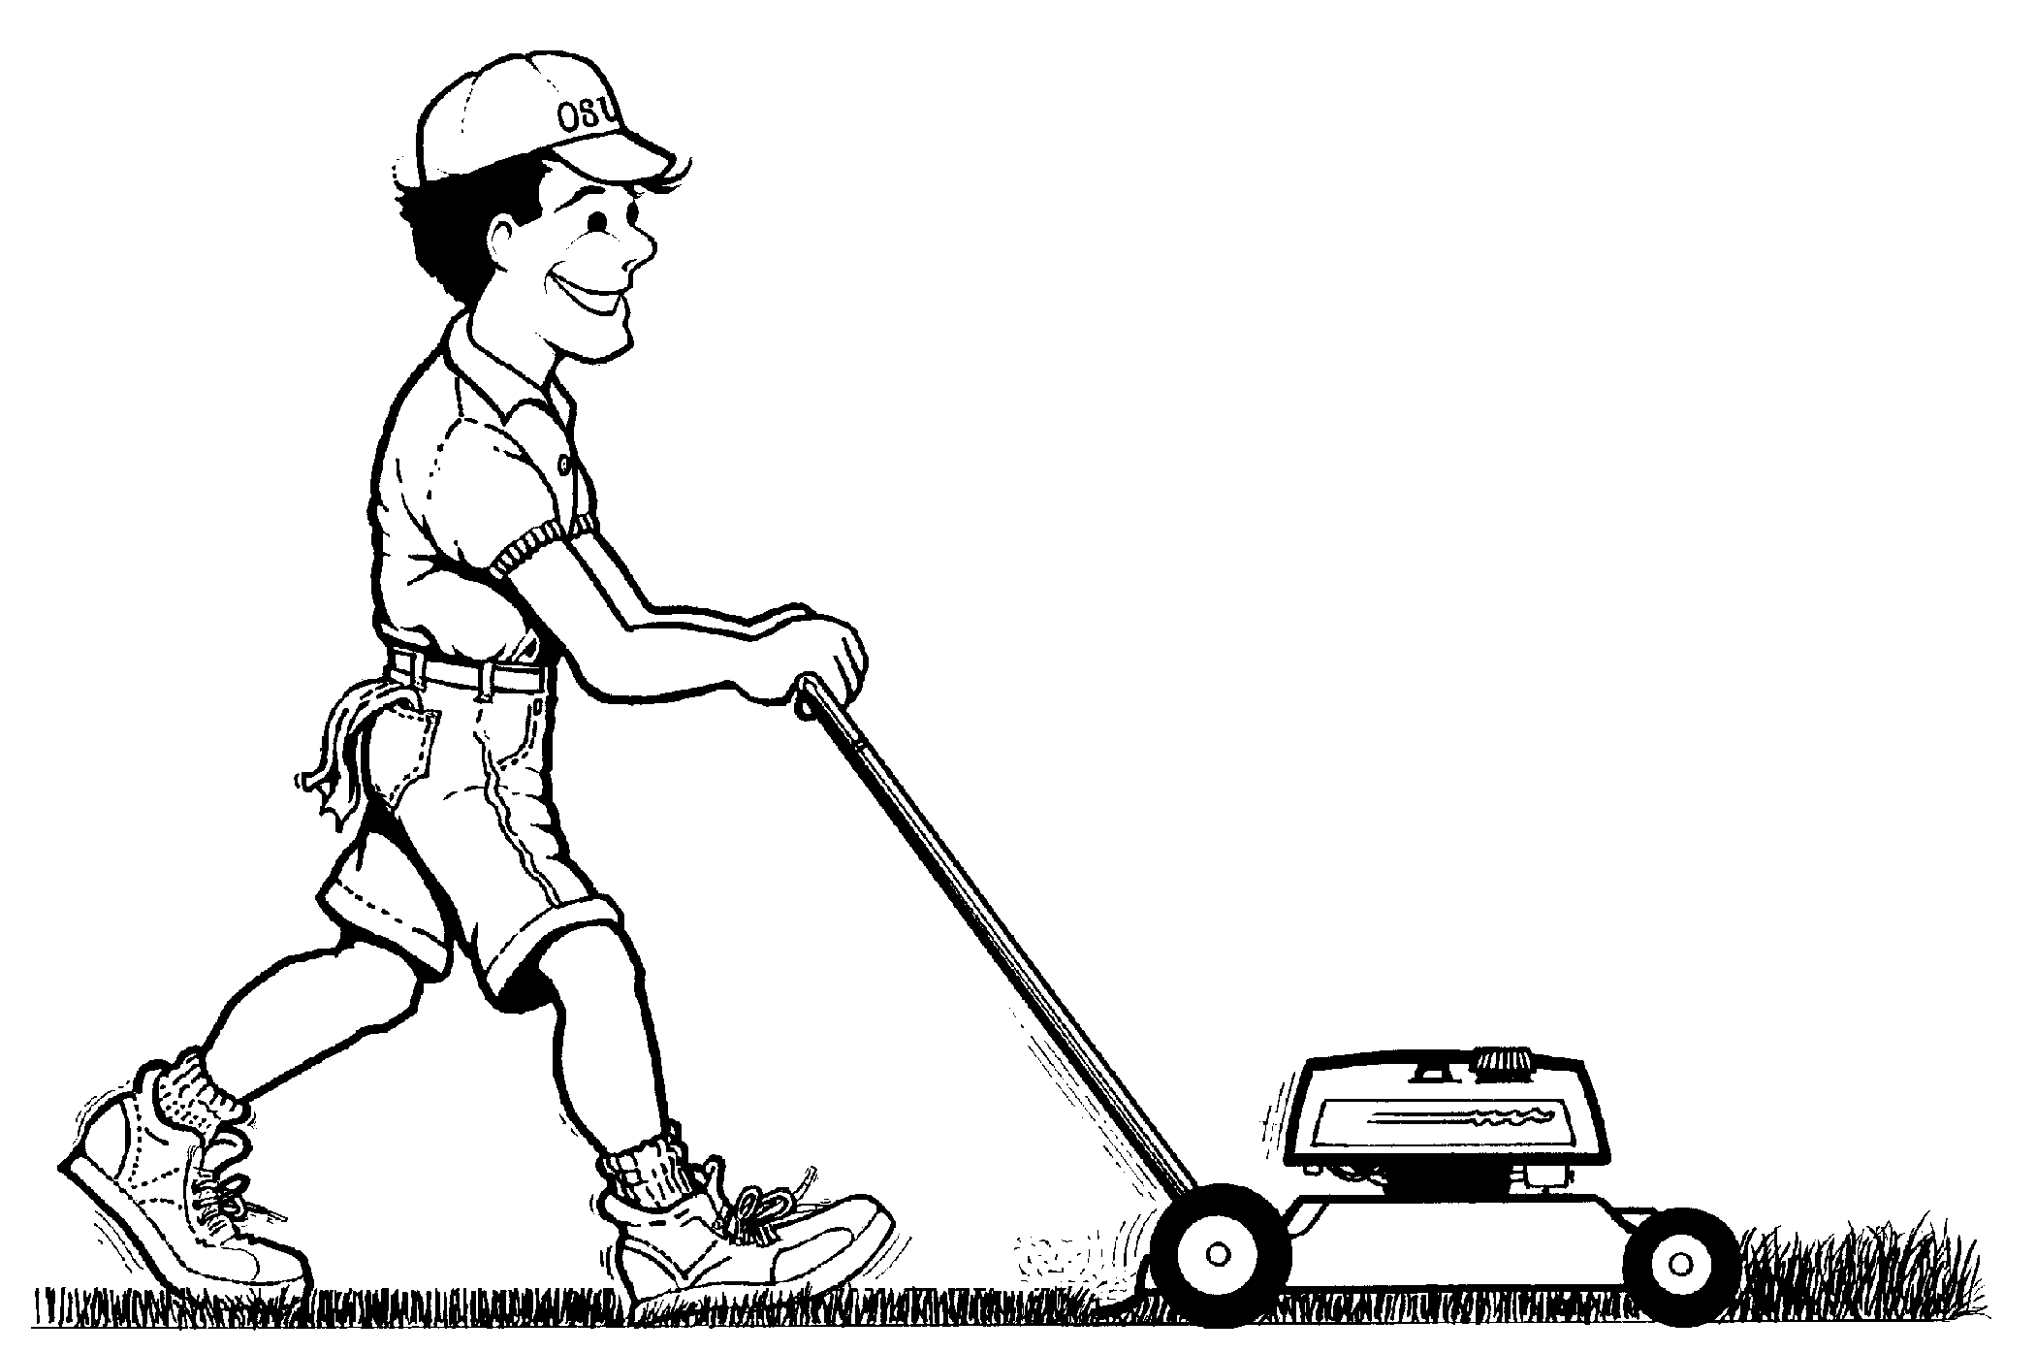
Try This
When you push a lawn mower, you are really applying a force down the angled handle bar as shown in this picture
F
How much work do you do when you push a lawn mower 20 m with a force of 200 N directed at an angle of 30° with the ground?
30°
$$W=Fs cosθ$$
$$=\left(200\right)\left(20\right)\cos\left(30°\right)$$
$$=3464 J$$

Slide 12
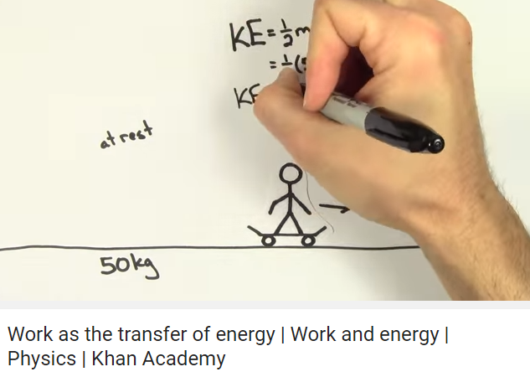
Work-Energy Theorem
If energy is truly conserved, how can things ever start or stop moving?
Energy is still conserved (not created or destroyed), it’s just being transferred in or out of the system/object that we are studying (gained or lost)

Slide 13
Work-Energy Theorem
Your engine applies 1000 N of force over a distance of 50 m. If you started from rest and your car has a mass of 2000 kg, how fast are you moving after travelling that distance?
Initial Energy
Final Energy
$$0 J$$
$$50,000 J$$
Work
$$\frac{1}{2}(2000)v^{2}=50,000$$
$$Fs=\left(1000\right)\left(50\right)$$
$$v=7.07 m s^{−1}$$
$$W=50,000 J$$

Slide 14
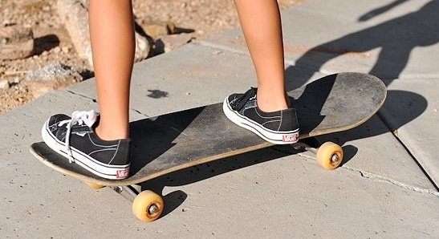
Try This
A 75 kg skateboarder kicks off with an initial velocity of 2 m s⁻¹ and comes to a stop after 15 m. What is the force of friction?
Initial Energy
Final Energy
$$\frac{1}{2}mv^{2}=\frac{1}{2}(75){(2)}^{2}$$
$$0 J$$
$$150 J$$
Work
$$150 J$$
$$=Fs$$
$$=F(15)$$
$$F=10 N$$

Slide 15
Think about it…
Is a waiter carrying a heavy tray of food at a constant velocity across a room doing any work on the tray?
No, the force is not in the same direction as the displacement
force
displacement
Doesn’t change the tray’s ENERGY

Slide 16
Think about it…
A particle of mass m is moving with constant speed v in uniform circular motion. What is the total work done by the centripetal force during one revolution?
A. Zero
B. mv²/2
C. mv²
D. 2πmv²
s
F
Is the earth’s gravity doing any work on the moon?
No

Slide 17
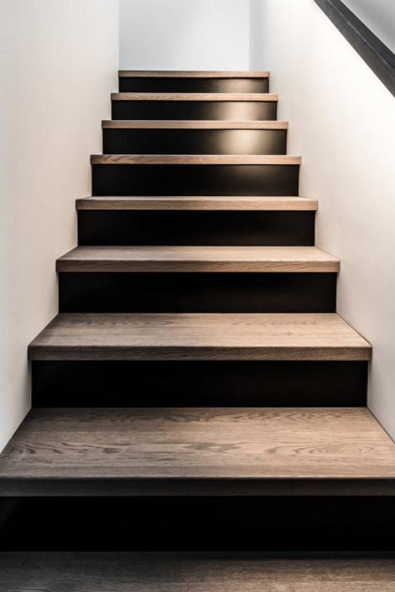
Think about it…
Two physics students, Maria and Paige, are going from the first floor to the second floor on their way to their next class.
Maria walks up the 3 meter tall staircase in 15 seconds
Paige runs up the 3 meter tall staircase in 5 seconds
If they both have a mass of 60 kg, which student does the most work?
Same
Work only depends on force and distance

Slide 18
What is Power?
Power is the rate at which work is done.
(how much work is done in a given amount of time)

Slide 19
How do you Calculate Power
Power = Work / Time
= /
= /
P
W
t
Symbols
[W]
[J]
[s]
Watts
Units

Slide 20
Say Watt?!?
Common Appliances | Estimated Watts
Blender | 300-1000
Microwave | 1000-2000
Waffle Iron | 600-1500
Toaster | 800-1500
Hair Dryer | 1000-1875
TV 32" LED/LCD | 50
TV 42" Plasma | 240
Blu-Ray or DVD Player | 15
Video Game Console (Xbox / PS4 / Wii) | 40-140
We will be looking at power again this year when we discuss electricity…

Slide 21
Lesson Takeaways
I can define and calculate the property of work
I can calculate work when the force is at an angle to the direction of the motion
I can equate work done on a system to the change in energy of an open system
I can use the work-energy theorem to solve for an unknown
I can identify situations where there is motion but no work being done

