Slide 1
Elastic Potential Energy
IB Physics | Energy & Momentum

Slide 2
Calculating from a Graph
Velocity (m/s)
Velocity (m/s)
Slope
Area
Time (s)
Time (s)
$$\left(x\right)\left(y\right)=\left(Velocity\right)\left(Time\right)$$
$$\frac{∆y}{∆x}=\frac{Velocity}{Time}=\frac{m/s}{s}=m/{s^{2}}$$
$$=\left(\frac{m}{s}\right)\left(s\right)=m$$
Acceleration
Displacement

Slide 3
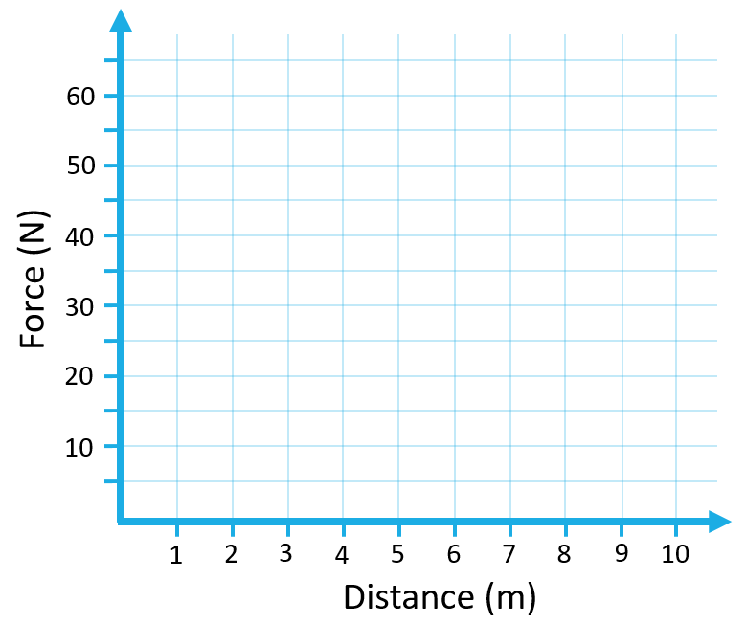
Graph of Force vs Displacement
40 N
40 N
Motion
2 m
8 m
$$W=Fs$$
$$Area=(6 m)(40 N)$$
40 N
$$=240 Nm$$
6 m
$=$ $240 J$

Slide 4
Work of a Varying Force
Our definition of work applies only for a constant force or an average force.
W = Fs cosθ
What if the force varies with displacement as with stretching a spring or rubber band?
F
F
F

Slide 5
Work of a Varying Force
Our definition of work applies only for a constant force or an average force.
W = Fs cosθ
What if the force varies with displacement as with stretching a spring or rubber band?
F
F
F

Slide 6
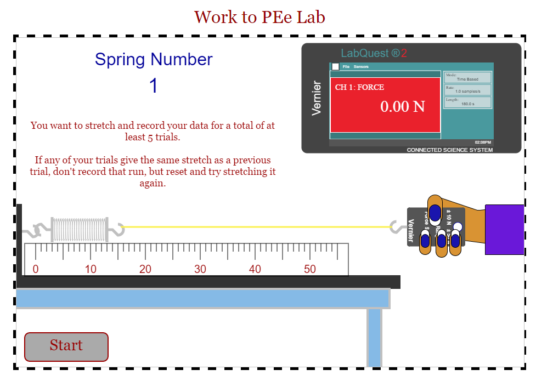
What about a Varying Force?
Click here for the simulation

Slide 7
Work of a Varying Force
How can you calculate the work?
$$Area=\frac{1}{2}(10 m)(40 N)$$
$$=200 J$$
40 N
10 m

Slide 8
Work of a Varying Force
What work is required to stretch this spring from x = 0 to x = 6 m?
6 m
F
$$Work=\frac{1}{2}(6 m)(40 N)$$
40 N
6 m
$$=120 J$$

Slide 9
Work of a Varying Force
What work is required to stretch this spring from x = 0 to x = 6 m?
6 m
F
$$Work=\frac{1}{2}(6 m)(40 N)$$
40 N
6 m
$$=120 J$$

Slide 10
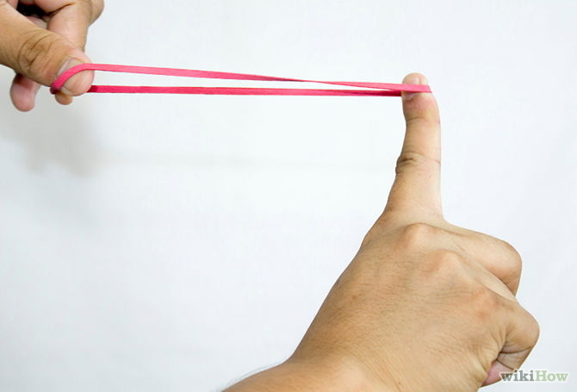
Elastic Potential Energy
As the pull back distance increases elastic potential energy ______________
increases

Slide 11
Hooke’s Law
F = kΔx
*The spring constant k is a property of the spring
Δx
k → [N m⁻¹]
F
F
When a spring is stretched, there is a restoring force that is proportional to the displacement.
F

Slide 12
Try this…
A block with a mass of 2 kg is suspended from a spring and produces the displacement shown. What is the spring constant?
1 m
2 m
3 m
4 m
5 m
6 m
7 m
8 m
$$F=k∆x$$
$$(19.62 N)=k(4 m)$$
$$∆x=4 m$$
2 kg
$$k=4.9 Nm^{−1}$$
$$F_{g}=mg=(2)(9.81)$$
$$F_{g}=19.62 N$$

Slide 13
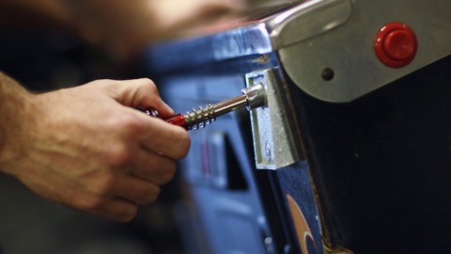
Work and Energy
Work done on a system causes the system to gain or lose energy
Stretching or compressing a spring stores energy

Slide 14
Work of a Varying Force
Now that we know that F = kΔx, we can calculate the stored elastic potential energy with the work equation
$$F$$
$$Work=Fs$$
$$\frac{1}{2}F$$
$$=\left(\frac{1}{2}F\right)s$$
Average Force
$$=\left(\frac{1}{2}k∆x\right)∆x$$
Elastic Potential
$$=\frac{1}{2}k{∆x}^{2}$$

Slide 15
Elastic Force and Work
F = kΔx
E_{p} = ½kΔx²
x
F
*The spring constant k is a property of the spring

Slide 16
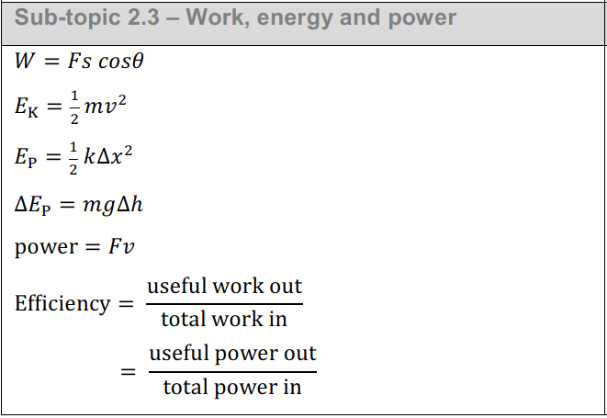
Data Booklet
velocity
KE
elastic
PE_{e}
gravity
PE_{g}

Slide 17
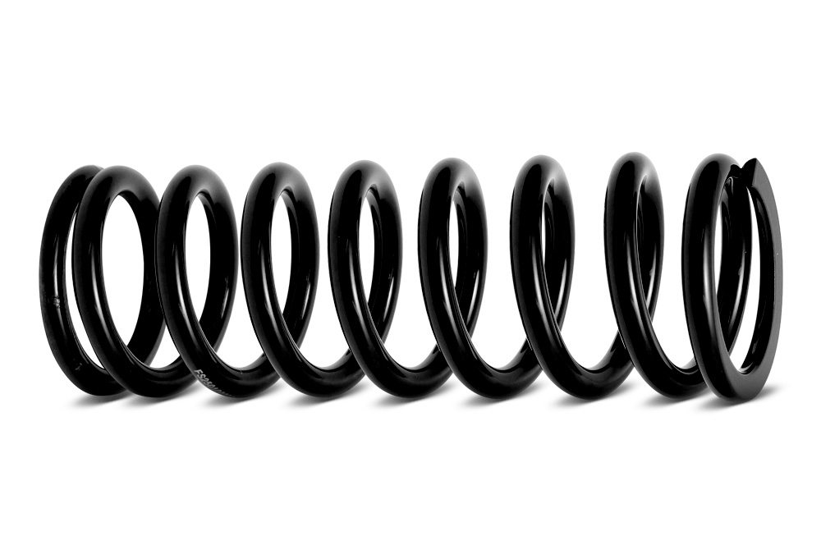
Conservation of Energy
PE_{g}
How far up the 15° incline of a pinball table will a 0.1 kg pinball move after it is launched? The spring constant is 100 N/m and is compressed by 0.08 m.
PE_{e}
h
$$KE+{PE}_{e}+{PE}_{g}=KE+{PE}_{e}+{PE}_{g}$$
$$Initial Energy=Final Energy$$
$$\frac{1}{2}k{∆x}^{2}=mgh$$
$$\frac{1}{2}(100){(0.08)}^{2}=(0.1)(9.81)(h)$$
$$\text{h}=0.33 m$$

Slide 18
Try this…
What work is required to stretch this spring
(k = 200 N m⁻¹) from Δx = 0.1 m to Δx = 0.4 m?
F
$$Initial$$
$$\frac{1}{2}k{∆x}^{2}$$
$$=\frac{1}{2}\left(200\right){\left(0.1\right)}^{2}=1 J$$
$$15 J$$
F
$$\frac{1}{2}k{∆x}^{2}$$
$$=\frac{1}{2}(200){\left(0.4\right)}^{2}=16 J$$
Added to the system through work on spring
$$Final$$
$$W=15 J$$

Slide 19
Try this…
What work is required to stretch this spring
(k = 200 N m⁻¹) from Δx = 0.1 m to Δx = 0.4 m?
Why not just use the stretch change?
F
$$\frac{1}{2}k{∆x}^{2} =\frac{1}{2}\left(200\right){\left(0.3\right)}^{2}=9 J$$
F
100
80
60
40
20
0
The force isn’t starting at zero!
15 J
Force (N)
9 J
$$W=15 J$$
0 | 0.1 | 0.2 | 0.3 | 0.4
Distance (m)

Slide 20
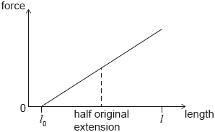
Example IB Question
An increasing force acts on a metal wire and the wire extends from an initial length l₀ to a new length l. The graph shows the variation of force with length for the wire. The energy required to extend the wire from l₀ to l is E. The wire then contracts to half its original extension. What is the work done by the wire as it contracts?
A. 0.25E
B. 0.50E
C. 0.75E
D. E
E – E_{new}
E
E – 0.25E
E_{new}
0.75E

Slide 21
Lesson Takeaways
I can calculate work as area bounded by a Force vs Distance graph
I can use Hooke’s Law to calculate the elastic force at a given displacement
I can describe and calculate elastic potential energy

