Slide 1
Conservation of Momentum
IB Physics | Energy & Momentum

Slide 2
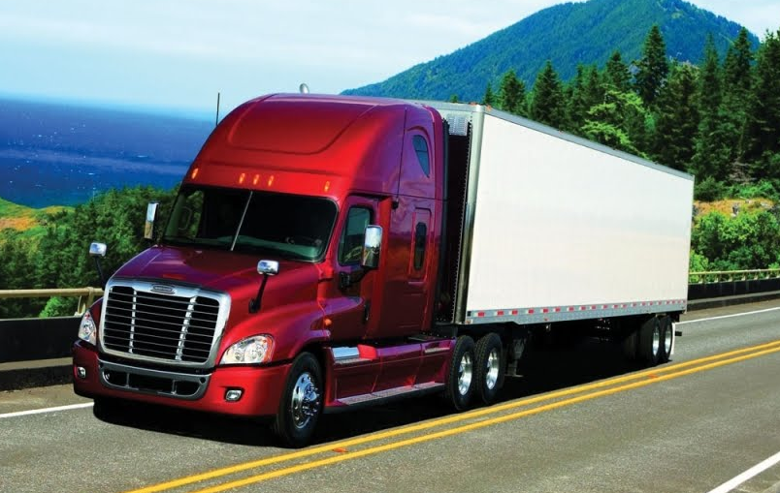
What is Momentum??
“Inertia in Motion”

Slide 3
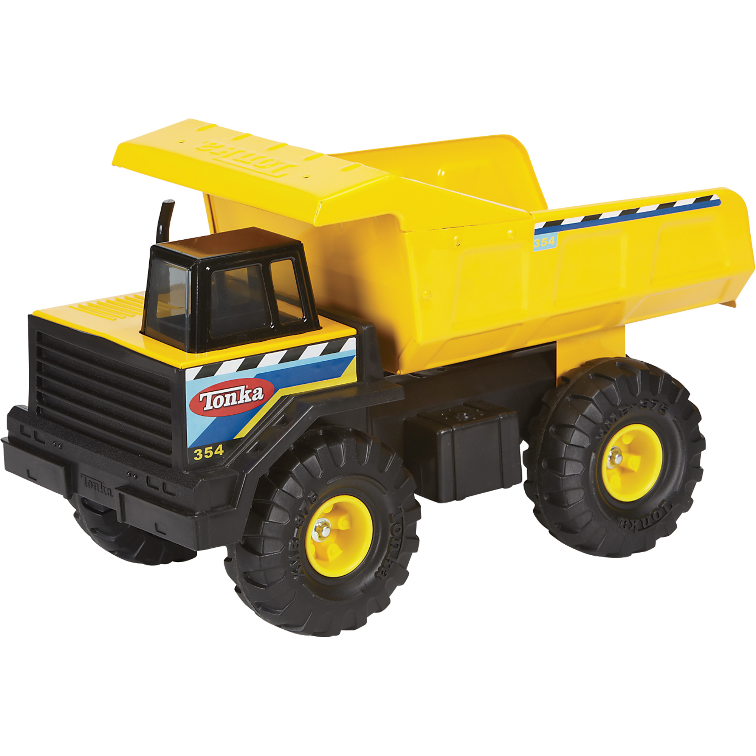
Which has more Momentum??
20000 kg
10 m/s
2 kg
Why?
More mass
10 m/s

Slide 4
Which has more Momentum??
2 kg
35 m/s
2 kg
Why?
More velocity
10 m/s

Slide 5
Momentum Equation
Momentum = mass × velocity
= ×
= ×
p
m
v
Symbols
kg m s⁻¹
kg
m s⁻¹
Units

Slide 6
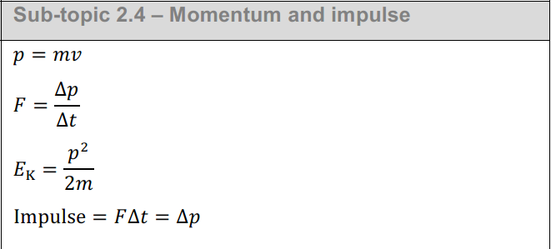
IB Physics Data Booklet

Slide 7
Explosion

Slide 8
Hit and Bounce

Slide 9
Hit and Stick

Slide 10
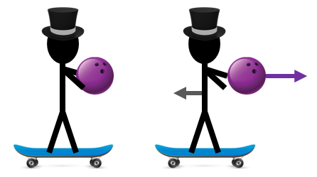
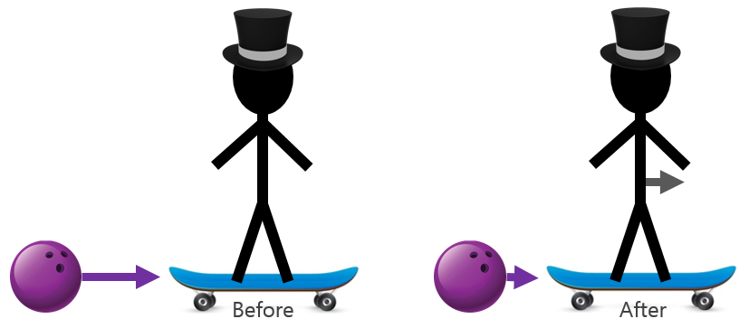
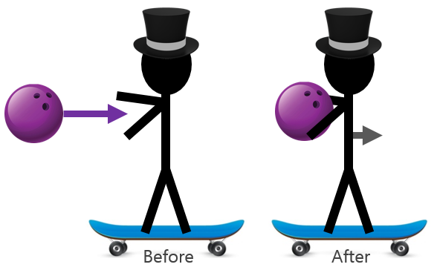
Conservation of Momentum
The total momentum of a system is constant
“Explosion”
“Hit and Bounce”
“Hit and Stick”

Slide 11
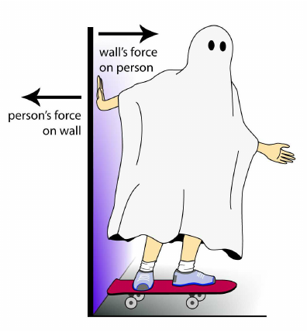
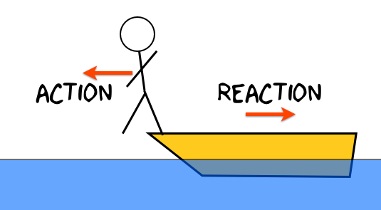
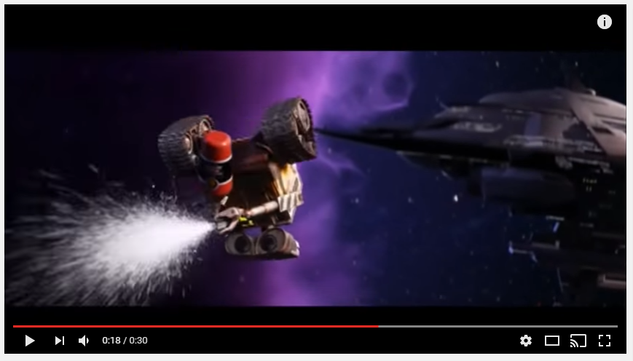
Newton’s Third Law
For every action, there is an equal and opposite reaction

Slide 12
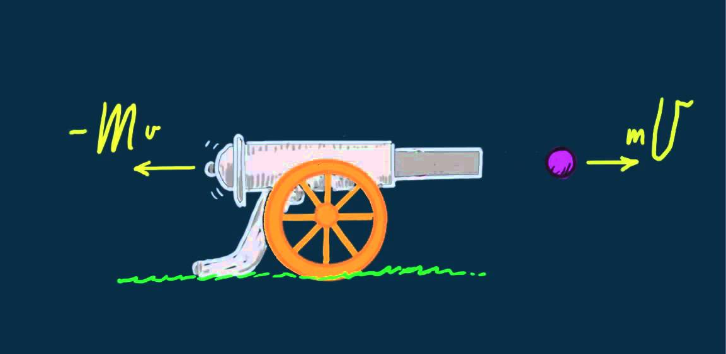
Conservation of Momentum
When a cannonball is fired out of a cannon, there is a recoil…
Equal and Opposite…
More mass → Less velocity
Less mass → More velocity

Slide 13
Explosion
? m/s
80 kg
10 m/s
8 kg

Slide 14
Explosion
80 kg
80 kg
10 m s⁻¹
8 kg
v
8 kg
ρ = mv
= (8)(10)
= 80 kg m s⁻¹
mv = mv
(80)(v) = (8)(10)
v = 1 m s⁻¹

Slide 15
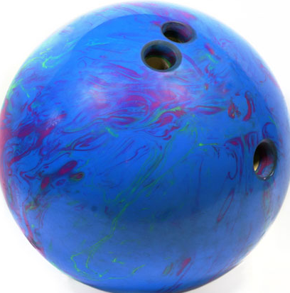
Hit and Bounce #1
10 m/s
2 m/s
8 kg
2 kg

Slide 16
Hit and Bounce #1
10 m s⁻¹
0 m s⁻¹
Before
After
8 kg
2 kg
(8)(10) + (2)(0)
=
(8)(2) + (2)(v)
80 + 0 = 16 + 2v
v = 32 m s⁻¹
2 m s⁻¹
v
8 kg
2 kg

Slide 17
Hit and Bounce #2
8 m/s
-5.5 m/s
? m/s
-4 m/s
12 kg
18 kg

Slide 18
Hit and Bounce #2
Before
After
(12)(8) + (18)(-4)
= (12)(-5.5) + (18)(v)
96 + -72 = -66 + 18v
v = 5 m s⁻¹
8 m s⁻¹
-4 m s⁻¹
-5.5 m s⁻¹
v
12 kg
18 kg
12 kg
18 kg
Before
After

Slide 19
Hit and Stick
8 m/s
? m/s
12 kg
18 kg

Slide 20
Hit and Stick
Before
After
(12)(4) + (18)(0)
= (30)(v)
96 + 0 = 30v
v = 1.6 m s⁻¹
4 m s⁻¹
0 m s⁻¹
v
30 kg
12 kg
18 kg
12 kg
18 kg
Before
After

Slide 21
Elastic vs Inelastic
Elastic
Inelastic
Kinetic Energy is conserved
Kinetic Energy
is not conserved
In both cases momentum is ALWAYS conserved

Slide 22
Try This…
A toy railcar of mass 2 kg travelling at 6 m s⁻¹ collides with another railcar of mass
3 kg travelling at 4 m s⁻¹ in the same direction. If after the collision the two trucks become joined together, what is their resulting velocity?
Compare the total Kinetic Energy before and after:
Before
After
$$(2)(6)+(3)(4)$$
$$=(2+3)(v)$$
$$v = 4.8 m s^{−1}$$
$$12+12=5v$$
Before
After
$$\frac{1}{2}\left(2\right){\left(6\right)}^{2}+\frac{1}{2}\left(3\right){\left(4\right)}^{2}$$
$$\frac{1}{2}\left(2+3\right){\left(4.8\right)}^{2}$$
System loses 2.4 J of Kinetic Energy so it is an inelastic collision
$$36+24$$
$$57.6 J$$
$$60 J$$

Slide 23
Lesson Takeaways
I can define and calculate momentum
I can use the conservation of momentum to solve for missing variables in linear collisions
I can describe the process required for explosion, hit and bounce, and hit and stick scenarios
I can describe the difference between elastic and non-elastic collisions
I can calculate the amount of energy retained in a non-elastic collision

