Slide 1
The Renewables
IB Physics | Energy Production

Slide 2
Renewable vs. Non Renewable
Highlight the primary energy sources that are considered renewable
*Note: this doesn’t mean that it cannot ever be replaced, just that it won’t happen in any sort of useful time frame…

Slide 3
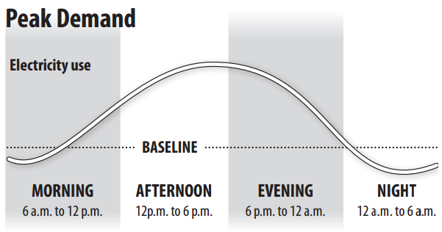
Energy Load Requirements
Energy needs to be available when electricity is most needed but should also be available other times as well.

Slide 4
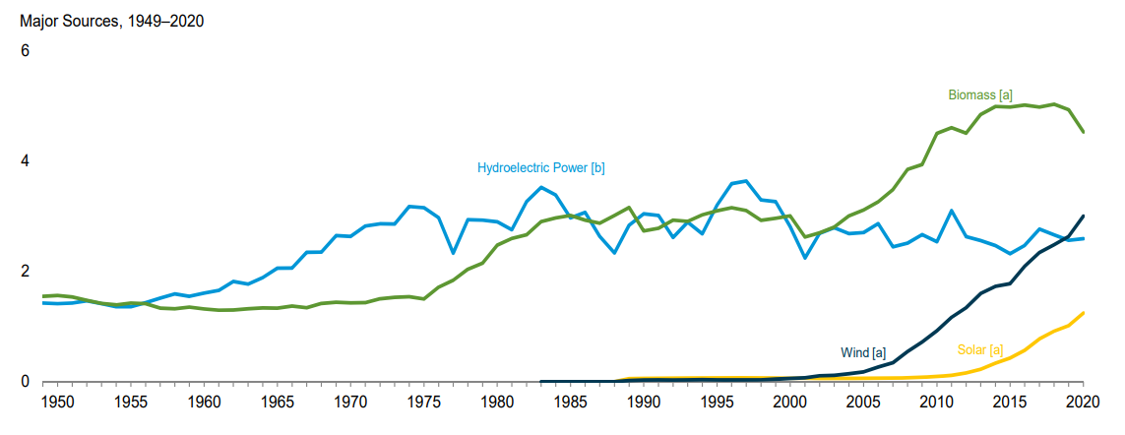
Renewable Energy in the US
https://www.eia.gov/totalenergy/data/monthly/pdf/mer.pdf

Slide 5
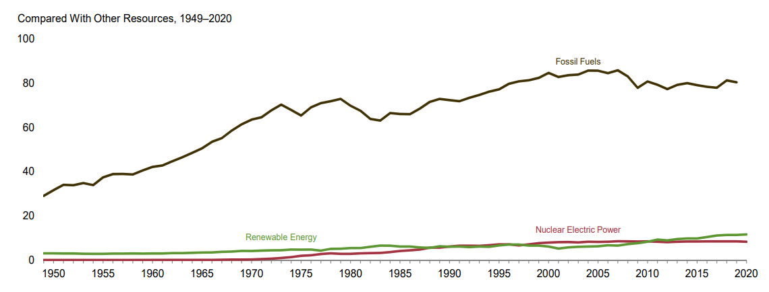
Renewable Energy in the US
https://www.eia.gov/totalenergy/data/monthly/pdf/mer.pdf

Slide 6
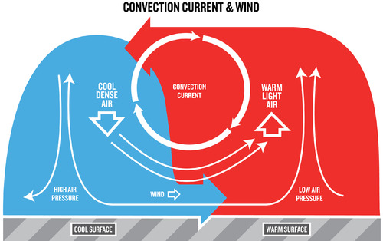
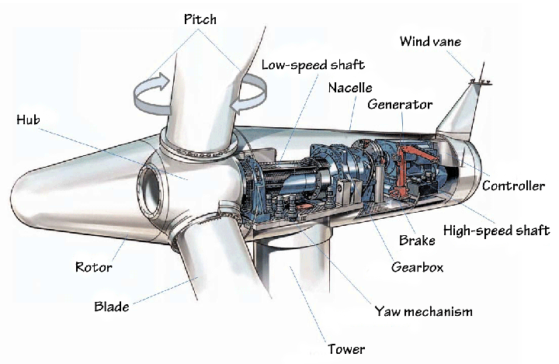
Wind Power
Land
Solar Energy
KE of Wind
KE of Turbine
Electricity

Slide 7
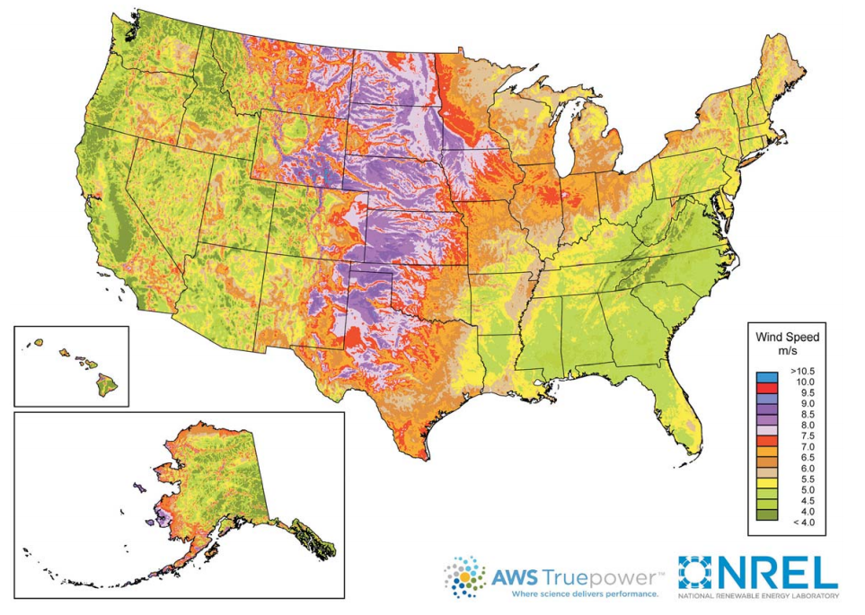
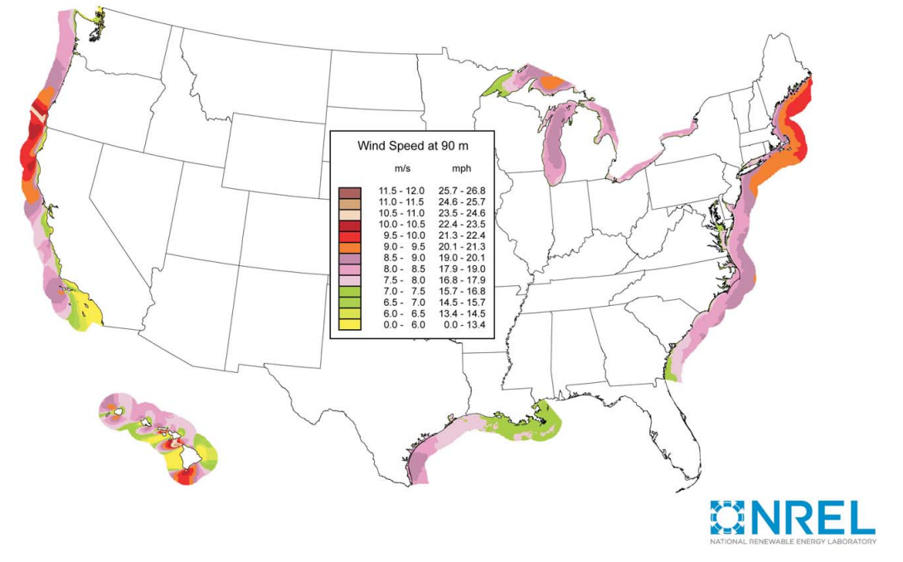
Wind Speeds

Slide 8
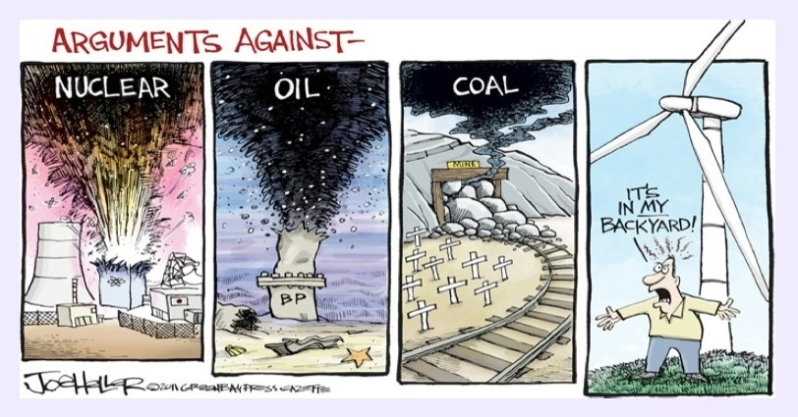
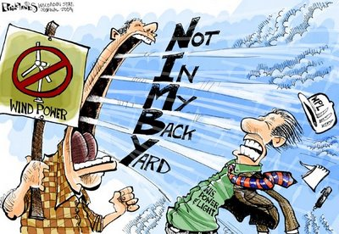
NIMBY

Slide 9
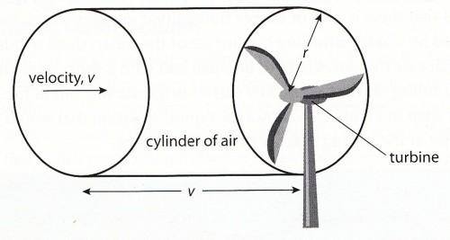
Calculating the Wind’s Energy
$$A=πr^{2}$$
$$E_{K}=\frac{1}{2}mv^{2}$$
$$= \frac{\frac{1}{2}\left[Avtρ\right]v^{2}}{t}$$
$$d=vt$$
$$Power=\frac{E_{K}}{t}$$
$$ρ→air density$$
$$V=A×vt$$
$$Power=\frac{1}{2}Aρv^{3}$$
$$m=\left(A×vt\right)×ρ$$

Slide 10
IB Physics Data Booklet
$$Power=\frac{1}{2}Aρv^{3}$$
Velocity
[m s⁻¹]
Area
[m²]
Air Density
[kg m⁻³]
(A = πr²)

Slide 11
Conceptual Meaning of Equation
$$Power=\frac{1}{2}Aρv^{3}$$
8
If the wind speed is doubled, then the power is multiplied by a factor of
2³
27
If the wind speed is tripled, then the power is multiplied by a factor of
3³

Slide 12
$$Power=\frac{1}{2}Aρv^{3}$$
Try This…
Given a turbine having a blade length of 12 m, and a wind speed of 15 ms⁻¹ find the power output if the density of air is ρ= 1.2 kg m⁻³.
$$P=\frac{1}{2}\left(π×{12}^{2}\right)\left(1.2\right){\left(15\right)}^{3}$$
$$=916,000 W$$
$$=0.916 MW$$
What is the actual power output if the efficiency is 45%?
$$0.916 MW×0.45=$$
$$0.412 MW$$

Slide 13
$$Power=\frac{1}{2}Aρv^{3}$$
Try This…
Air of constant density 1.2 kg m⁻³ is incident at a speed of 9.0 m s⁻¹ on the blades of a wind turbine. The turbine blades are each of length 7.5 m. The air passes through the turbine without any change of direction. Immediately after passing through the blades, the speed of the air is 5.0 m s⁻¹. The density of air immediately after passing through the blades is 2.2 kg m⁻³.
$$P=\frac{1}{2}\left(π×{7.5}^{2}\right)\left(1.2\right){\left(9\right)}^{3}=77,300 W$$
$$P=\frac{1}{2}\left(π×{7.5}^{2}\right)\left(2.2\right){\left(5\right)}^{3}=24,300 W$$
$$53,000 W$$

Slide 14
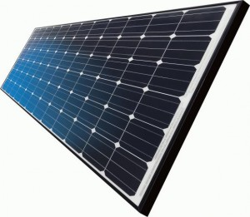
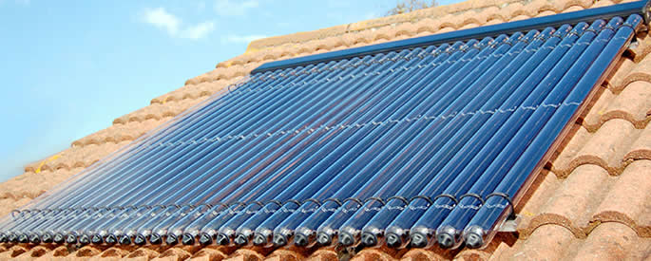
Solar Power
Photovoltaic Cells
Solar Energy
Electricity
Solar Concentrator
Solar Energy
Thermal Energy
Electricity
Solar Heating Panel
Solar Energy
Thermal Energy

Slide 15
Efficiency of PV Cells
Photovoltaic Cells
10%-20%
Efficient

Slide 16
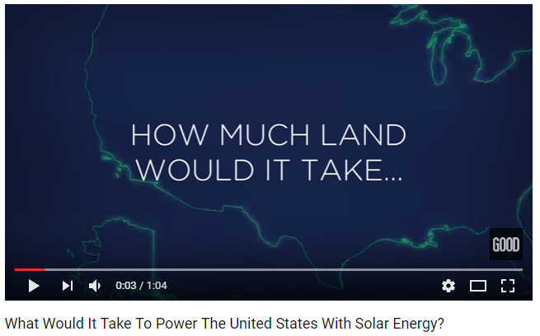
Solar Power
Issues
Infrastructure to transport electricity
Storage for non-sun times
High up front cost

Slide 17
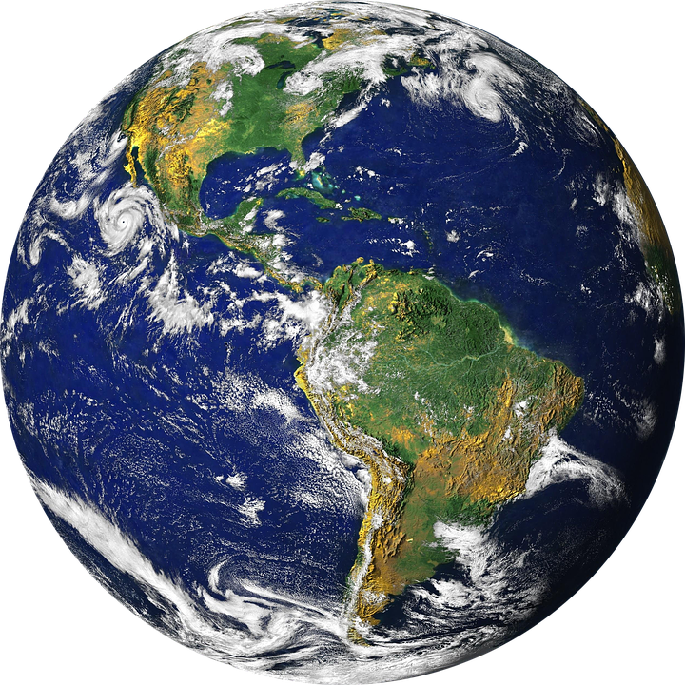
Solar Power Intensity
Same Power
Different Area
Solar intensity depends on the latitude

Slide 18
This also affects the seasons

Slide 19
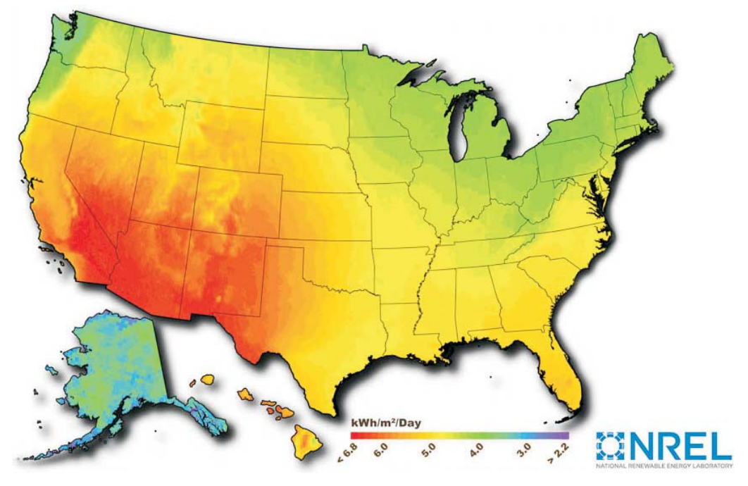
Solar Map

Slide 20
Calculating Solar Power
A photovoltaic cell has an area of 1.00 cm² and an efficiency of 10.5%. If the cell is placed in a position where the sun's intensity is 1250 W m⁻², what is the power output of the cell?
$$1 {cm}^{2}×\frac{1 m}{100 cm}×\frac{1 m}{100 cm}=0.0001 m^{2}$$
$$\frac{1250 W}{1 m^{2}}×0.0001 m^{2}×0.105=$$
$$0.0131 W$$
Area
Efficiency

Slide 21
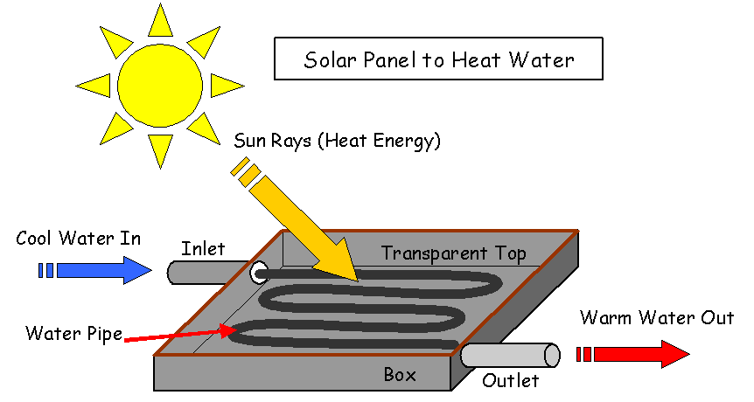
Solar Heating Panel

Slide 22
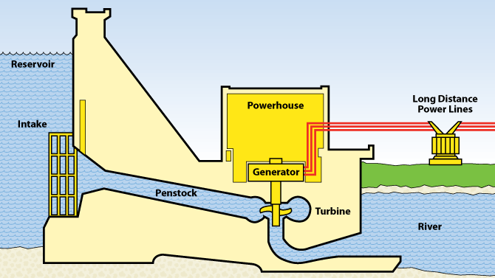
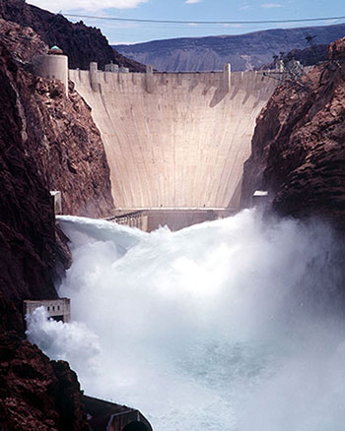
Hydropower
PE of Water
KE of Water
KE of Turbine
Electricity

Slide 23
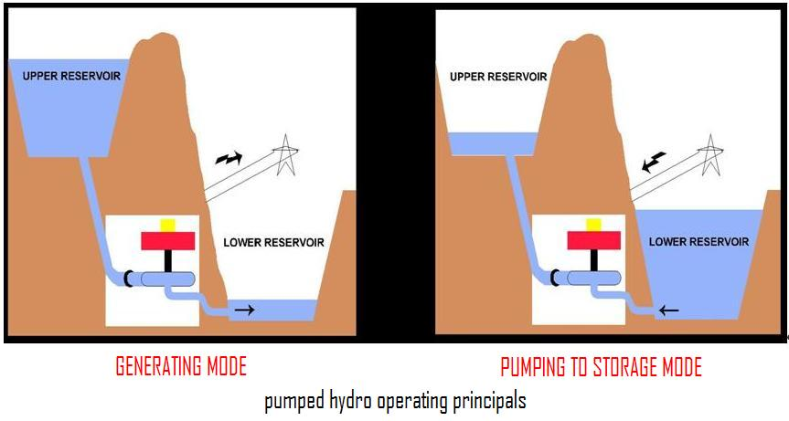
Storing Energy in Hydropower
If there is excess electricity, this energy can be stored by pumping water back up to the reservoir

Slide 24
Issues of the Renewables
Storage
Upfront cost
Control over timing

