Slide 1
Electrostatic and Gravitational Force
IB Physics | Force Fields

Slide 2
Review of Charges
+
-
+
+
-
+
-
-
Opposite Charges
Attract
Like Charges
Repel

Slide 3
Coulomb’s Law
$$F=k\frac{q_{1}q_{2}}{r^{2}}$$
The force of attraction or repulsion between two point charges is directly proportional to the product of the two charges and inversely proportional to the square of the distance between them.
-
Symbol
Unit
+
Electrostatic Force | $$F$$ | $$\left[N\right]$$
Object 1 Charge | $$q_{1}$$ | $$\left[C\right]$$
Object 2 Charge | $$q_{2}$$ | $$\left[C\right]$$
Separation Distance | $$r$$ | $$\left[m\right]$$
F
F
q₁
q₂
r
F
F
q₁
q₂
-
-

Slide 4
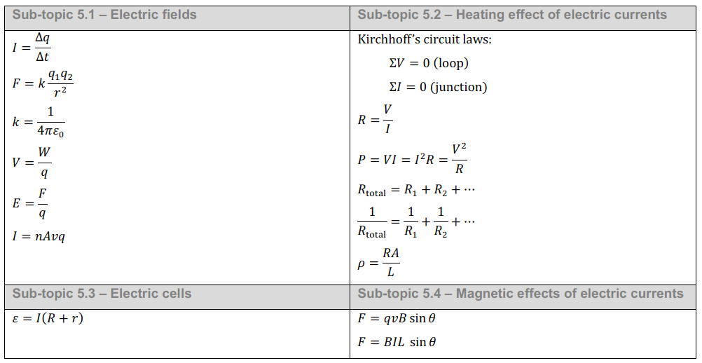
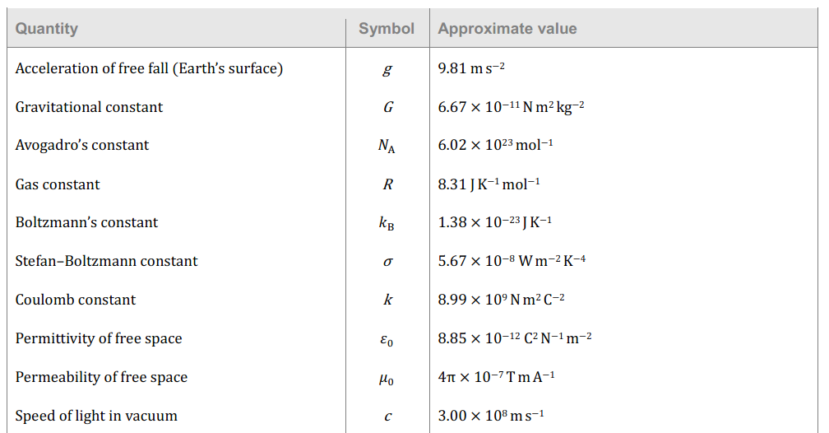
IB Physics Data Booklet
*Coulomb’s Law

Slide 5
Sign is important!
$$F=k\frac{q_{1}q_{2}}{r^{2}}$$
$$k=8.99×{10}^{9} N m^{2} C^{−2}$$
+ F →
Repel (+)(+) or (-)(-)
- F →
Attract (+)(-) or (-)(+)

Slide 6
Quantifying Charge
The total charge in Coulombs can be related to the number of electrons

Slide 7
Quantifying Charge
The coulomb was selected to use with electric currents which makes it a very large unit for static electricity. Get your metric prefixes ready
Milli- (10⁻³)
m-
Micro- (10⁻⁶)
µ-
Nano- (10⁻⁹)
n-
Pico- (10⁻¹²)
p-
BASE UNIT

Slide 8
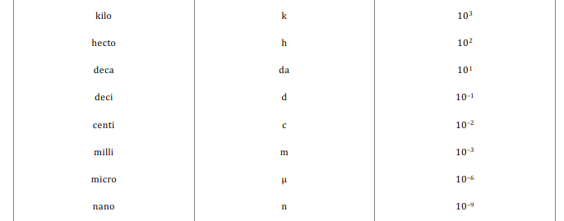
Conversion Check
7 μC → C
7 × 10⁻⁶ C

Slide 9
Try This
A small cork with an excess charge of +7.0 µC is placed 14 cm from another cork, which carries a charge of −3.2 µC. What is the magnitude of the electric force between the corks?
$$F=k\frac{q_{1}q_{2}}{r^{2}}$$
$$=(8.99×{10}^{9})\frac{(7×{10}^{−6})(−3.2×{10}^{−6})}{{(0.14)}^{2}}$$
$$F=−10.3 N$$
attract
$$F=k\frac{q_{1}q_{2}}{r^{2}}$$
k = 8.99 × 10⁹ N m² C⁻²
Elementary Charge = 1.60 × 10⁻¹⁹ C

Slide 10
How many electrons??
A small cork with an excess charge of +7.0 µC is placed 14 cm from another cork, which carries a charge of −3.2 µC. What is the magnitude of the electric force between the corks?
How many excess electrons on the second cork??
$$× \frac{1 electron}{−1.60×{10}^{−19} C}$$
$$−3.2×{10}^{−6} C$$
$$=2×{10}^{13}electrons$$
$$F=k\frac{q_{1}q_{2}}{r^{2}}$$
k = 8.99 × 10⁹ N m² C⁻²
Elementary Charge = 1.60 × 10⁻¹⁹ C

Slide 11
Gravity
What is Gravity?
Idea #1: A downward force that stops you from flying away
Idea #2: An attraction towards larger objects
Idea #3: All mass attracts all other mass
Circle the answer that you agree with most

Slide 12
Universal Law of Gravitation
$$F=G\frac{Mm}{r^{2}}$$
The force of attraction between bodies with mass is directly proportional to the product of the two masses and inversely proportional to the square of the distance between them.
Symbol
Unit
Gravitational Force
Object 1 Mass
Object 2 Mass
Separation Distance
r
$$F$$
$$[N]$$
M
$$M$$
$$[kg]$$
m
$$m$$
$$[kg]$$
$$r$$
$$[m]$$

Slide 13
Universal Law of Gravitation
$$F=G\frac{Mm}{r^{2}}$$
G → Universal Gravitational Constant
G =
6.67 × 10⁻¹¹ N m² kg⁻²

Slide 14
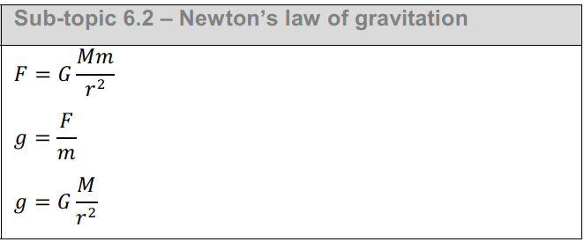
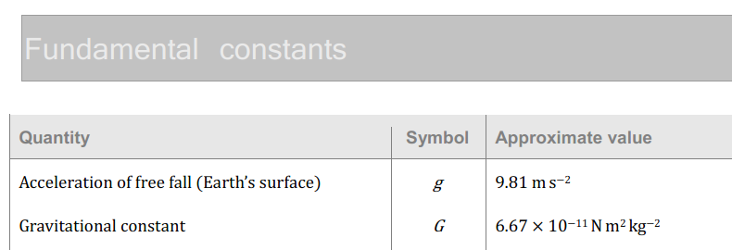
IB Physics Data Booklet
*Universal Law of Gravitation

Slide 15
Gravity – Equal and Opposite
The force on the skydiver is the same as the force on the earth but the earth’s huge mass means that there is hardly any acceleration

Slide 16
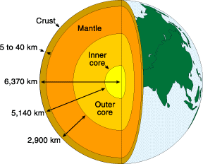
Measuring the proper distance
Technically Newton’s Law of Gravitation defines how to calculate the gravitational force between two point masses
(Not a point mass)
Fortunately, Newton’s shell theorem states that:
“A spherically symmetric shell of mass M acts as if all of its mass is located at its center.”
r

Slide 17
Try This
Determine the force of gravitational attraction between the earth (m = 5.98 x 10²⁴ kg) and a 70-kg physics student if the student is in an airplane at 40000 feet above earth's surface. This would place the student a distance of 6.39 x 10⁶ m from earth's center.
$$F=G\frac{Mm}{r^{2}}$$
$$=(6.67×{10}^{−11})\frac{(5.98×{10}^{24})(70)}{{(6.39×{10}^{6})}^{2}}$$
$$F=684 N$$

Slide 18
Comparison
Electrostatic Force
Gravitational Force
$$F=k\frac{q_{1}q_{2}}{r^{2}}$$
$$F=G\frac{Mm}{r^{2}}$$
$$k→Coulomb Constant$$
$$G→Gravitational Constant$$
$$q_{1}{,q}_{2}→Charges [C]$$
$$M, m→Masses [kg]$$

Slide 19
Permittivity
Coulomb’s Constant is sometimes expanded to this form:
$$k=\frac{1}{4πε_{0}}$$
$ε_{0}$ → Permittivity of Free Space (vacuum)
$ε_{0}=$ 8.85 × 10⁻¹² C² N⁻¹ m⁻²
*Solving for k will get Coulomb’s Constant for a vacuum

Slide 20
IB Physics Data Booklet
*Solving for k

Slide 21
Permittivity
Permittivity changes relative to the substance
Relative Permittivity
$$ε_{r}=\frac{ε}{ε_{0}}$$
Relative Permittivities
Free Space (a vacuum) | 1
Dry Air | 1.0005
Paper | 4
Concrete | 4
Rubber | 6
IB might ask you about this: the higher the relative permittivity, the harder it is for electrostatic forces to travel over a distance…

