Slide 1
Force Fields
IB Physics | Force Fields

Slide 2
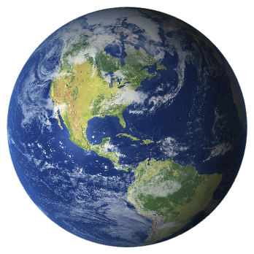
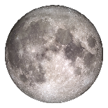
Warm Up
What is the force of gravity between the earth and the moon?
r = 3.8 × 10⁸ m
m = 7.4 × 10²² kg
m = 6 × 10²⁴ kg
$$F=(6.67×{10}^{−11})\frac{(6×{10}^{24})(7.4×{10}^{22})}{{(3.8×{10}^{8})}^{2}}$$
$$F=2.05×{10}^{20} N$$
$$F=G\frac{Mm}{r^{2}}$$
G = 6.67 × 10⁻¹¹ N m² kg⁻²

Slide 3
Review of Circular Motion
How fast (in m/s) is the moon moving?
r = 3.8 × 10⁸ m
$$F=2.05×{10}^{20} N$$
m = 7.4 × 10²² kg
m = 6 × 10²⁴ kg
$$2.05×{10}^{20}=\frac{(7.4×{10}^{22})v^{2}}{(3.8×{10}^{8})}$$
$$v=1026 m s^{−1}$$
$$F=\frac{mv^{2}}{r}=mω^{2}r$$

Slide 4
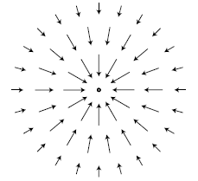
Force Fields
Vector field that describes the force that would act on a particle at various positions
 | Electric Field | Gravitational Field
Symbol
Unit
$$E$$
$$g$$
$$\frac{N}{C}=N{ C}^{−1}$$
$$\frac{N}{kg}=N{ kg}^{−1}$$

Slide 5
Electric Fields
Electric Fields point in the direction that a ___________ charge would travel
positive
+
+
+
-
+
+

Slide 6
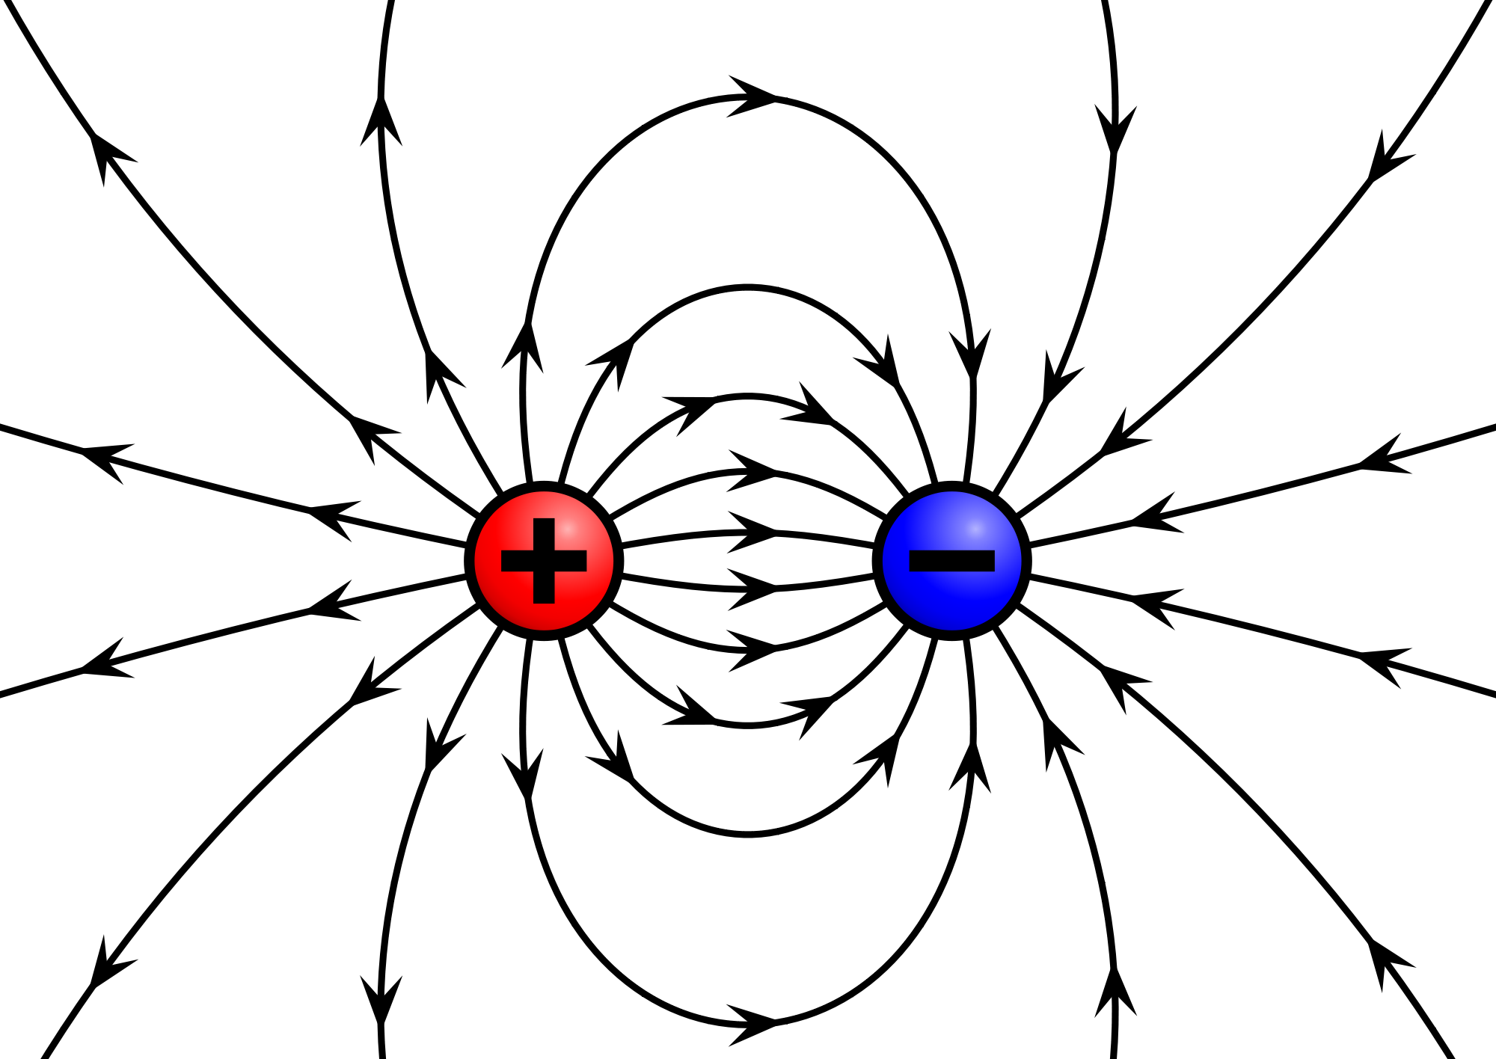
Try This
Label these charges as positive (+) or negative (-)
+
–

Slide 7
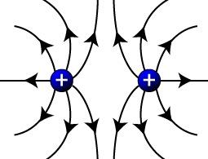
Try This
Predict what the field lines will look like:
+
+

Slide 8
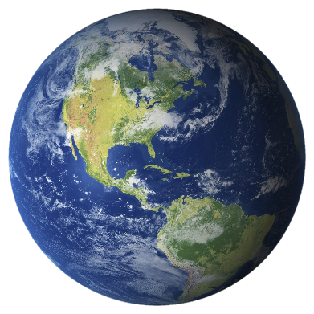
Gravity as a field

Slide 9
Gravity as a field

Slide 10
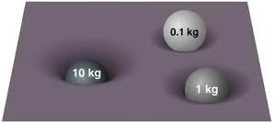
Gravity as a field
The gravitational field distorts the space around the mass that is causing it so that any other mass placed at any position in the field will “know” how to respond immediately.
Bigger masses “curve” the rubber sheet more than smaller masses.

Slide 11
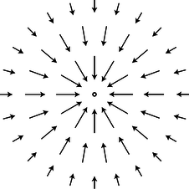
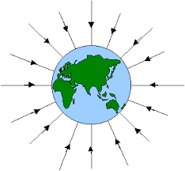
Gravity as a field
How do we visually represent the strength of the field?
Vector Length
Vector Density

Slide 12
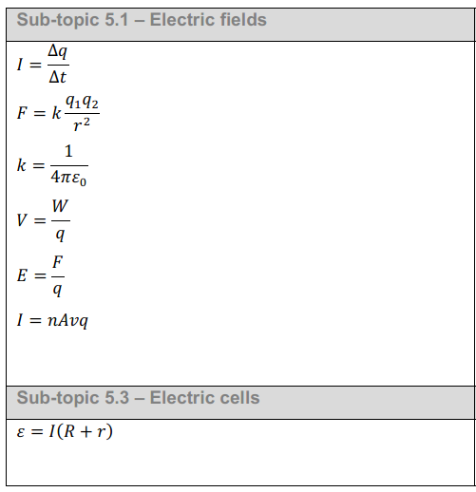
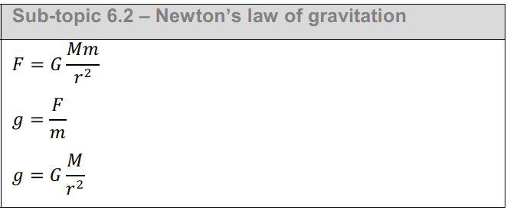
IB Physics Data Booklet

Slide 13
Remember g?
g = 9.81 m s⁻²
g representing acceleration is not the whole story…
g →
Gravitational Field Strength
$$g=\frac{N}{kg}$$
$$=\frac{kg×m s^{−2}}{kg}$$
$$=m s^{−2}$$

Slide 14
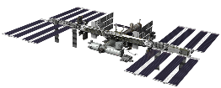
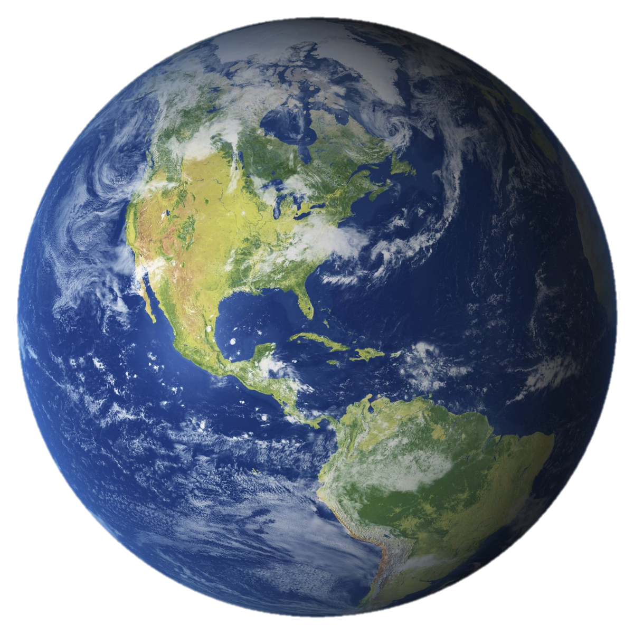
Wait, does that mean g changes?
$$400 km+6370 km=6770 km$$
$$g=G\frac{M}{r^{2}}$$
Orbiting Altitude = 400 km
$$g=G\frac{M}{r^{2}}=(6.67×{10}^{−11})\frac{(6×{10}^{24})}{{(6,770,000)}^{2}}$$
Earth Radius
= 6,370 km
$$g=8.73 N {kg}^{−1}$$
M = 6 × 10²⁴ kg

Slide 15
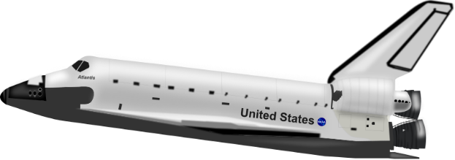
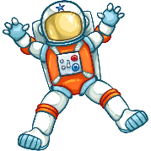
Using g
= 2,000,000 kg
= 75 kg
g = 5 N kg⁻¹
What is the force of gravity for each position?
g = 8 N kg⁻¹
$$F=(75 kg)(5 N {kg}^{−1})$$
$$F=(2,000,000 kg)(5 N {kg}^{−1})$$
$$F=375 N$$
$$F=10,000,000 N$$
$$F=(75 kg)(8 N {kg}^{−1})$$
$$F=(2,000,000 kg)(8 N {kg}^{−1})$$
$$F=600 N$$
$$F=16,000,000 N$$

Slide 16
Try This
What is the electric field strength if a particle with a charge of +6.3 μC experiences a force of 0.0025 N?
$$E=\frac{F}{q}$$
$$=\frac{0.0025 N}{6.3×{10}^{−6} C}$$
$$E=397 N C^{−1}$$

Slide 17
Think about this…
Two isolated point charges, –7 μC and +2 μC, are at a fixed distance apart. At which point is it possible for the electric field strength to be zero?
-7 μC
+2 μC
A
B
C
D
Forces cancel out

Slide 18
Try this
What is the gravitational field strength halfway between the centers of the earth and the moon?
r = 3.8 × 10⁸ m
/ 2 = 1.9 × 10⁸ m
m = 7.3 × 10²² kg
m = 6 × 10²⁴ kg
$$g=\left(6.67×{10}^{−11}\right)\frac{\left(6×{10}^{24}\right)}{{\left(1.9×{10}^{8}\right)}^{2}}=0.011 N {kg}^{−1}$$
$$g=\left(6.67×{10}^{−11}\right)\frac{\left(7.3×{10}^{22}\right)}{{\left(1.9×{10}^{8}\right)}^{2}}=0.00013 N {kg}^{−1}$$
g$=0.011−0.00013=$
$$g=G\frac{M}{r^{2}}$$
$$g=0.0109 N {kg}^{−1}$$
G = 6.67 × 10⁻¹¹ $\frac{N×m^{2}}{{kg}^{2}}$

Slide 19
Try this
Where would an object experience a
gravitational field of 0 N kg⁻¹
$$G\frac{M_{e}}{{r_{e}}^{2}}=G\frac{M_{m}}{{r_{m}}^{2}}$$
r = 3.8 × 10⁸ m
r_{m} = 3.8 × 10⁸ - r_{e}
r_{e}
r_{m}
m = 7.3 × 10²² kg
m = 6 × 10²⁴ kg
$$\sqrt{G\frac{M_{e}}{{r_{e}}^{2}}}=\sqrt{G\frac{M_{m}}{{r_{m}}^{2}}}$$
$$\frac{\sqrt{6×{10}^{24}}}{r_{e}}=\frac{\sqrt{7.3×{10}^{22}}}{(3.8×{10}^{8}−r_{e}) }$$
cancel out G
and
square root everything
$$\frac{\sqrt{M_{e}}}{r_{e}}=\frac{\sqrt{M_{m}}}{r_{m}}$$
$$\left(9.31×{10}^{20}\right)−\left(2.45×{10}^{12}\right)r_{e}=\left(2.70×{10}^{11}\right)r_{e}$$
$$\left(9.31×{10}^{20}\right)=\left(2.72×{10}^{12}\right)r_{e}$$
$$g=G\frac{M}{r^{2}}$$
G = 6.67 × 10⁻¹¹ $\frac{N×m^{2}}{{kg}^{2}}$
$$r_{e}=3.42×{10}^{8} m$$

