Slide 1
Electromagnetic Force
IB Physics | Force Fields

Slide 2
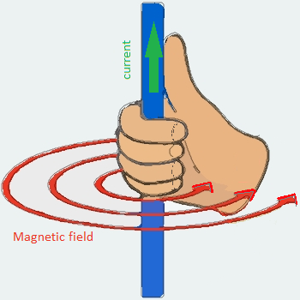
Remember the Right Hand Rule?
Thumb points in direction of the current
Fingers point in direction of the field lines
I
I

Slide 3
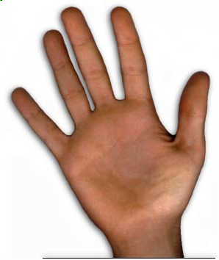
Right Hand Rule #2
Thumb points in direction of the current
Fingers point in direction of the field lines
Palm points in direction of the force
How do you represent a direction that’s perpendicular to the paper?
Into the paper
Out of the paper

Slide 4
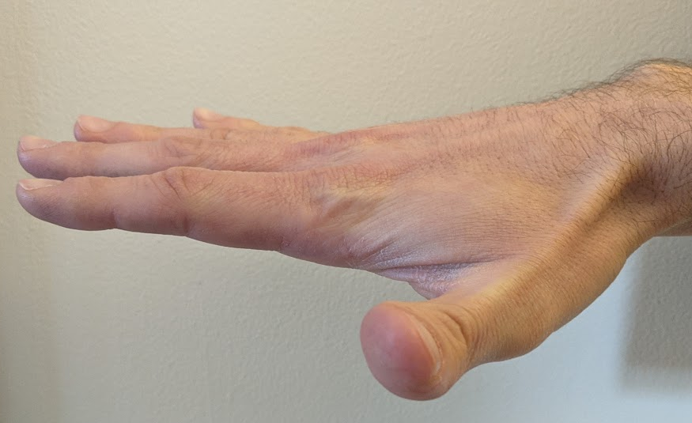
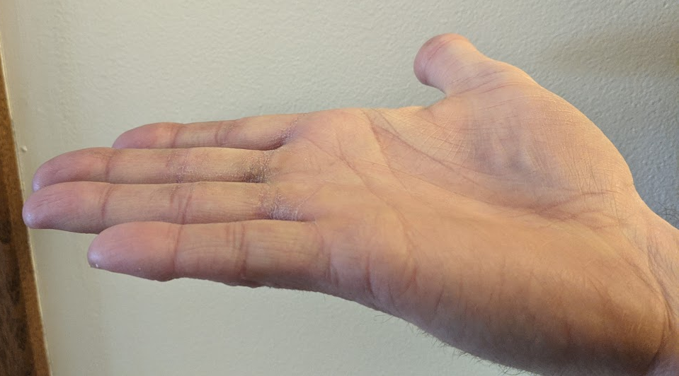
Right Hand Rule #2
A current-carrying wire is placed in a magnetic field and the magnetic field exerts a force on the wire
F
S
N
S
N
F

Slide 5
Designing a Motor
When electric current is passed through a magnetic field, you get ____________
motion
S
N

Slide 6
Motors vs Generators
Electric Motors convert
Electricity
Motion
Electric Generators convert
Motion
Electricity

Slide 7
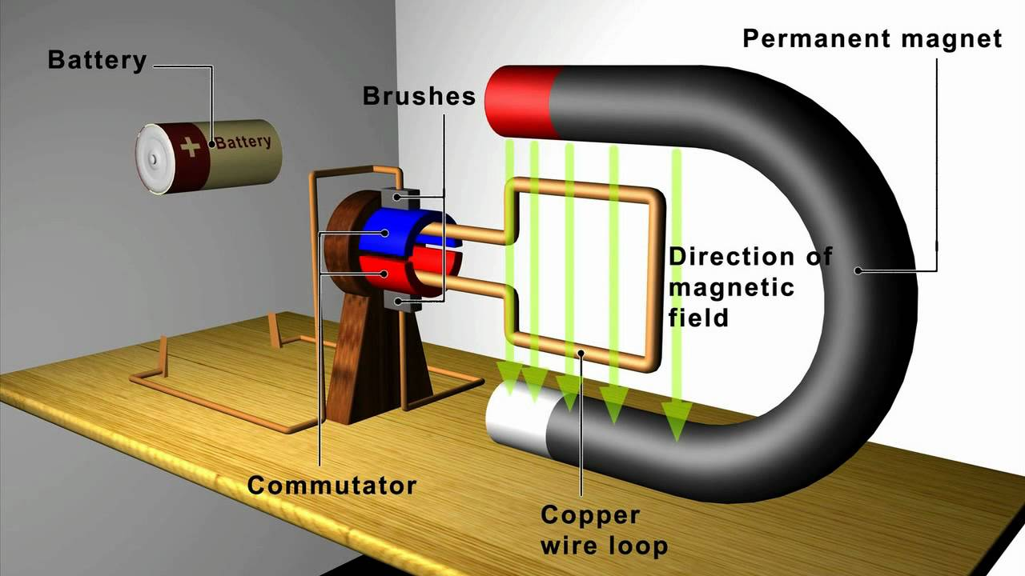
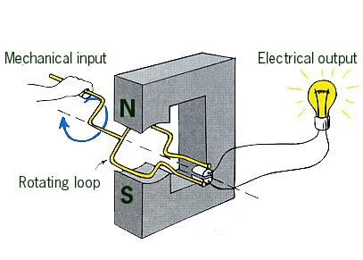
Examples

Slide 8
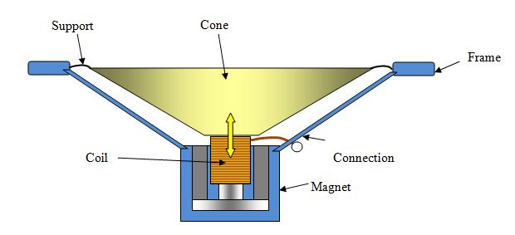
Speakers
F
S
N
S
N
F

Slide 9
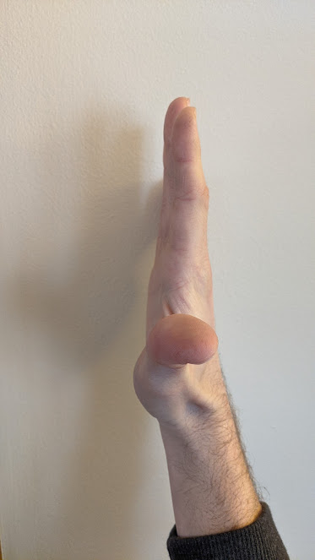
Definition of the Ampere
Consider two parallel wires, with current in the same direction. Do they attract or repel??
F
F
**One ampere is defined as the current that would cause a force of 2 × 10⁻⁷ N per meter between two long parallel conductors separated by 1 m in a vacuum

Slide 10
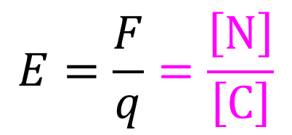
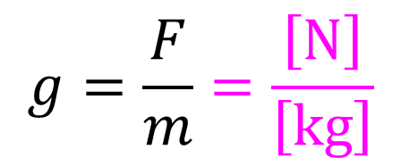
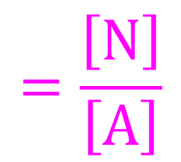
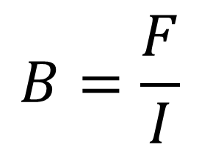
Fields
Gravitational Field
Magnetic Field
$$g=\frac{F}{m}=\frac{\left[N\right]}{\left[kg\right]}$$
$$B=\frac{F}{I}$$
$$=\frac{\left[N\right]}{\left[A\right]}$$
$$=\left[T\right]$$
Electric Field
$$E=\frac{F}{q}=\frac{\left[N\right]}{\left[C\right]}$$

Slide 11
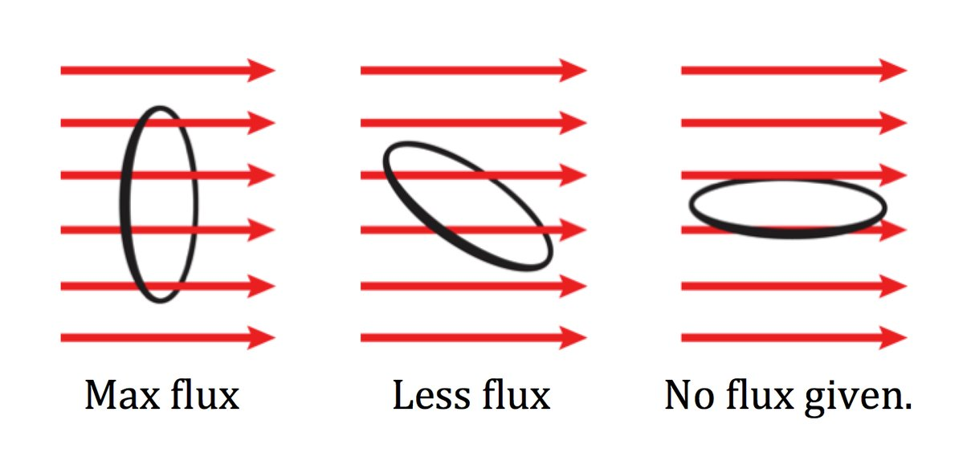
Magnetic Flux
The magnetic field strength is sometimes referred to as magnetic flux and depends on how perpendicular the current is in relation to the field direction

Slide 12
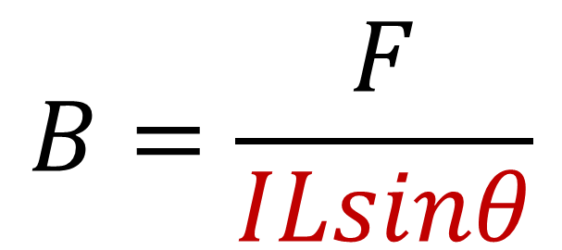
Magnetic field Strength
Current, I
$$B=\frac{F}{ILsinθ}$$
θ
Length of wire in field, L
θ
The force on the wire is proportional to the charge moving perpendicular to the field. Because of these the perpendicular component must be used in the calculation
Angle between field and current

Slide 13
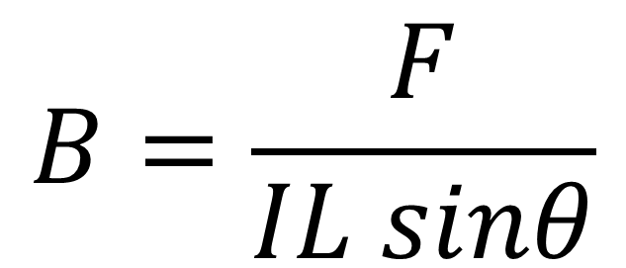
Fields
$$B=\frac{F}{IL sinθ}$$
$$F=BIL sinθ$$
F | Magnetic force Newtons [N]
B | Magnetic field strength Tesla [T]
I | Current Amperes [A]
L | Length of conductor in uniform magnetic field
θ | Angle between magnetic field and current

Slide 14
IB Physics Data Booklet

Slide 15
Try This…
A current of 3.8 A in a long wire experiences a force of 5.7 × 10⁻³ N when it flows through a magnetic field of strength 25 mT. If the length of wire in the field is 10 cm, what is the angle between the field and current?
$$F=BIL sinθ$$
$$θ=\sin^{−1}\left(\frac{F}{BIL}\right)$$
$$=\sin^{−1}\left(\frac{(5.7×{10}^{−3})}{(25×{10}^{−3})(3.8)(0.1)}\right)$$
$$F=5.7×{10}^{−3} N$$
$$B=25 mT=25×{10}^{−3} T$$
$$θ=36.87°$$
$$I=3.8 A$$
$$L=10 cm=0.1 m$$

Slide 16
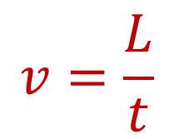
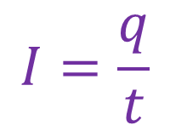
Force on a Charged Particle
When there is a magnetic force on a current carrying wire, the force is really on the moving charges inside of the conductor.
Single charged particles can also experience a magnetic force when moving through a magnetic field…
$$v=\frac{L}{t}$$
$$F=BIL sinθ$$
+
$$F=B\left(\frac{q}{t}\right)\left(vt\right) sinθ$$
$$L=vt$$
$$I=\frac{q}{t}$$
$$F=Bqv sinθ$$

Slide 17
IB Physics Data Booklet

Slide 18
Try This…
What is the magnetic force acting on a proton (+1.6 × 10⁻¹⁹ C) moving at an angle of 32° across a magnetic field of 5.3 × 10⁻³ T at a speed of 3.4 × 10⁵ m s⁻¹?
$$F=qvB sinθ$$
$$F=\left(1.6×{10}^{−19}\right)\left(3.4×{10}^{5}\right)\left(5.3×{10}^{−3}\right)sin32°$$
$$q=1.6×{10}^{−19} C$$
$$F=1.5×{10}^{−16} N$$
$$v=3.4×{10}^{5} m s^{−1}$$
$B=5.3×{10}^{−3} T$
$$θ=32°$$

Slide 19
Particles Moving Across Fields
+
fast
slow
+
magnetic field out of screen
magnetic field into screen
-
-

