Slide 1
Newton’s 2nd Law
IB Physics | Forces

Slide 2
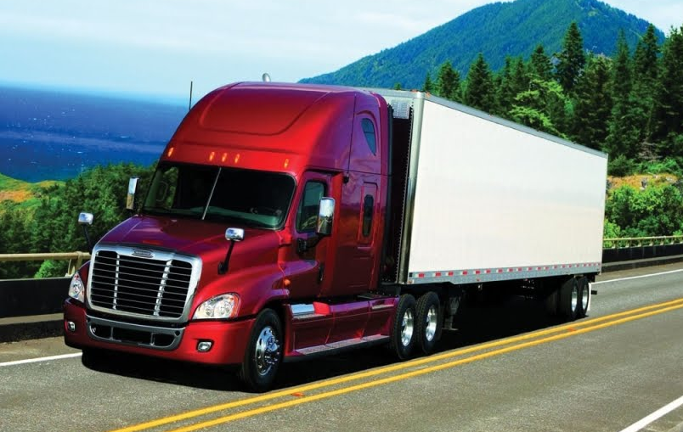
What is Momentum?
An object’s tendency to continue moving
Momentum = m × v

Slide 3



Newton’s Second Law
The rate of change of momentum of a body is directly proportional to the unbalanced force acting on that body and takes place in same direction.
$$F_{net}=\frac{mv−mu}{t}$$
$$=m\left(\frac{v−u}{t}\right)$$
$$=ma$$
$$v=u+at$$
$$F_{net}=ma$$
$$a=\frac{v−u}{t}$$

Slide 4
Newton’s Second Law
Force = mass × acceleration
F
=
m
×
a
Symbols
N
=
kg
×
m s⁻²
Newton
Units

Slide 5



2nd Law | Try This… | #1
Your shiny new motorcycle has an engine capable of 2450 N of force. If it has a max acceleration of 15 m s⁻², what is its mass in kilograms?
$$F=2450 N$$
$$F=ma$$
$$a=15 m s^{−2}$$
$$m=\frac{F}{a}$$
$$=\frac{2450}{15}$$
$$m=163 kg$$

Slide 6

2nd Law | Try This… | #2
How fast is this 100 kg block accelerating?
500 N
400 N
600 N
300 N
100 N
400 N
$$a=\frac{F}{m}$$
$$=\frac{500 N}{100 kg}=5 m s^{−2}$$
200 N

Slide 7
2nd Law | Try This… | #2
How fast is this 100 kg block accelerating?
400 N
500 N
600 N
300 N
100 N
400 N
$$a=\frac{F}{m}=\frac{500 N}{100 kg}=5 m s^{−2}$$
200 N

Slide 8

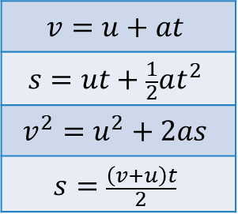
2nd Law is the Bridge
Forces
Motion
$$F=ma$$
$$v=u+at$$
$$s=ut+\frac{1}{2}at^{2}$$
$$v^{2}=u^{2}+2as$$
$$s=\frac{\left(v+u\right)t}{2}$$

Slide 9
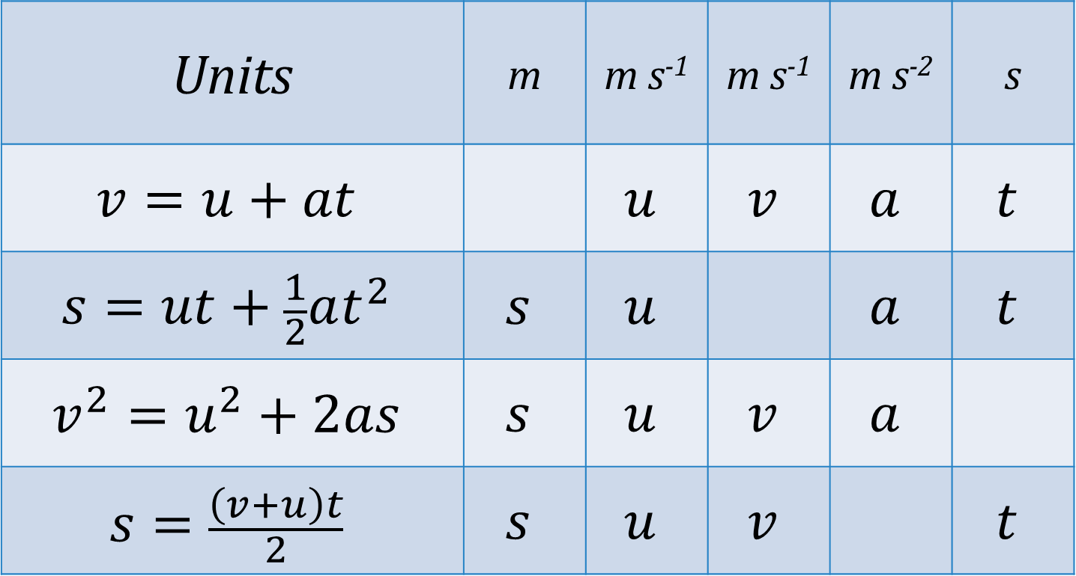
Equations
Units | m | m s⁻¹ | m s⁻¹ | m s⁻² | s
$$v=u+at$$ |  | $$u$$ | $$v$$ | $$a$$ | $$t$$
$$s=ut+\frac{1}{2}at^{2}$$ | $$s$$ | $$u$$ |  | $$a$$ | $$t$$
$$v^{2}=u^{2}+2as$$ | $$s$$ | $$u$$ | $$v$$ | $$a$$
$$s=\frac{\left(v+u\right)t}{2}$$ | $$s$$ | $$u$$ | $$v$$ |  | $$t$$

Slide 10
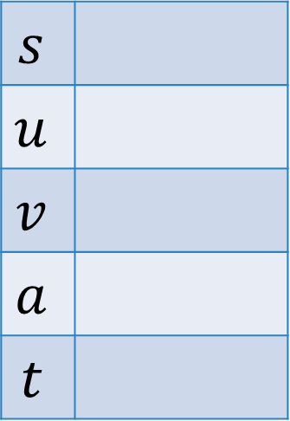
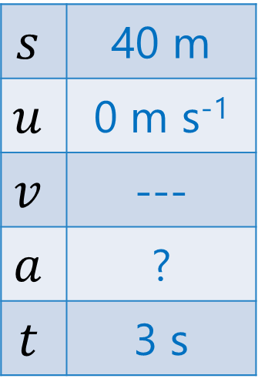
2nd Law | Try This… | #3
A race car has a mass of 710 kg. It starts from rest and travels 40 meters in 3.0 seconds. That car is uniformly accelerated during the entire time. What net force is applied to it?
$$s$$
$$u$$
$$v$$
$$a$$
$$t$$
$$s=ut+\frac{1}{2}at^{2}$$
$$s$$ | 40 m
$$u$$ | 0 m s⁻¹
$$v$$ | ---
$$a$$ | ?
$$t$$ | 3 s
$$40=\frac{1}{2}(a){(3)}^{2}$$
$$F=ma$$
$$a=8.89 m s^{−2}$$
$$F=(710)(8.89)$$
$$F=6311 N$$

Slide 11
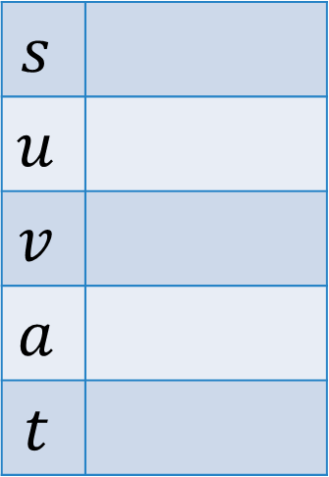
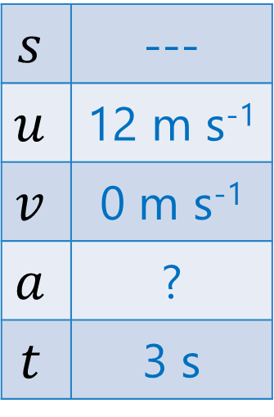
2nd Law | Try This… | #4
You slide a 0.20 kg hockey puck on the ice at a velocity of 12 m s⁻¹. After 3 seconds, the force of friction causes it to stop. What is the force of friction?
$$s$$
$$u$$
$$v$$
$$a$$
$$t$$
$$s$$ | ---
$$u$$ | 12 m s⁻¹
$$v$$ | 0 m s⁻¹
$$a$$ | ?
$$t$$ | 3 s
$$v=u+at$$
$$0=12+a(3)$$
$$F=ma$$
$$a=−4 m s^{−2}$$
$$F=(0.2)(−4)$$
$$F=−0.8 N$$

Slide 12
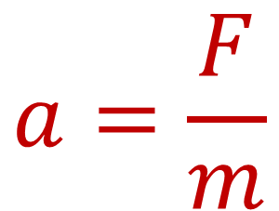
Net Force → Acceleration
Any time there is a net force that is not zero, there will be acceleration in that direction
$$a=\frac{F}{m}$$

Slide 13
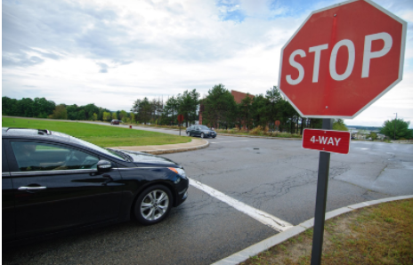
Equilibrium → Acceleration = 0
If the net force is 0 N, then the object is not accelerating.
This can mean two different things:
Not Moving
Constant Velocity

Slide 14
Lesson Takeaways
I can describe Newton’s second law in terms of momentum
I can calculate force given mass and acceleration and calculate acceleration given force and mass
I can combine Newton’s second law with the kinematic equations to solve force/motion problems
I can explain the connection between constant velocity and balanced forces

