Slide 1
Weight, Normal Reaction, & Tension
IB Physics | Forces

Slide 2
Types of Forces | Weight
F = m × a
Newton’s 2nd Law:
F_{g} = m × g
Weight:
F_{g} → Force of Gravity (weight) [N]
m → mass [kg]
g → Acceleration due to Gravity → 9.81 m s⁻²

Slide 3
Mass vs Weight
Mass
Weight
Metric Units
Mass
Weight
kg
Amount of matter
N
Force due to gravity

Slide 4
Types of Forces | Weight
What is your mass in kilograms? (1 kg = 2.2 lbs)
$$m=165 lbs × \frac{1 kg}{2.2 lbs}=75 kg$$
What is your weight in Newtons?
$$F_{g}=mg=(75)(9.81)=736 N$$

Slide 5
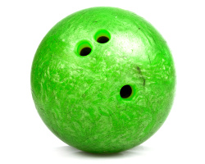
Types of Forces | Normal Reaction
R
R for normal Reaction force
Some sources use F_{N} for “Normal Force”
F_{g}

Slide 6
Types of Forces | Normal Reaction
*Always perpendicular to the surface applying the force
R
F_{g}

Slide 7
Normal Force Depends on Scenario
R = F_{g} = 49 N
F_{T} = 20 N
R = F_{g} – F_{T}
R = 49 – 20
5 kg
5 kg
R = 29 N
F_{g} = 5 × 9.81
F_{g} = 5 × 9.81
F_{g} = 49 N
F_{g} = 49 N

Slide 8
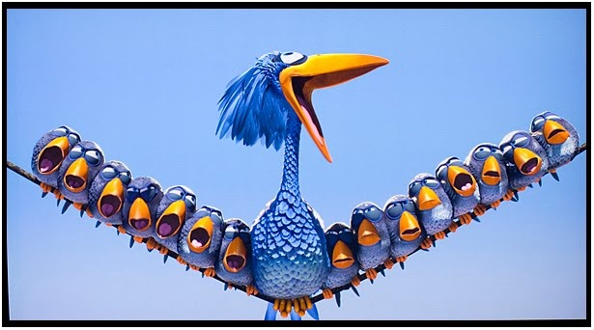
Types of Forces | Tension
F_{T}
*Always pulls in the direction of the rope or chain
100 N

Slide 9
Lesson Takeaways
I can calculate the weight of an object
I can describe the difference between mass and weight
I can use Newton’s third law to describe how to find the normal reaction force with force pairs
I can use a diagram to identify the direction of tension force acting on an object

