Slide 1
Air Resistance
IB Physics | Forces

Slide 2
Air Resistance
constant
Force of gravity is always _________
10 m s⁻¹
F_{g}
30 m s⁻¹
F_{g}
Force of air resistance
__________ when
velocity increases
50 m s⁻¹
increases
F_{g}

Slide 3
Calculate the Acceleration
100 N
400 N
700 N
10 m s⁻¹
30 m s⁻¹
50 m s⁻¹
70 kg
70 kg
70 kg
700 N
700 N
700 N
F_{net} = 600 N
F_{net} = 300 N
F_{net} = 0 N
$$a=\frac{F}{m}$$
$$=\frac{600}{70}=8.57 m s^{−2}$$
$$a=\frac{300}{70}=4.29 m s^{−2}$$
$$a=\frac{0}{70}=0 m s^{−2}$$

Slide 4
Terminal Velocity
At a certain velocity, the air resistance acting on an object (or person) is equal to the force of gravity.
F_{air resistance}
50 m s⁻¹
0 N
F_{net} =
F_{gravity}
This is the top speed for a falling object

Slide 5
Motion Graphs Guide
Constant Displacement
Constant
+ Velocity
Constant
- Velocity
+ Acceleration
Speeding up
+ Acceleration
Slowing Down
- Acceleration
Speeding up
- Acceleration
Slowing Down
d
v

Slide 6
Terminal Velocity
Terminal Velocity
Displacement (m)
Terminal Velocity
Velocity (m s⁻¹)
Time (s)
Time (s)
Note: these graphs treat the downward direction as positive

Slide 7
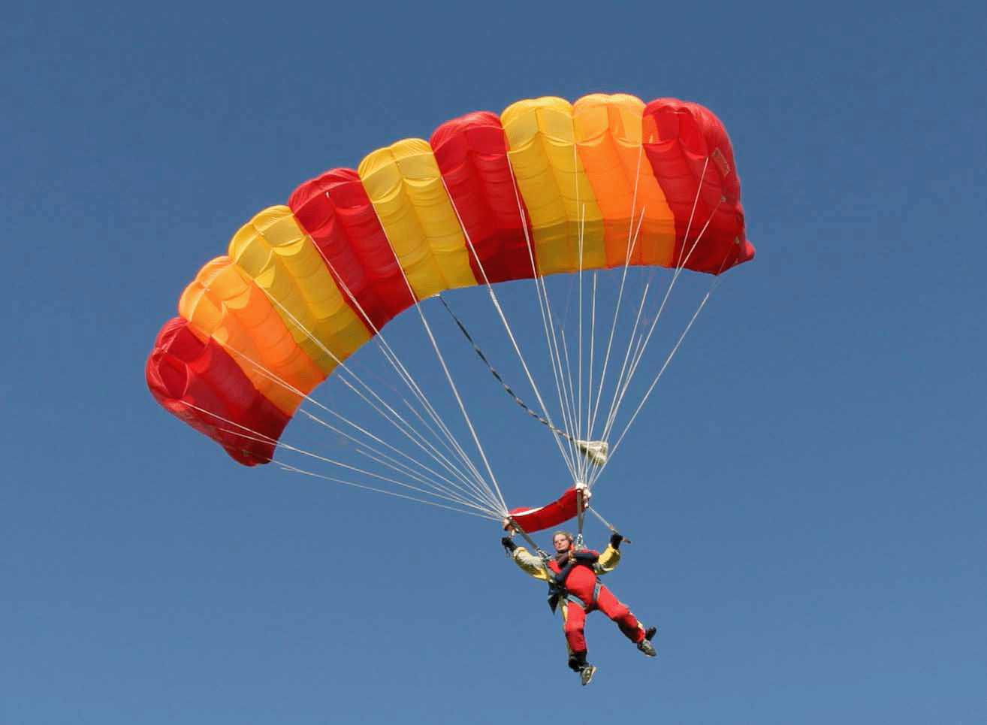
When the Parachute opens…
1200 N
1000 N
700 N
50 m s⁻¹
25 m s⁻¹
8 m s⁻¹
70 kg
70 kg
70 kg
700 N
700 N
700 N
F_{net} = 500 N
F_{net} = 300 N
F_{net} = 0 N
$$a=\frac{F}{m}=\frac{500}{70}=7.14 m s^{−2}$$
$$a=\frac{300}{70}=4.29 m s^{−2}$$
$$a=\frac{0}{70}=0 m s^{−2}$$

Slide 8
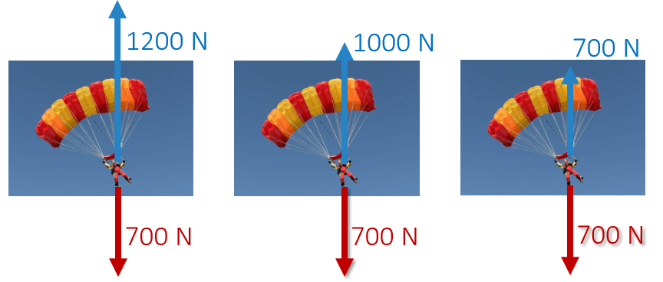
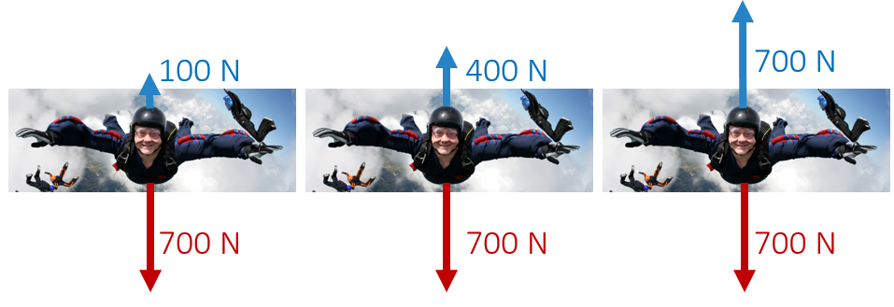
Terminal Velocity
50 m/s
Velocity (m s⁻¹)
8 m/s
Time (s)

Slide 9
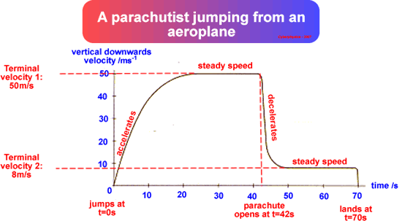
Terminal Velocity
F_{air resistance}
A parachute dramatically decreases the terminal velocity where air resistance balances out the weight
8 m s⁻¹
F_{gravity}

Slide 10
Sample IB Problem
An object falls vertically from rest. Air resistance acts on the object and it reaches a terminal speed. Which of the following is the distance-time graph for its motion?

Slide 11
Sample IB Problem

Slide 12
Sample IB Problem
Constant
Displacement (m)
Increasing
Time (s)

Slide 13
Lesson Takeaways
I can describe the factors that affect air resistance and how the resistance changes with velocity
I can define Terminal Velocity in terms of net force
I can graph the change in position and velocity for an object falling with air resistance and reaching terminal velocity

