Slide 1
FORCES
IB Physics | Completed Notes

Slide 2
Newton’s 1st Law & Net Force
1
IB Physics | Forces

Slide 3
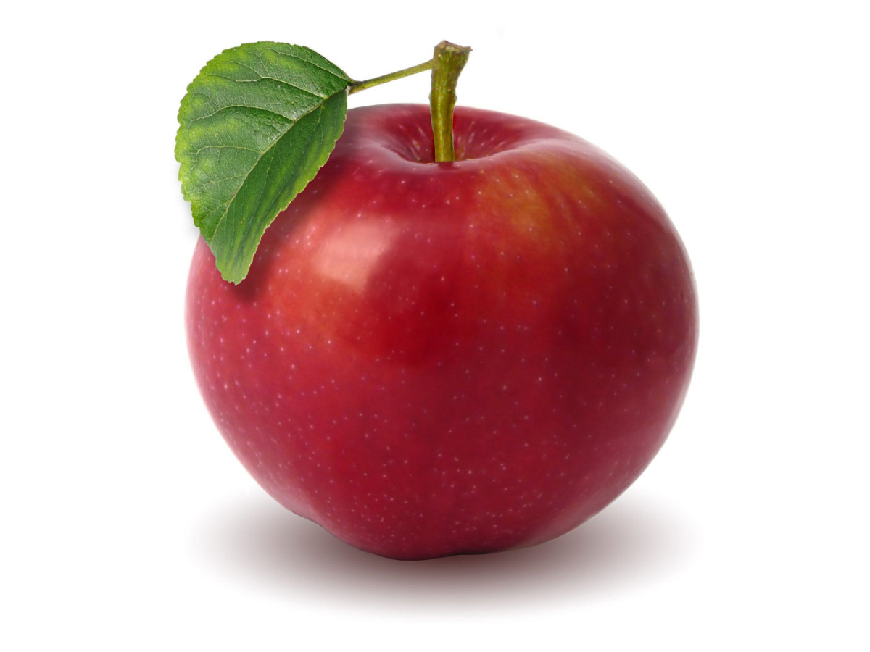
What is a Newton??
Unit of Force
N
= kg × m s⁻²
*An apple weighs about 1 N
1 N

Slide 4
REMINDER: Vector vs Scalar
Vector Quantities | Scalar Quantities
Displacement
Distance
Velocity
Speed
Force
Energy
Can be negative to indicate direction
Only Positive

Slide 5
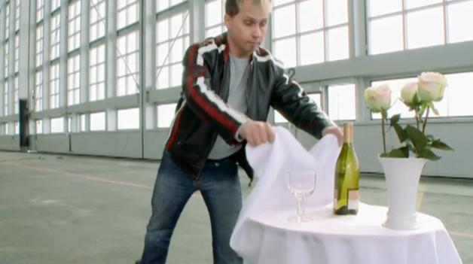
Newton’s First Law
A body will remain at rest or moving with constant velocity unless acted upon by an unbalanced force
“Law of
Inertia”

Slide 6
(Total)
Net Force
The vector sum of all the forces acting on an object
F_{net} =
22 N
20 N
8 N
10 N

Slide 7
Equilibrium
When all forces cancel out, the object is in equilibrium
F_{net} =
0 N
20 N
30 N
10 N

Slide 8
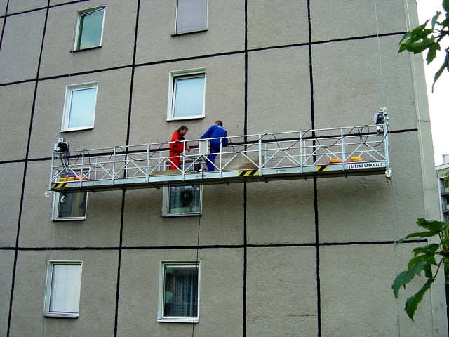
Using Equilibrium
What is the tension force on the second cable if the window washers are in equilibrium?
1350 N
T
$$F_{net}=0 N$$
$$1350+T−750−900−800=0 N$$
750 N
800 N
$$T=1100 N$$
900 N
Weight of Guy #1 = 750 N
Weight of Guy #2 = 800 N
Weight of Platform = 900 N

Slide 9
What is the Net Force? | 1
11 N
10 N
14 N
11 N
F_{net} = 4 N

Slide 10
What is the Net Force? | 2
8 N
14 N
4 N
4
10 N
3
5
3 N
11 N
F_{net} = 5 N

Slide 11
What is the Net Force? | 3
Remember SOHCAHTOA?
x = 20 cos(30) = 17.3 N
y = 20 sin(30) = 10 N
20 N
y
30°
10 N
x
17.3 N
10 N
F_{net} = 17.3 N
10 N

Slide 12
What is the Missing Force?
x = 50 cos(45)
= 35.4 N
y = 50 sin(45)
= 35.4 N
F_{net} = 0 N
50 N
50 N
y
y
45°
35.4 N
35.4 N
35.4 N
35.4 N
45°
x
x
35.4 N
35.4 N
35.4 N
35.4 N
F = 70.8 N
F

Slide 13
Cable Tension
What is the tension of these cables?
30°
30°
Each cable must support half the vertical force if the weight is evenly distributed
F
150 N
30°
F_{T} sin(30) = 150 N
300 N
300 N
300 N
F_{T} = 300 N
300 N

Slide 14
Lesson Takeaways
I can define a force (with proper units) in terms of the interaction between two objects
I can describe Newton’s first law
I can calculate the net force on an object
I can calculate an unknown force for an object in equilibrium

Slide 15
Newton’s 2nd Law
2
IB Physics | Forces

Slide 16
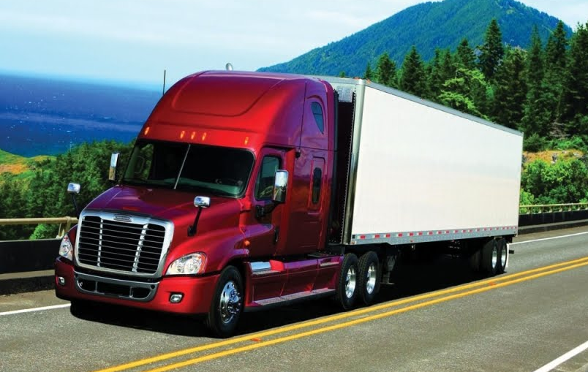
What is Momentum?
An object’s tendency to continue moving
Momentum = m × v

Slide 17
Newton’s Second Law
The rate of change of momentum of a body is directly proportional to the unbalanced force acting on that body and takes place in same direction.
$$F_{net}=\frac{mv−mu}{t}$$
$$=m\left(\frac{v−u}{t}\right)$$
$$=ma$$
$$v=u+at$$
$$F_{net}=ma$$
$$a=\frac{v−u}{t}$$

Slide 18
Newton’s Second Law
Force = mass × acceleration
F
=
m
×
a
Symbols
N
=
kg
×
m s⁻²
Newton
Units

Slide 19
2nd Law | Try This… | #1
Your shiny new motorcycle has an engine capable of 2450 N of force. If it has a max acceleration of 15 m s⁻², what is its mass in kilograms?
$$F=2450 N$$
$$F=ma$$
$$a=15 m s^{−2}$$
$$m=\frac{F}{a}$$
$$=\frac{2450}{15}$$
$$m=163 kg$$

Slide 20
2nd Law | Try This… | #2
How fast is this 100 kg block accelerating?
400 N
500 N
600 N
300 N
100 N
400 N
$$a=\frac{F}{m}=\frac{500 N}{100 kg}=5 m s^{−2}$$
200 N

Slide 21
2nd Law is the Bridge
Forces
Motion
$$F=ma$$
$$v=u+at$$
$$s=ut+\frac{1}{2}at^{2}$$
$$v^{2}=u^{2}+2as$$
$$s=\frac{\left(v+u\right)t}{2}$$

Slide 22
Equations
Units | m | m s⁻¹ | m s⁻¹ | m s⁻² | s
$$v=u+at$$ |  | $$u$$ | $$v$$ | $$a$$ | $$t$$
$$s=ut+\frac{1}{2}at^{2}$$ | $$s$$ | $$u$$ |  | $$a$$ | $$t$$
$$v^{2}=u^{2}+2as$$ | $$s$$ | $$u$$ | $$v$$ | $$a$$
$$s=\frac{\left(v+u\right)t}{2}$$ | $$s$$ | $$u$$ | $$v$$ |  | $$t$$

Slide 23
2nd Law | Try This… | #3
A race car has a mass of 710 kg. It starts from rest and travels 40 meters in 3.0 seconds. That car is uniformly accelerated during the entire time. What net force is applied to it?
$$s$$
$$u$$
$$v$$
$$a$$
$$t$$
$$s=ut+\frac{1}{2}at^{2}$$
$$s$$ | 40 m
$$u$$ | 0 m s⁻¹
$$v$$ | ---
$$a$$ | ?
$$t$$ | 3 s
$$40=\frac{1}{2}(a){(3)}^{2}$$
$$F=ma$$
$$a=8.89 m s^{−2}$$
$$F=(710)(8.89)$$
$$F=6311 N$$

Slide 24
2nd Law | Try This… | #4
You slide a 0.20 kg hockey puck on the ice at a velocity of 12 m s⁻¹. After 3 seconds, the force of friction causes it to stop. What is the force of friction?
$$s$$
$$u$$
$$v$$
$$a$$
$$t$$
$$s$$ | ---
$$u$$ | 12 m s⁻¹
$$v$$ | 0 m s⁻¹
$$a$$ | ?
$$t$$ | 3 s
$$v=u+at$$
$$0=12+a(3)$$
$$F=ma$$
$$a=−4 m s^{−2}$$
$$F=(0.2)(−4)$$
$$F=−0.8 N$$

Slide 25
Net Force → Acceleration
Any time there is a net force that is not zero, there will be acceleration in that direction
$$a=\frac{F}{m}$$

Slide 26
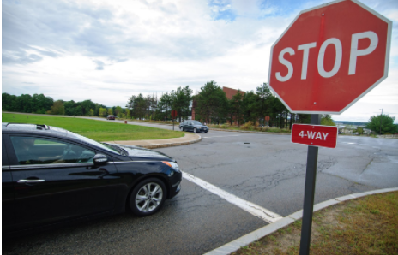
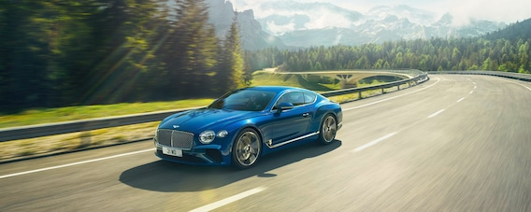
Equilibrium → Acceleration = 0
If the net force is 0 N, then the object is not accelerating.
This can mean two different things:
Not Moving
Constant Velocity

Slide 27
Lesson Takeaways
I can describe Newton’s second law in terms of momentum
I can calculate force given mass and acceleration and calculate acceleration given force and mass
I can combine Newton’s second law with the kinematic equations to solve force/motion problems
I can explain the connection between constant velocity and balanced forces

Slide 28
Weight, Normal Reaction, & Tension
3
IB Physics | Forces

Slide 29
Types of Forces | Weight
F = m × a
Newton’s 2nd Law:
F_{g} = m × g
Weight:
F_{g} → Force of Gravity (weight) [N]
m → mass [kg]
g → Acceleration due to Gravity → 9.81 m s⁻²

Slide 30
Mass vs Weight
Mass
Weight
Metric Units
Mass
Weight
kg
Amount of matter
N
Force due to gravity

Slide 31
Types of Forces | Weight
What is your mass in kilograms? (1 kg = 2.2 lbs)
$$m=165 lbs × \frac{1 kg}{2.2 lbs}=75 kg$$
What is your weight in Newtons?
$$F_{g}=mg=(75)(9.81)=736 N$$

Slide 32
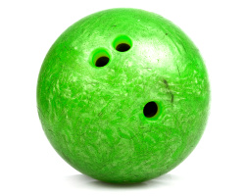
Types of Forces | Normal Reaction
R
R for normal Reaction force
Some sources use F_{N} for “Normal Force”
F_{g}

Slide 33
Types of Forces | Normal Reaction
*Always perpendicular to the surface applying the force
R
F_{g}

Slide 34
Normal Force Depends on Scenario
R = F_{g} = 49 N
F_{T} = 20 N
R = F_{g} – F_{T}
R = 49 – 20
5 kg
5 kg
R = 29 N
F_{g} = 5 × 9.81
F_{g} = 5 × 9.81
F_{g} = 49 N
F_{g} = 49 N

Slide 35
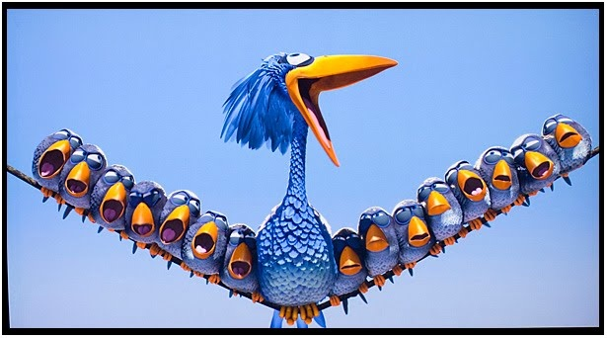
Types of Forces | Tension
F_{T}
*Always pulls in the direction of the rope or chain
100 N

Slide 36
Lesson Takeaways
I can calculate the weight of an object
I can describe the difference between mass and weight
I can use Newton’s third law to describe how to find the normal reaction force with force pairs
I can use a diagram to identify the direction of tension force acting on an object

Slide 37
Friction
4
IB Physics | Forces

Slide 38
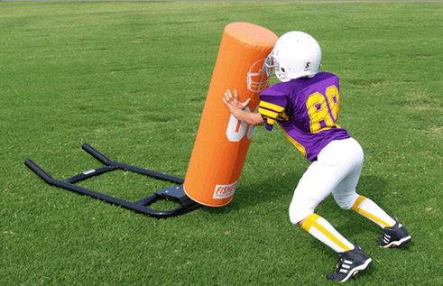
Types of Forces | Friction
F_{f}
*Always opposes motion

Slide 39
What is Friction?
The force ___________ the motion between two objects that are in ___________.
opposing
contact

Slide 40
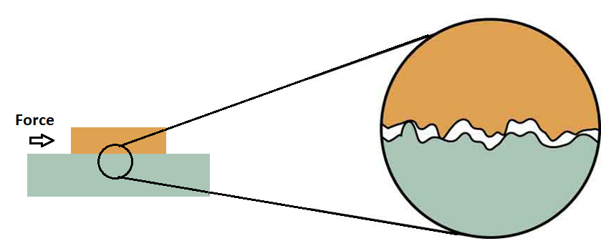
Types of Friction
Static Friction-
Dynamic (Kinetic) Friction-
Not Moving
In Motion
Static > Dynamic

Slide 41
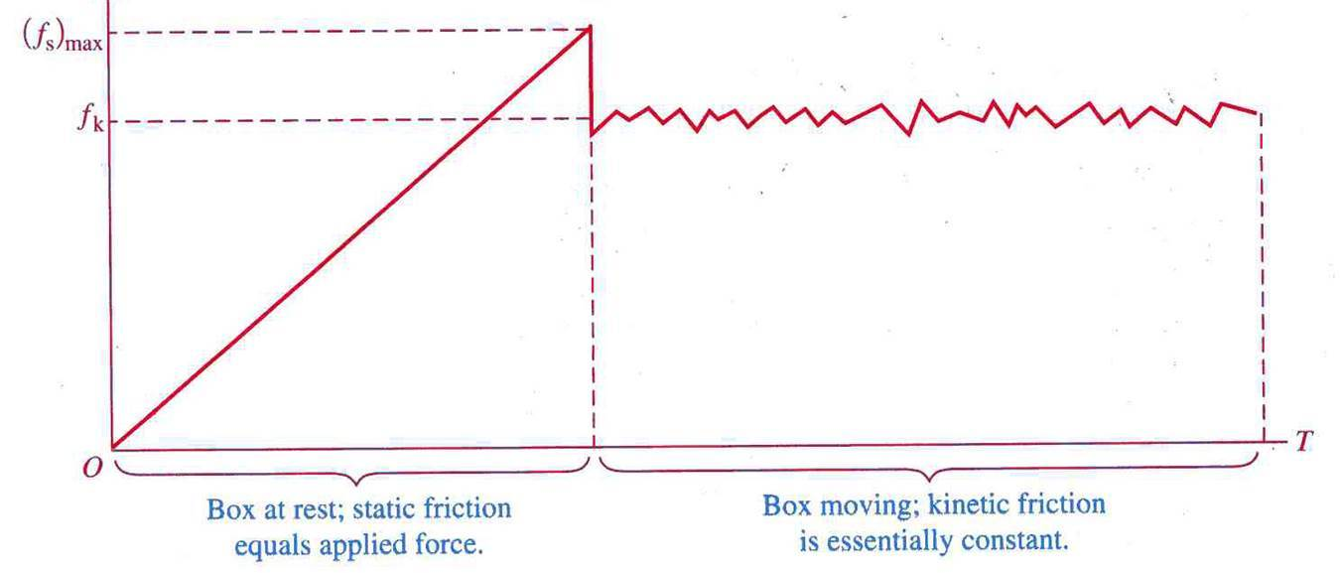
Static vs. Dynamic Friction
Friction decreases once motion starts

Slide 42
How do we Calculate Friction?
F_{f} = μ × R
Normal Reaction Force
Coefficient of Friction
Materials | μ_{s} | μ_{d}
Steel on ice | 0.1 | 0.05
Steel on steel (dry) | 0.6 | 0.4
Steel on steel (greased) | 0.1 | 0.05
Rope on wood | 0.5 | 0.3
Teflon on steel | 0.04 | 0.04
Shoes on ice | 0.1 | 0.05
Climbing boots on rock | 1.0 | 0.8
*unitless
Large μ → “Sticky”
Small μ → “Slippery”

Slide 43
Static Friction
μ_{s}× R calculates the limit of static friction but below that, it will be equal and opposite to external force

Slide 44
Physics Data Booklet
F_{f} = μR

Slide 45
How do we Calculate Friction?
F
F_{g}
R
F_{f}
R
External Force
g = 9.81 m s⁻²
F_{f}
F
mg
*when flat
F_{g}
F_{g}
μR

Slide 46
Calculate Friction | Try This…
Santa’s Sleigh is loaded up with toys for all the good little girls and boys until it has a total mass of 2000 kg. What is the static friction force that must be overcome if µ_{s} is 0.1?
R
F_{g} = mg
= (2000)(9.81) = 19,620 N
R = F_{g}
= 19,620 N
F_{f} = μR
= (0.1)(19,620) = 1,962 N
F_{g}

Slide 47
Calculating Acceleration w/ Friction
Step 1:
Find the Force from Friction
F_{g} = mg
R = F_{g}
F_{f} = μ × R
Step 2:
Find F_{net}
F_{net} = F_{push} - F_{f}
Step 3:
Find acceleration
R
F_{net} = ma
a = F_{net} / m
F_{f}
F_{push}
F_{g}

Slide 48
Calculate Friction | Try This…
Santa’s reindeer pull his 2000 kg sleigh with a force of 4980 N. How fast does the sleigh accelerate if the coefficient of kinetic friction (µ_{k}) is 0.05?
19,620 N
F_{g} = mg = (2000)(9.81) = 19,620 N
R
R = F_{g} = 19,620 N
F_{f}
F_{pull}
F_{f} = μR = (0.05)(19,620) = 981 N
981 N
4,980 N
F_{net}
= 4980 – 981 = 3999 N
F_{g}
a = F/m
= 3999/2000 = 2 m s⁻²
19,620 N

Slide 49
Lesson Takeaways
I can calculate the force of friction when given the reaction force and coefficient of friction
I can quantitatively compare surfaces based on their coefficients of friction
I can calculate the acceleration of an object with friction based on the external force and mass

Slide 50
Air Resistance
5
IB Physics | Forces

Slide 51
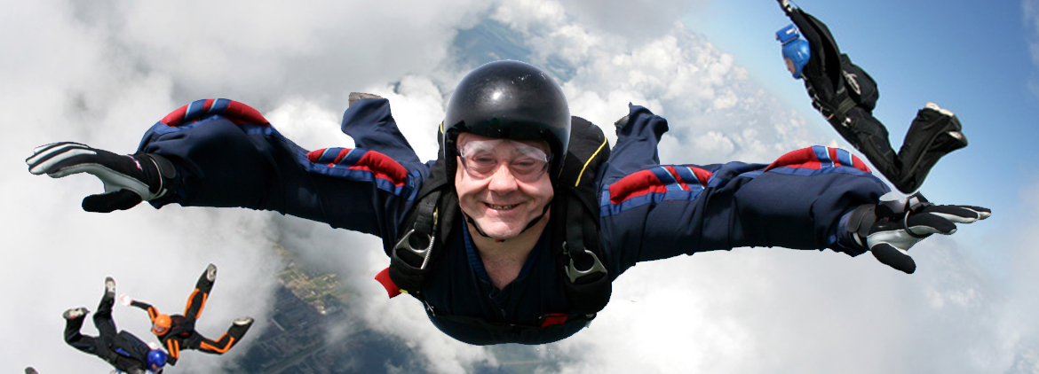
Air Resistance
constant
Force of gravity is always _________
10 m s⁻¹
F_{g}
30 m s⁻¹
F_{g}
Force of air resistance
__________ when
velocity increases
50 m s⁻¹
increases
F_{g}

Slide 52
Calculate the Acceleration
100 N
400 N
700 N
10 m s⁻¹
30 m s⁻¹
50 m s⁻¹
70 kg
70 kg
70 kg
700 N
700 N
700 N
F_{net} = 600 N
F_{net} = 300 N
F_{net} = 0 N
$$a=\frac{F}{m}$$
$$=\frac{600}{70}=8.57 m s^{−2}$$
$$a=\frac{300}{70}=4.29 m s^{−2}$$
$$a=\frac{0}{70}=0 m s^{−2}$$

Slide 53
Terminal Velocity
At a certain velocity, the air resistance acting on an object (or person) is equal to the force of gravity.
F_{air resistance}
50 m s⁻¹
0 N
F_{net} =
F_{gravity}
This is the top speed for a falling object

Slide 54
Motion Graphs Guide
Constant Displacement
Constant
+ Velocity
Constant
- Velocity
+ Acceleration
Speeding up
+ Acceleration
Slowing Down
- Acceleration
Speeding up
- Acceleration
Slowing Down
d
v

Slide 55
Terminal Velocity
Terminal Velocity
Displacement (m)
Terminal Velocity
Velocity (m s⁻¹)
Time (s)
Time (s)
Note: these graphs treat the downward direction as positive

Slide 56
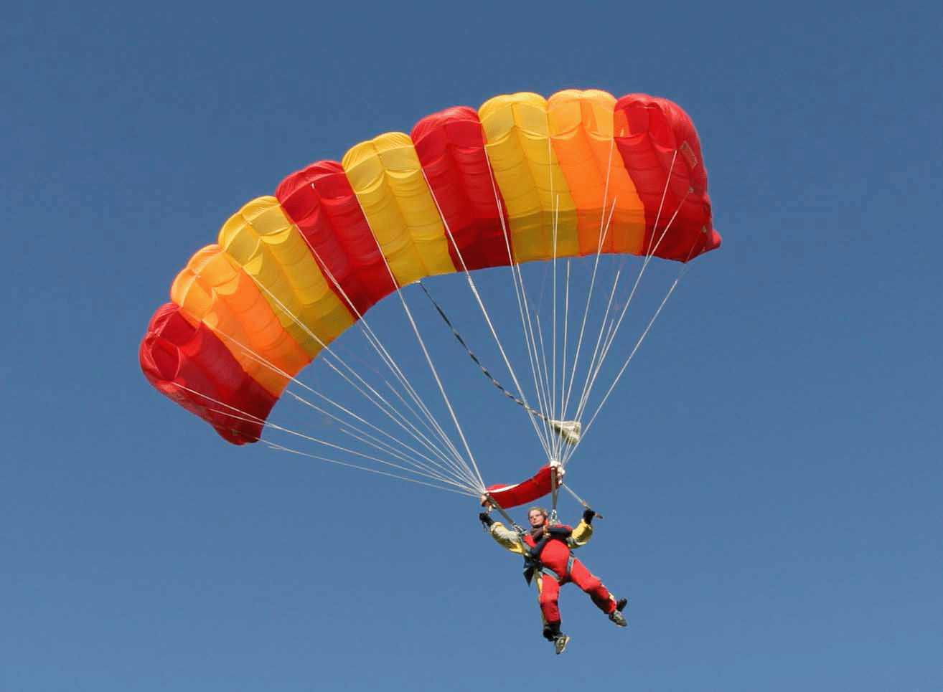
When the Parachute opens…
1200 N
1000 N
700 N
50 m s⁻¹
25 m s⁻¹
8 m s⁻¹
70 kg
70 kg
70 kg
700 N
700 N
700 N
F_{net} = 500 N
F_{net} = 300 N
F_{net} = 0 N
$$a=\frac{F}{m}=\frac{500}{70}=7.14 m s^{−2}$$
$$a=\frac{300}{70}=4.29 m s^{−2}$$
$$a=\frac{0}{70}=0 m s^{−2}$$

Slide 57
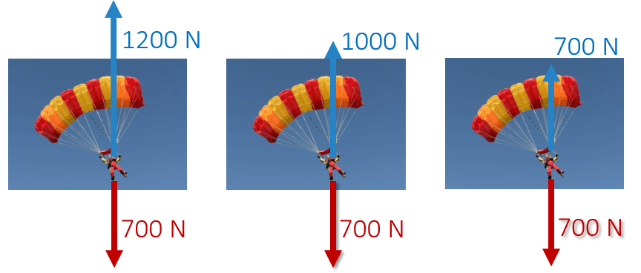
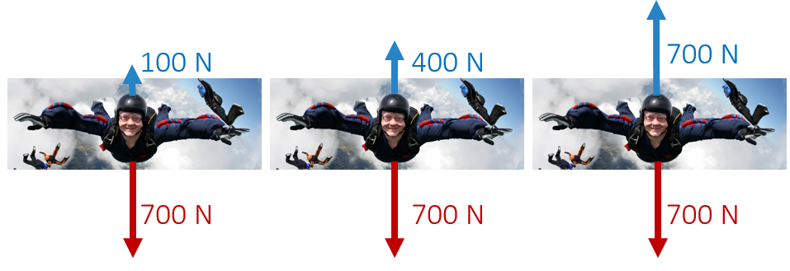
Terminal Velocity
50 m/s
Velocity (m s⁻¹)
8 m/s
Time (s)

Slide 58
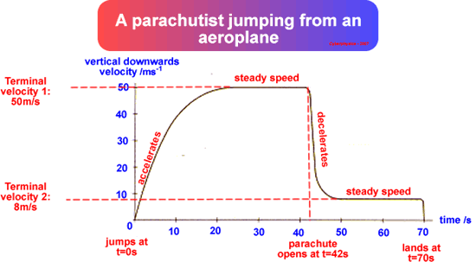
Terminal Velocity
F_{air resistance}
A parachute dramatically decreases the terminal velocity where air resistance balances out the weight
8 m s⁻¹
F_{gravity}

Slide 59
Sample IB Problem
An object falls vertically from rest. Air resistance acts on the object and it reaches a terminal speed. Which of the following is the distance-time graph for its motion?

Slide 60
Sample IB Problem

Slide 61
Sample IB Problem
Constant
Displacement (m)
Increasing
Time (s)

Slide 62
Lesson Takeaways
I can describe the factors that affect air resistance and how the resistance changes with velocity
I can define Terminal Velocity in terms of net force
I can graph the change in position and velocity for an object falling with air resistance and reaching terminal velocity

Slide 63
Forces on a Ramp
6
IB Physics | Forces

Slide 64
Warm up
What is the acceleration of this 10 kg block?
75.1 N
F_{net} = 51.8 N
11.3 N
63.1 N
75.1 N
$$a=\frac{F_{net}}{m}$$
$$=\frac{51.8 N}{10 kg}$$
$$F_{net}=ma$$
$$a=5.18 m s^{−2}$$

Slide 65
Big Ideas so Far….
Acceleration is zero when net force is zero
This doesn’t mean just mean “stopped” (constant velocity)
If you have acceleration of an object, you can find the net force causing that acceleration
(Think F = ma)
Force of friction is related to the normal force by the coefficient of friction (µ)
F_{f} = µR

Slide 66
What Forces are acting?
Force of Friction always opposes motion
R
Normal Reaction Force is always perpendicular to the surface applying the force
F_{f}
What we need to calculate F_{net}
F_{g}
Force of Gravity is always straight down

Slide 67
Components of F_{g}
We try to choose our axes so that we are only looking at forces that are parallel and perpendicular to the motion.
This means that we need to break F_{g} down into components! ☺
sinθ = F∥ / F_{g}
F∥ = F_{g}sinθ
F⊥
F_{g}
θ
F∥
θ
cosθ = F⊥ / F_{g}
F∥
F⊥
θ
F_{g}
F⊥ = F_{g}cosθ

Slide 68
Normal and Friction Forces on Ramp
Normal Reaction Force (R)
Force perpendicular to the surface
R
R = F⊥
F_{f}
Friction Force (F_{f})
F_{f} = μR
F∥
*For Equilibrium
F_{g}
F_{f} = F∥
F⊥
θ

Slide 69
Example IB Question
A wooden block is sliding down an inclined plane at constant speed. The magnitude of the frictional force between the block and the plane is equal to
A. zero.
B. the magnitude of the weight of the block.
C. the magnitude of the component of weight of the block parallel to the plane.
D. the magnitude of the component of the normal reaction parallel to the plane.

Slide 70
Warm up
What is the acceleration of this 10 kg block?
75.1 N
F_{net} = 51.8 N
11.3 N
63.1 N
75.1 N
$$a=\frac{F_{net}}{m}$$
$$=\frac{51.8 N}{10 kg}$$
$$F_{net}=ma$$
$$a=5.18 m s^{−2}$$

Slide 71
Ramp Example
F_{g} = mg
= (10)(9.81) = 98.1 N
m | 10 kg
F_{g}
F⊥
F∥
R
F_{f}
F_{net}
a
F⊥ = F_{g}cosθ
= 98.1 × cos(40) = 75.1 N
98.1 N
F∥ = F_{g}sinθ
= 98.1 × sin(40) = 63.1 N
R = F⊥
75.1 N
= 75.1 N
F_{f} = μR
= (0.15)(75.1) = 11.3 N
63.1 N
F_{net} = 63.1 – 11.3 = 51.8 N
75.1 N
a = F/m
= 51.8/10 = 5.18 m s⁻²
11.3 N
75.1 N
11.3 N
51.8 N
40°
63.1 N
5.18 m s⁻²
75.1 N
40°
μ = 0.15

Slide 72
What if we didn’t know mass?
F_{g} = mg
For this Example…
F⊥ = F_{g}cosθ
= (mg)cosθ
a = (9.81)sin40 – 0.15((9.81)cos40)
F∥ = F_{g}sinθ
= (mg)sinθ
a = 6.31 – 1.13
R = F⊥
a = 5.18 m s⁻²
= (mg)cosθ
F_{f} = μR
= μ((mg)cosθ)
F_{net} = ma
= (mg)sinθ - μ((mg)cosθ)
a = (g)sinθ - μ((g)cosθ)
(mg)cosθ
μ((mg)cosθ)
40°
(mg)sinθ
(mg)cosθ
40°
μ = 0.15

