Slide 1
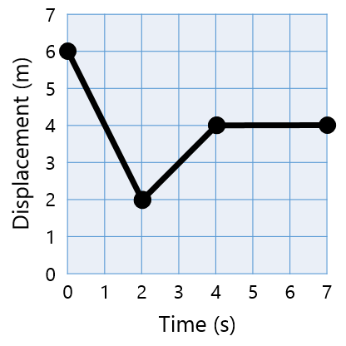
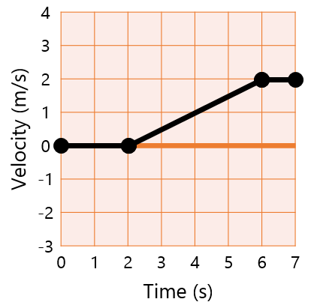
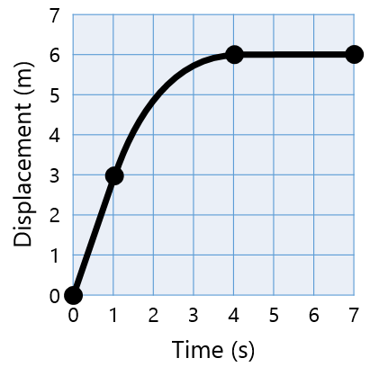
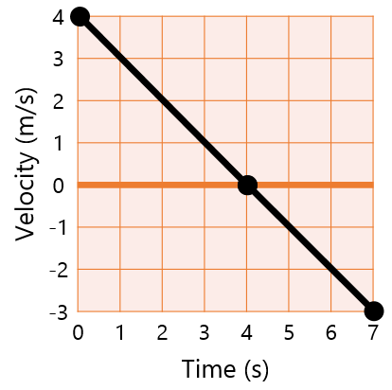
Graphing Motion Walk Around

Slide 2
List a time when the object is not moving
7
6
5
4
3
2
1
0
1
Displacement (m)
0 | 1 | 2 | 3 | 4 | 5 | 6 | 7
Time (s)
Notes:
4-7

Slide 3
What is the total displacement during the interval of 0-7 seconds?
7
6
5
4
3
2
1
0
2
Displacement (m)
0 | 1 | 2 | 3 | 4 | 5 | 6 | 7
Time (s)
Notes:
-2

Slide 4
List a time when the object is moving at its maximum speed
7
6
5
4
3
2
1
0
3
Displacement (m)
0 | 1 | 2 | 3 | 4 | 5 | 6 | 7
Time (s)
Notes:
0-2

Slide 5
List a time when the object is accelerating
4
3
2
1
0
-1
-2
-3
4
Velocity (m/s)
0 | 1 | 2 | 3 | 4 | 5 | 6 | 7
Time (s)
Notes:
2-6

Slide 6
What is displacement during the time interval of 0-7 seconds?
4
3
2
1
0
-1
-2
-3
5
Velocity (m/s)
0 | 1 | 2 | 3 | 4 | 5 | 6 | 7
Time (s)
Notes:
6

Slide 7
What is the velocity at 4 seconds?
4
3
2
1
0
-1
-2
-3
6
Velocity (m/s)
0 | 1 | 2 | 3 | 4 | 5 | 6 | 7
Time (s)
Notes:
1

Slide 8
List a time when the object is accelerating
7
6
5
4
3
2
1
0
7
Displacement (m)
0 | 1 | 2 | 3 | 4 | 5 | 6 | 7
Time (s)
Notes:
1-4

Slide 9
What is the velocity at 6 seconds?
7
6
5
4
3
2
1
0
8
Displacement (m)
0 | 1 | 2 | 3 | 4 | 5 | 6 | 7
Time (s)
Notes:
0

Slide 10
What is the velocity between 0-1 seconds?
7
6
5
4
3
2
1
0
9
Displacement (m)
0 | 1 | 2 | 3 | 4 | 5 | 6 | 7
Time (s)
Notes:
3

Slide 11
At what time does the object change directions?
4
3
2
1
0
-1
-2
-3
10
Velocity (m/s)
0 | 1 | 2 | 3 | 4 | 5 | 6 | 7
Time (s)
Notes:
4

Slide 12
List a time when the object is speeding up
4
3
2
1
0
-1
-2
-3
11
Velocity (m/s)
0 | 1 | 2 | 3 | 4 | 5 | 6 | 7
Time (s)
Notes:
4-7

Slide 13
What is the acceleration represented by the time interval in this graph?
4
3
2
1
0
-1
-2
-3
12
Velocity (m/s)
0 | 1 | 2 | 3 | 4 | 5 | 6 | 7
Time (s)
Notes:
-1

Slide 14
What is the displacement over the time interval 0-4 seconds?
4
3
2
1
0
-1
-2
-3
13
Velocity (m/s)
0 | 1 | 2 | 3 | 4 | 5 | 6 | 7
Time (s)
Notes:
8

Slide 15
What is the displacement over the time interval 0-7 seconds?
4
3
2
1
0
-1
-2
-3
14
Velocity (m/s)
0 | 1 | 2 | 3 | 4 | 5 | 6 | 7
Time (s)
Notes:
3.5

Slide 16
What is the total displacement during the interval of 0-7 seconds?
7
6
5
4
3
2
1
0
15
Displacement (m)
0 | 1 | 2 | 3 | 4 | 5 | 6 | 7
Time (s)
Notes:
1

Slide 17
What is the total distance traveled during the interval of 0-7 seconds?
7
6
5
4
3
2
1
0
16
Displacement (m)
0 | 1 | 2 | 3 | 4 | 5 | 6 | 7
Time (s)
Notes:
5

Slide 18
At what time does the object change directions?
7
6
5
4
3
2
1
0
17
Displacement (m)
0 | 1 | 2 | 3 | 4 | 5 | 6 | 7
Time (s)
Notes:
4

Slide 19
List a time when the object is moving at a constant velocity
4
3
2
1
0
-1
-2
-3
18
Velocity (m/s)
0 | 1 | 2 | 3 | 4 | 5 | 6 | 7
Time (s)
Notes:
5-7

Slide 20
What is the acceleration over the time interval of 0-4 seconds?
4
3
2
1
0
-1
-2
-3
19
Velocity (m/s)
0 | 1 | 2 | 3 | 4 | 5 | 6 | 7
Time (s)
Notes:
0

Slide 21
What is the total displacement over the time interval of 0-7 seconds?
4
3
2
1
0
-1
-2
-3
20
Velocity (m/s)
0 | 1 | 2 | 3 | 4 | 5 | 6 | 7
Time (s)
Notes:
-5

