Slide 1
Circular Motion Scenarios The Curve
IB Physics | Circular Motion

Slide 2
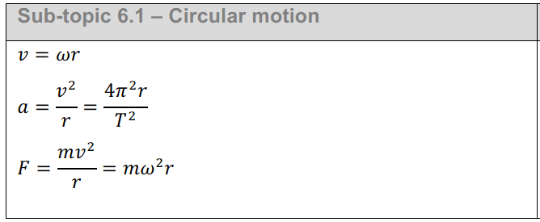
IB Physics Data Booklet
$v$ – linear velocity (m s⁻¹)
$ω$ – angular velocity (rad s⁻¹)
$r$ – radius (m)
$T$ – period (s)
$a$ – centripetal acceleration (m s⁻²)
$F$ – centripetal force (N)

Slide 3
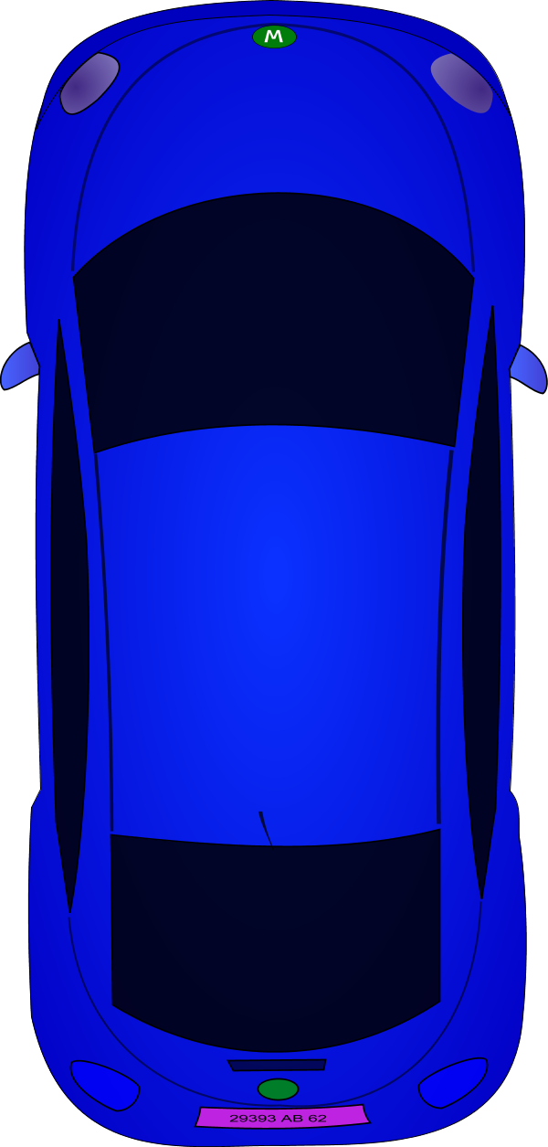
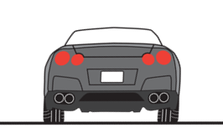
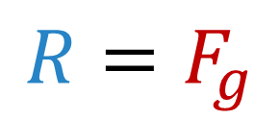
Skidding Around a Curve
v
What is providing the centripetal force causing the car to move around the curve?
Friction
F_{f}
r
R
$$F_{net}=F_{c}=F_{f}$$
F_{f} =μR
$$R=F_{g}$$
F_{g} = mg

Slide 4

Skidding Around a Curve
A car of mass 1240 kg moves around a bend of radius 63 m on a horizontal road at a speed of 18 m s⁻¹. If the car was to be driven any faster there would not be enough friction and it would begin to skid.
What is the coefficient of friction between the road and the tires?
$$m=1240 kg$$
$$F_{net}=F_{c}=F_{f}$$
$$\frac{mv^{2}}{r}=μR$$
$$r=63 m$$
R
$v=18 m s^{−1}$
$$\frac{(1240){(18)}^{2}}{63}=μ(12,164)$$
F_{f} =μR
$$R=F_{g}=mg$$
F_{g} = mg
$$μ=0.52$$
$$=\left(1240\right)\left(9.81\right)=12164 N$$

Slide 5
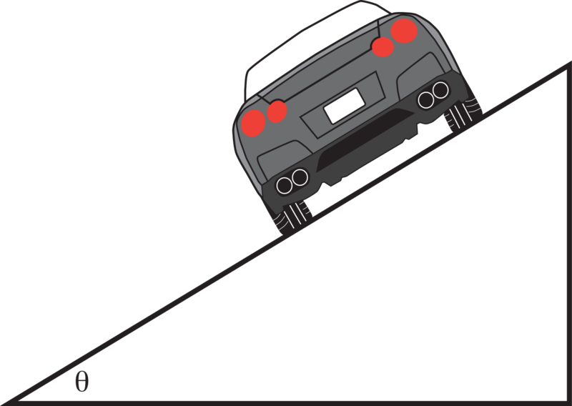
Banked Curve
v
R
R_{y}
R_{x}
F_{f}
F_{f}
R_{x}
r
*The centripetal force creating the circular motion doesn’t rely entirely on friction when a component of the normal force is horizontal

Slide 6
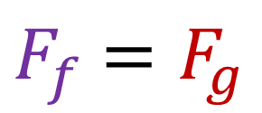
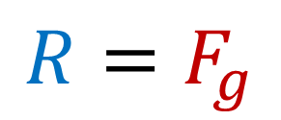
All Together Now!
$F_{f}$ $=F_{g}$
$$R=F_{g}$$
$$F_{c}=R$$
$$F_{c}{=F}_{f}$$
F_{f}
R
R
F_{f}
F_{g}
F_{g}

Slide 7
Lesson Takeaways
I can draw a free body diagram and solve a problem when circular motion is produced by a friction force

