Slide 1
Centripetal Force and Acceleration
IB Physics | Circular Motion

Slide 2
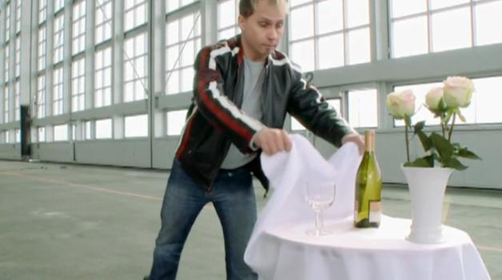
Remember Newton’s 1st?
A body will remain at rest or moving with constant velocity unless acted upon by an unbalanced force
“Law of
Inertia”

Slide 3
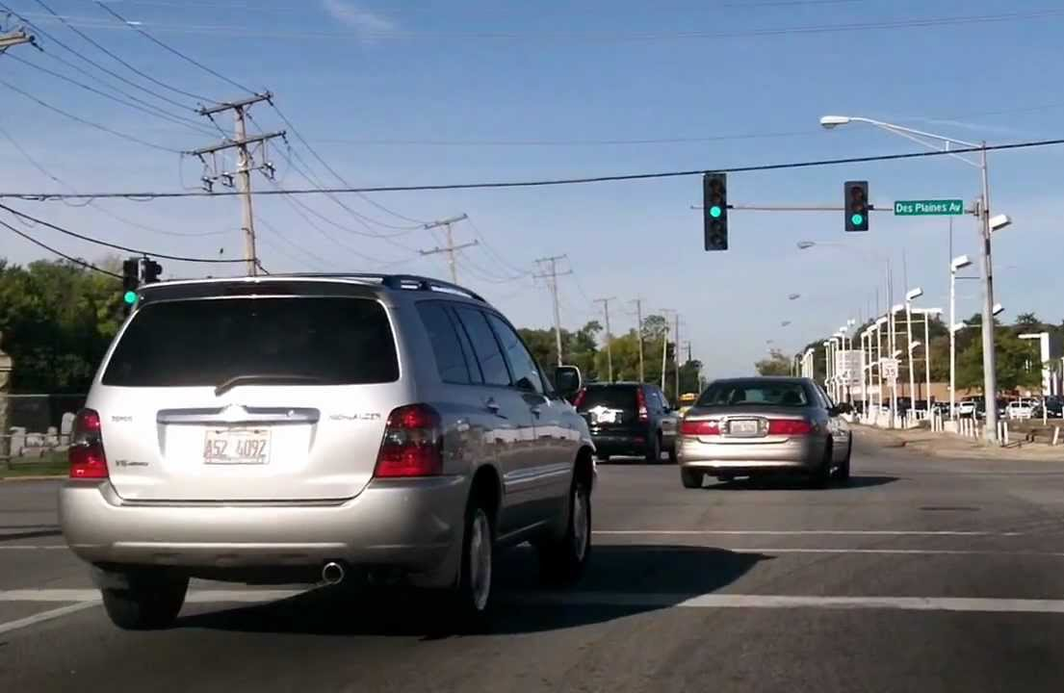
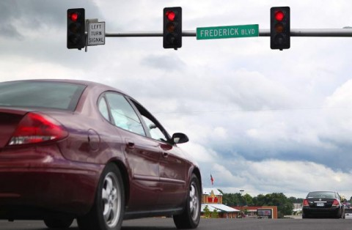
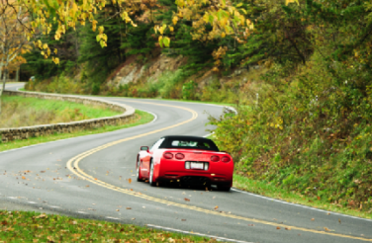
Remember back…
There are 3 ways that an object can be experiencing acceleration?
Speeding Up
Slowing Down
Changing Direction

Slide 4
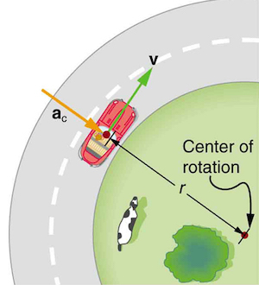
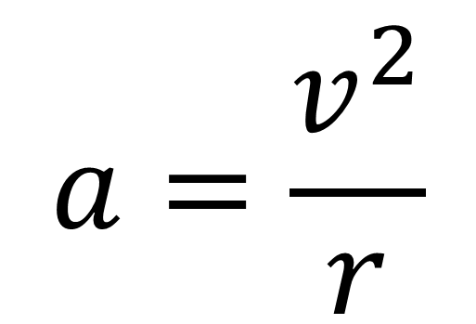
Centripetal Acceleration
Centripetal acceleration represents the rate of change of velocity and its direction
$$a=\frac{v^{2}}{r}$$

Slide 5
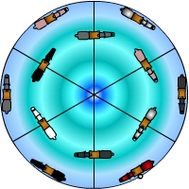
Centripetal Acceleration
Centripetal acceleration can be seen when finding the change between velocity vectors
u
Centripetal acceleration will always point to the
v
a
center

Slide 6
Centripetal Acceleration
Centripetal acceleration can be seen when finding the change between velocity vectors
u
u
Centripetal acceleration will always point to the
v
a
a
v
center

Slide 7


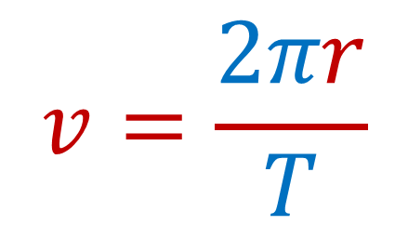
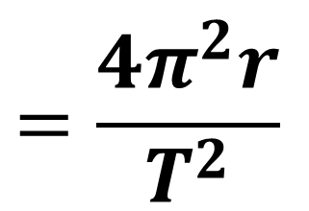
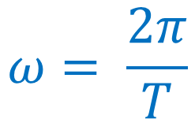

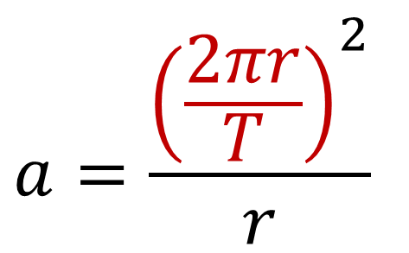
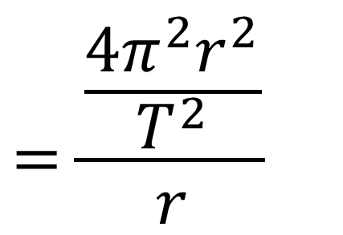
Calculating Centripetal Acceleration
$$v= ωr$$
$$a=\frac{v^{2}}{r}$$
$$v= ωr$$
$$v=\frac{2πr}{T}$$
$$a=\frac{v^{2}}{r}$$
$$ω= \frac{2π}{T}$$
$$a=\frac{{\left(\frac{2πr}{T}\right)}^{2}}{r}$$
$$=\frac{\frac{4π^{2}r^{2}}{T^{2}}}{r}$$
$$=\frac{4π^{2}r^{2}}{T^{2}r}$$
$$=\frac{4π^{2}r}{T^{2}}$$

Slide 8
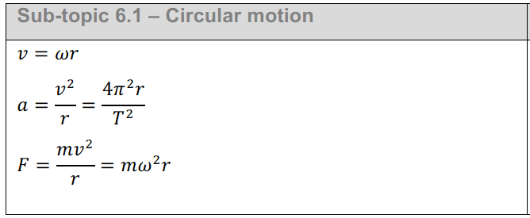
IB Physics Data Booklet

Slide 9
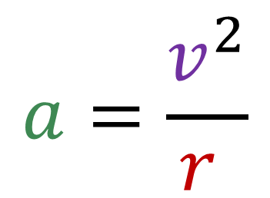
Try this….
A
If the carousel spins at 1 complete rotation every 10 seconds, what is the centripetal acceleration for each row?
2 m
3 m
B
A | ω = 0.63 rad s⁻¹ | v = 1.3 m s⁻¹
B | ω = 0.63 rad s⁻¹ | v = 1.9 m s⁻¹
$$a=\frac{{1.3}^{2}}{2}=0.843 m s^{−2}$$
$$a=\frac{v^{2}}{r }$$
$$a=\frac{{1.9}^{2}}{3}=1.20 m s^{−2}$$

Slide 10
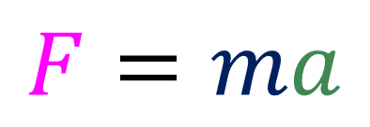
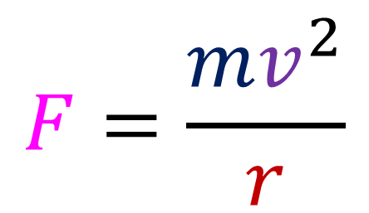
Wait… Where’s the Force?
We know from Newton’s 2nd Law that every time that we have acceleration, there must be a force causing that change in velocity
$$F=ma$$
$$F=\frac{mv^{2}}{r}$$
$$a=\frac{v^{2}}{r }$$

Slide 11


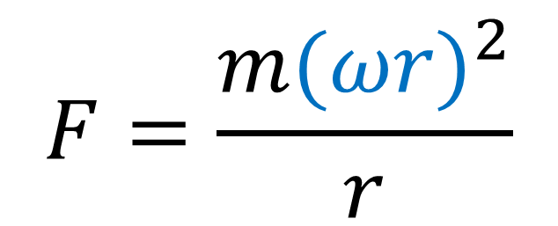
Calculating Centripetal Force
$$F=\frac{{mv}^{2}}{r}$$
$$F=\frac{{mv}^{2}}{r}$$
$$v= ωr$$
$$F=\frac{{m(ωr)}^{2}}{r}$$
$$={mω}^{2}r$$

Slide 12
IB Physics Data Booklet
F = ma

Slide 13
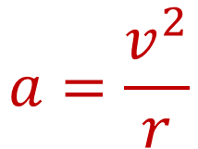
Try This…
A 3 kg rock swings in a circle of radius 5 m. If its constant speed is 8 m s⁻¹, what is the centripetal acceleration and force?
m = 3 kg
r = 5 m
v = 8 m s⁻¹
$$a=\frac{v^{2}}{r}$$
$$=\frac{8^{2}}{5}=12.8 m s^{−2}$$
$$F=ma$$
$$=\left(3\right)\left(12.8\right)=38.4 N$$

Slide 14
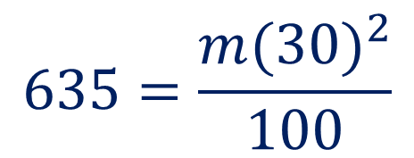
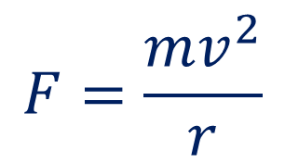
Try This…
A pilot is flying a small plane at 30.0 m s⁻¹ with a radius of 100.0 m. If a force of 635 N is needed to maintain the pilot’s circular motion, what is the pilot’s mass?
v | 30 m s⁻¹
r | 100 m
F | 635 N
m | ?
$$F=\frac{mv^{2}}{r}$$
$$635=\frac{m{(30)}^{2}}{100}$$
$$m=70.56 kg$$

Slide 15
Equation Summary
Velocity
Linear
v → m s⁻¹
Angular
ω → rad s⁻¹
Centripetal Acceleration
a_{c} → m s⁻²
changes direction toward center
Centripetal Force
F = ma
directed toward center
See derived equations

Slide 16
Lesson Takeaways
I can determine the direction and magnitude of centripetal acceleration and centripetal force
I can identify circular motion properties in a description and choose an appropriate equation to relate them

