Slide 1
4
Lamb
13
17
5
7
6
Horse
Chicken
Donkey
11
55
7
0
3
18
8
Level ??
Duckling
5
13

Slide 2
4
Lamb
13
17
5
7
6
Horse
Chicken
Donkey
11
55
7
0
3
18
8
Duckling
Level ??
5
13

Slide 3
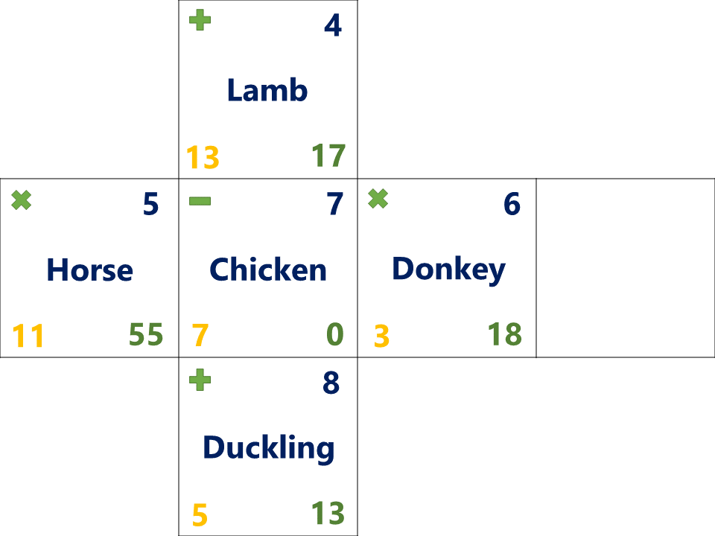
This puzzle is intended to have multiple correct interpretations. The following are some of the patterns that can be used to predict, but this list is not exhaustive
ANSWERS
Top Left: Mathematical operation to match opposite side
Top Right: Consecutive numerical sequence
3, 4, 5, 6, 7, 8 | 4, 5, 6, 7, 8, 9
Bottom Left: odd #’s, prime #’s, or Δ8 with opposite side
Odd: 3, 5, 7, 9, 11, 13 | Prime: 2, 3, 5, 7, 11, 13 | Δ8: 3/11, 5/13, 7/15
Bottom Right: Solution to the calculation incorporating Bottom Left, Top Left, & Top Right
No order can be determined though so the equation could be “(BL)[TL](TR)=“ or “(TR)[TL](BL)=“. This means that a subtraction problem could result in a positive or negative number
Middle: Animal that has the same number of letters as the number in the top right.
There could be other more specific rules decided upon as well (for example: must be a farm animal) to limit the list of possible answers
Some examples of possible solutions:
3
9
3
Level ??
Dog
Crocodile
Cow
15
12
2
7
9
-6

