Slide 1
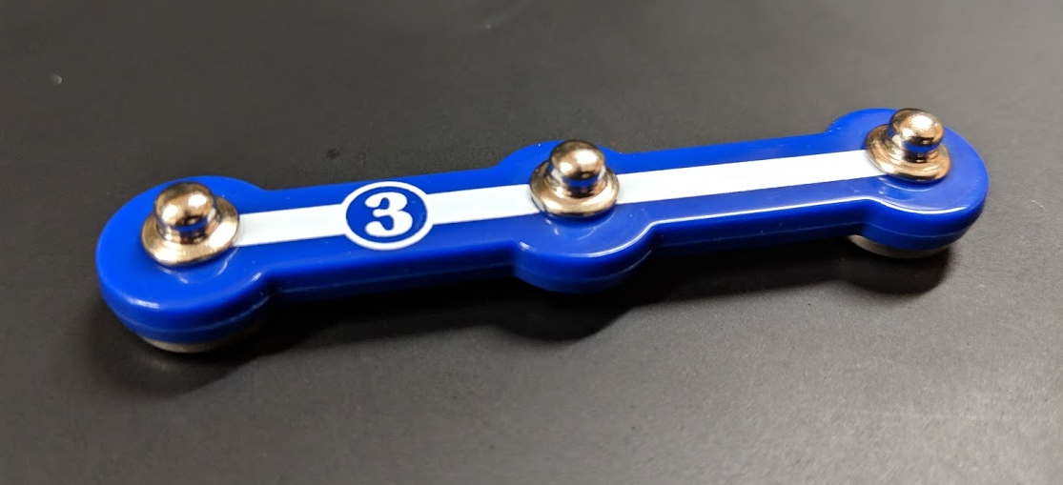
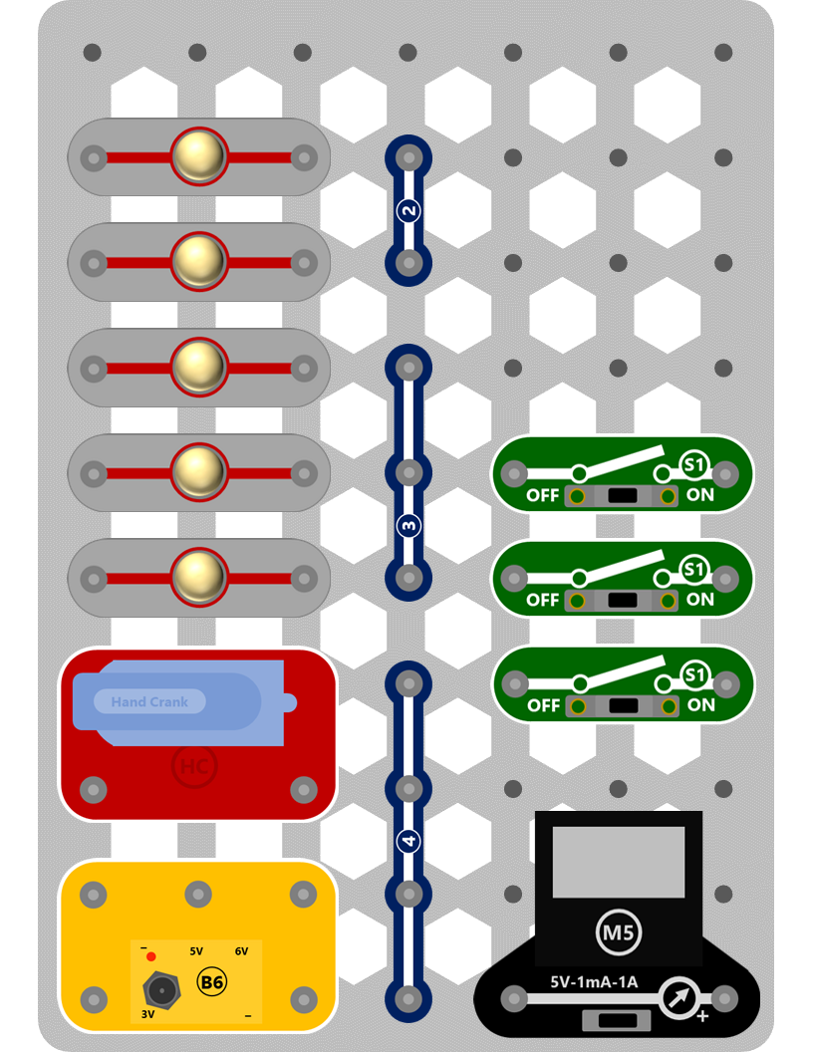
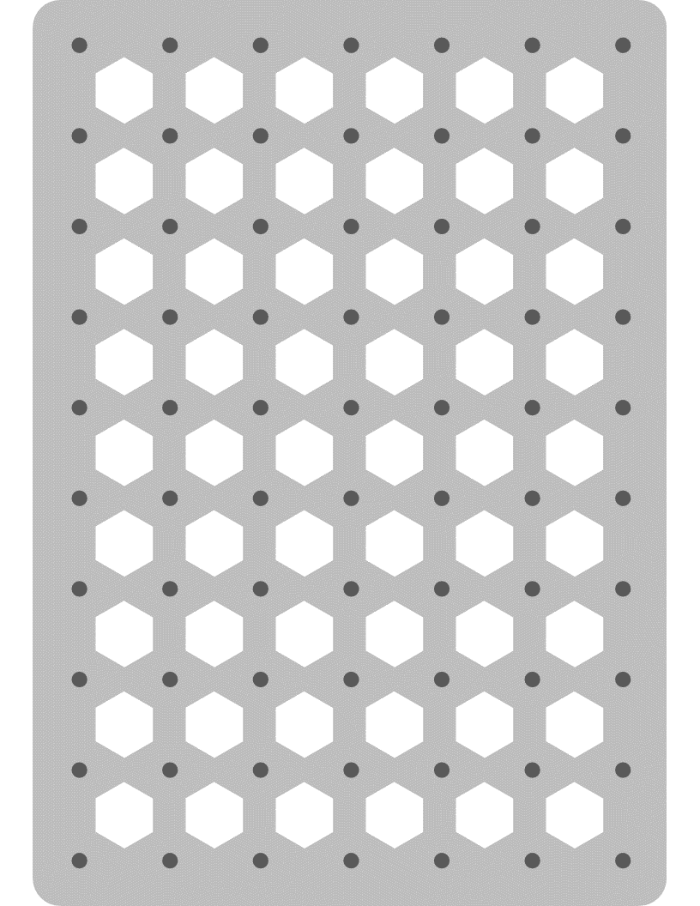
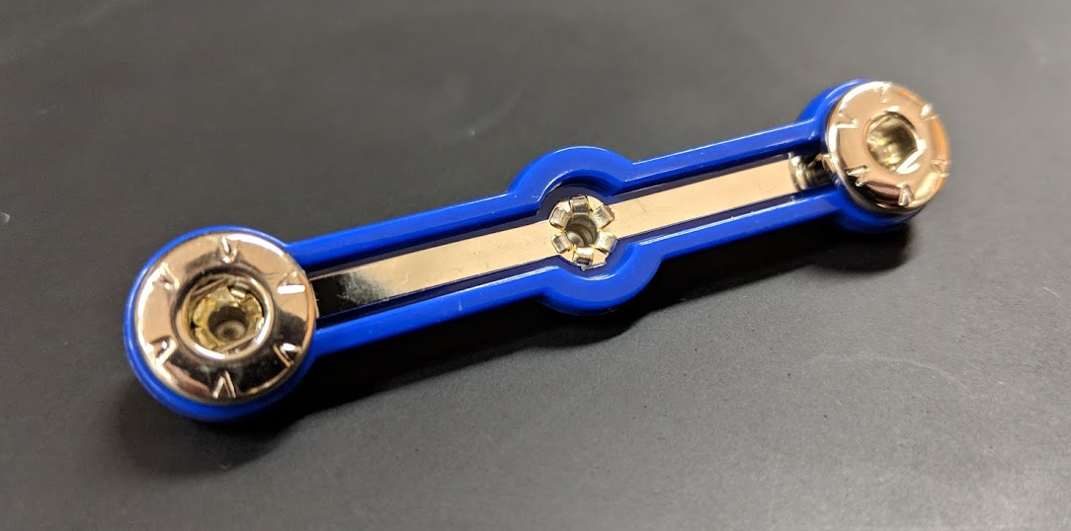
Snap Circuits!
Storage Board
Building Board
When you are done, please snap components back on to the storage board

Slide 2
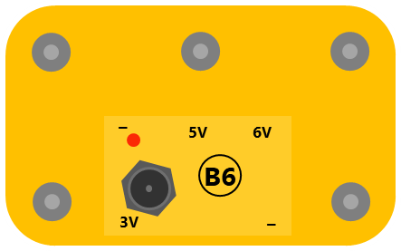
Snap Circuits Challenges
Challenges:
Get two lightbulbs to light up
Build a circuit with two lightbulbs and a switch that turns on/off BOTH bulbs
Build a circuit with two lightbulbs and a switch that turns on/off ONE bulb
Build a circuit with three lightbulbs that are at two different brightness levels
Build a circuit with three lightbulbs that can be independently switched on/off
3 Volts
5 Volts
6 Volts

