Slide 1
Units
IB Physics | Motion

Slide 2
Two Types of Observations
Provide some examples of each
Quantitative
Qualitative
“How Many” / “How Much”
Numerical
Description

Slide 3
Measurement
How can you quantify a measurement?

Slide 4
Systems and Units
Fundamental S.I. Units:
Length
Mass
Time
Electric Current
Temperature
Amount of Substance
Luminous Intensity
Meter
m
Kilogram
kg
Second
s
Ampere (amp)
A
Kelvin
K
Mole
mol
Candela
cd

Slide 5
Units are Arbitrary
Take the history of the meter…
1790 - The length of a pendulum that swings half of its maximum distance in one second
1795 - The length of an official bar of brass fabricated to be exactly one meter as determined in 1791
1889 – The distance between two lines on an official bar of platinum-iridium alloy, measured at 0°C
1791 - The length of one ten-millionth of the distance between the North Pole and the equator
1799 - The length of an official bar of platinum, measured from the brass bar and stored at the French National archives
1983 – The length traveled by light in a vacuum during 1/299,792,458 of a second
1/10,000,000th

Slide 6
What’s ‘the standard’?
All of our base SI units are grounded in some “standard” that helps maintain consistency.
Some of these units even reference each other…
Definition of the Second
The “second” is defined as the interval required for 9,192,631,770 vibrations of the cesium-133 atom measured via an atomic beam clock

Slide 7
Primary and Secondary Colors
Primary Colors
Secondary Colors

Slide 8

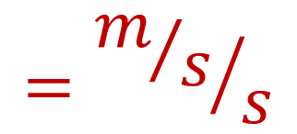
Fundamental vs Derived
Fundamental
S.I. Units
Derived Units
Velocity:
Acceleration:
Force:
$$m/s$$
Length | m
Mass | kg
Time | s
$$={m/s}/s$$
$$m/{s^{2}}$$
$$N$$
$$=kg×m/{s^{2}}$$

Slide 9
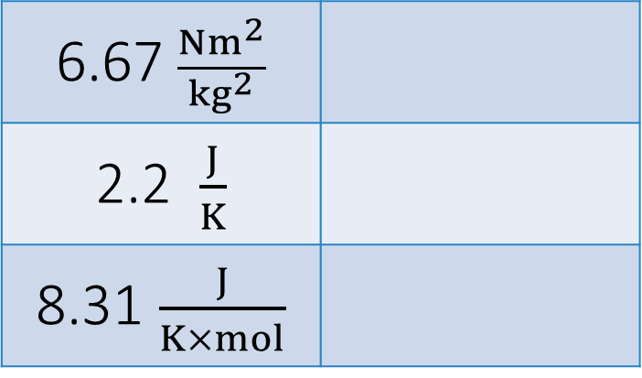
Welcome to IB Land!
Since this course is International all of the units must be in the “European” format rather than the “American” format
This means that instead of writing units with a fraction slash, we must use negative exponents
7 m/s
9.81 m/s²
87 g/cm³
6.67 $\frac{Nm^{2}}{{kg}^{2}}$
2.2 $\frac{J}{K}$
8.31 $\frac{J}{K×mol}$
m s⁻¹
N m² kg⁻²
m s⁻²
J K⁻¹
g cm⁻³
J K⁻¹ mol⁻¹

Slide 10
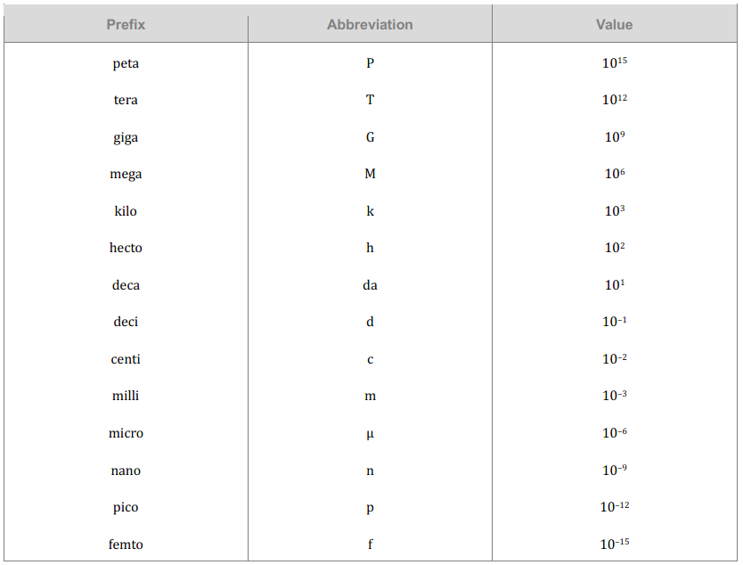
The Metric System
*Taken directly from the IB Physics Data Booklet

Slide 11
The Metric System
P
T
G
M
k
h
da
d
c
m
μ
n
p
f
The value given is the number of places the decimal moves
Please make sure that you go in the correct direction!
900 nm = 900,000,000,000 m
or
900 nm = 0.0000009 m

Slide 12
The Metric System
P
T
G
M
k
h
da
d
c
m
μ
n
p
f
0.0000009
900 nm → _______________ m
900 × 10⁻⁹ m
base
9

Slide 13
The Metric System
Prefix | Abbreviation | Power
giga- | G | 10⁹
mega- | M | 10⁶
kilo- | K | 10³
hecto- | h | 10²
deca- | da | 10¹
Base
deci- | d | 10⁻¹
centi- | c | 10⁻²
milli- | m | 10⁻³
micro- | μ | 10⁻⁶
nano- | n | 10⁻⁹
Conversions:
250 g = kg
0.00325 kg = μg
54 mm = km
0.25
3
3
3
3,250,000
3
6
0.000054

Slide 14
The Metric System | Try These
Prefix | Abbreviation | Power
giga- | G | 10⁹
mega- | M | 10⁶
kilo- | K | 10³
hecto- | h | 10²
deca- | da | 10¹
Base
deci- | d | 10⁻¹
centi- | c | 10⁻²
milli- | m | 10⁻³
micro- | μ | 10⁻⁶
nano- | n | 10⁻⁹
65 μC = C
0.000065
6
12 MW = W
12,000,000
6

Slide 15
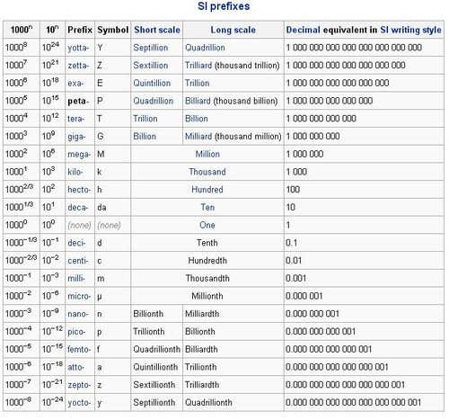
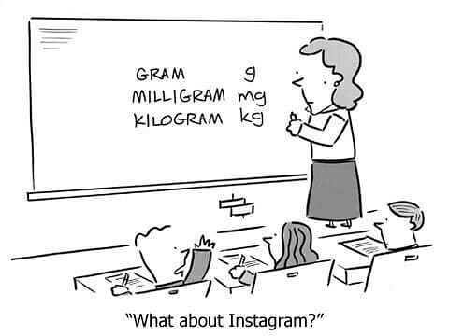
The Metric System
There’s more…

Slide 16
Lesson Takeaways
I can describe the difference between quantitative and qualitative observations
I can identify the 7 Fundamental SI units
I can define and give an example of a derived unit
I can represent fractional units with negative exponents
I can convert metric units between prefixes

