Slide 1
Dimensional Analysis
IB Physics | Motion

Slide 2
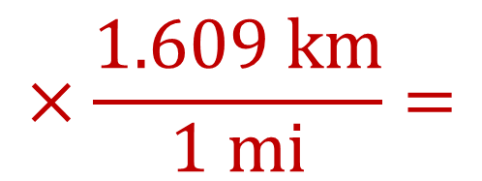
Conversions
Convert the Following:
26.2 miles → kilometers
1 Mile = 1.609 Kilometers
$$×\frac{1.609 km}{1 mi}=$$
$$26.2 mi$$
$$42.2 km$$

Slide 3
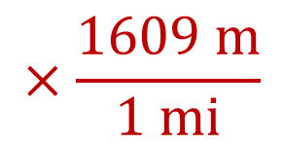
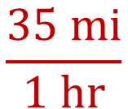
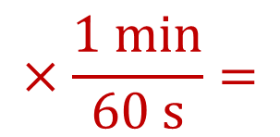

Conversions with fractions
Convert the Following:
35 mi hr⁻¹ → m s⁻¹
1 Mile = 1609 meters
$$\frac{35 mi}{1 hr}$$
$$×\frac{1609 m}{1 mi}$$
$$×\frac{1 hr}{60 min}$$
$$×\frac{1 min}{60 s}=$$
$$15.6 m s^{−1}$$

Slide 4
Conversions with Exponents
How many cm² are there in 1 m²?
$$100×100=$$
$${100}^{2}=$$
$$10,000 {cm}^{2}$$
How many cm³ are there in 1 m³?
$$100×100×100=$$
$${100}^{3}=$$
$$1,000,000 {cm}^{2}$$

Slide 5
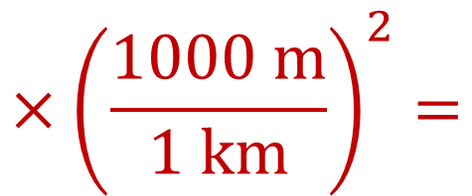
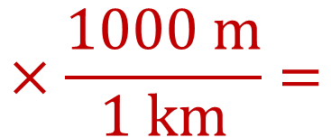
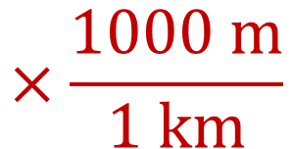
Conversions with Exponents
Convert the Following:
0.05 km² → m²
$$×\frac{1000 m}{1 km}$$
$$×\frac{1000 m}{1 km}=$$
$$0.05 {km}^{2}$$
$$50,000 m^{2}$$
$$0.05 {km}^{2}$$
$$×{\left(\frac{1000 m}{1 km}\right)}^{2}=$$
$$0.05 {km}^{2}$$
$$50,000 m^{2}$$

Slide 6
Conversions with Exponents
Convert the Following:
5 m² → ft²
5 m³ → ft³
1 meter = 3.28 feet
$$5 m^{2} ×\left(\frac{3.28 ft}{1 m}\right)=$$
$$^{2}$$
$$53.8 {ft}^{2}$$
$$5 m^{3} ×\left(\frac{3.28 ft}{1 m}\right)=$$
$$^{3}$$
$$176.4 {ft}^{3}$$

Slide 7
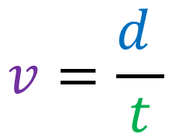
Dimensional Analysis
Start with the formula and substitute units in for variables
$$v=\frac{d }{t}$$
Is this formula valid?
$$d=at$$

Slide 8




Dimensional Analysis
Start with the formula and substitute units in for variables
$$\left[\frac{m}{s}\right]=\frac{\left[m\right]}{\left[s\right]}$$
$$v =\frac{ d }{t}$$
Is this formula valid?
not valid
$$\left[m\right]=\left[\frac{m}{s^{2}}\right]\left[s\right]$$
$$\left[m\right]=\left[\frac{m}{s}\right]$$
$$d = a t$$

Slide 9
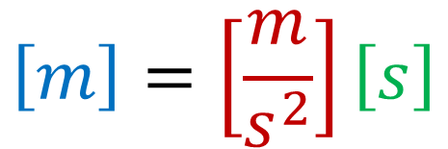
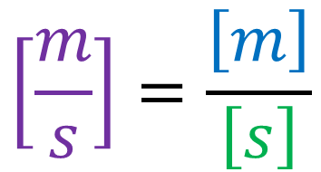

Dimensional Analysis
Start with the formula and substitute units in for variables
$$v=\frac{d }{t}$$
$$\left[\frac{m}{s}\right]=\frac{\left[m\right]}{\left[s\right]}$$
Is this formula valid?
$$\left[m\right]=\left[\frac{m}{s^{2}}\right]\left[s\right]$$
$$d=at$$
not valid
$$\left[m\right]=\left[\frac{m}{s}\right]$$

Slide 10
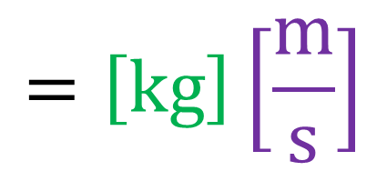
Dimensional Analysis
We can use equations with units that we know to find units that we don’t.
Variable | Unit
Momentum p
Mass m | Kilogram [kg]
Velocity v | Meters per second [ms⁻¹]
$$p=m×v$$
kg m s⁻¹
$$=\left[kg\right]\left[\frac{m}{s}\right]$$

Slide 11
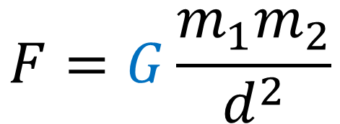
Dimensional Analysis
Constants have units too! That’s what makes our equation valid
Variable | Unit
Force F | Newton [N]
Mass m₁ and m₂ | Kilogram [kg]
Distance d | Meter [m]
Universal Gravitation Constant G
$$F=G\frac{m_{1}m_{2}}{d^{2}}$$

Slide 12
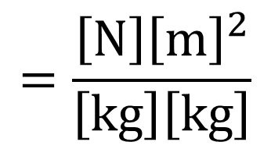
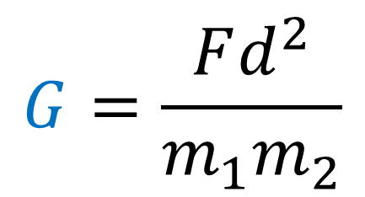
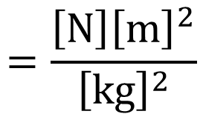
Dimensional Analysis
Constants have units too! That’s what makes our equation valid
$$G=\frac{Fd^{2}}{m_{1}m_{2}}$$
Variable | Unit
Force F | Newton [N]
Mass m₁ and m₂ | Kilogram [kg]
Distance d | Meter [m]
Universal Gravitation Constant G
$$=\frac{\left[N\right]{\left[m\right]}^{2}}{\left[kg\right]\left[kg\right]}$$
$$=\frac{\left[N\right]{\left[m\right]}^{2}}{{\left[kg\right]}^{2}}$$
N m² kg⁻²

Slide 13
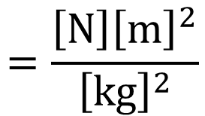
Dimensional Analysis
Constants have units too! That’s what makes our equation valid
Variable | Unit
Force F | Newton [N]
Mass m₁ and m₂ | Kilogram [kg]
Distance d | Meter [m]
Universal Gravitation Constant G | N m² kg⁻²
$$F=G\frac{m_{1}m_{2}}{d^{2}}$$
$$G=\frac{Fd^{2}}{m_{1}m_{2}}=\frac{\left[N\right]{\left[m\right]}^{2}}{\left[kg\right]\left[kg\right]}$$
$$=\frac{\left[N\right]{\left[m\right]}^{2}}{{\left[kg\right]}^{2}}$$

Slide 14
Normalized Scientific Notation
Helpful for very big numbers
89,000,000 =
750,000,000,000 =
8,759,000,000 =
8.9 × 10⁷
or
8.9E7
7.5 × 10¹¹
or
7.5E11
8.759 × 10⁹
or
8.759E9

Slide 15
Normalized Scientific Notation
Helpful for very small numbers
0.00125 =
0.0000008255 =
0.00000082550 =
1.25 × 10⁻³
or
1.25E-3
8.255 × 10⁻⁷
or
8.255E-7
8.2550 × 10⁻⁷
or
8.2550E-7

Slide 16
Lesson Takeaways
I can convert fraction units and exponential units using Dimensional Analysis
I can use dimensional analysis to verify a formula
I can use dimensional analysis to determine the units for a solution
I can represent large and small numbers using scientific notation

