Slide 1
Displacement Graphs
IB Physics | MOtion

Slide 2
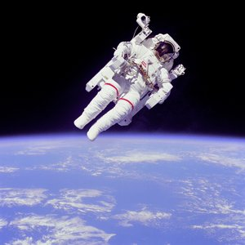
What is Motion?
position
An object's change in _____________ relative to a reference point.
Relative to the earth:
Moving 17,500 mph
Relative to the shuttle:
Not moving

Slide 3
Distance vs. Displacement
Distance
Displacement
How far travelled
How far from origin

Slide 4
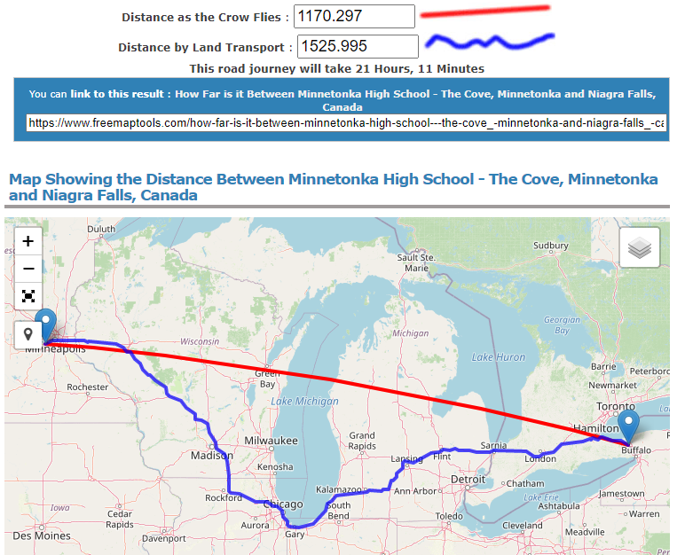
Distance and Displacement in 2D

Slide 5
Try this | Distance and Displacement
You walked 5 km East, turned around and walked 2 km West, turned around again and walked another 4 km East. What is your distance? What is your displacement?
0 | 1 | 2 | 3 | 4 | 5 | 6 | 7 | 8
5
+ 2
+ 4
Distance
Displacement
11 km
7 km

Slide 6
Graphing Displacement
You walked 5 km East, turned around and walked 2 km West, turned around again and walked another 4 miles km. What is your distance? What is your displacement?
7
6
5
4
3
2
1
0
Position (km)
Displacement (km)
Time

Slide 7
Stroboscopic Photographs
In a stroboscopic photograph, a new snapshot is captured every ___ seconds and combined to show the motion over a period of time.
Circle the part of the motion where this soccer ball is moving the FASTEST
New Capture every 0.04 sec
Circle the part of the motion where this soccer ball is moving the SLOWEST

Slide 8
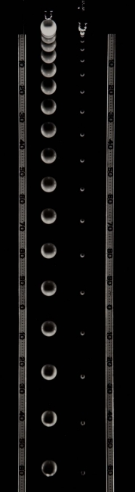
Stroboscopic Photographs
Constant Velocity or Accelerating?
How do you know?
More spacing between pictures = moving faster

Slide 9
Predict the Motion…
Which cart do you think has the best chance of reaching the 10-meter location first?
Time | 0.0 s | 1.0 s | 2.0 s | 3.0 s
Cart A | 0.0 m
Cart B | 2.0 m
Cart C | 3.0 m

Slide 10
Predict the Motion…
Now which cart do you think has the best chance of reaching the 10-meter location first?
Time | 0.0 s | 1.0 s | 2.0 s | 3.0 s
Cart A | 0.0 m | 4.0 m
Cart B | 2.0 m | 4.0 m
Cart C | 3.0 m | 4.0 m
What new information do you have about the carts now that you didn’t before?

Slide 11
Predict the Motion…
Now which cart do you think has the best chance of reaching the 10-meter location first?
Time | 0.0 s | 1.0 s | 2.0 s | 3.0 s
Cart A | 0.0 m | 4.0 m | 7.0 m | ??
Cart B | 2.0 m | 4.0 m | 6.0 m | ??
Cart C | 3.0 m | 4.0 m | 6.0 m | ??
What patterns do you see? Can you use these to predict the next position?

Slide 12
Predict the Motion…
It’s more than just position, you need multiple frames to see motion
Time | 0.0 s | 1.0 s | 2.0 s | 3.0 s
Cart A | 0.0 m | 4.0 m | 7.0 m | 9.0 m
Cart B | 2.0 m | 4.0 m | 6.0 m | 8.0 m
Cart C | 3.0 m | 4.0 m | 6.0 m | 9.0 m

Slide 13
An object not moving
7
6
5
4
3
2
1
0
7
6
5
4
3
2
1
0
Displacement
Time
Position

Slide 14
An object moving forward
7
6
5
4
3
2
1
0
7
6
5
4
3
2
1
0
Displacement
Time
Position

Slide 15
An object moving backward
7
6
5
4
3
2
1
0
7
6
5
4
3
2
1
0
Displacement
Time
Position

Slide 16
Showing Velocity
7
6
5
4
3
2
1
0
7
6
5
4
3
2
1
0
Displacement
Time
Position

Slide 17
Speeding Up (moving positive)
7
6
5
4
3
2
1
0
7
6
5
4
3
2
1
0
Displacement
Time
Time
Position

Slide 18
Speeding Up (moving negative)
7
6
5
4
3
2
1
0
7
6
5
4
3
2
1
0
Displacement
Time
Time
Position

Slide 19
How are these Similar?
d
d
t
t
Getting faster because the graph is getting steeper (farther spacing)

Slide 20
Slowing Down (moving positive)
7
6
5
4
3
2
1
0
7
6
5
4
3
2
1
0
Displacement
Time
Time
Position

Slide 21
Slowing Down (moving negative)
7
6
5
4
3
2
1
0
7
6
5
4
3
2
1
0
Displacement
Time
Time
Position

Slide 22
Displacement vs Time Graphs
Which graph(s) represent an object moving in the negative direction?
Which graph(s) represent an object slowing down?
A
B
C
D
6
6
6
6
5
5
5
5
4
4
4
4
3
3
3
3
Displacement (m)
Displacement (m)
Displacement (m)
Displacement (m)
2
2
2
2
1
1
1
1
0
0
0
0
0
1
2
3
4
5
6
0
1
2
3
4
5
6
0
1
2
3
4
5
6
0
1
2
3
4
5
6
Time (s)
Time (s)
Time (s)
Time (s)

Slide 23
Lesson Takeaways
I can describe the difference between distance and displacement
I can calculate distance and displacement for 1D motion
I can plot constant velocity on a displacement vs time graph
I can plot changing velocity on a displacement vs time graph
I can use a displacement vs time graph to identify if an object is moving in the positive or negative direction as well as if it is speeding up or slowing down

