Slide 1
Velocity Graphs
IB Physics | Motion

Slide 2
What is…
Speed
Velocity
The rate of change of position
“how fast”
Speed with direction

Slide 3
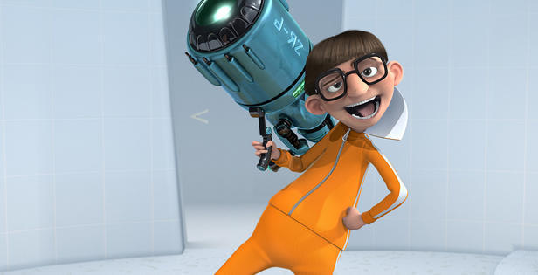
What is a Vector?
A Vector is a quantity that includes both
direction and magnitude

Slide 4
Vector vs Scalar
Vector Quantities | Scalar Quantities
Displacement
Distance
Velocity
Speed
Force
Energy
Can be negative to indicate direction
Only Positive

Slide 5
An object not moving
3
2
1
0
-1
-2
-3
7
6
5
4
3
2
1
0
Time
Velocity
Position

Slide 6
An object moving forward
3
2
1
0
-1
-2
-3
7
6
5
4
3
2
1
0
Time
Velocity
Position

Slide 7
An object moving backward
3
2
1
0
-1
-2
-3
7
6
5
4
3
2
1
0
Time
Velocity
Position

Slide 8
Showing Velocity
3
2
1
0
-1
-2
-3
7
6
5
4
3
2
1
0
Time
Velocity
Position

Slide 9
Speeding Up (moving positive)
3
2
1
0
-1
-2
-3
7
6
5
4
3
2
1
0
Time
Velocity
Position

Slide 10
Speeding Up (moving negative)
3
2
1
0
-1
-2
-3
7
6
5
4
3
2
1
0
Time
Velocity
Position

Slide 11
How are these Similar?
v
v
t
t
Getting faster because velocity is getting farther from zero

Slide 12
Slowing Down (moving positive)
3
2
1
0
-1
-2
-3
7
6
5
4
3
2
1
0
Time
Velocity
Position

Slide 13
Slowing Down (moving negative)
3
2
1
0
-1
-2
-3
7
6
5
4
3
2
1
0
Time
Velocity
Position

Slide 14
Velocity vs Time Graphs
Which graph(s) represent an object moving in the negative direction?
Which graph(s) represent an object slowing down?
A
B
C
D
3
3
3
3
2
2
2
2
1
1
1
1
Velocity (m/s)
Velocity (m/s)
Velocity (m/s)
Velocity (m/s)
0
0
0
0
-1
-1
-1
-1
-2
-2
-2
-2
-3
-3
-3
-3
0
1
2
3
4
5
6
0
1
2
3
4
5
6
0
1
2
3
4
5
6
0
1
2
3
4
5
6
Time (s)
Time (s)
Time (s)
Time (s)

Slide 15
What is…
Velocity
Acceleration
change in position over time
“speed with direction”
change in velocity over time

Slide 16
Types of Acceleration
Speeding Up
Slowing Down
Changing Direction

Slide 17
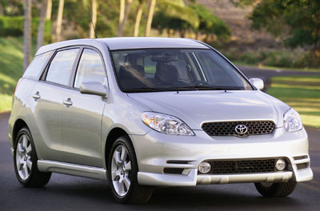
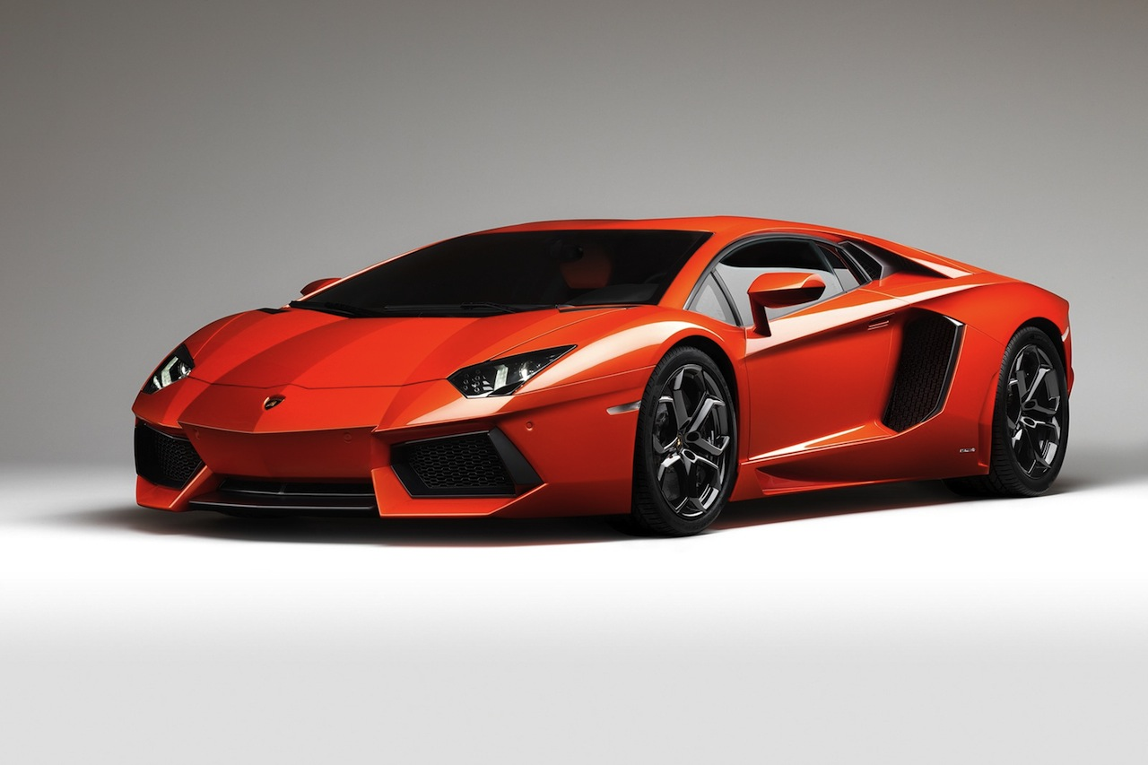
Acceleration is Related to Force
30
25
Velocity (m s⁻¹)
0-30 m s⁻¹ in 10 seconds
20
15
10
5
0-30 m s⁻¹ in 2.5 seconds
1
2
3
4
5
6
7
8
9
10
11
12
Time (s)

Slide 18
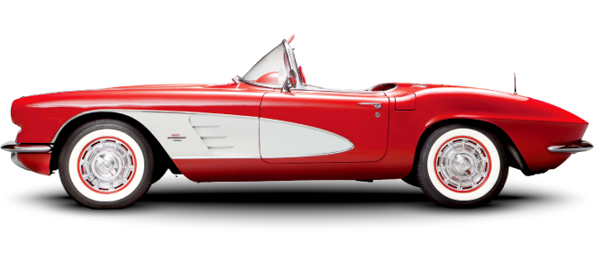
Acceleration | Slowing or Speeding?
When the acceleration is in the same direction as the velocity the object is ______________
When the acceleration is in the opposite direction as the velocity the object is ______________
speeding up
slowing down
“Foot on the Gas”
“Foot on the Brake”
v
v
a
a
v
v
a
a

Slide 19
Lesson Takeaways
I can describe the difference between speed and velocity
I can compare the difference between a vector and scalar quantity
I can plot constant velocity on a velocity vs time graph
I can plot changing velocity on a velocity vs time graph
I can use a velocity vs time graph to identify if an object is moving in the positive or negative direction as well as if it is speeding up or slowing down
I can define acceleration in terms of velocity

