Slide 1
Calculating from Graphs
IB Physics | Motion

Slide 2
Motion Graphs Guide
Constant Displacement
Constant
+ Velocity
Constant
- Velocity
+ Acceleration
Speeding up
+ Acceleration
Slowing Down
- Acceleration
Speeding up
- Acceleration
Slowing Down
d
v

Slide 3
Calculating Instantaneous Velocity
$$Slope= \frac{2 m}{1 s}=2 m/s$$
7
6
5
4
3
2
1
0
7
6
5
4
3
2
1
0
2 m
2 m
Displacement (m)
1 s
2 s
$$Slope= \frac{2 m}{2 s}=1 m/s$$
0 | 1 | 2 | 3 | 4 | 5 | 6 | 7
Position
Time (s)

Slide 4
The power of the slope!
Displacement vs Time
Slope
Velocity

Slide 5
Average Speed and Velocity
$$=\frac{Total Distance}{Total Time}$$
$$Average Speed$$
* Always Positive
$$=\frac{Total Displacement}{Total Time}$$
$$Average Velocity$$
* Includes Direction

Slide 6
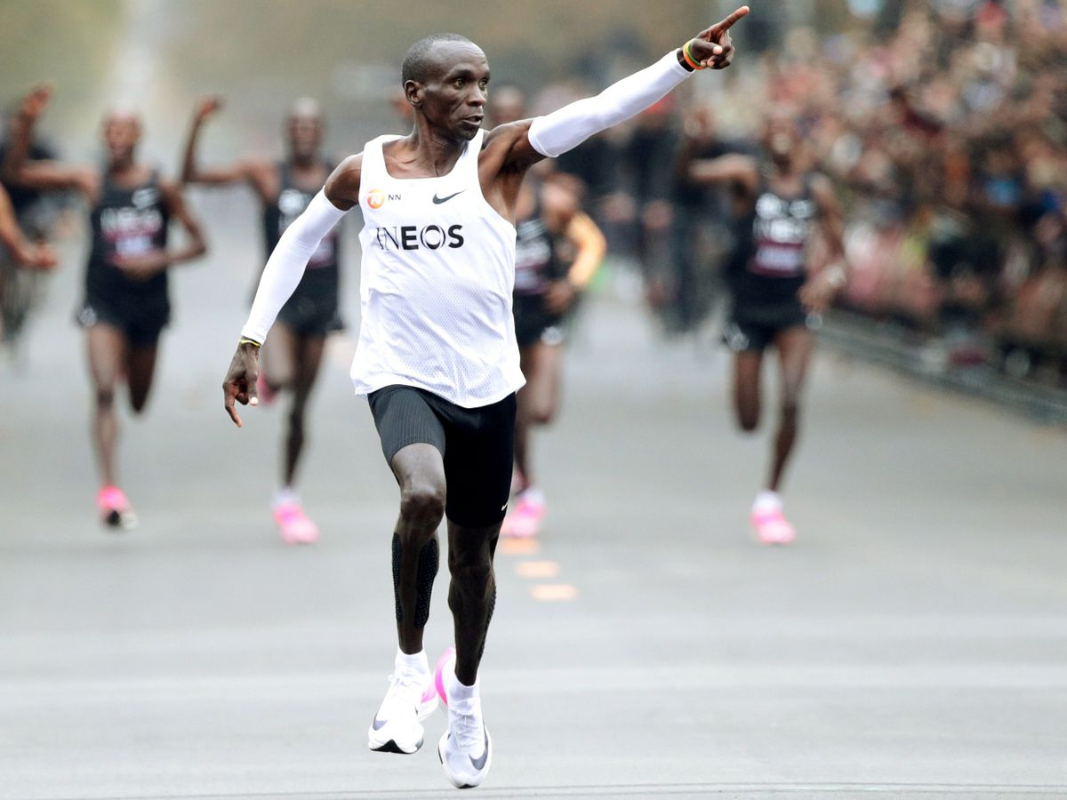
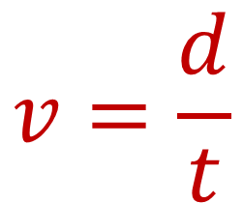
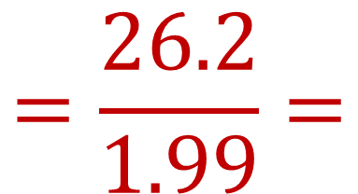
Calculating Average Speed
Eliud Kipchoge broke the 2-hour marathon (26.2 miles) in October of 2019. Kipchoge finished in 1.99 hours. What was his average speed in mph?
$$v=\frac{d}{t}$$
$$=\frac{26.2}{1.99}=$$
$$13.2 mi {hr}^{−1}$$

Slide 7
Average vs Instantaneous
Same average velocity for the whole journey
Displacement
Different instantaneous velocity throughout
Time

Slide 8

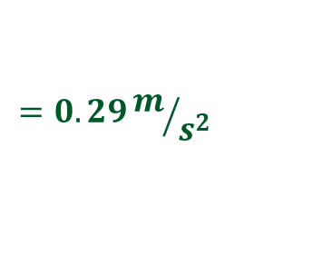
An object speeding up (positive)
$$Slope= \frac{2 m/s}{7 s}$$
$$=0.29{m/s}/s$$
$$=0.29m/{s^{2}}$$
$$=0.29 m s^{−2}$$
3
2
1
0
-1
-2
-3
7
6
5
4
3
2
1
0
2 m/s
7 s
Time (s)
Velocity (m/s)
 | 1 | 2 | 3 | 4 | 5 | 6 | 7
Position

Slide 9
The power of the slope!
Displacement vs Time
Slope
Velocity
Velocity vs Time
Slope
Acceleration

Slide 10

Calculating Displacement
$$v=\frac{d}{t}$$
$$d=vt$$
3
2
1
0
-1
-2
-3
7 m
6 m
5 m
4 m
3 m
2 m
1 m
0 m
$$d=\left(2 \frac{m}{s}\right)(3 s)$$
$$d=6 m$$
Time (s)
Velocity (m/s)
 | 1 | 2 | 3 | 4 | 5 | 6 | 7
$Area=(3 s)$ $\left(2 \frac{m}{s}\right)$
$$=6 m$$
Position

Slide 11
Information from a V vs T graph
4
$$\frac{4}{4}$$
What is the velocity at 4 seconds?
3
2
4 m s⁻¹
Velocity (m s⁻¹)
1
0
-1
1
2
3
4
What is the acceleration from 1 s – 4 s?
-2
-3
$$\frac{1}{2}\left(4\right)\left(4\right)$$
Slope = 1 m s⁻²
-4
What is the displacement after 4 s?
Area = 8 m

Slide 12
Information from a V vs T graph
4
What is the velocity at 4 seconds?
3
$$\frac{1}{2}\left(4\right)\left(−4\right)$$
2
-4 m s⁻¹
Velocity (m s⁻¹)
1
0
-1
1
2
3
4
What is the acceleration from 0 s – 4 s?
-2
-3
$$\frac{−4}{4}$$
Slope = -1 m s⁻²
-4
What is the displacement after 4 s?
Area = -8 m

Slide 13
Information from a V vs T graph
$$\frac{2}{4}=0.5$$
What is the velocity at 4 seconds?
4
3
2
4 m s⁻¹
Velocity (m s⁻¹)
1
0
-1
1
2
3
4
What is the acceleration from 0 s – 4 s?
-2
$$\left(4\right)\left(2\right)=8$$
-3
$$\frac{1}{2}\left(4\right)\left(2\right)=4$$
Slope = 0.5 m s⁻²
-4
What is the displacement after 4 s?
Area = 12 m

Slide 14
Information from a V vs T graph
$$\frac{−4}{2}=−2$$
What is the velocity at 3 seconds?
4
3
2
$$\frac{1}{2}\left(2\right)\left(2\right)=1$$
-2 m s⁻¹
Velocity (m s⁻¹)
1
0
-1
1
2
3
What is the acceleration from 1 s – 3 s?
-2
$\left(1\right)\left(2\right)=$2
-3
$$\frac{1}{2}\left(2\right)\left(−2\right)=−1$$
Slope = -2 m s⁻²
-4
What is the displacement after 3 s?
(2) + (1) + (-1) =
Area = 2 m

Slide 15
Use the graphs to tell you MORE!
Displacement vs Time
Slope
Velocity
Displacement
Area Under Curve
Velocity vs Time
Velocity vs Time
Slope
Acceleration

Slide 16
Lesson Takeaways
I can use an equation to calculate average speed/velocity
I can calculate instantaneous velocity using the slope of a displacement vs time graph
I can calculate instantaneous acceleration using the slope of a velocity vs time graph
I can calculate overall displacement using the area of a velocity vs time graph

