Slide 1
The Kinematic Equations
IB Physics | Motion

Slide 2
Motion Variables
Displacement | Initial Velocity | Final Velocity | Acceleration | Time
s
u
v
a
t
Whenever we are describing the motion of an accelerating object, there are five variables that we need to take into account
Note: The variables used in IB Physics vary slightly from other nomenclature standards

Slide 3
Calculating Acceleration
$$acceleration = \frac{final velocity −initial velocity}{change in time}$$
v - u
a
=
Symbols
t
ms⁻¹
-
ms⁻¹
=
ms⁻²
Units
s

Slide 4
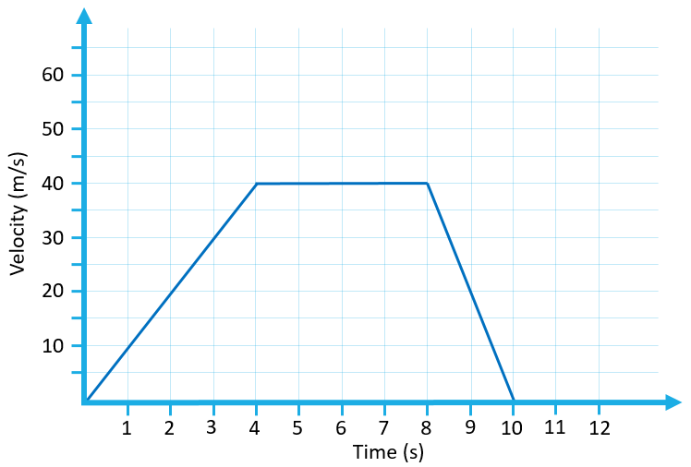

Think about this unit…
m/s/s
$$a = \frac{v−u}{t}$$
m/s²
m s⁻²

Slide 5
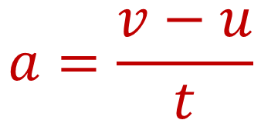
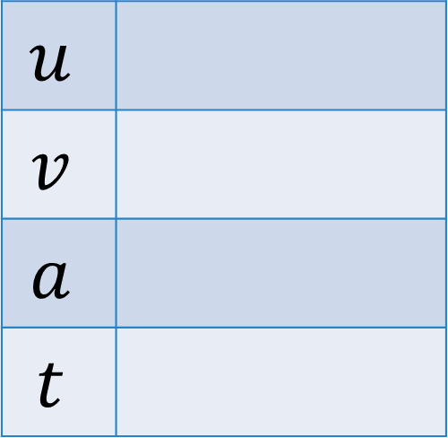
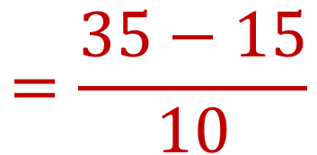
Try This | 1
What is the acceleration of a car that accelerates from 15 m s⁻¹ to 35 m s⁻¹ in 10 seconds?
$$u$$
$$v$$
$$a$$
$$t$$
15 ms⁻¹
$$a=\frac{v−u}{t}$$
$$=\frac{35−15}{10}$$
35 ms⁻¹
?
$$a=2 ms^{−2}$$
10 s

Slide 6
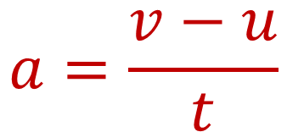
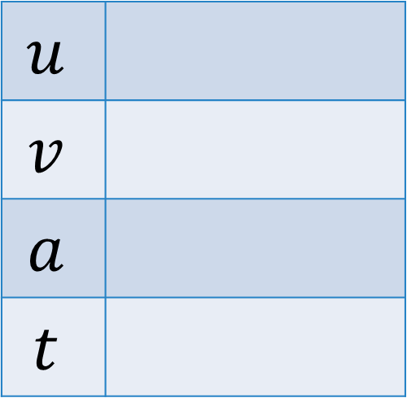
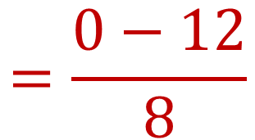
Try This | 2
Find the average acceleration of a northbound train that slows down from 12 m s⁻¹ to a complete stop in 8 sec
*Tip: You can get a negative value!
$$u$$
$$v$$
$$a$$
$$t$$
12 ms⁻¹
$$a=\frac{v−u}{t}$$
$$=\frac{0−12}{8}$$
0 ms⁻¹
?
$$a=−1.5 ms^{−2}$$
8 s

Slide 7
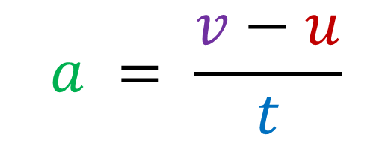
Solve for v
$$a = \frac{v−u}{t}$$
$$v=u+at$$

Slide 8
Physics Data Booklet

Slide 9
How far have I gone?
$$s=vt=\left(80 m s^{−1}\right)\left(10 s\right)=800 m$$
120
$$area under graph=\left(80 m s^{−1}\right)\left(10 s\right)=800 m$$
100
10 s
Velocity (m s⁻¹)
80
60
40
80 m s⁻¹
20
1
2
3
4
5
6
7
8
9
10
11
12
Time (s)

Slide 10
Use the graphs to tell you MORE!
Displacement vs Time
Slope
Velocity
Displacement
Area Under Curve
Velocity vs Time
Velocity vs Time
Slope
Acceleration

Slide 11
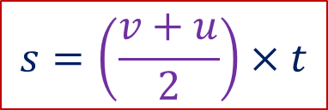
How far have I gone?
$$area under graph=\left(60 m s^{−1}\right)\left(8 s\right)=480 m$$
120
100
$$s=\left(\frac{v+u}{2}\right)×t$$
Velocity (m s⁻¹)
80
60
$$Average Velocity=\frac{v+u}{2}$$
40
20
1
2
3
4
5
6
7
8
9
10
11
12
Time (s)

Slide 12
Physics Data Booklet

Slide 13
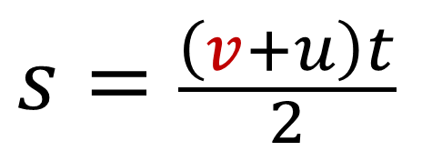
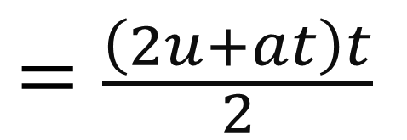
What if I don’t know v?
$$s=\frac{\left(v+u\right)t}{2}$$
$$v=u+at$$
$$s=\frac{\left(u+at+u\right)t}{2}$$
$$=\frac{\left(2u+at\right)t}{2}$$
$$s=\frac{2ut+at^{2}}{2}$$
$$s=ut+\frac{1}{2}at^{2}$$

Slide 14
Physics Data Booklet

Slide 15
One more equation
$$v^{2}=u^{2}+2as$$

Slide 16
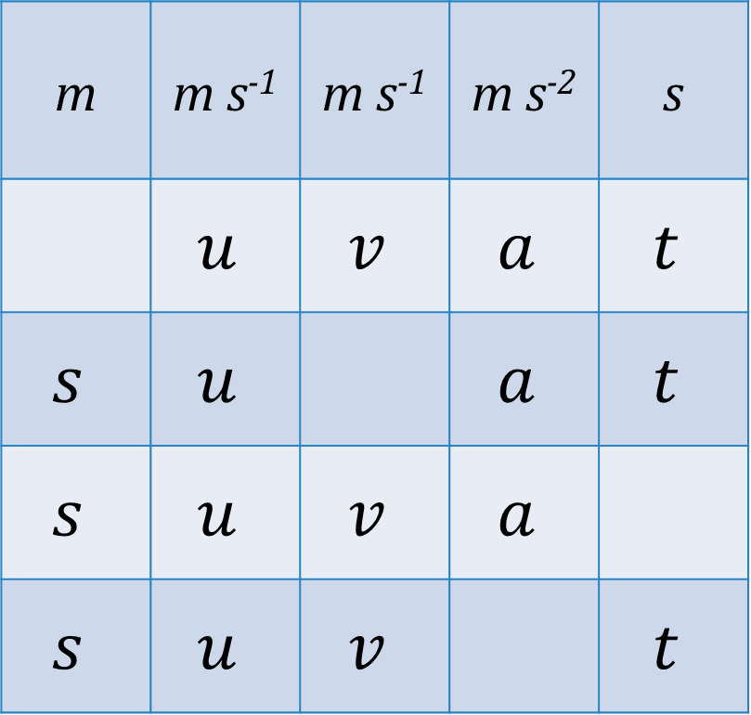
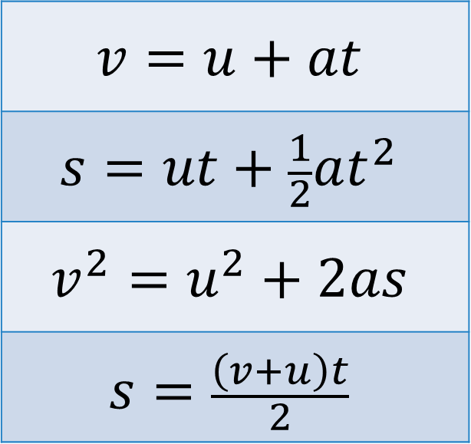
Equations
m | m s⁻¹ | m s⁻¹ | m s⁻² | s
 | $$u$$ | $$v$$ | $$a$$ | $$t$$
$$s$$ | $$u$$ |  | $$a$$ | $$t$$
$$s$$ | $$u$$ | $$v$$ | $$a$$
$$s$$ | $$u$$ | $$v$$ |  | $$t$$
$$v=u+at$$
$$s=ut+\frac{1}{2}at^{2}$$
$$v^{2}=u^{2}+2as$$
$$s=\frac{\left(v+u\right)t}{2}$$

Slide 17
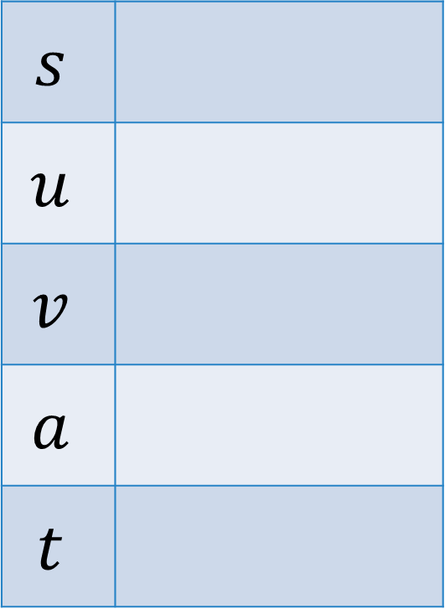
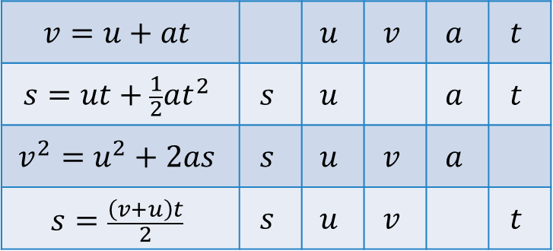
Try This | 3
You speed up with a uniform acceleration from 0 m/s to 30 m/s in 5 seconds. How far have you gone?
$$s$$
$$u$$
$$v$$
$$a$$
$$t$$
?
0 m s⁻¹
$$v=u+at$$ |  | $$u$$ | $$v$$ | $$a$$ | $$t$$
$$s=ut+\frac{1}{2}at^{2}$$ | $$s$$ | $$u$$ |  | $$a$$ | $$t$$
$$v^{2}=u^{2}+2as$$ | $$s$$ | $$u$$ | $$v$$ | $$a$$
$$s=\frac{\left(v+u\right)t}{2}$$ | $$s$$ | $$u$$ | $$v$$ |  | $$t$$
30 m s⁻¹
------
$$s=\frac{\left(30+0\right)(5)}{2}$$
$$=75 m$$
5 s

Slide 18
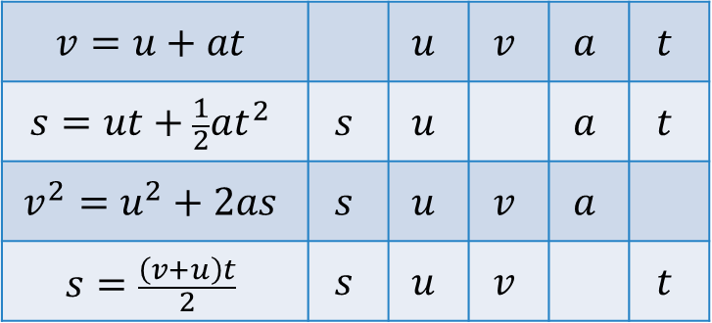
Try This | 4
If a plane on a runway is accelerating at 4.8 m s⁻² for 15 seconds before taking off, how long should the runway be?
$$s$$
$$u$$
$$v$$
$$a$$
$$t$$
?
0 m s⁻¹
$$s=ut+\frac{1}{2}at^{2}$$
$$v=u+at$$ |  | $$u$$ | $$v$$ | $$a$$ | $$t$$
$$s=ut+\frac{1}{2}at^{2}$$ | $$s$$ | $$u$$ |  | $$a$$ | $$t$$
$$v^{2}=u^{2}+2as$$ | $$s$$ | $$u$$ | $$v$$ | $$a$$
$$s=\frac{\left(v+u\right)t}{2}$$ | $$s$$ | $$u$$ | $$v$$ |  | $$t$$
------
$$=(0)(15)+\frac{1}{2}(4.8){(15)}^{2}$$
4.8 m s⁻²
$$s=540 m$$
15 s

Slide 19

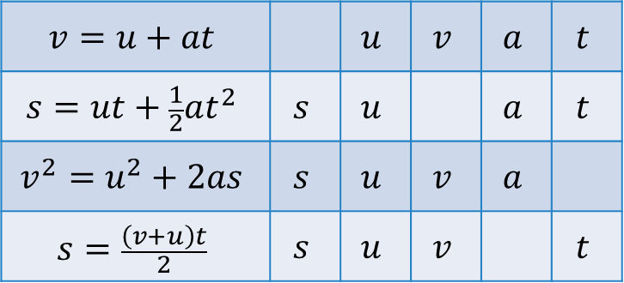

Try This | 5
A driver slams on the brakes and skids for 3 seconds before coming to a stop. You go and measure that the skid marks show a deceleration over 9 m. What was the initial speed of the car?
$$s$$
$$u$$
$$v$$
$$a$$
$$t$$
9 m
?
0 m s⁻¹
$$s=\frac{\left(v+u\right)t}{2}$$
$$v=u+at$$ |  | $$u$$ | $$v$$ | $$a$$ | $$t$$
$$s=ut+\frac{1}{2}at^{2}$$ | $$s$$ | $$u$$ |  | $$a$$ | $$t$$
$$v^{2}=u^{2}+2as$$ | $$s$$ | $$u$$ | $$v$$ | $$a$$
$$s=\frac{\left(v+u\right)t}{2}$$ | $$s$$ | $$u$$ | $$v$$ |  | $$t$$
$$u=\frac{2s}{t}−v$$
$$=\frac{2(9)}{(3)}−0$$
-----
3 s
$$u=6 m s^{−1}$$

Slide 20
Lesson Takeaways
I can identify the 5 primary variables of motion
I can identify the proper kinematic equation to use for a problem that is presented
I can rearrange to solve for the unknown variable
I can calculate for an unknown

