Slide 1
MOTION
IB Physics | Completed Notes

Slide 2
Units
1
IB Physics | Motion

Slide 3
Two Types of Observations
Provide some examples of each
Quantitative
Qualitative
“How Many” / “How Much”
Numerical
Description

Slide 4
Measurement
How can you quantify a measurement?

Slide 5
Systems and Units
Fundamental S.I. Units:
Length
Mass
Time
Electric Current
Temperature
Amount of Substance
Luminous Intensity
Meter
m
Kilogram
kg
Second
s
Ampere (amp)
A
Kelvin
K
Mole
mol
Candela
cd

Slide 6
Units are Arbitrary
Take the history of the meter…
1790 - The length of a pendulum that swings half of its maximum distance in one second
1795 - The length of an official bar of brass fabricated to be exactly one meter as determined in 1791
1889 – The distance between two lines on an official bar of platinum-iridium alloy, measured at 0°C
1791 - The length of one ten-millionth of the distance between the North Pole and the equator
1799 - The length of an official bar of platinum, measured from the brass bar and stored at the French National archives
1983 – The length traveled by light in a vacuum during 1/299,792,458 of a second
1/10,000,000th

Slide 7
What’s ‘the standard’?
All of our base SI units are grounded in some “standard” that helps maintain consistency.
Some of these units even reference each other…
Definition of the Second
The “second” is defined as the interval required for 9,192,631,770 vibrations of the cesium-133 atom measured via an atomic beam clock

Slide 8
Primary and Secondary Colors
Primary Colors
Secondary Colors

Slide 9
Fundamental vs Derived
Fundamental
S.I. Units
Derived Units
Velocity:
Acceleration:
Force:
$$m/s$$
Length | m
Mass | kg
Time | s
$$={m/s}/s$$
$$m/{s^{2}}$$
$$N$$
$$=kg×m/{s^{2}}$$

Slide 10
Welcome to IB Land!
Since this course is International all of the units must be in the “European” format rather than the “American” format
This means that instead of writing units with a fraction slash, we must use negative exponents
7 m/s
9.81 m/s²
87 g/cm³
6.67 $\frac{Nm^{2}}{{kg}^{2}}$
2.2 $\frac{J}{K}$
8.31 $\frac{J}{K×mol}$
m s⁻¹
N m² kg⁻²
m s⁻²
J K⁻¹
g cm⁻³
J K⁻¹ mol⁻¹

Slide 11
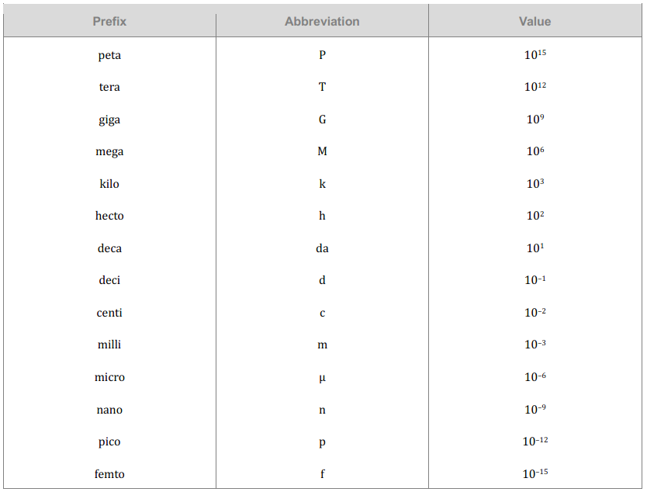
The Metric System
*Taken directly from the IB Physics Data Booklet

Slide 12
The Metric System
P
T
G
M
k
h
da
d
c
m
μ
n
p
f
The value given is the number of places the decimal moves
Please make sure that you go in the correct direction!
900 nm = 900,000,000,000 m
or
900 nm = 0.0000009 m

Slide 13
The Metric System
P
T
G
M
k
h
da
d
c
m
μ
n
p
f
0.0000009
900 nm → _______________ m
900 × 10⁻⁹ m
base
9

Slide 14
The Metric System
Prefix | Abbreviation | Power
giga- | G | 10⁹
mega- | M | 10⁶
kilo- | K | 10³
hecto- | h | 10²
deca- | da | 10¹
Base
deci- | d | 10⁻¹
centi- | c | 10⁻²
milli- | m | 10⁻³
micro- | μ | 10⁻⁶
nano- | n | 10⁻⁹
Conversions:
250 g = kg
0.00325 kg = μg
54 mm = km
0.25
3
3
3
3,250,000
3
6
0.000054

Slide 15
The Metric System | Try These
Prefix | Abbreviation | Power
giga- | G | 10⁹
mega- | M | 10⁶
kilo- | K | 10³
hecto- | h | 10²
deca- | da | 10¹
Base
deci- | d | 10⁻¹
centi- | c | 10⁻²
milli- | m | 10⁻³
micro- | μ | 10⁻⁶
nano- | n | 10⁻⁹
65 μC = C
0.000065
6
12 MW = W
12,000,000
6

Slide 16
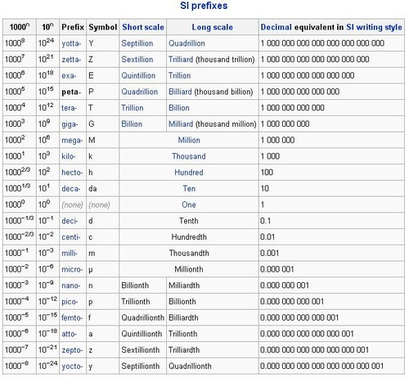
The Metric System
There’s more…

Slide 17
Lesson Takeaways
I can describe the difference between quantitative and qualitative observations
I can identify the 7 Fundamental SI units
I can define and give an example of a derived unit
I can represent fractional units with negative exponents
I can convert metric units between prefixes

Slide 18
Dimensional Analysis
2
IB Physics | Motion

Slide 19
Conversions
Convert the Following:
26.2 miles → kilometers
1 Mile = 1.609 Kilometers
$$×\frac{1.609 km}{1 mi}=$$
$$26.2 mi$$
$$42.2 km$$

Slide 20
Conversions with fractions
Convert the Following:
35 mi hr⁻¹ → m s⁻¹
1 Mile = 1609 meters
$$\frac{35 mi}{1 hr}$$
$$×\frac{1609 m}{1 mi}$$
$$×\frac{1 hr}{60 min}$$
$$×\frac{1 min}{60 s}=$$
$$15.6 m s^{−1}$$

Slide 21
Conversions with Exponents
How many cm² are there in 1 m²?
$$100×100=$$
$${100}^{2}=$$
$$10,000 {cm}^{2}$$
How many cm³ are there in 1 m³?
$$100×100×100=$$
$${100}^{3}=$$
$$1,000,000 {cm}^{2}$$

Slide 22
Conversions with Exponents
Convert the Following:
0.05 km² → m²
$$×\frac{1000 m}{1 km}$$
$$×\frac{1000 m}{1 km}=$$
$$0.05 {km}^{2}$$
$$50,000 m^{2}$$
$$0.05 {km}^{2}$$
$$×{\left(\frac{1000 m}{1 km}\right)}^{2}=$$
$$0.05 {km}^{2}$$
$$50,000 m^{2}$$

Slide 23
Conversions with Exponents
Convert the Following:
5 m² → ft²
5 m³ → ft³
1 meter = 3.28 feet
$$5 m^{2} ×\left(\frac{3.28 ft}{1 m}\right)=$$
$$^{2}$$
$$53.8 {ft}^{2}$$
$$5 m^{3} ×\left(\frac{3.28 ft}{1 m}\right)=$$
$$^{3}$$
$$176.4 {ft}^{3}$$

Slide 24
Dimensional Analysis
Start with the formula and substitute units in for variables
$$v=\frac{d }{t}$$
$$\left[\frac{m}{s}\right]=\frac{\left[m\right]}{\left[s\right]}$$
Is this formula valid?
$$\left[m\right]=\left[\frac{m}{s^{2}}\right]\left[s\right]$$
$$d=at$$
not valid
$$\left[m\right]=\left[\frac{m}{s}\right]$$

Slide 25
Dimensional Analysis
We can use equations with units that we know to find units that we don’t.
Variable | Unit
Momentum p
Mass m | Kilogram [kg]
Velocity v | Meters per second [ms⁻¹]
$$p=m×v$$
kg m s⁻¹
$$=\left[kg\right]\left[\frac{m}{s}\right]$$

Slide 26
Dimensional Analysis
Constants have units too! That’s what makes our equation valid
Variable | Unit
Force F | Newton [N]
Mass m₁ and m₂ | Kilogram [kg]
Distance d | Meter [m]
Universal Gravitation Constant G | N m² kg⁻²
$$F=G\frac{m_{1}m_{2}}{d^{2}}$$
$$G=\frac{Fd^{2}}{m_{1}m_{2}}=\frac{\left[N\right]{\left[m\right]}^{2}}{{\left[kg\right]}^{2}}$$
$$=\frac{\left[N\right]{\left[m\right]}^{2}}{{\left[kg\right]}^{2}}$$

Slide 27
Normalized Scientific Notation
Helpful for very big numbers
89,000,000 =
750,000,000,000 =
8,759,000,000 =
8.9 × 10⁷
or
8.9E7
7.5 × 10¹¹
or
7.5E11
8.759 × 10⁹
or
8.759E9

Slide 28
Normalized Scientific Notation
Helpful for very small numbers
0.00125 =
0.0000008255 =
0.00000082550 =
1.25 × 10⁻³
or
1.25E-3
8.255 × 10⁻⁷
or
8.255E-7
8.2550 × 10⁻⁷
or
8.2550E-7

Slide 29
Lesson Takeaways
I can convert fraction units and exponential units using Dimensional Analysis
I can use dimensional analysis to verify a formula
I can use dimensional analysis to determine the units for a solution
I can represent large and small numbers using scientific notation

Slide 30
Displacement Graphs
3
IB Physics | MOtion

Slide 31
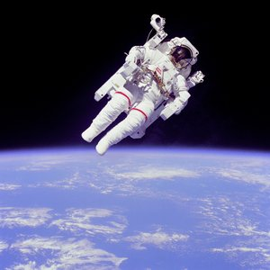
What is Motion?
position
An object's change in _____________ relative to a reference point.
Relative to the earth:
Moving 17,500 mph
Relative to the shuttle:
Not moving

Slide 32
Distance vs. Displacement
Distance
Displacement
How far travelled
How far from origin

Slide 33
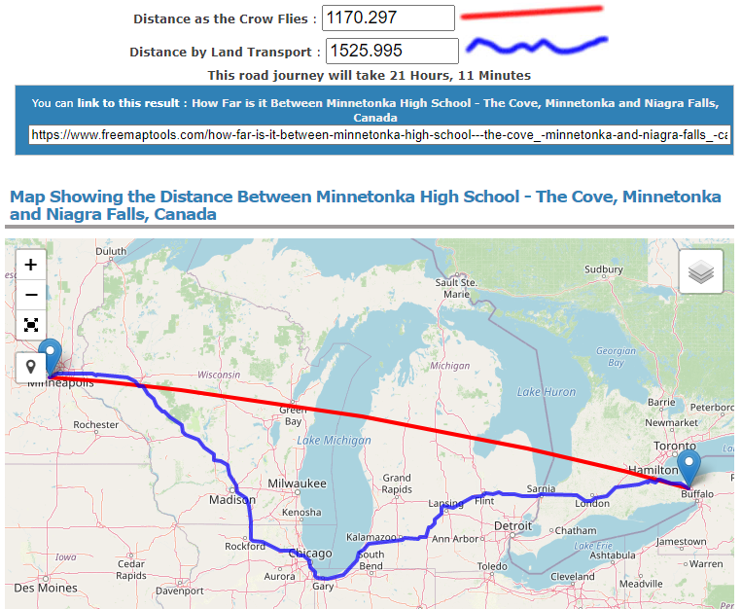
Distance and Displacement in 2D

Slide 34
Try this | Distance and Displacement
You walked 5 km East, turned around and walked 2 km West, turned around again and walked another 4 km East. What is your distance? What is your displacement?
0 | 1 | 2 | 3 | 4 | 5 | 6 | 7 | 8
5
+ 2
+ 4
Distance
Displacement
11 km
7 km

Slide 35
Graphing Displacement
You walked 5 km East, turned around and walked 2 km West, turned around again and walked another 4 miles km. What is your distance? What is your displacement?
7
6
5
4
3
2
1
0
Position (km)
Displacement (km)
Time

Slide 36
Stroboscopic Photographs
In a stroboscopic photograph, a new snapshot is captured every ___ seconds and combined to show the motion over a period of time.
Circle the part of the motion where this soccer ball is moving the FASTEST
New Capture every 0.04 sec
Circle the part of the motion where this soccer ball is moving the SLOWEST

Slide 37
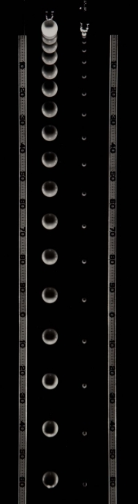
Stroboscopic Photographs
Constant Velocity or Accelerating?
How do you know?
More spacing between pictures = moving faster

Slide 38
Predict the Motion…
Which cart do you think has the best chance of reaching the 10-meter location first?
Time | 0.0 s | 1.0 s | 2.0 s | 3.0 s
Cart A | 0.0 m
Cart B | 2.0 m
Cart C | 3.0 m

Slide 39
Predict the Motion…
Now which cart do you think has the best chance of reaching the 10-meter location first?
Time | 0.0 s | 1.0 s | 2.0 s | 3.0 s
Cart A | 0.0 m | 4.0 m
Cart B | 2.0 m | 4.0 m
Cart C | 3.0 m | 4.0 m
What new information do you have about the carts now that you didn’t before?

Slide 40
Predict the Motion…
Now which cart do you think has the best chance of reaching the 10-meter location first?
Time | 0.0 s | 1.0 s | 2.0 s | 3.0 s
Cart A | 0.0 m | 4.0 m | 7.0 m | ??
Cart B | 2.0 m | 4.0 m | 6.0 m | ??
Cart C | 3.0 m | 4.0 m | 6.0 m | ??
What patterns do you see? Can you use these to predict the next position?

Slide 41
Predict the Motion…
It’s more than just position, you need multiple frames to see motion
Time | 0.0 s | 1.0 s | 2.0 s | 3.0 s
Cart A | 0.0 m | 4.0 m | 7.0 m | 9.0 m
Cart B | 2.0 m | 4.0 m | 6.0 m | 8.0 m
Cart C | 3.0 m | 4.0 m | 6.0 m | 9.0 m

Slide 42
An object not moving
7
6
5
4
3
2
1
0
7
6
5
4
3
2
1
0
Displacement
Time
Position

Slide 43
An object moving forward
7
6
5
4
3
2
1
0
7
6
5
4
3
2
1
0
Displacement
Time
Position

Slide 44
An object moving backward
7
6
5
4
3
2
1
0
7
6
5
4
3
2
1
0
Displacement
Time
Position

Slide 45
Showing Velocity
7
6
5
4
3
2
1
0
7
6
5
4
3
2
1
0
Displacement
Time
Position

Slide 46
Speeding Up (moving positive)
7
6
5
4
3
2
1
0
7
6
5
4
3
2
1
0
Displacement
Time
Time
Position

Slide 47
Speeding Up (moving negative)
7
6
5
4
3
2
1
0
7
6
5
4
3
2
1
0
Displacement
Time
Time
Position

Slide 48
How are these Similar?
d
d
t
t
Getting faster because the graph is getting steeper (farther spacing)

Slide 49
Slowing Down (moving positive)
7
6
5
4
3
2
1
0
7
6
5
4
3
2
1
0
Displacement
Time
Time
Position

Slide 50
Slowing Down (moving negative)
7
6
5
4
3
2
1
0
7
6
5
4
3
2
1
0
Displacement
Time
Time
Position

Slide 51
Displacement vs Time Graphs
Which graph(s) represent an object moving in the negative direction?
Which graph(s) represent an object slowing down?
A
B
C
D
6
6
6
6
5
5
5
5
4
4
4
4
3
3
3
3
Displacement (m)
Displacement (m)
Displacement (m)
Displacement (m)
2
2
2
2
1
1
1
1
0
0
0
0
0
1
2
3
4
5
6
0
1
2
3
4
5
6
0
1
2
3
4
5
6
0
1
2
3
4
5
6
Time (s)
Time (s)
Time (s)
Time (s)

Slide 52
Lesson Takeaways
I can describe the difference between distance and displacement
I can calculate distance and displacement for 1D motion
I can plot constant velocity on a displacement vs time graph
I can plot changing velocity on a displacement vs time graph
I can use a displacement vs time graph to identify if an object is moving in the positive or negative direction as well as if it is speeding up or slowing down

Slide 53
Velocity Graphs
4
IB Physics | Motion

Slide 54
What is…
Speed
Velocity
The rate of change of position
“how fast”
Speed with direction

Slide 55
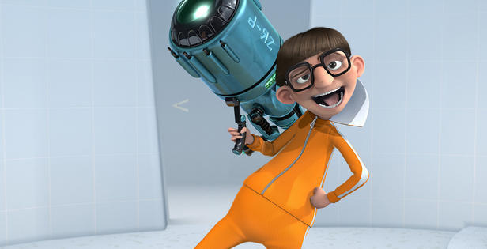
What is a Vector?
A Vector is a quantity that includes both
direction and magnitude

Slide 56
Vector vs Scalar
Vector Quantities | Scalar Quantities
Displacement
Distance
Velocity
Speed
Force
Energy
Can be negative to indicate direction
Only Positive

Slide 57
An object not moving
3
2
1
0
-1
-2
-3
7
6
5
4
3
2
1
0
Time
Velocity
Position

Slide 58
An object moving forward
3
2
1
0
-1
-2
-3
7
6
5
4
3
2
1
0
Time
Velocity
Position

Slide 59
An object moving backward
3
2
1
0
-1
-2
-3
7
6
5
4
3
2
1
0
Time
Velocity
Position

Slide 60
Showing Velocity
3
2
1
0
-1
-2
-3
7
6
5
4
3
2
1
0
Time
Velocity
Position

Slide 61
Speeding Up (moving positive)
3
2
1
0
-1
-2
-3
7
6
5
4
3
2
1
0
Time
Velocity
Position

Slide 62
Speeding Up (moving negative)
3
2
1
0
-1
-2
-3
7
6
5
4
3
2
1
0
Time
Velocity
Position

Slide 63
How are these Similar?
v
v
t
t
Getting faster because velocity is getting farther from zero

Slide 64
Slowing Down (moving positive)
3
2
1
0
-1
-2
-3
7
6
5
4
3
2
1
0
Time
Velocity
Position

Slide 65
Slowing Down (moving negative)
3
2
1
0
-1
-2
-3
7
6
5
4
3
2
1
0
Time
Velocity
Position

Slide 66
Velocity vs Time Graphs
Which graph(s) represent an object moving in the negative direction?
Which graph(s) represent an object slowing down?
A
B
C
D
3
3
3
3
2
2
2
2
1
1
1
1
Velocity (m/s)
Velocity (m/s)
Velocity (m/s)
Velocity (m/s)
0
0
0
0
-1
-1
-1
-1
-2
-2
-2
-2
-3
-3
-3
-3
0
1
2
3
4
5
6
0
1
2
3
4
5
6
0
1
2
3
4
5
6
0
1
2
3
4
5
6
Time (s)
Time (s)
Time (s)
Time (s)

Slide 67
What is…
Velocity
Acceleration
change in position over time
“speed with direction”
change in velocity over time

Slide 68
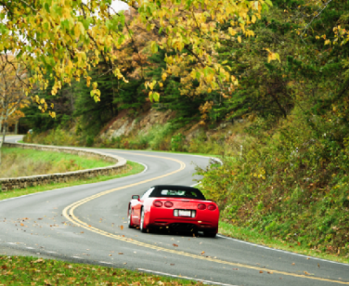
Types of Acceleration
Speeding Up
Slowing Down
Changing Direction

Slide 69
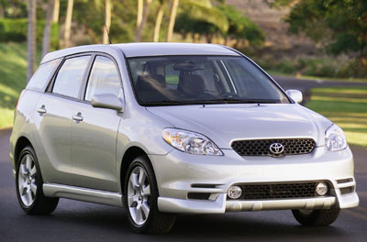
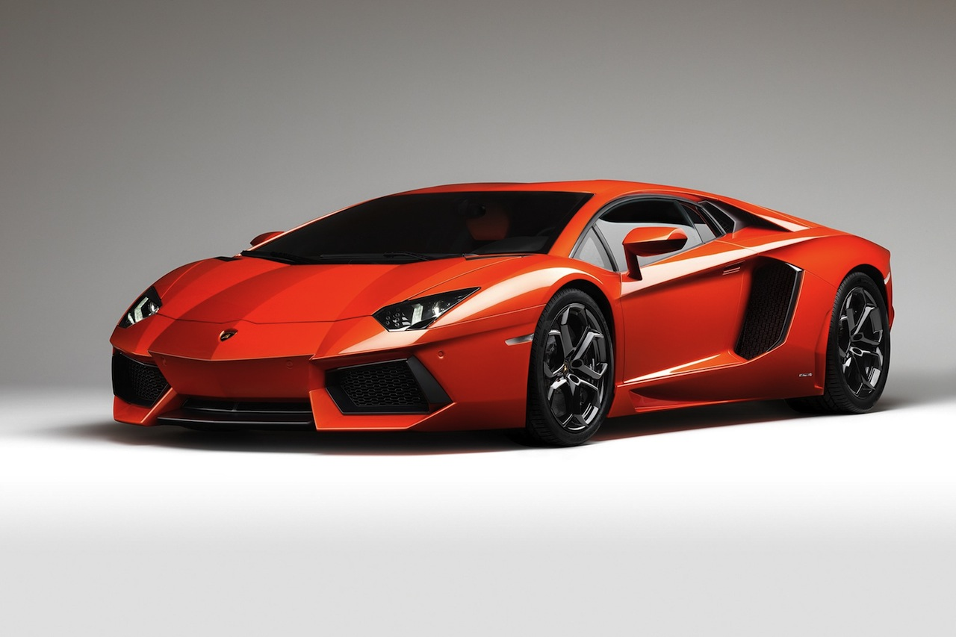
Acceleration is Related to Force
30
25
Velocity (m s⁻¹)
0-30 m s⁻¹ in 10 seconds
20
15
10
5
0-30 m s⁻¹ in 2.5 seconds
1
2
3
4
5
6
7
8
9
10
11
12
Time (s)

Slide 70
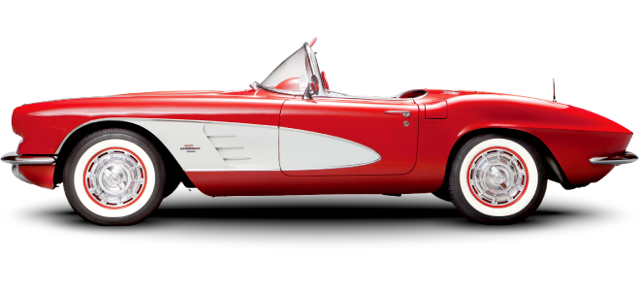
Acceleration | Slowing or Speeding?
When the acceleration is in the same direction as the velocity the object is ______________
When the acceleration is in the opposite direction as the velocity the object is ______________
speeding up
slowing down
“Foot on the Gas”
“Foot on the Brake”
v
v
a
a
v
v
a
a

Slide 71
Lesson Takeaways
I can describe the difference between speed and velocity
I can compare the difference between a vector and scalar quantity
I can plot constant velocity on a velocity vs time graph
I can plot changing velocity on a velocity vs time graph
I can use a velocity vs time graph to identify if an object is moving in the positive or negative direction as well as if it is speeding up or slowing down
I can define acceleration in terms of velocity

Slide 72
Calculating from Graphs
5
IB Physics | Motion

Slide 73
Motion Graphs Guide
Constant Displacement
Constant
+ Velocity
Constant
- Velocity
+ Acceleration
Speeding up
+ Acceleration
Slowing Down
- Acceleration
Speeding up
- Acceleration
Slowing Down
d
v

Slide 74
Calculating Instantaneous Velocity
$$Slope= \frac{2 m}{1 s}=2 m/s$$
7
6
5
4
3
2
1
0
7
6
5
4
3
2
1
0
2 m
2 m
Displacement (m)
1 s
2 s
$$Slope= \frac{2 m}{2 s}=1 m/s$$
0 | 1 | 2 | 3 | 4 | 5 | 6 | 7
Position
Time (s)

Slide 75
The power of the slope!
Displacement vs Time
Slope
Velocity

Slide 76
Average Speed and Velocity
$$=\frac{Total Distance}{Total Time}$$
$$Average Speed$$
* Always Positive
$$=\frac{Total Displacement}{Total Time}$$
$$Average Velocity$$
* Includes Direction

Slide 77
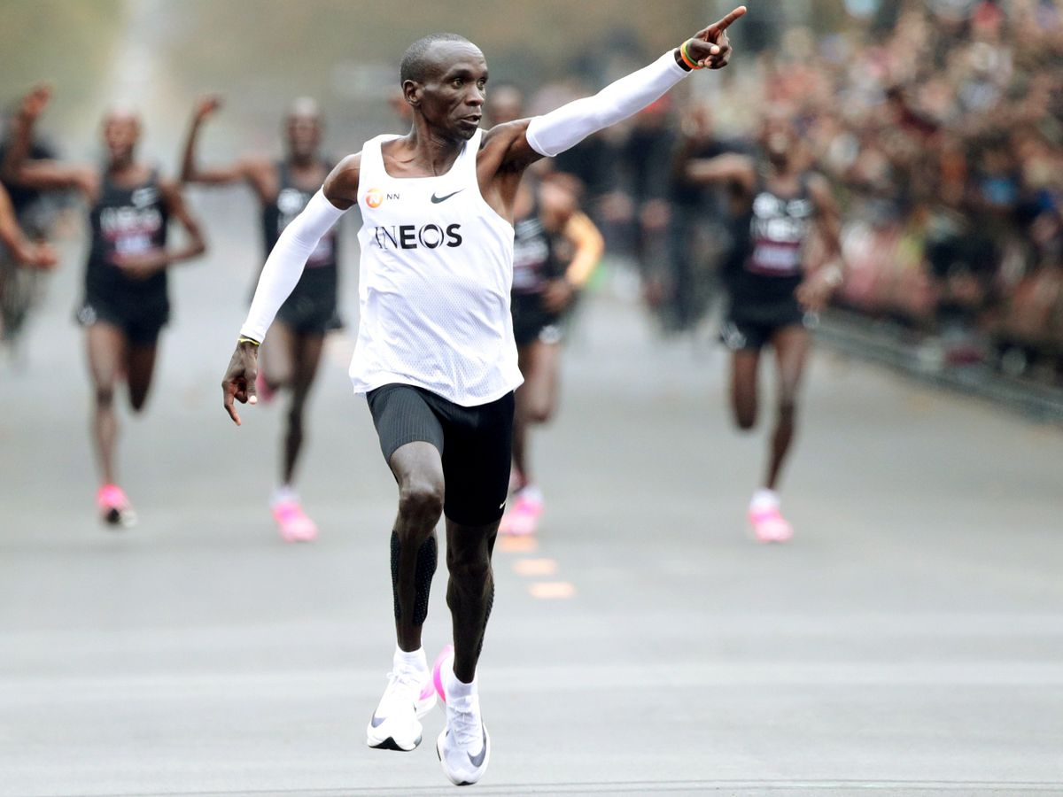
Calculating Average Speed
Eliud Kipchoge broke the 2-hour marathon (26.2 miles) in October of 2019. Kipchoge finished in 1.99 hours. What was his average speed in mph?
$$v=\frac{d}{t}$$
$$=\frac{26.2}{1.99}=$$
$$13.2 mi {hr}^{−1}$$

Slide 78
Average vs Instantaneous
Same average velocity for the whole journey
Displacement
Different instantaneous velocity throughout
Time

Slide 79
An object speeding up (positive)
$$Slope= \frac{2 m/s}{7 s}$$
$$=0.29{m/s}/s$$
$$=0.29m/{s^{2}}$$
$$=0.29 m s^{−2}$$
3
2
1
0
-1
-2
-3
7
6
5
4
3
2
1
0
2 m/s
7 s
Time (s)
Velocity (m/s)
 | 1 | 2 | 3 | 4 | 5 | 6 | 7
Position

Slide 80
The power of the slope!
Displacement vs Time
Slope
Velocity
Velocity vs Time
Slope
Acceleration

Slide 81
Calculating Displacement
$$v=\frac{d}{t}$$
$$d=vt$$
3
2
1
0
-1
-2
-3
7 m
6 m
5 m
4 m
3 m
2 m
1 m
0 m
$$d=\left(2 \frac{m}{s}\right)(3 s)$$
$$d=6 m$$
Time (s)
Velocity (m/s)
 | 1 | 2 | 3 | 4 | 5 | 6 | 7
$Area=(3 s)$ $\left(2 \frac{m}{s}\right)$
$$=6 m$$
Position

Slide 82
Information from a V vs T graph
4
$$\frac{4}{4}$$
What is the velocity at 4 seconds?
3
2
4 m s⁻¹
Velocity (m s⁻¹)
1
0
-1
1
2
3
4
What is the acceleration from 1 s – 4 s?
-2
-3
$$\frac{1}{2}\left(4\right)\left(4\right)$$
Slope = 1 m s⁻²
-4
What is the displacement after 4 s?
Area = 8 m

Slide 83
Information from a V vs T graph
4
What is the velocity at 4 seconds?
3
$$\frac{1}{2}\left(4\right)\left(−4\right)$$
2
-4 m s⁻¹
Velocity (m s⁻¹)
1
0
-1
1
2
3
4
What is the acceleration from 0 s – 4 s?
-2
-3
$$\frac{−4}{4}$$
Slope = -1 m s⁻²
-4
What is the displacement after 4 s?
Area = -8 m

Slide 84
Information from a V vs T graph
$$\frac{2}{4}=0.5$$
What is the velocity at 4 seconds?
4
3
2
4 m s⁻¹
Velocity (m s⁻¹)
1
0
-1
1
2
3
4
What is the acceleration from 0 s – 4 s?
-2
$$\left(4\right)\left(2\right)=8$$
-3
$$\frac{1}{2}\left(4\right)\left(2\right)=4$$
Slope = 0.5 m s⁻²
-4
What is the displacement after 4 s?
Area = 12 m

Slide 85
Information from a V vs T graph
$$\frac{−4}{2}=−2$$
What is the velocity at 3 seconds?
4
3
2
$$\frac{1}{2}\left(2\right)\left(2\right)=1$$
-2 m s⁻¹
Velocity (m s⁻¹)
1
0
-1
1
2
3
What is the acceleration from 1 s – 3 s?
-2
$\left(1\right)\left(2\right)=$2
-3
$$\frac{1}{2}\left(2\right)\left(−2\right)=−1$$
Slope = -2 m s⁻²
-4
What is the displacement after 3 s?
(2) + (1) + (-1) =
Area = 2 m

Slide 86
Use the graphs to tell you MORE!
Displacement vs Time
Slope
Velocity
Displacement
Area Under Curve
Velocity vs Time
Velocity vs Time
Slope
Acceleration

Slide 87
Lesson Takeaways
I can use an equation to calculate average speed/velocity
I can calculate instantaneous velocity using the slope of a displacement vs time graph
I can calculate instantaneous acceleration using the slope of a velocity vs time graph
I can calculate overall displacement using the area of a velocity vs time graph

Slide 88
The Kinematic Equations
6
IB Physics | Motion

Slide 89
Motion Variables
Displacement | Initial Velocity | Final Velocity | Acceleration | Time
s
u
v
a
t
Whenever we are describing the motion of an accelerating object, there are five variables that we need to take into account
Note: The variables used in IB Physics vary slightly from other nomenclature standards

Slide 90
Calculating Acceleration
$$acceleration = \frac{final velocity −initial velocity}{change in time}$$
v - u
a
=
Symbols
t
ms⁻¹
-
ms⁻¹
=
ms⁻²
Units
s

Slide 91
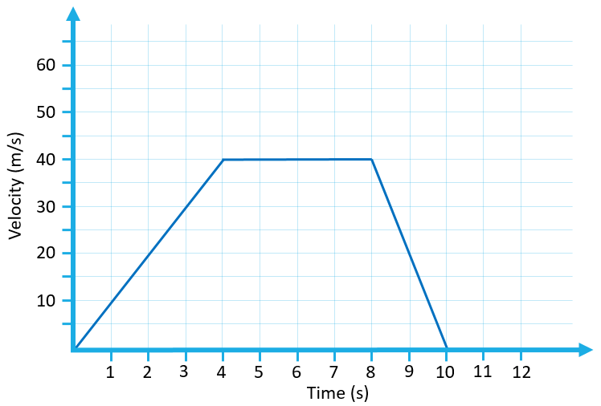
Think about this unit…
m/s/s
$$a = \frac{v−u}{t}$$
m/s²
m s⁻²

Slide 92
Try This | 1
What is the acceleration of a car that accelerates from 15 m s⁻¹ to 35 m s⁻¹ in 10 seconds?
$$u$$
$$v$$
$$a$$
$$t$$
15 ms⁻¹
$$a=\frac{v−u}{t}$$
$$=\frac{35−15}{10}$$
35 ms⁻¹
?
$$a=2 ms^{−2}$$
10 s

Slide 93
Try This | 2
Find the average acceleration of a northbound train that slows down from 12 m s⁻¹ to a complete stop in 8 sec
*Tip: You can get a negative value!
$$u$$
$$v$$
$$a$$
$$t$$
12 ms⁻¹
$$a=\frac{v−u}{t}$$
$$=\frac{0−12}{8}$$
0 ms⁻¹
?
$$a=−1.5 ms^{−2}$$
8 s

Slide 94
Solve for v
$$a = \frac{v−u}{t}$$
$$v=u+at$$

Slide 95
Physics Data Booklet

Slide 96
How far have I gone?
$$s=vt=\left(80 m s^{−1}\right)\left(10 s\right)=800 m$$
120
$$area under graph=\left(80 m s^{−1}\right)\left(10 s\right)=800 m$$
100
10 s
Velocity (m s⁻¹)
80
60
40
80 m s⁻¹
20
1
2
3
4
5
6
7
8
9
10
11
12
Time (s)

Slide 97
Use the graphs to tell you MORE!
Displacement vs Time
Slope
Velocity
Displacement
Area Under Curve
Velocity vs Time
Velocity vs Time
Slope
Acceleration

Slide 98
How far have I gone?
$$area under graph=\left(60 m s^{−1}\right)\left(8 s\right)=480 m$$
120
100
$$s=\left(\frac{v+u}{2}\right)×t$$
Velocity (m s⁻¹)
80
60
$$Average Velocity=\frac{v+u}{2}$$
40
20
1
2
3
4
5
6
7
8
9
10
11
12
Time (s)

Slide 99
Physics Data Booklet

Slide 100
What if I don’t know v?
$$s=\frac{\left(v+u\right)t}{2}$$
$$v=u+at$$
$$s=\frac{\left(u+at+u\right)t}{2}$$
$$=\frac{\left(2u+at\right)t}{2}$$
$$s=\frac{2ut+at^{2}}{2}$$
$$s=ut+\frac{1}{2}at^{2}$$

Slide 101
Physics Data Booklet

Slide 102
One more equation
$$v^{2}=u^{2}+2as$$

Slide 103
Equations
m | m s⁻¹ | m s⁻¹ | m s⁻² | s
 | $$u$$ | $$v$$ | $$a$$ | $$t$$
$$s$$ | $$u$$ |  | $$a$$ | $$t$$
$$s$$ | $$u$$ | $$v$$ | $$a$$
$$s$$ | $$u$$ | $$v$$ |  | $$t$$
$$v=u+at$$
$$s=ut+\frac{1}{2}at^{2}$$
$$v^{2}=u^{2}+2as$$
$$s=\frac{\left(v+u\right)t}{2}$$

Slide 104
Try This | 3
You speed up with a uniform acceleration from 0 m/s to 30 m/s in 5 seconds. How far have you gone?
$$s$$
$$u$$
$$v$$
$$a$$
$$t$$
?
0 m s⁻¹
$$v=u+at$$ |  | $$u$$ | $$v$$ | $$a$$ | $$t$$
$$s=ut+\frac{1}{2}at^{2}$$ | $$s$$ | $$u$$ |  | $$a$$ | $$t$$
$$v^{2}=u^{2}+2as$$ | $$s$$ | $$u$$ | $$v$$ | $$a$$
$$s=\frac{\left(v+u\right)t}{2}$$ | $$s$$ | $$u$$ | $$v$$ |  | $$t$$
30 m s⁻¹
------
$$s=\frac{\left(30+0\right)(5)}{2}$$
$$=75 m$$
5 s

Slide 105
Try This | 4
If a plane on a runway is accelerating at 4.8 m s⁻² for 15 seconds before taking off, how long should the runway be?
$$s$$
$$u$$
$$v$$
$$a$$
$$t$$
?
0 m s⁻¹
$$s=ut+\frac{1}{2}at^{2}$$
------
$$=(0)(15)+\frac{1}{2}(4.8){(15)}^{2}$$
4.8 m s⁻²
$$s=540 m$$
15 s

Slide 106
Try This | 5
A driver slams on the brakes and skids for 3 seconds before coming to a stop. You go and measure that the skid marks show a deceleration over 9 m. What was the initial speed of the car?
$$s$$
$$u$$
$$v$$
$$a$$
$$t$$
9 m
?
0 m s⁻¹
$$s=\frac{\left(v+u\right)t}{2}$$
$$u=\frac{2s}{t}−v$$
$$=\frac{2(9)}{(3)}−0$$
-----
3 s
$$u=6 m s^{−1}$$

Slide 107
Lesson Takeaways
I can identify the 5 primary variables of motion
I can identify the proper kinematic equation to use for a problem that is presented
I can rearrange to solve for the unknown variable
I can calculate for an unknown

Slide 108
Free Fall
7
IB Physics | Motion

Slide 109
What is Free Fall?
The only force acting on the object is gravity
*No Air Resistance*

Slide 110
Acceleration due to Gravity
-9.81 m s⁻²
negative

Slide 111
What if you drop something?
What do you know?
$$s$$
$$u$$
$$v$$
$$a$$
$$t$$
0 m s⁻¹
-9.81 m s⁻²

Slide 112
What if you throw something up?
0 m s⁻¹
What do you know?
$$s$$
$$u$$
$$v$$
$$a$$
$$t$$
$$s$$
$$u$$
$$v$$
$$a$$
$$t$$
1st Half
2nd Half
0 m s⁻¹
0 m s⁻¹
-9.81 m s⁻²
-9.81 m s⁻²

Slide 113
What if you throw something down?
What do you know?
$$s$$
$$u$$
$$v$$
$$a$$
$$t$$
-9.81 m s⁻²

Slide 114
Reminder of our Equations
Units | m | m s⁻¹ | m s⁻¹ | m s⁻² | s
$$v=u+at$$ |  | $$u$$ | $$v$$ | $$a$$ | $$t$$
$$s=ut+\frac{1}{2}at^{2}$$ | $$s$$ | $$u$$ |  | $$a$$ | $$t$$
$$v^{2}=u^{2}+2as$$ | $$s$$ | $$u$$ | $$v$$ | $$a$$
$$s=\frac{\left(v+u\right)t}{2}$$ | $$s$$ | $$u$$ | $$v$$ |  | $$t$$

Slide 115
Dropping a marble
If you drop a marble off of the Empire State Building (~380 m), how fast will it be going once it reaches the ground?
$$s$$
$$u$$
$$v$$
$$a$$
$$t$$
-
380 m
0 m s⁻¹
$$v^{2}=u^{2}+2as$$
?
$$v=\sqrt{0^{2}+2(−9.81)(380)}$$
$$v=\sqrt{0^{2}+2(−9.81)(−380)}$$
-9.81 m s⁻²
$$v=−86.3 m s^{−1}$$
---
*The negative indicates a downward direction

Slide 116
Shooting a Basket
0 m s⁻¹
What is the vertical velocity of a basketball required to reach the rim of the basketball hoop? (~3.0 m high)
$$s$$
$$u$$
$$v$$
$$a$$
$$t$$
3 m
?
3 m
$$v^{2}=u^{2}+2as$$
0 m s⁻¹
$$0^{2}=u^{2}+2\left(−9.81\right)(3)$$
-9.81 m s⁻²
$$u=7.67 m s^{−1}$$
---

Slide 117
Flipping a Coin
0 m s⁻¹
You flip a coin and catch it. It is in the air for a total of 0.6 seconds. How high did it go?
$$s$$
$$u$$
$$v$$
$$a$$
$$t$$
?
0.3 s
0.3 s
$$s=ut+\frac{1}{2}at^{2}$$
0 m s⁻¹
$$s=\frac{1}{2}(−9.81){(0.3)}^{2}$$
---
$$s=0.441 m$$
-9.81 m s⁻²
0.6 s
0.3 s
Half the time

Slide 118
Lesson Takeaways
I can identify the constant acceleration due to gravity neglecting air resistance
I can interpret a free fall problem to identify hidden values and understand when to look at only half of the problem
I can use the kinematic equations to solve a free fall problems

Slide 119
Projectile Motion
8
IB Physics | Motion

Slide 120
Reminder of our Equations
Units | m | m s⁻¹ | m s⁻¹ | m s⁻² | s
$$v=u+at$$ |  | $$u$$ | $$v$$ | $$a$$ | $$t$$
$$s=ut+\frac{1}{2}at^{2}$$ | $$s$$ | $$u$$ |  | $$a$$ | $$t$$
$$v^{2}=u^{2}+2as$$ | $$s$$ | $$u$$ | $$v$$ | $$a$$
$$s=\frac{\left(v+u\right)t}{2}$$ | $$s$$ | $$u$$ | $$v$$ |  | $$t$$

Slide 121
Dropping the Ball
How much time will it take this ball to hit the ground when dropped? The impact velocity?
$$s$$ | -25 m
$$u$$ | 0 m s⁻¹
$$v$$ | ?
$$a$$ | -9.81 m s⁻²
$$t$$ | ?
$$s=ut+\frac{1}{2}at^{2}$$
$$t=2.26 s$$
$$−25=\frac{1}{2}(−9.81)t^{2}$$
25 m
$$v^{2}=u^{2}+2as$$
$v=\sqrt{2as}=$ $\sqrt{2(−9.81)(−25)}$
$$v=−22.2 m s^{−1}$$

Slide 122
Air Time - Comparison
Which ball will have more air time?
10 m/s
The balls hit the ground at EXACTLY the same time

Slide 123
Air Time - Comparison

Slide 124
Constant
Velocity
Free Fall

Slide 125
Horizontal Projectile
10 m/s
Vertical Only
$$s$$ | -25 m
$$u$$ | 0 m s⁻¹
$$v$$ | -22.2 m s⁻¹
$$a$$ | -9.81 m s⁻²
$$t$$ | 2.26 s
From Previous Problem
How far does the ball travel?
$$v=\frac{d}{t}$$
25 m
$$d=vt$$
$$=(10 m s^{−1})(2.26 s)$$
$$d=22.6 m$$

Slide 126
One Dimensional Motion
Vertical
Accelerating
Horizontal
Constant Velocity
[v = d/t]

Slide 127
Horizontal Projectile

Slide 128
Two-Dimensional Projectile
Same as the horizontal projectile

Slide 129
Which one lands first??
A
B

Slide 130
Which one lands first??
Only vertical velocity and height affects air time
A
B

Slide 131
Lesson Takeaways
I can compare the motion of an object dropped from rest and an object with an initial horizontal velocity
I can calculate the air time and speed for a horizontal projectile
I can describe how the vertical and horizontal components are independent from each other for a projectile’s motion
I can compare the air time for two projectiles given their trajectories.

