Slide 1
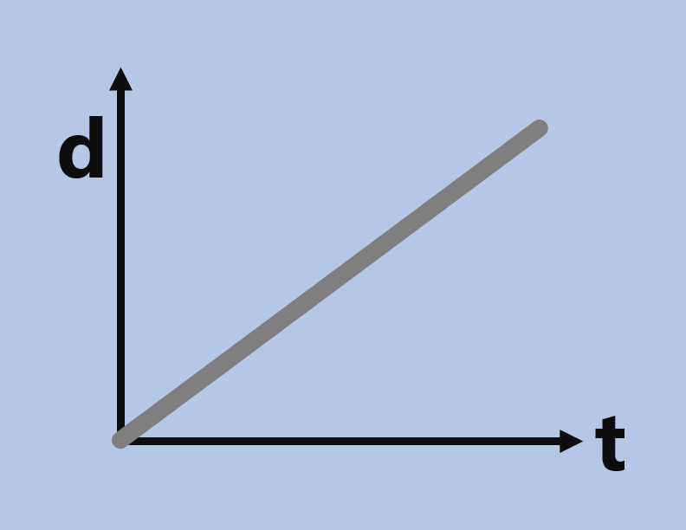
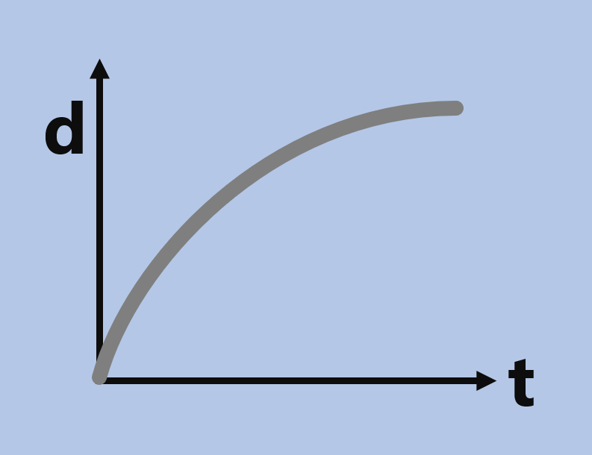
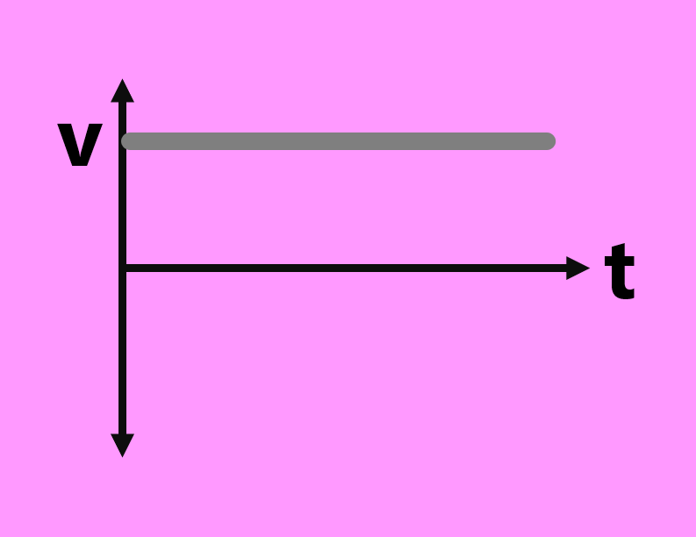
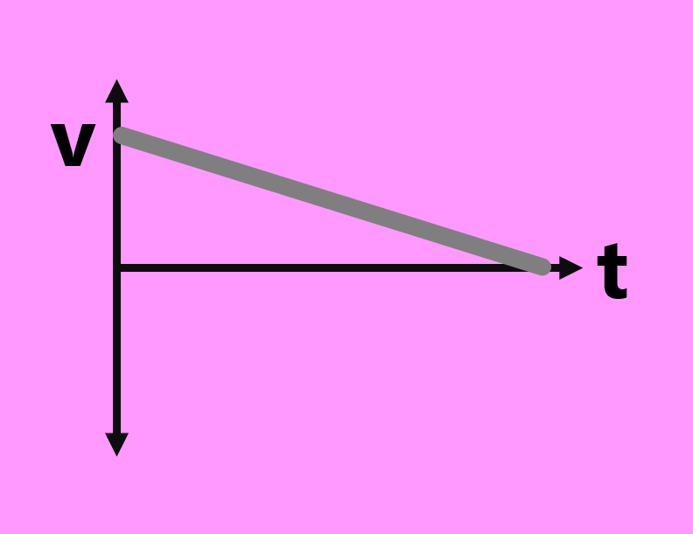
Motion Graph
Scavenger Hunt

Slide 2
d
d
t
t
Einstein
Franklin

Slide 3
v
v
t
t
Goodall
Meitner

Slide 4
d
d
t
t
Darwin
Newton

Slide 5
v
v
t
t
Johnson
Tyson

Slide 6
d
d
t
t
Curie
Tesla

Slide 7
v
v
t
t
Carver
Cannon

Slide 8
d
d
t
t
Hawking
Bohr

Slide 9
v
v
t
t
Doudna
Kaku

