Slide 1
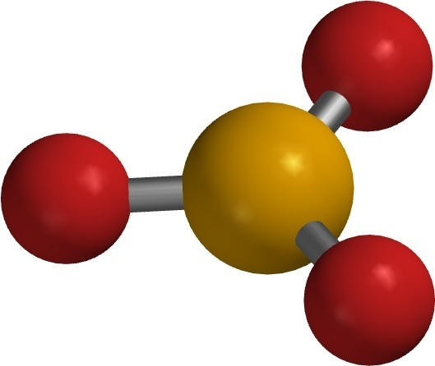
Naming Compounds Walk Around #1

Slide 2
Li₂SO₃
1
Notes:
Lithium Sulfite

Slide 3
2
CaS
Notes:
Calcium Sulfide

Slide 4
SF₆
3
Notes:
Sulfur Hexafluoride

Slide 5
Barium Hydroxide
4
Notes:
Ba(OH)₂

Slide 6
Tetraiodine Nonoxide
5
Notes:
I₄O₉

Slide 7
Iron (III) Oxide
6
Notes:
Fe₂O₃

