Slide 1
Net Force Walk Around
2 N
5 N
4 N

Slide 2
A
What is the unit for FORCE?
Notes:
N or Newton

Slide 3
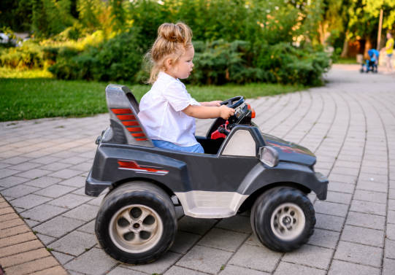
B
500 N
1000 N
300 N
500 N
What is the force of gravity?
Notes:
500

Slide 4
C
500 N
1000 N
300 N
500 N
What is the force of friction?
Notes:
700

Slide 5
D
500 N
1000 N
300 N
500 N
What is the normal force?
Notes:
700

Slide 6
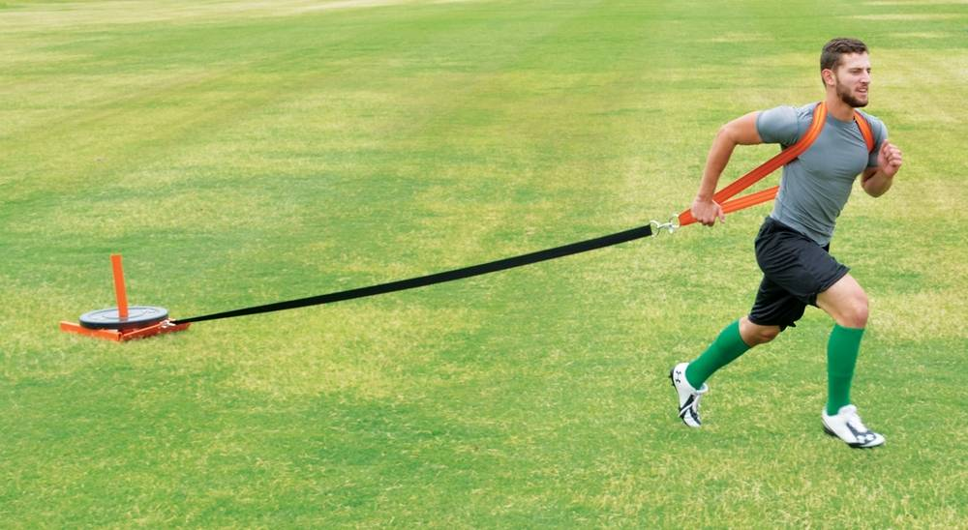
E
Pull
?
Label the missing force
Notes:
Friction

Slide 7
F
Air Resistance
?
Label the missing force
Notes:
Gravity or Weight

Slide 8
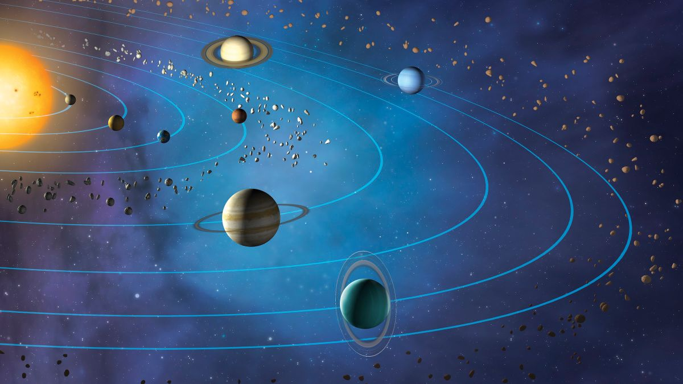
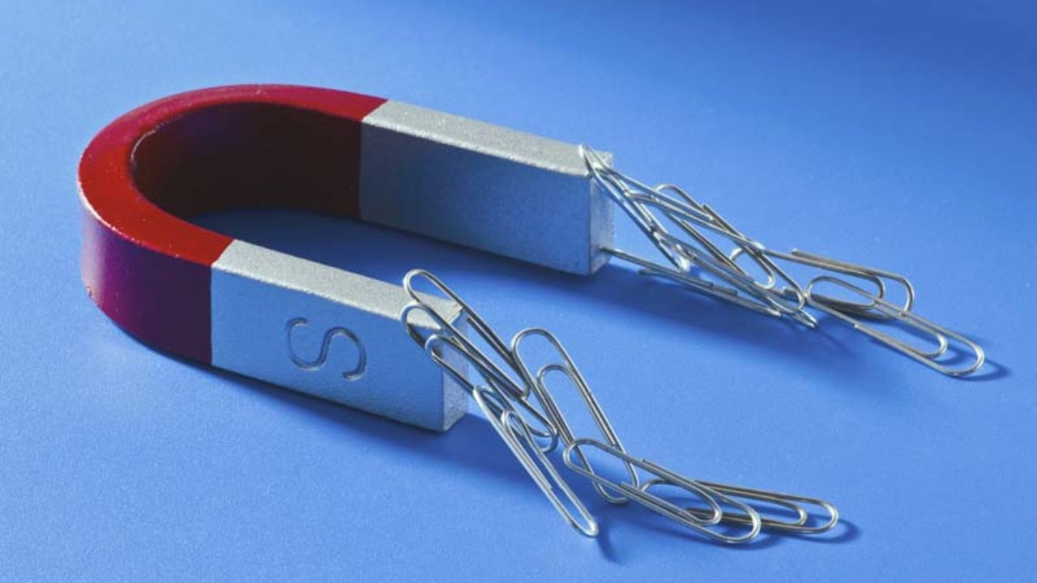
G
Electrostatic Force
Normal Force
Force of Gravity
Magnetic Force
Which of the following can only pull?
Notes:
Gravity

Slide 9
H
Electrostatic Force
Normal Force
Force of Gravity
Magnetic Force
Which of the following can only push?
Notes:
Normal

Slide 10
I
1
2
3
4
5
Which object is in equilibrium?
Notes:
5

Slide 11
J
1
2
3
4
5
Which object is in equilibrium?
Notes:
4

Slide 12
K
1
2
3
4
5
A car overcoming friction and accelerating to the right
Notes:
1

Slide 13
L
1
2
3
4
5
A book at rest on a table top
Notes:
4

Slide 14
M
900 N
What is the Net Force?
Notes:
5.6

Slide 15
N
2 N
8 N
What is the Net Force?
Notes:
6

Slide 16
O
5 N
2 N
6 N
5 N
What is the Net Force?
Notes:
4

Slide 17
P
2 N
2 N
2 N
5 N
What is the Net Force?
Notes:
4

Slide 18
Q
500 N
1000 N
300 N
500 N
What is the Net Force?
Notes:
700

Slide 19
R
5 N
4 N
6 N
1 N
5 N
What is the Net Force?
Notes:
3

Slide 20
S
2 N
3 N
5 N
2 N
3 N
5 N
What is the Net Force?
Notes:
6

Slide 21
T
2.3 N
? N
F_{net} = 0 N
What is the missing force?
Notes:
2.3

Slide 22
U
7.8 N
3 N
? N
F_{net} = 0 N
What is the missing force?
Notes:
4.8

Slide 23
V
6 N
? N
F_{net} = 5 N
What is the missing force?
Notes:
11

Slide 24
W
7 N
? N
F_{net} = 3 N
What is the missing force?
Notes:
4

Slide 25
X
5 N
? N
6 N
F_{net} = 2 N
What is the missing force?
Notes:
1

Slide 26
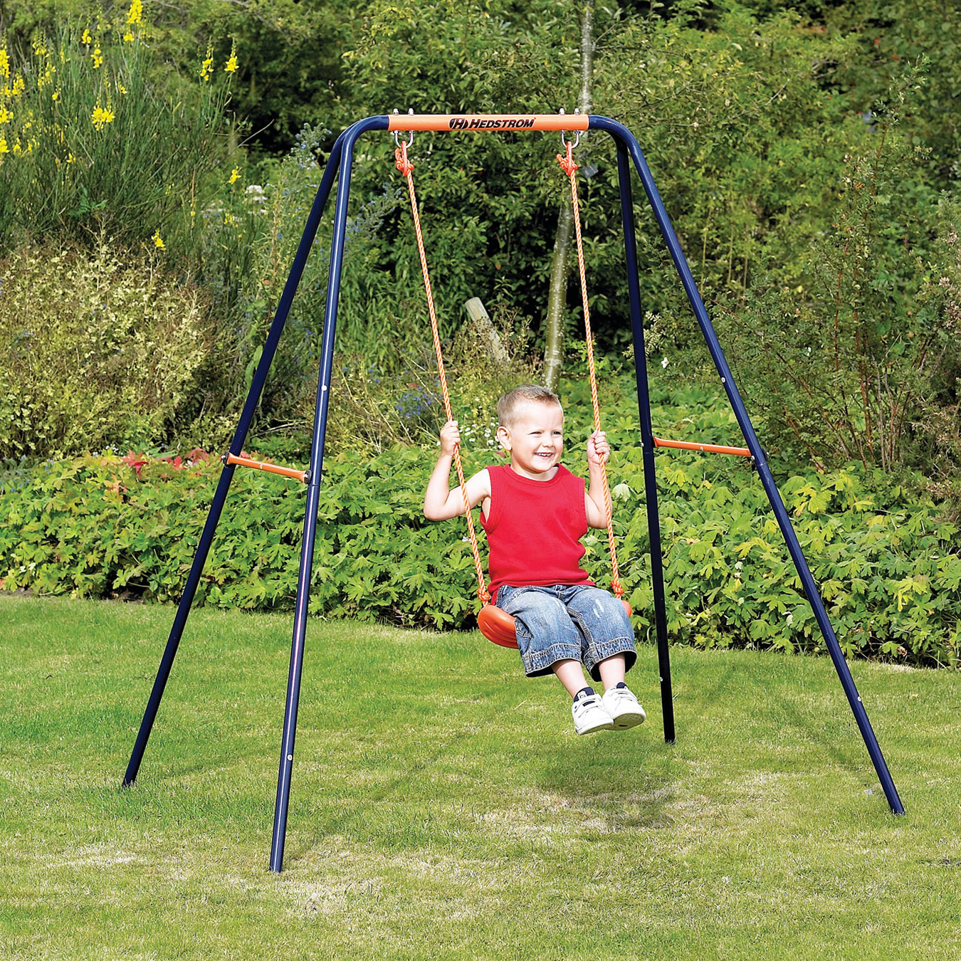
Y
X
Y
500 N
What is the missing force Y?
Notes:
250

Slide 27
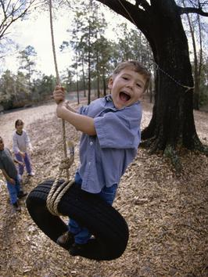
Z
? N
500 N
What is the missing force?
Notes:
500

