Slide 1
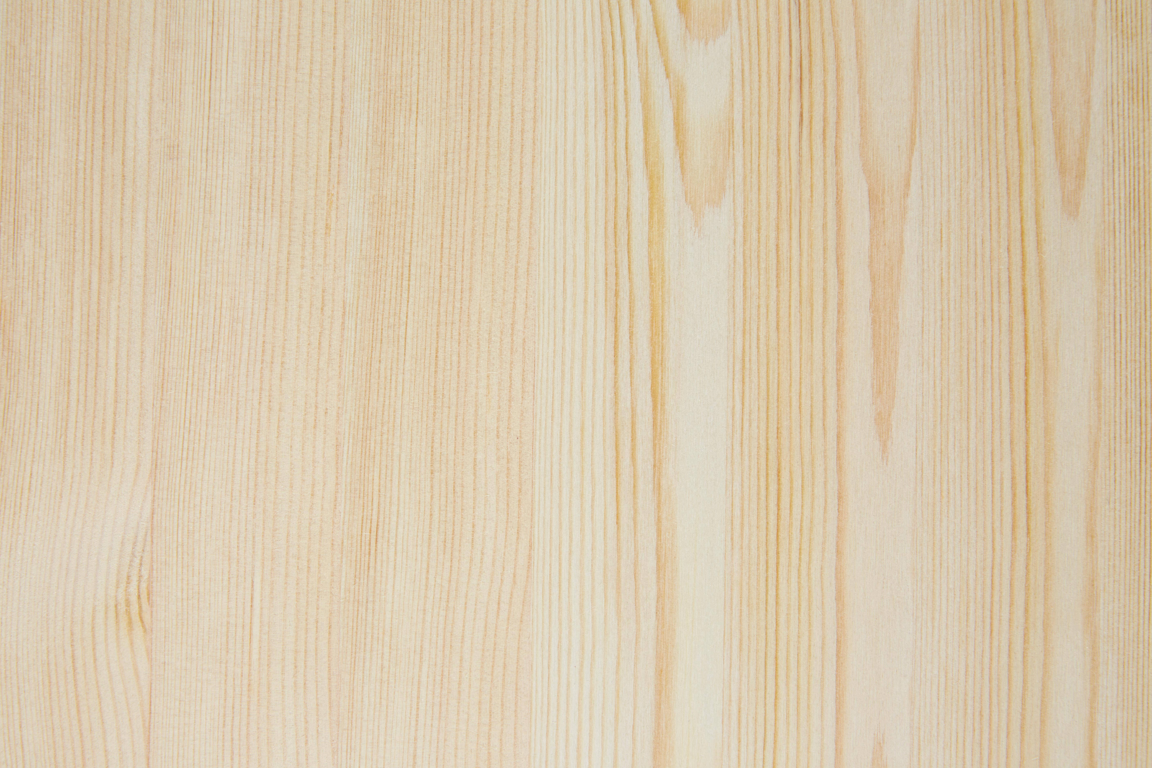
Organize aliens on the grid and draw the missing gaps
Stack of Alien Cards

Slide 2
Now, recreate your grid and extend the pattern beyond…
Stack of Alien Cards

