Slide 1
Uncertainty
IB Physics | Unit 1 | Science skills

Slide 2
Precision/Accuracy
Precision: The degree of exactness in a measurement
Accuracy: The closeness of a measured value to the standard

Slide 3
Precision/Accuracy
Precision: The degree of exactness in a measurement
Accuracy: The closeness of a measured value to the standard
*Repeatability

Slide 4
Precision/Accuracy
High Precision
Low Precision
High Accuracy
Low Accuracy

Slide 5
Precision/Accuracy
High Precision | ✔️ | ✔️
Low Precision |  |  | ✔️ | ✔️
High Accuracy | ✔️ |  | ✔️
Low Accuracy |  | ✔️ |  | ✔️

Slide 6
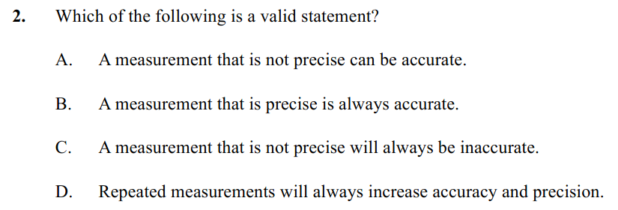
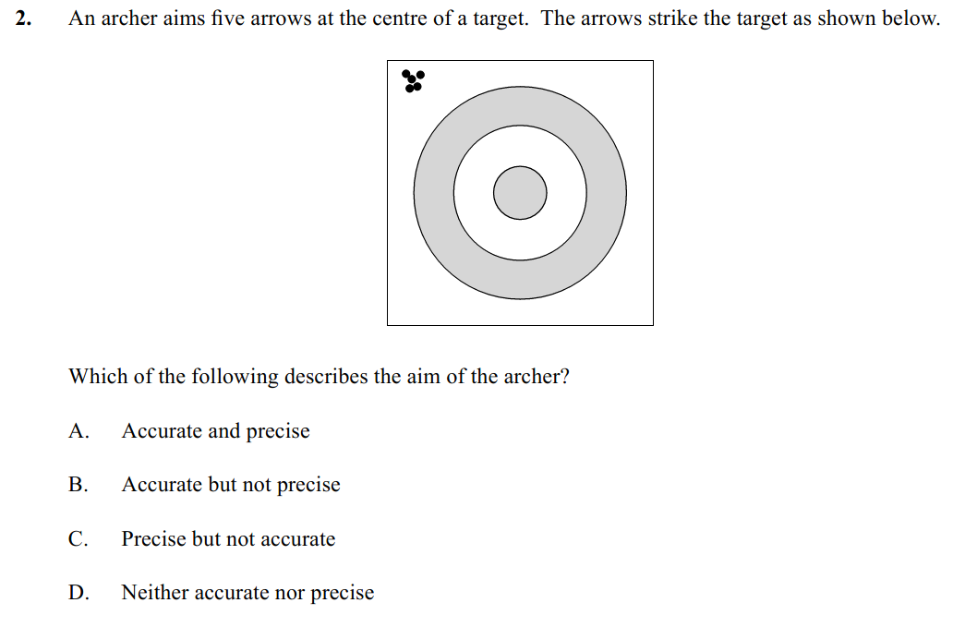
Example IB Question

Slide 7
Example IB Question

Slide 8
Types of Error
Random Error
Systematic Error

Slide 9
Types of Error
Random Error
Systematic Error
“Human
Factor”
Error/Offset
in the instrumentation

Slide 10
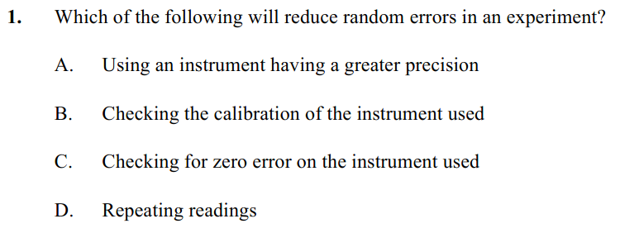
Example IB Question

Slide 11
Example IB Question

Slide 12
Uncertainty Game Show
Question | Answer | Uncertainty | Actual | Points
1
2
3
4
5
6
7
8
 |  |  | Total

Slide 13
Uncertainty Game Show
Question | Answer | Uncertainty | Actual | Points
1
2
3
4
5
6
7
8
 |  |  | Total

Slide 14
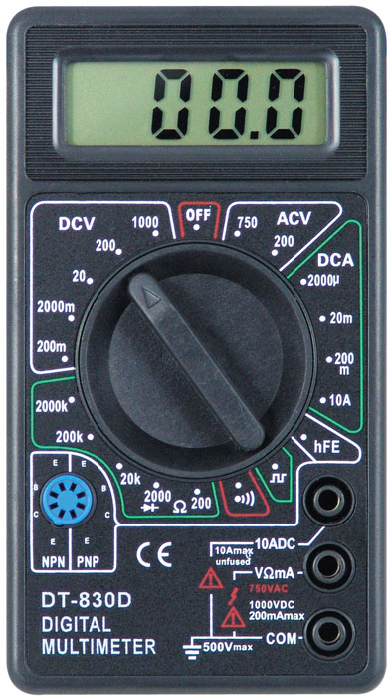
Measurement Precision
Analog:
Estimate to one digit beyond the smallest marking
0
1
1 cm
1 mm
Digital:
Only go the least significant digit’s place

Slide 15
Measurement Precision
Analog:
Estimate to one digit beyond the smallest marking
0
1
1 cm
1 mm
Digital:
Only go the least significant digit’s place

Slide 16
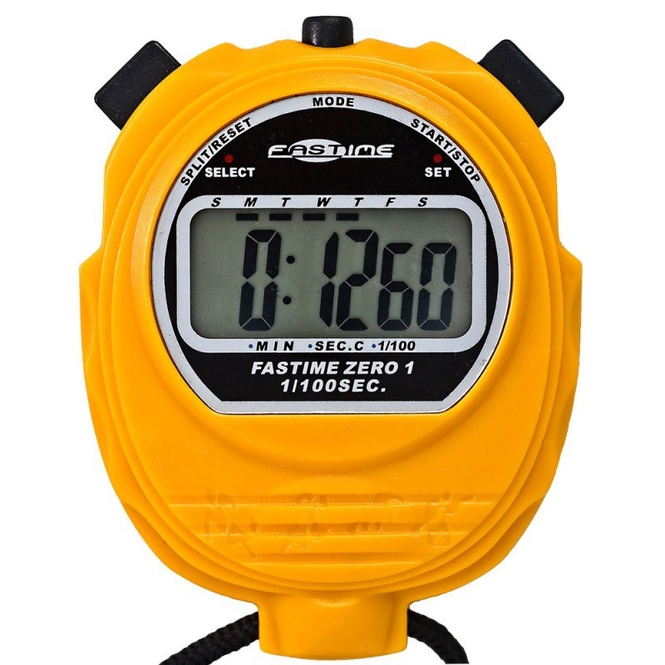
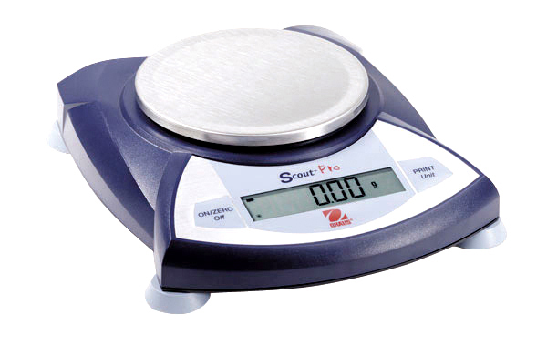
Estimating Uncertainty Range
Uncertainty
Analog Scale
± (half the smallest division)
0
1
Digital Scale
± (the smallest division)

Slide 17
Estimating Uncertainty Range
Uncertainty
Analog Scale
± (half the smallest division)
0
1
Digital Scale
± (the smallest division)

Slide 18
Other General Rules
Your uncertainty should typically only have one significant digit (two are okay in some situations)
Your precision in the measurement and uncertainty MUST match

Slide 19
Other General Rules
Your uncertainty should typically only have one significant digit (two are okay in some situations)
Your precision in the measurement and uncertainty MUST match
i.e. Same number of decimal places

Slide 20
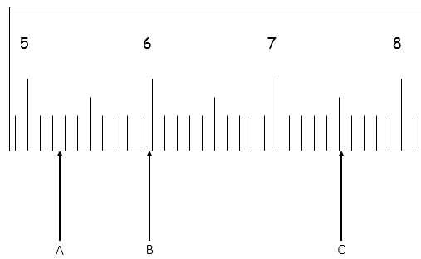
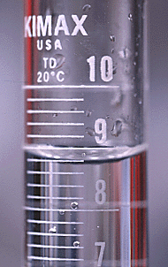
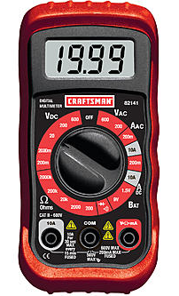
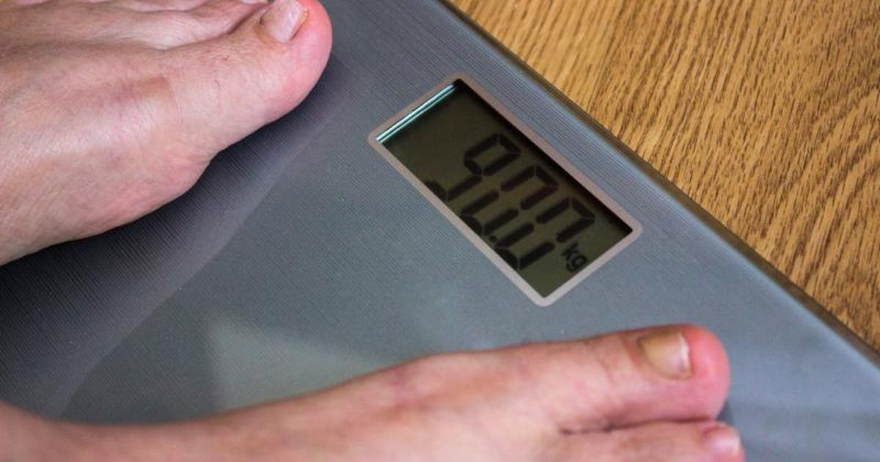
Report these Measurements!

Slide 21
Report these Measurements!
8.78 ± 0.10
5.27 ± 0.05
90.0 ± 0.1
19.99 ± 0.01

Slide 22
Significant Digits
How many significant digits?
3.45 cm
226.5 cm
2.50 cm
0.025 cm
12060 m
0.0000250 km
25.0 mm
25000 mm
2.50 × 10⁴ mm
*IB will give full credit as long as your answer is within 1 sig fig

Slide 23
Significant Digits
How many significant digits?
3.45 cm | 3
226.5 cm | 4
2.50 cm | 3
0.025 cm | 2
12060 m | 4
0.0000250 km | 3
25.0 mm | 3
25000 mm | 2
2.50 × 10⁴ mm
Recommendation for IB Exam:
Round all answers to 3 sig figs unless otherwise stated
*IB will give full credit as long as your answer is within 1 sig fig

