Slide 1
Specific Heat
IB Physics | Thermal Physics

Slide 2
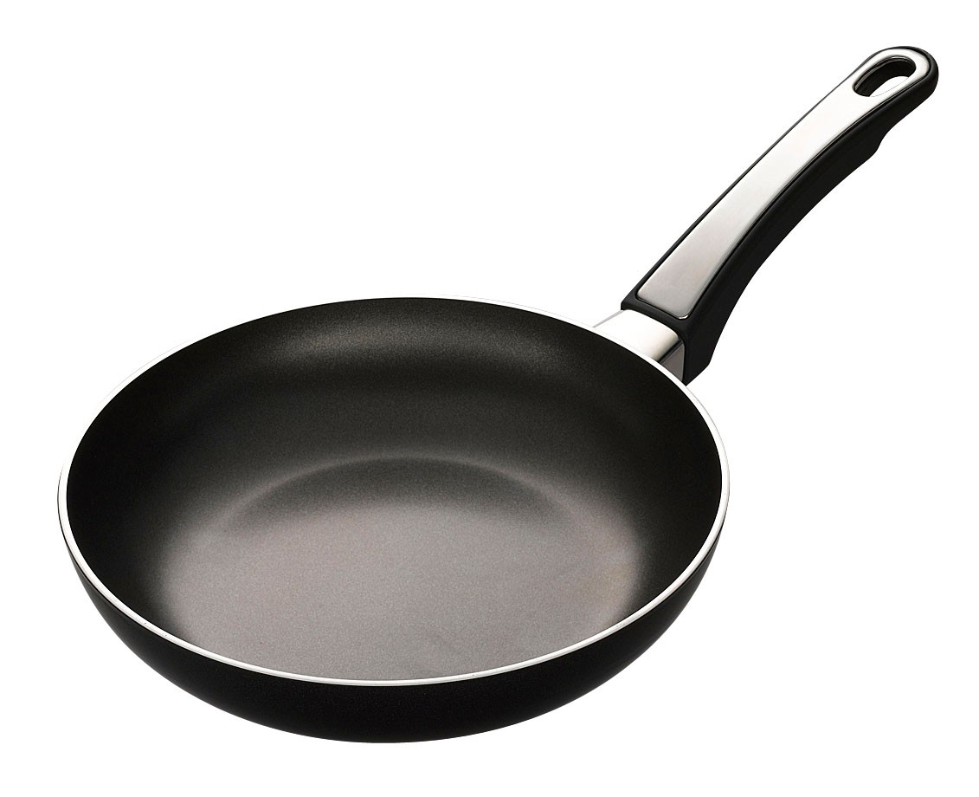
Conductors and Insulators
Label this image
Conductor
A material through which energy can be easily transferred as heat
Conductor
Insulator
A material that transfers energy poorly
Insulator

Slide 3
Specific Heat
Energy
Specific Heat is the amount of _______________ required to raise the temperature of 1 kg of a substance by 1 K
Specific Heat of Copper:
390 J kg⁻¹ K⁻¹

Slide 4
Specific Heat
Lower
The ___________ the number, the less energy it takes to heat up
Material | Specific Heat (J kg⁻¹ K⁻¹)
Aluminum | 910
Copper | 390
Iron | 448
Lead | 130
Water | 4180
Air | 1000
Dry Earth | 1250
1) Which substance take the most energy to heat up?
Water
2) Which substance take the least energy to heat up?
Lead

Slide 5
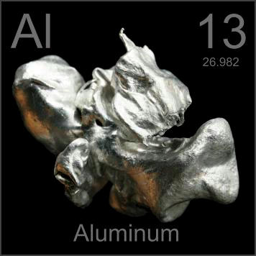
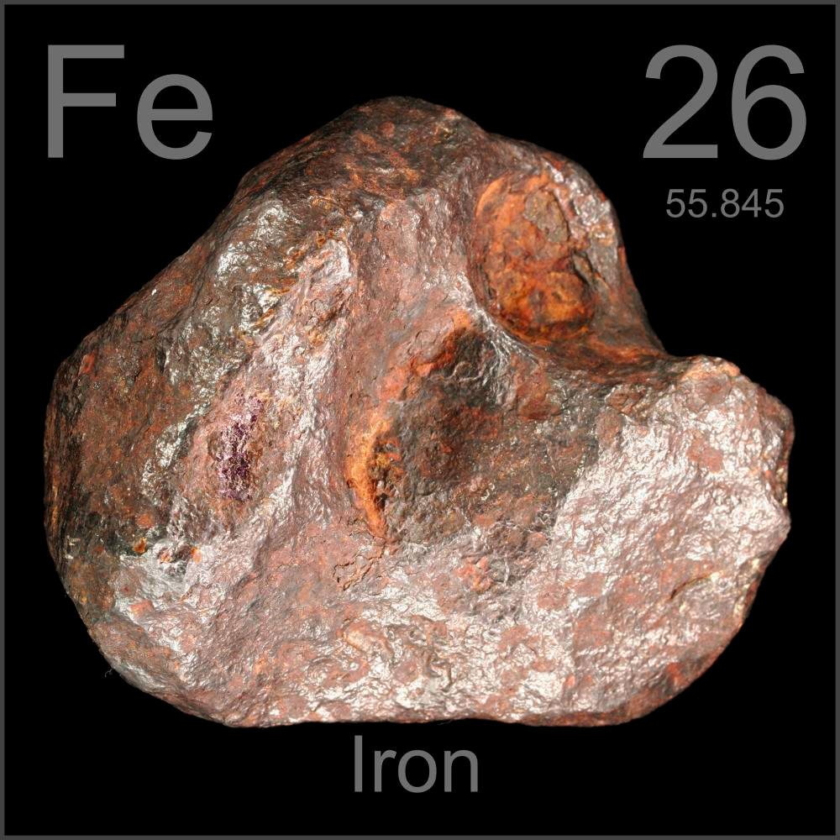
Specific Heat
Which metal will heat up faster, Aluminum or Iron?
Material | Specific Heat (J kg⁻¹ K⁻¹)
Aluminum | 910
Copper | 390
Iron | 448
Lead | 130
Water | 4180
Air | 1000
Dry Earth | 1250

Slide 6
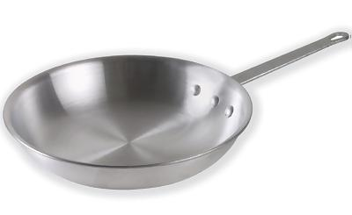
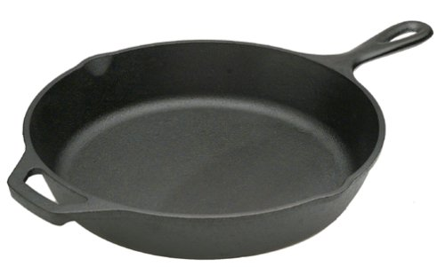
Specific Heat
If Iron heats up faster based on its specific heat, then why do aluminum fry pans heat up faster?
more mass
Aluminum Skillet
C = 910 J kg⁻¹ K⁻¹
Iron Skillet
C = 448 J kg⁻¹ K⁻¹

Slide 7

Specific Heat Equations
Quantity | Symbol | Unit
Heat Energy
Mass
Specific Heat
Change in Temp
$$Q=mc∆T$$
$$Q$$
$$\left[J\right]$$
$$m$$
$$\left[kg\right]$$
$$c$$
$$\left[J{ kg}^{−1}K^{−1}\right]$$
$$∆T$$
$$\left[K\right] or \left[℃\right]$$

Slide 8
Specific Heat Calculations
How much energy is needed to increase the temperature of 0.755 kg of iron 20 K?
Material | Specific Heat (J kg⁻¹ K⁻¹)
Aluminum | 910
Copper | 390
Iron | 448
Lead | 130
Water | 4180
Air | 1000
Dry Earth | 1250
$$Q=mc∆T$$
$$=(0.755)(448)(20)$$
$$Q=6,765 J$$
How much energy must a refrigerator absorb from 0.225 kg of water to decrease the temperature of the water from 35 °C to 5 °C?
$$Q=mc∆T$$
$$=(0.225)(4180)(5−35)$$
$$Q=−28,215 J$$

Slide 9
More Specific Heat Calculations
Air has a density of 1.3 kg m⁻³ and a specific heat capacity of 1000 J kg⁻¹ K⁻¹. If 500 kJ was transferred to a room of volume 80 m³, what was the temperature rise?
$$Q=500,000 J$$
$$∆T=\frac{Q}{mc}=\frac{500,000}{(104)(1,000)}$$
$$c=1000 J {kg}^{−1}{ K}^{−1}$$
$$m=D×V$$
$$=\left(1.3\right)\left(80\right)$$
$$=104 kg$$
$$∆T=4.81 K$$
How long will it take a 2.20 kW kettle to raise the temperature of 800 g of water from 16.0°C to its boiling point if the specific heat capacity of water is 4180 J kg⁻¹ K⁻¹?
$$Q=mc∆T$$
$$=(0.8)(4180)(100−16)$$
$$=280,896 J$$
$$2.2 kW$$
$$=2,200 W$$
$$=2,200 J s^{−1}$$
$$\frac{280,896 J}{2,200 J s^{−1}}=$$
$$128 s$$

Slide 10
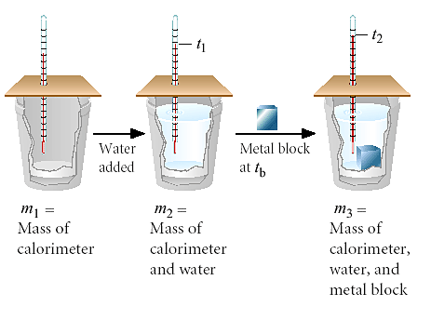
Conservation of Heat
If our system is closed to the surroundings, heat must be conserved
Heat energy lost by the metal
Heat energy gained by the water

Slide 11
Conservation of Heat
Heat energy gained by the water = heat energy lost by the metal
If you have 0.05 kg of water at 20°C and you put in 0.031 kg of an unknown substance that is originally 100°C, you measure that the final temp of everything is 25°C. What is the unknown metal?
Specific Heat of Water
4180 J kg⁻¹ K⁻¹
Step 1: Find the Heat Energy of the Water
$$Q=mc∆T$$
$$=(0.05)(4180)(25−20)$$
$$Q=1,045 J$$

Slide 12
Conservation of Heat
Heat energy gained by the water = heat energy lost by the metal
If you have 0.05 kg of water at 20°C and you put in 0.031 kg of an unknown substance that is originally 100°C, you measure that the final temp of everything is 25°C. What is the unknown metal?
Step 2: Using the heat energy step one. Find mystery specific heat
Specific Heat (J/kg*K)
Water (liquid) | 4190
Steam | 1870
Ammonia (gas) | 2060
Ethanol (liquid) | 2440
Aluminum | 897
Carbon (graphite) | 709
Copper | 390
Gold | 129
Iron | 448
Mercury | 140
Lead | 129
Silver | 234
$$1,045 J$$
$$=mc∆T$$
$$=(0.031)(c)(100−25)$$
$$c=449 J {kg}^{−1} K^{−1}$$

Slide 13
Lesson Takeaways
I can define specific heat capacity with proper units
I can describe the effect of larger or smaller specific heat values
I can relate specific heat capacity to the heat energy and temperature change
I can describe how a calorimeter uses the conservation of heat to study a material’s specific heat

