Slide 1
The Mole
IB Physics | Thermal Physics

Slide 2
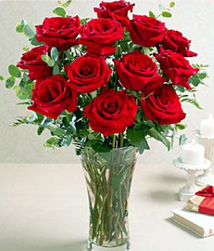
Grouping Items
We can use many different terms to describe the amount of substance.
A pair of shoes
____ shoes
BONUS!
A Baker’s Dozen =
A Score =
A Gross =
2
13
20
A dozen roses
____ roses
12
144

Slide 3
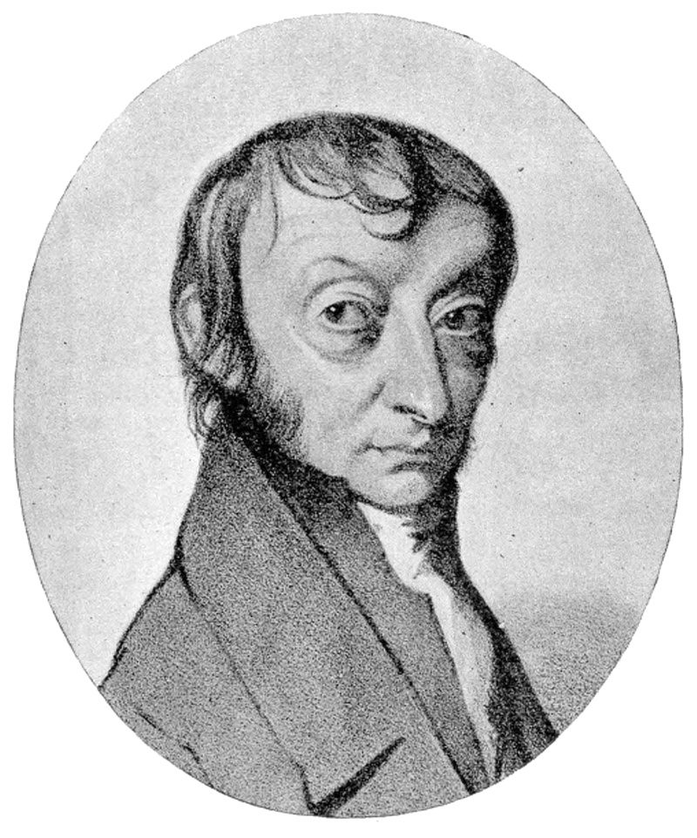
Counting Atoms
The primary counting unit for atoms is called
The Mole
1 mole =
6.02 × 10²³
= N_{A}
This is also called Avogadro's Number named after the scientist who first proposed this concept

Slide 4
Counting Atoms
The primary counting unit for atoms is called
The Mole
1 mole =
6.02 × 10²³
This is also called Avogadro's Number named after the scientist who first proposed this concept

Slide 5
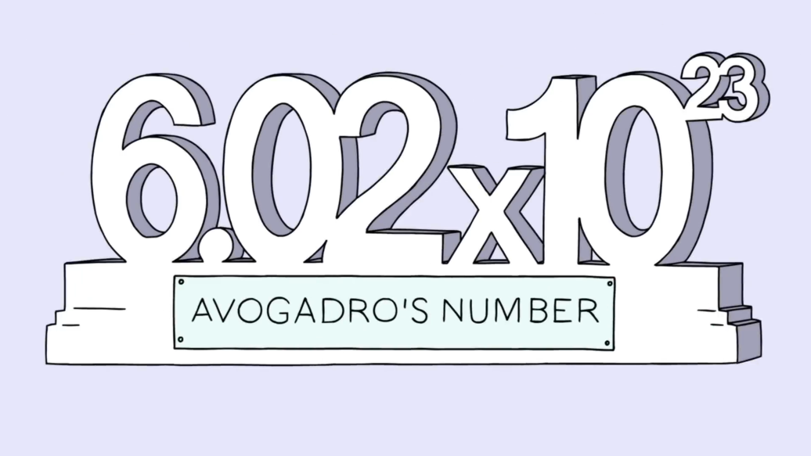
How Big is a Mole??
602,000,000,000,000,000,000,000

Slide 6
How Big is a Mole??
Taken from the book “What if?” by Randall Munroe

Slide 7
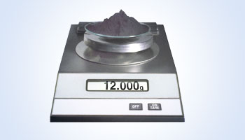
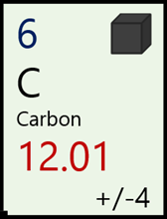
Using Moles in Chemistry
Atoms don’t weigh very much on their own:
1 Carbon Atom = 1.9927 × 10⁻²³ g
0.000000000000000000000019927 g
1 mole of Carbon Atoms =
(1.9927 × 10⁻²³ g) × (6.02 × 10²³) = ~12 g
Where else have you seen this number for Carbon?

Slide 8
Example IB Questions

Slide 9
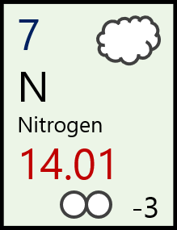
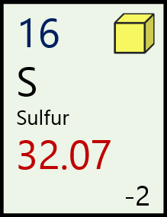
Molar Mass
1 mole
Molar Mass – the mass of ________ of a substance
Unit
g mol⁻¹
Molar mass of N = 14.01 g mol⁻¹
Molar mass of S = 32.07 g mol⁻¹

Slide 10
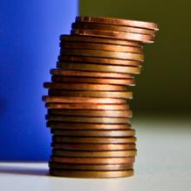
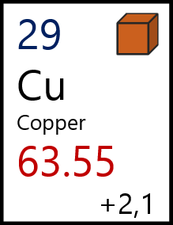
Molar Mass
1 mole of copper can be represented by this stack of pure copper pennies
How many atoms are in 1 mole of copper?
6.02 × 10²³ atoms

Slide 11
Molar Mass
1 mole of copper can be represented by this stack of pure copper pennies
What is the mass of one mole of copper?
63.55 g

Slide 12
Molar Mass
1 mole of copper can be represented by this stack of pure copper pennies
What is the mass of one atom of copper?
$$\frac{63.55 g}{6.02×{10}^{23} atoms}$$
$$=1.05×{10}^{−22} g$$

Slide 13
More than one mole…
How much mass would 3 moles of Copper have?
$$3 mol×63.55 g {mol}^{−1}=$$
$$190.65 g$$
How many moles are in 28 g of Nitrogen?
$$\frac{28 g}{14.01 g {mol}^{−1}}=$$
$$\sim 2 mol$$

Slide 14
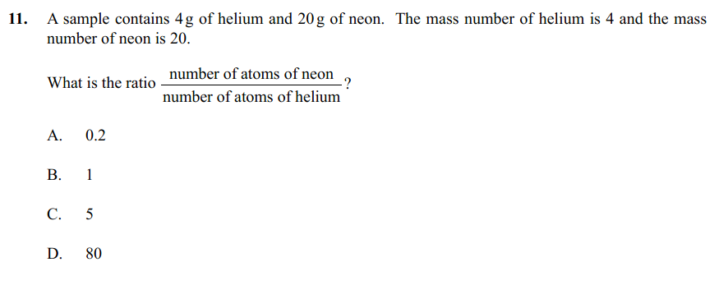
Example IB Questions
$$\frac{14 g}{28 g {mol}^{−1}}$$
$$=0.5 mol$$
$$0.5 mol×12 g {mol}^{−1}=6 g$$
$$\frac{4 g}{4 g {mol}^{−1}}$$
$$=1 mol$$
$$\frac{20 g}{20 g {mol}^{−1}}$$
$$=1 mol$$

Slide 15
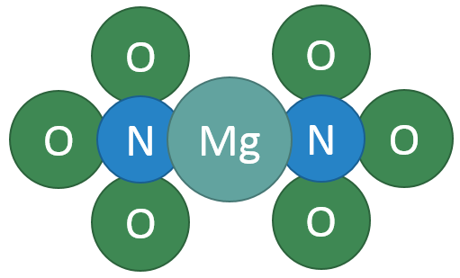
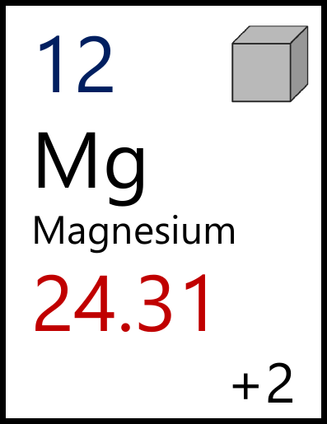
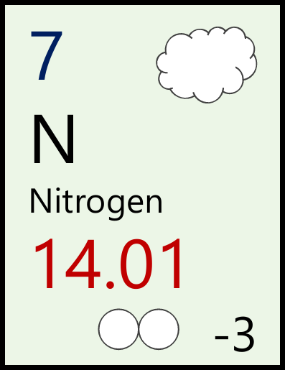
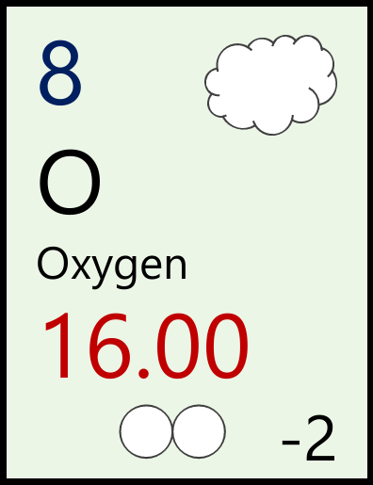
More than one atom…
What is the mass of one mole of Magnesium Nitrate?
Mg(NO₃)₂
Mg
N
O
$$\left(1×24.31\right)$$
$$+ \left(2×14.01\right)$$
$$+ (6×16.00)$$
$$=148.33 g {mol}^{−1}$$

Slide 16
Lesson Takeaways
I can describe the importance of having a large quantity like the “mole” defined
I can use the average atomic weight of an element or compound to convert between mass and moles and numbers of atoms

