Slide 1
Diffraction
IB Physics | Waves - Light

Slide 2
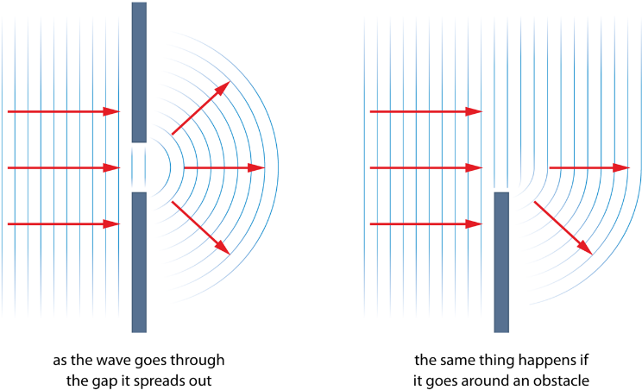
Diffraction

Slide 3
What would you expect?
You shine a light through two vertical slits in a barrier.
What is the resulting image on the screen behind?

Slide 4
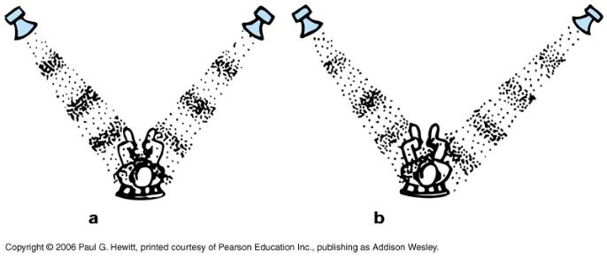
Remember Interference?
Constructive
Destructive

Slide 5
Diffraction
Destructive
Constructive
Destructive

Slide 6
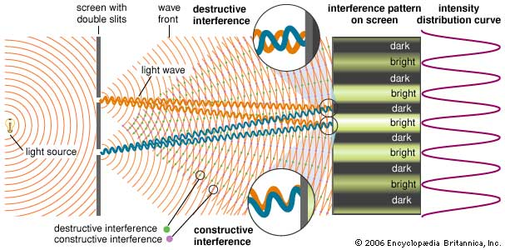
Double Slit Experiment

Slide 7
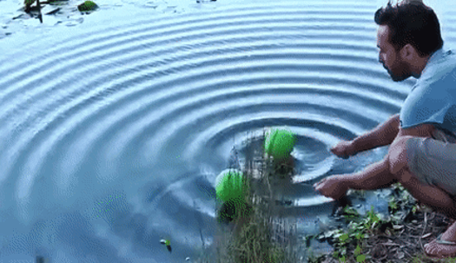
Double Slit Experiment

Slide 8
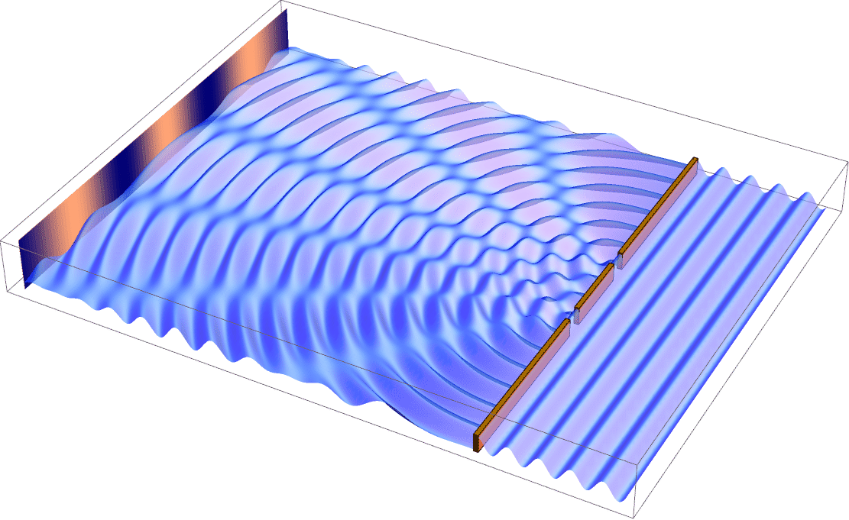
Double Slit Experiment

Slide 9
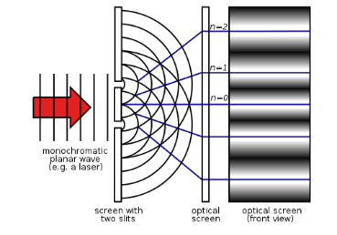
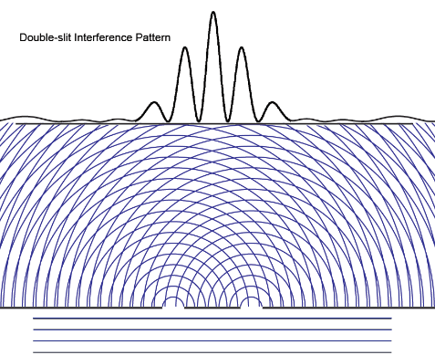
Double Slit Experiment

Slide 10
Double Slit Experiment
$$s=\frac{λD}{d}$$
D
s
s
d
λ → wavelength
s
s

Slide 11
IB Physics Data Booklet

Slide 12
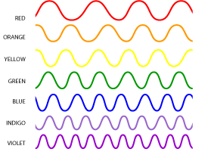
Double Slit Experiment
As wavelength (λ) increases,
s increases
$$s=\frac{λD}{d}$$
As gap (d) increases,
s decreases

Slide 13
$$s=\frac{λD}{d}$$
Try This
Blue laser light of wavelength 450 nm is shone on two slits that are 0.1 mm apart. How far apart are the fringes on a screen placed 5.0 m away?
$$s=\frac{(450×{10}^{−9})(5)}{(0.1×{10}^{−3})}$$
λ = 450 nm
= 450 × 10⁻⁹ m
d = 0.1 mm
= 0.1 × 10⁻³ m
D = 5 m
$$s=0.02 m$$
Would red laser light have fringes closer together or farther apart?
As wavelength increases, fringes get farther apart
Increasing Wavelength

Slide 14
Lesson Takeaways
I can describe how light bends around a boundary
I can predict the resulting image from a double slit experiment
I can calculate the spacing between bright spots for the double slit experiment
I can conceptually relate band spacing with wavelength and gap distance

