Slide 1
Polarization
IB Physics | Waves - Light

Slide 2
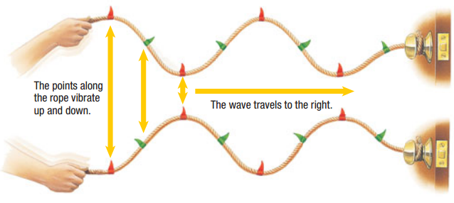
Light is a Transverse Wave
This isn’t the whole story though…
When unpolarized, light can be thought of as oscillating at every perpendicular to the wave’s motion
Diagram of a light ray coming out of the page

Slide 3
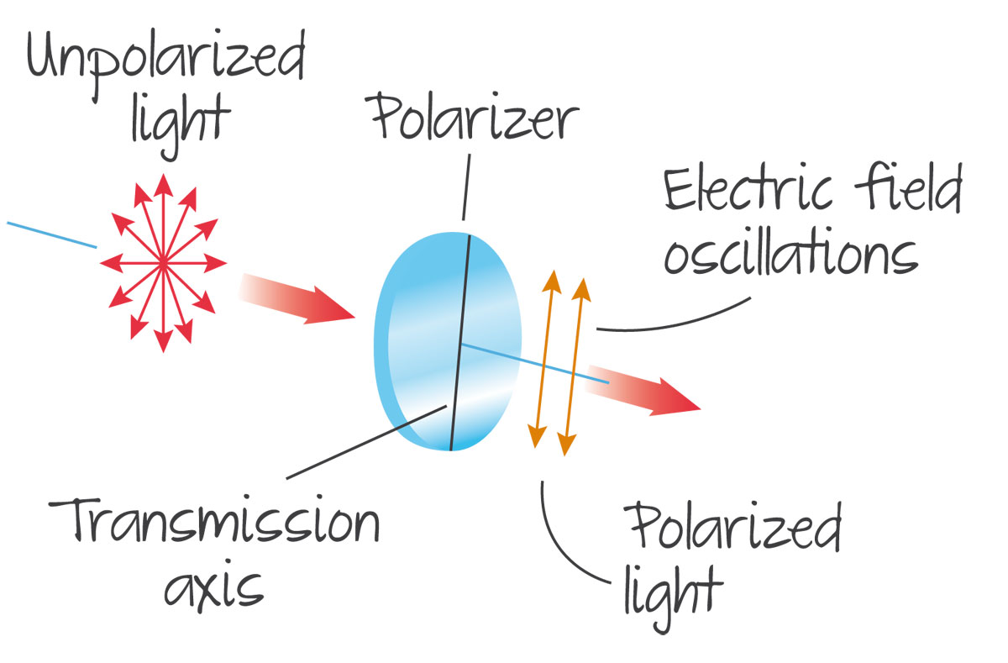
Polarizers
Unpolarized light loses 50% intensity when passing through a polarizer

Slide 4
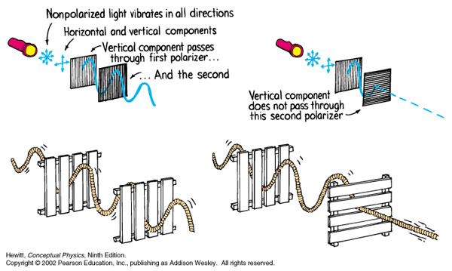
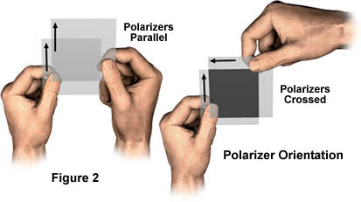
Polarized Light

Slide 5
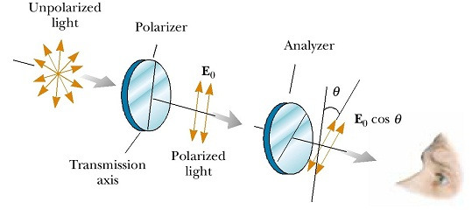
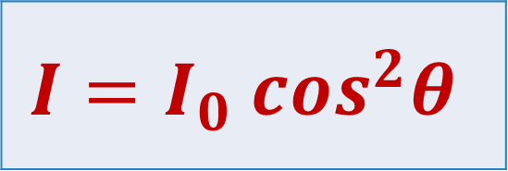
Malus’ Law
$$I=I_{0} \cos^{2}θ$$
I₀
θ
I
θ = angle between filters
Same thing as
$$I=I_{0} {(cosθ)}^{2}$$

Slide 6
IB Physics Data Booklet

Slide 7
Loses Intensity Twice
50% loss when unpolarized light is polarized
Equation calculates loss through subsequent filters
-50%
$$I=I_{0} \cos^{2}θ$$

Slide 8
Angle Difference
The intensity of plane polarized light, at 40° to the vertical is I₀. After passing through an analyzer at 60° to the vertical, what is the intensity measured?
$$θ=60°−40°=20°$$
$I=I_{0} \cos^{2}\left(20°\right)=0.883$ $I_{0}$
88.3% of the original intensity

Slide 9
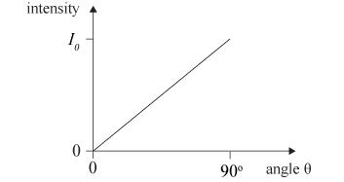
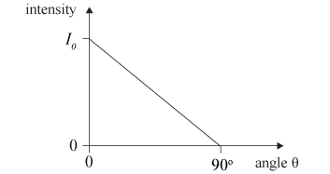
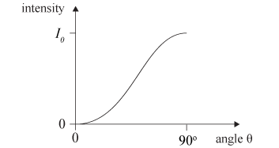
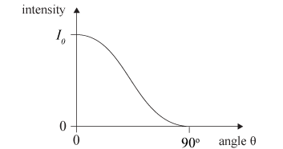
Sample IB Question
Polarized light of intensity I₀ is incident on a polarizing filter. The angle between the plane of polarization of the incident light and the transmission plane of the polarizer is θ. Which graph shows how the intensity I of the light transmitted through the polarizer varies with θ?
90° → Intensity = 0
cos² shape

Slide 10
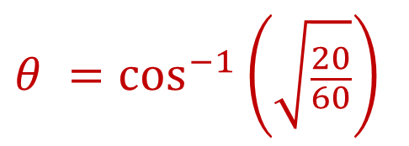
Try this Calculation
After passing through one polarized filter, the intensity of vertically polarized light is 60 W m⁻². What is the angle of the analyzer relative to the vertical if the intensity observed is 20 W m⁻²?
$$I=I_{0} \cos^{2}θ$$
$$20=60{ (cos⁡θ)}^{2}$$
$$I=I_{0} {(cos⁡θ)}^{2}$$
$$θ =\cos^{−1}\left(\sqrt{\frac{20}{60}}\right)$$
$$=54.7°$$
What was the intensity of the unpolarized light?
120 W m⁻²
Loses 50% from first filter

Slide 11
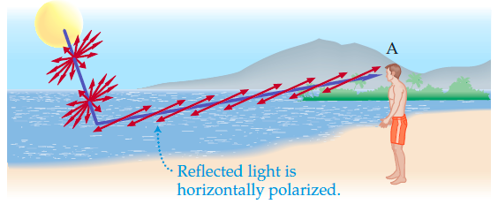
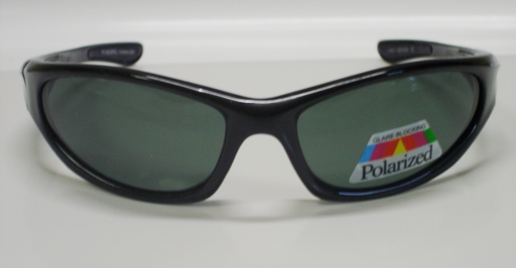
This isn’t the only way

Slide 12
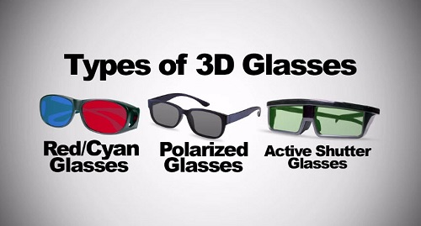
What about 3D Movies?

Slide 13
Lesson Takeaways
I can describe the transformation that takes place when unpolarized light is polarized
I can describe the interaction between two polarized filters at different orientations
I can use Malus’s Law to calculate the change in intensity when passing through polarized filters

